Slide 1

Slide 1
End-to-End ETL project
End-to-End ETL project
End-to-End ETL project

Slide 2

Objective : Build a robust Data Warehouse to answer critical business questions for an ecommerce platform.
Phases:
1- Business Case
2- DWH schema
3- ETL pipeline
4- Analytical queries with SQL

Slide 3

Business Case
This ETL project combines scattered e-commerce data into one system to help the business make better decisions, improve customer satisfaction, and grow sales.

Slide 4
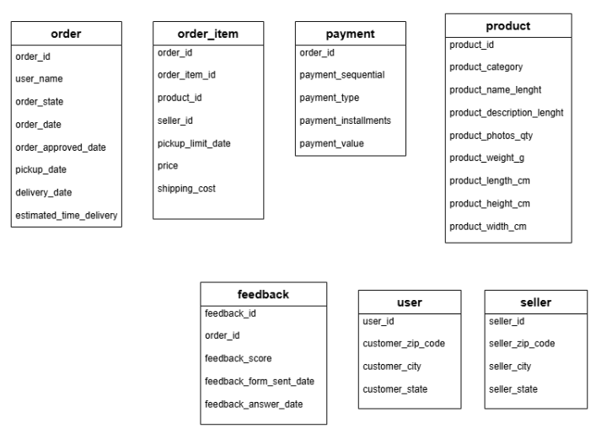
OLTP TABELS

Slide 5
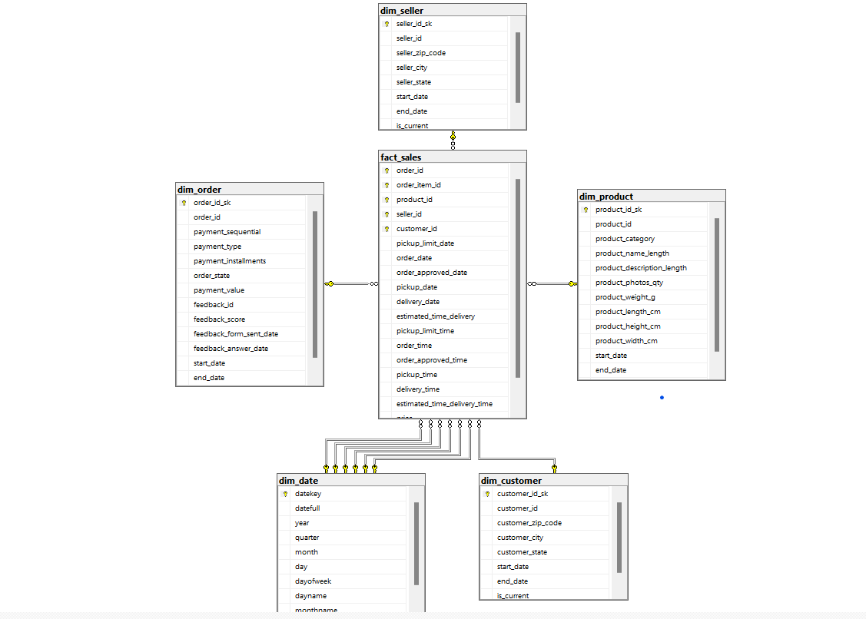
DWH Schema

Slide 6
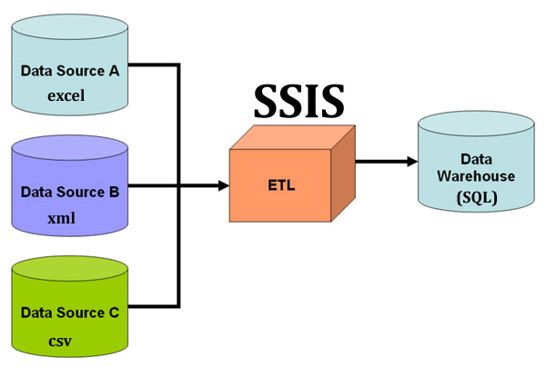

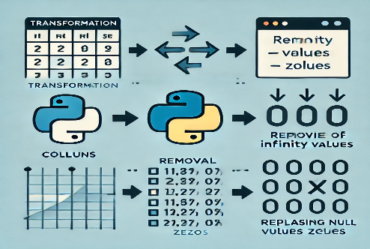
ETL Pipeline
from csv files
Transform data

Slide 7
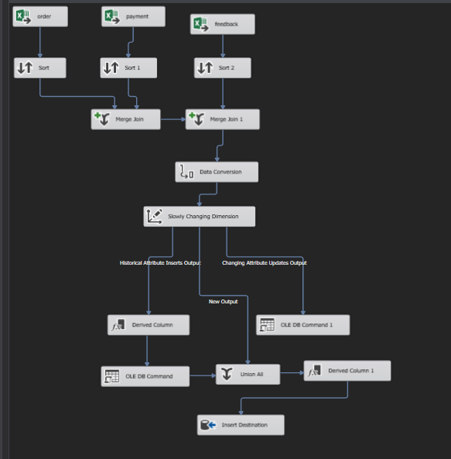
DIM_ORDER

Slide 8
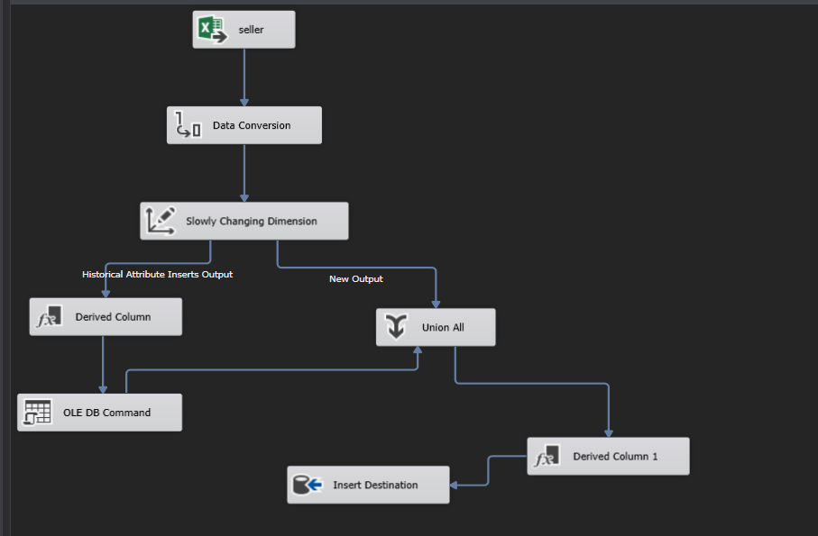
DIM_SELLER

Slide 9
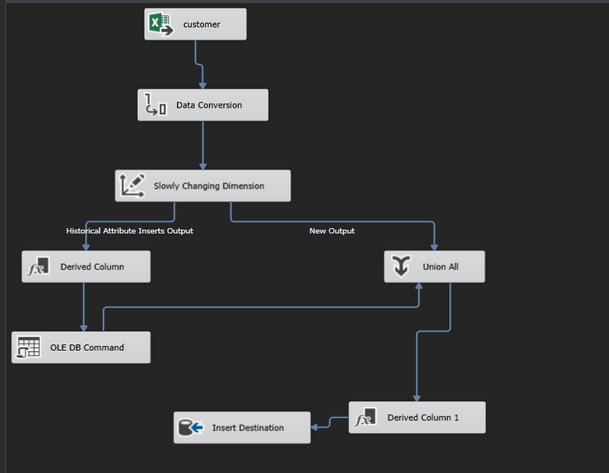
DIM_CUSTOMER

Slide 10
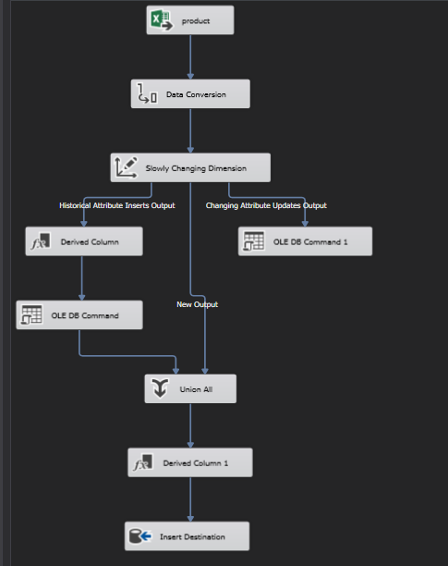
DIM_PRODUCT

Slide 11
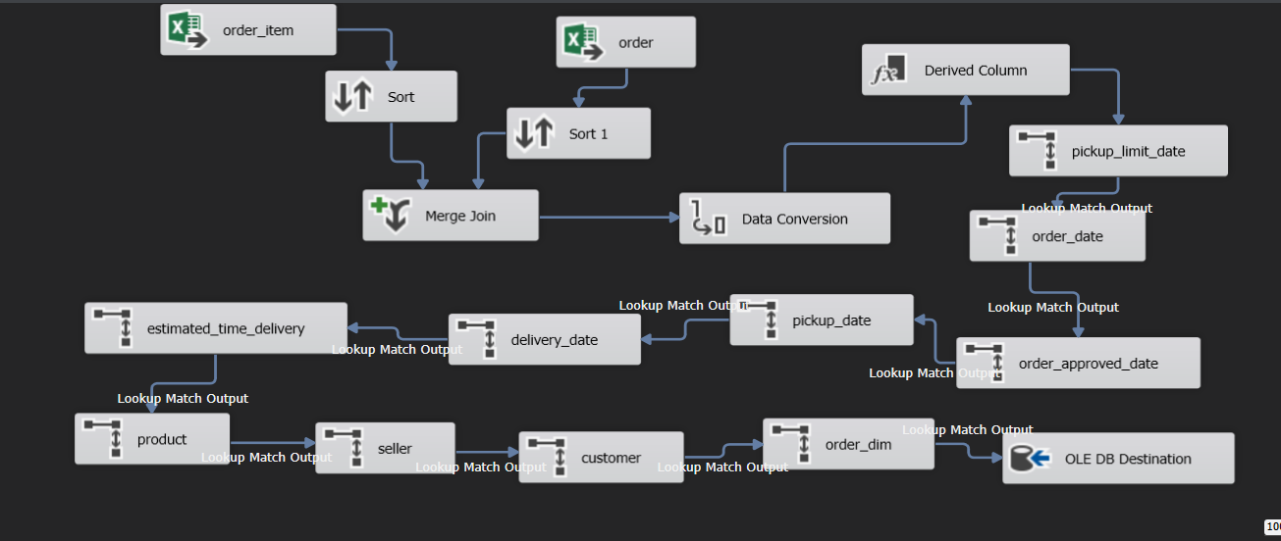
FACT_SALES

Slide 12
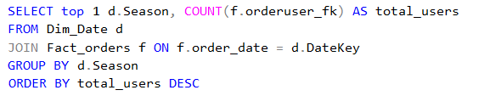

Analytical Queries
When is the peak season of our ecommerce?
Answer :

Slide 13
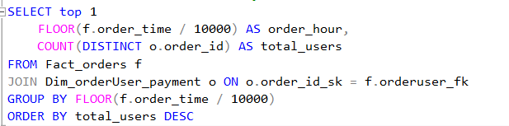

Analytical Queries
What time users are most likely to make an order or use the ecommerce app?
Answer :

Slide 14
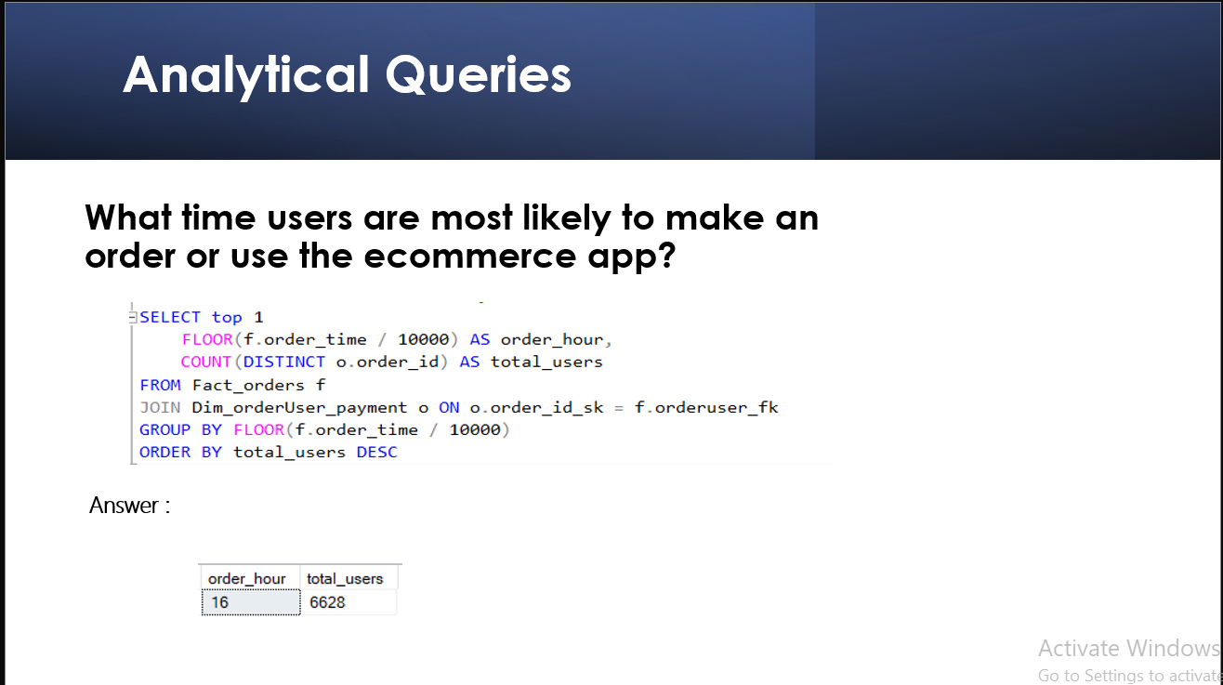
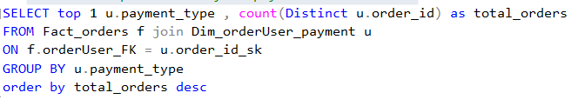

What is the preferred way to pay in the ecommerce?
Answer :

Slide 15
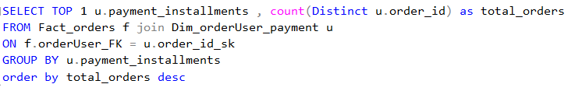

How many installments are usually done when paying in the ecommerce?
Answer :

Slide 16
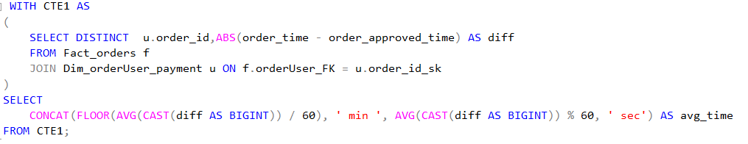

What is the average spending time for users on our ecommerce?
Answer :

Slide 17
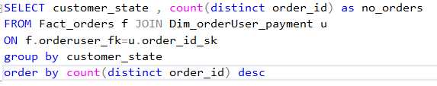
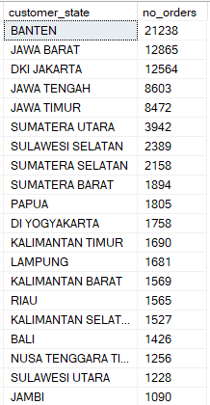
What is the frequency of purchases in each state?
Answer :

Slide 18
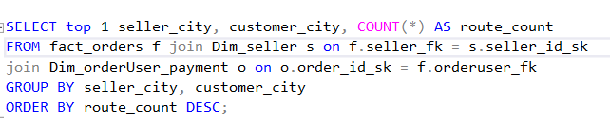

Which logistic route has heavy traffic in our ecommerce?
Answer :

Slide 19
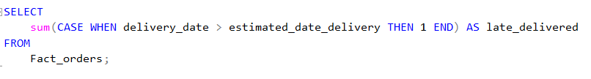

How many late-delivered orders are there in our ecommerce?
Answer :

Slide 20
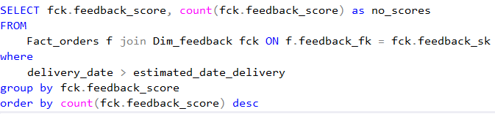
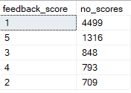
Are late orders affecting customer satisfaction?
Answer : yes, as most of them give a feedback score 1

Slide 21
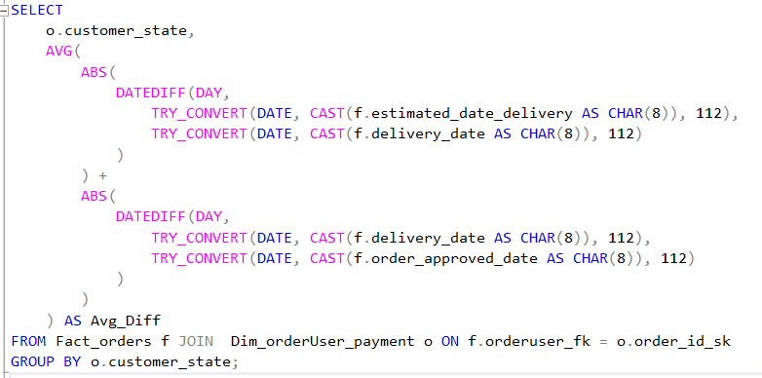
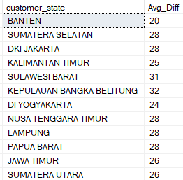
How long is the delay for the delivery/shipping process in each state?
Answer :

Slide 22
Slide 1
End-to-End ETL project
THANK YOU
End-to-End ETL project

