Slide 1
Gravity Modeling

Slide 2
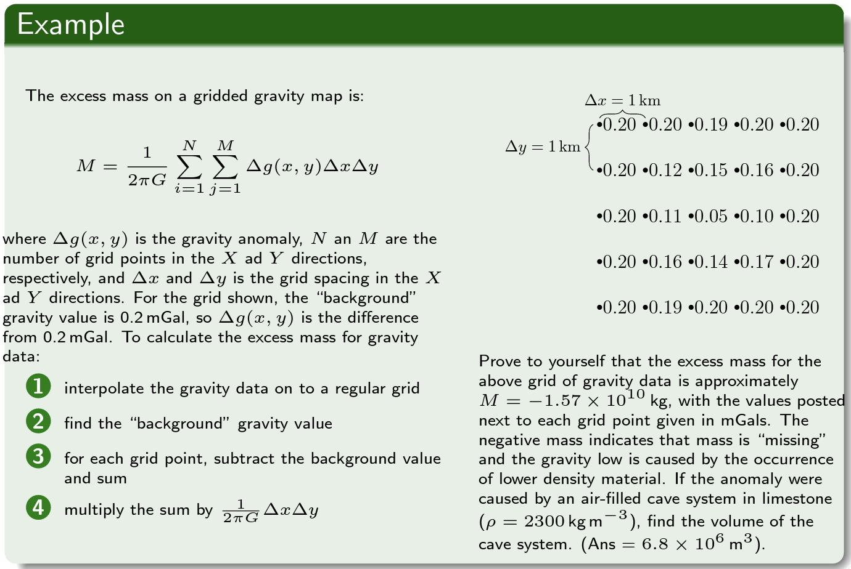
Going from gravity to density is not easy
Example from Chuck Connor, USF

Slide 3
Simple to set up Challenging to perfect
Basic approach:
Discretize domain into small sub-regions (e.g. a grid)
Assumption is anomalies are due to variations in the background density
Can adjust density variations and solve for predicted gravity signal (forward problem)
Can try to solve for density variations that produced a given dataset (inverse problem)
0 | 0 | 0 | 0
0 | 1 | 1 | 0
0 | 0 | 0 | 0
Cartoon illustrating density and gravity anomalies

Slide 4
References
Barzaghi R, Carrion D, Pepe M, Prezioso G. Computing the Deflection of the Vertical for Improving Aerial Surveys: A Comparison between EGM2008 and ITALGEO05 Estimates. Sensors (Basel). 2016 Jul 26;16(8):1168. doi: 10.3390/s16081168. PMID: 27472333; PMCID: PMC5017334.

