Slide 1

CIND 820: Predictive Analytics of Bank Customers Credit: A Case Study of Germany
Professor:Dr Derya Kici
Student:Mohsen Sesleleh
Fall 2021

Slide 2
Introduction
Bank credit means amount of money that a person could borrow from a bank or other financial institution. The bank decides on basis borrower’s credit rating, income, assets, debts, etc. This process for banks always has risk of failure, when borrower neglects to pay the money obtained. Therefore, credit scoring is a challenging management issue.

Slide 3
Goal and Questions
My goal is comparing performance different machine learning algorithms for classification and prediction customer credit.
The main part of my study is detection good and bad customers which is an imperative task for the banks.
I will try to answer these questions:
Traditional models or ensemble models are better at prediction customer credit?
Which model has a better performance at prediction of credit customer?
Is there significant relation between independent variables?

Slide 4
Literature review
There are a lot of researches that study machine learning algorithms in banking field and make a great improvement.
My research is unique because It tries to compare traditional supervised learning (neural network, svm, logistic regression analysis, knn, and naïve bayes) algorithms with ensemble algorithms (gradient boosting , random forest, decision tree)

Slide 5
Methodology
This research is a supervised machine learning which there are pre-defined set(labeled) of “training examples”,
I extract data set from UCI website, transform and extract and load it to python software.
I preprocessed the data set in a few stages as:
data preparation, check missing data,
data visualization, handling outliers, correlations and heatmap, handling multicollinearity (drop two independent variables; Duration in month, Age in years that had high correlation with other variables), handling imbalanced data set with under sampling method (randomly throwing out samples from the majority class until the class fractions are equal , or at least less imbalanced).
Finally, I did data analysis with different classification algorithms with cross-validation method to increase accuracy for prediction customer credit.

Slide 6
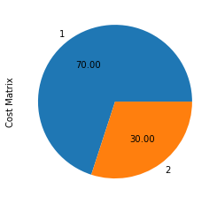
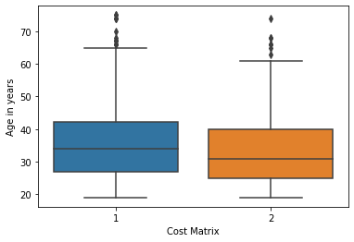
Dataset
The dataset sourced from UCI machine learning repository. This dataset classifies people described by a set of attributes as good or bad credit risks by a German bank in 1994, it consists of 1000 customers. The data set is highly imbalanced and skewed. We have 21 attributes; twenty attributes are independent variable, and we have one dependent variable. 7 variables are quantitative and 13 are qualitative.

Slide 7
Result: First, there was multicollinearity between independent variables and I handle it.Then, I could see that there is not significant difference between ensemble methods and traditional methods for prediction customer credit at my data set. All the methods had good metrics for classification and prediction. Although, random forest and neural network had the highest accuracy
Algorithms | Accuracy | AUC | Precision | Recall
XG | 68.09 | 68.02 | 68.18 | 65.15
RF | 75.5 | 71.0 | 58.78 | 58.67
KNN | 62 | 61.8 | 59 | 70
DT | 61.7 | 77.0 | 63 | 52.17
SVM | 53 | 51.72 | 50 | 82.08
ANN | 77 | 68.02 | 68.18 | 65.21
NB | 54.18 | 68.02 | 68.00 | 65.17
LR | 57.5 | 68.02 | 68.00 | 65.21

