Slide 1


Team Details
  Team name:
  Team leader name:
  Problem Statement: Shelf space is priced by position, not by how many shoppers actually see it.

Slide 2
Brief about the idea
ShelfSense
AI that turns a store's existing CCTV into a price tag for every shelf.
Brands pay retailers for end-caps, eye-level slots and promotional bays, but that space is priced by position and negotiation. A shelf passed by 2,000 shoppers a day can cost the same as one passed by 200.
ShelfSense sends store camera clips to Gemini, which measures for every shelf zone who walks past, who stops, who reaches for a product, how long they stay and their approximate age band. Those counts become a Shelf Value Index (0–100) and a suggested monthly rent. An AI assistant answers questions like “Which shelf reaches the most 18–35 shoppers on weekend evenings?”
Live today: https://shelfsense-demo.web.app
5.2 s
to analyse a store clip with Gemini
median of 12 live runs
4 → 12
cameras → priced shelf zones
in the live demo store
0
faces or identities stored
only anonymous counts reach Firestore

Slide 3
Opportunities
HOW IS IT DIFFERENT?
Prices the shelf, not the store
Footfall counters (ShopperTrak, RetailNext) count the store entrance.
Shelf recognition (Trax) checks stock and planograms.
ShelfSense measures who sees each shelf and outputs a price.
HOW DOES IT SOLVE IT?
Attention becomes a number
Gemini turns camera footage into per-zone visitors, stops, reaches, dwell and age mix.
The SVI blends them; rent = base rate × SVI ÷ store median.
Brands get proof of what a placement delivered.
USP
Existing cameras, privacy-first
No new hardware for the prototype: any store clip works.
Audience-aware pricing: the same shelf is worth more to the brand whose shoppers walk past it.
Only anonymous counts are kept; video is deleted after analysis.
Market Modern retail chains in Pakistan (hypermarkets, supermarkets, pharmacies) and the FMCG brands that rent their shelves.
Model Retailers pay a per-store subscription to price their space; brands pay for reach and audience reports on their placements.

Slide 4
List of features offered by the solution
01
Video → shelf metrics
Gemini 3 Flash watches a clip and returns visitors, stops, reaches, dwell, age bands and a timestamped event log per zone.
02
Shelf Value Index
0.40 footfall + 0.25 stop rate + 0.20 reach + 0.15 dwell, robust-normalised within the store.
03
Suggested rent
Base rate × SVI ÷ store median SVI, with a 40% floor. Sortable ranking with CSV export.
04
Brand audience view
AudienceFit re-weights every shelf by how well its shoppers match a brand's target age group.
05
Ask ShelfSense
Plain-language questions answered by Gemini from Firestore data only, citing shelf ids.
06
Floor heatmap & insights
Shelves coloured by any metric, hour × weekday heatmaps, and a weekly summary written by Gemini.

Slide 5
Process flow diagram or Use-case diagram
1 Capture
Store camera clip, or upload
2 Cloud Run
API stores clip, builds zone prompt
3 Gemini
Counts per zone, JSON schema
4 Firestore
Hourly buckets: seed + live
5 Score
SVI, audience fit, rent
6 Act
Dashboard, chat, CSV
Use cases
Retailer
• Price end-caps and bays from evidence
• Staff the floor for real peaks
• Re-plan layout from the heatmap
FMCG brand
• Choose shelves that reach its audience
• Verify reach and attention after launch
• Compare placements across stores
Store manager
• Ask questions in plain language
• Weekly summary with one action
• Spot under-priced shelves

Slide 6
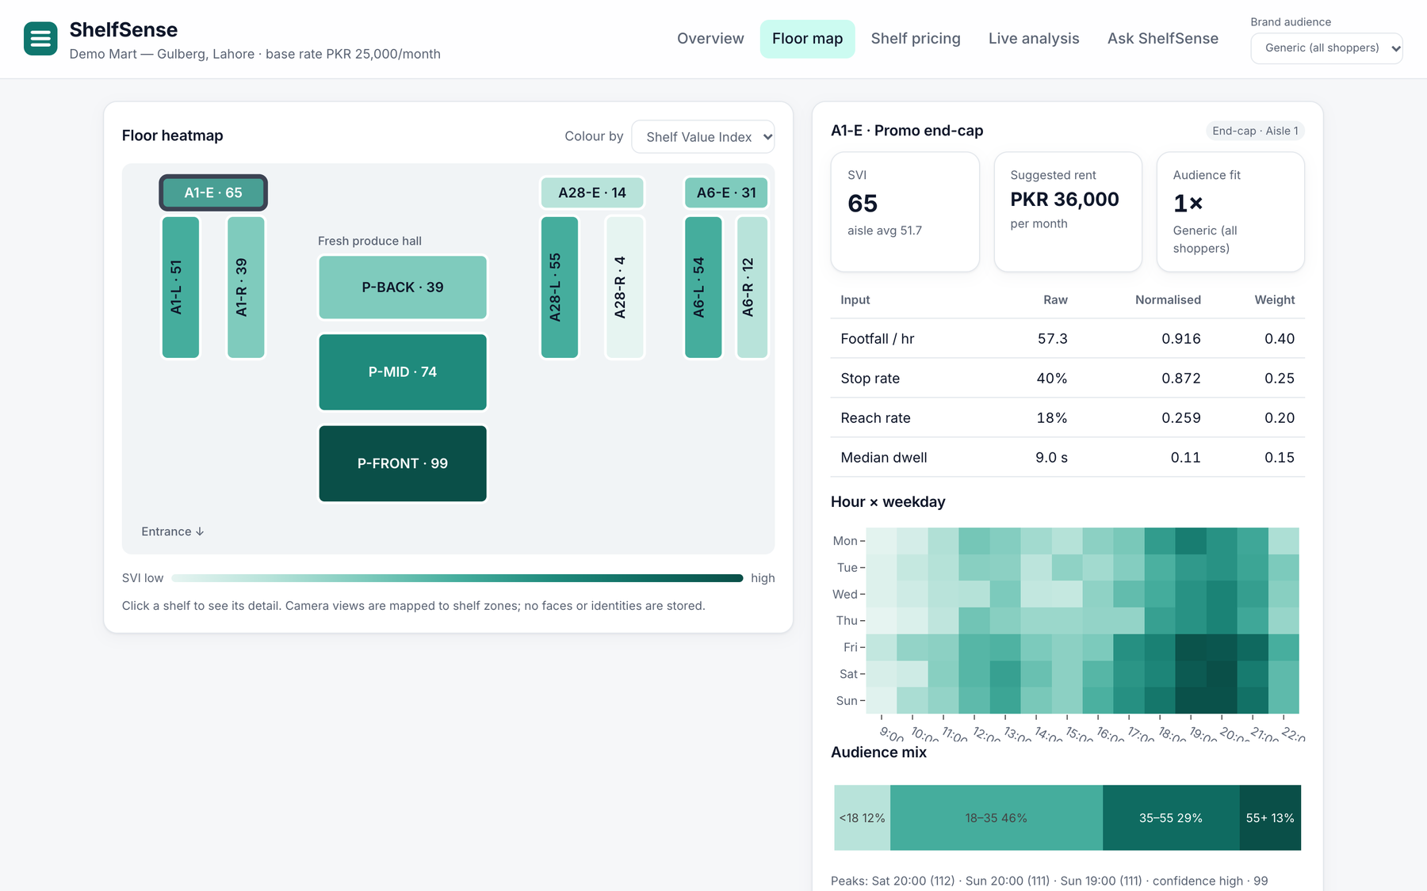
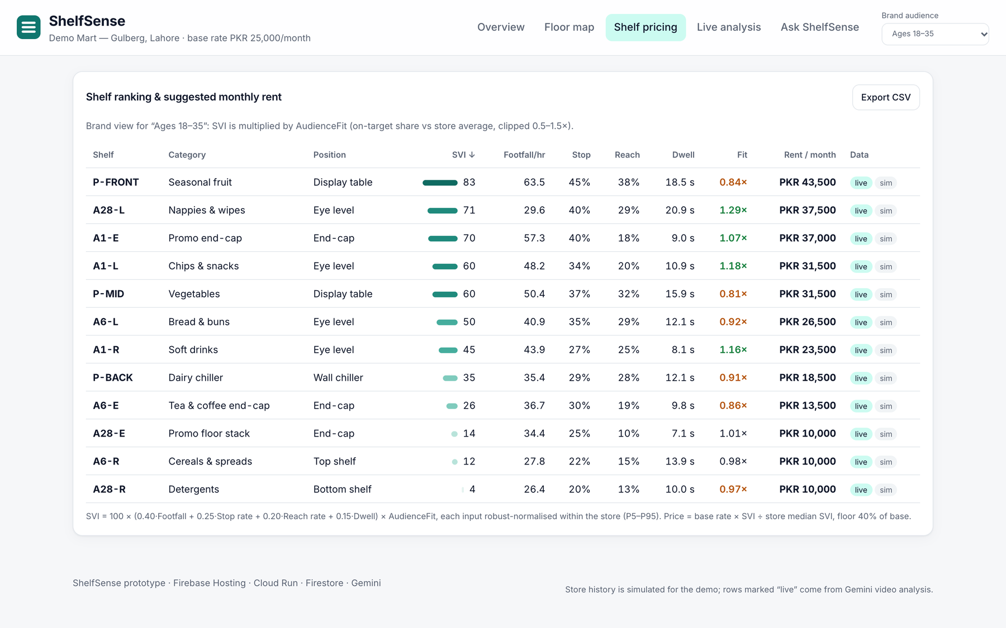
Wireframes/Mock diagrams of the proposed solution (optional)
Floor heatmap + shelf detail: how each SVI is built
Shelf pricing in a brand's view (ages 18–35)

Slide 7
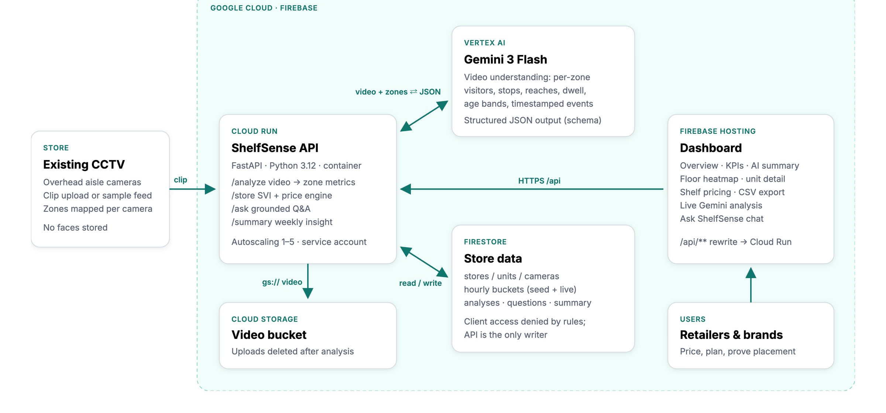
Architecture diagram of the proposed solution

Slide 8
Technologies to be used in the solution
Gemini 3 Flash · Vertex AI
Video understanding with structured JSON output; grounded Q&A; weekly summary
Cloud Run
FastAPI service in a container, autoscaling, dedicated service account
Firestore
System of record: units, cameras, hourly buckets, analyses, questions
Firebase Hosting
Dashboard + /api/** rewrite to Cloud Run on one origin
Cloud Storage
Video bucket; uploads deleted after analysis + 1-day lifecycle
Cloud Build · Artifact Registry
Source-to-container builds for every deploy
Python · FastAPI · Pydantic
API, SVI engine, Gemini response schema
JavaScript · Plotly
Dashboard charts, floor plan SVG, chat UI
Shaded: the four required technologies. Demo video narration uses Cloud Text-to-Speech.

Slide 9
Estimated implementation cost (optional)
Item
Prototype (today)
Pilot store (estimate)
Gemini video analysis
≈ US$0.0028 per 15 s clip
Edge detection; Gemini for audits + Q&A
Cloud Run API
≈ US$10 / month (1 warm instance)
≈ US$10–20 / month shared
Firestore + Hosting + Storage
Within free tier
< US$5 / store / month
Edge device
Not needed (clips)
≈ US$250 one-time (Jetson Orin Nano class)
Cameras
Existing
Existing IP cameras
Per-clip cost uses measured median tokens (2,020 in / 594 out) at Gemini 3 Flash list price (US$0.50 / US$3.00 per million). Other figures are estimates to be confirmed in a pilot. Because raw video never leaves the store in production, cloud cost stays small and flat per store.

Slide 10
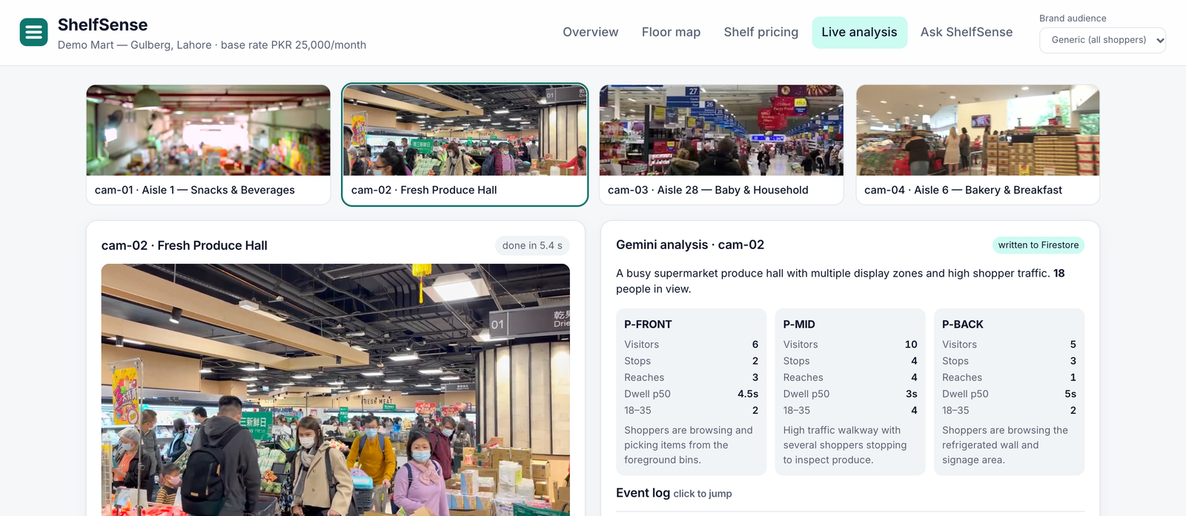
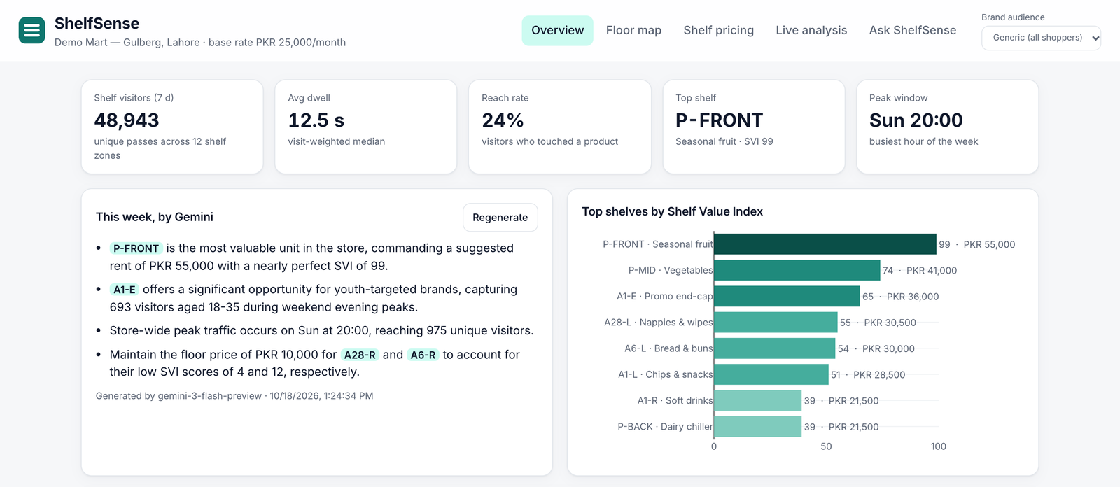
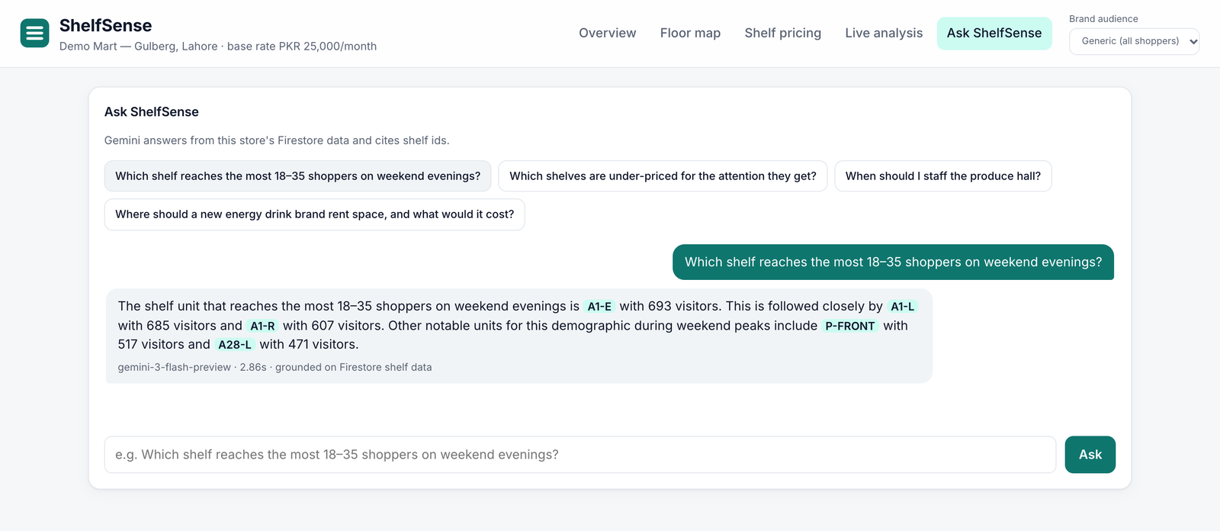
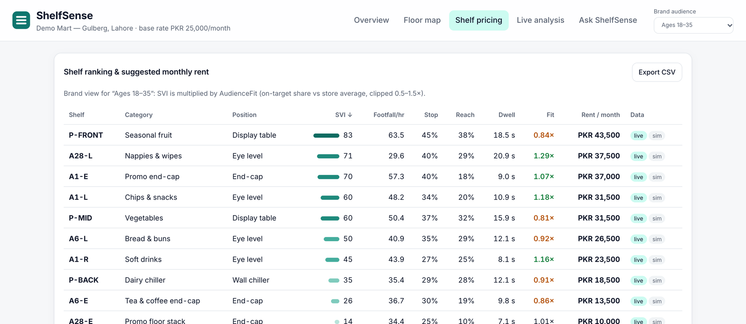
Snapshots of the prototype
Live analysis: Gemini counts per zone with a clickable event log
Overview: KPIs, Gemini weekly summary, footfall by hour
Ask ShelfSense: grounded answers citing shelves
Pricing table with audience fit

Slide 11
Prototype Performance report/Benchmarking
5.2 s
Gemini video analysis
median, end to end · worst 7.3 s
2.8 s
Ask ShelfSense answer
5 questions · worst 3.4 s
0.78 s
Dashboard API
median /store response, 10 calls
12 / 12
Schema-valid results
every video run parsed into the JSON schema
Consistency across repeated runs
Same clip, 3 runs each. Total people counted: produce hall [18, 18, 18], aisle 28 [12, 12, 12], aisle 6 [12, 12, 12], aisle 1 [3, 2, 2].
Per-zone counts vary most in the busiest zone (produce hall middle: 8–12 visitors).
≈ 2,020 input / 594 output tokens per 15 s clip.
Method and limits
Measured on the live deployment (Firebase Hosting → Cloud Run → Vertex AI), 18 Oct 2026, scripts/benchmark.py in the repo.
Count accuracy is not yet scored against hand labels. Next: the MERL Shopping dataset's labelled reach events, then a store pilot.
Model: gemini-3-flash-preview, low thinking, medium media resolution.

Slide 12
Additional Details/Future Development (if any)
PILOT · MONTHS 1–3
One chain, 3–5 stores
• In-store edge box: detection + tracking on device, only counts leave
• Calibrate SVI weights against POS data
• Face blurring at the first step
PRODUCT · MONTHS 4–9
Multi-store platform
• Firebase Auth with retailer / brand tenants
• Brand portal and automated reach reports
• Store-manager mobile app
SCALE · MONTHS 10–18
Marketplace
• More chains, cross-chain brand benchmarks
• Book shelf space at the suggested price
• Export to similar emerging markets
Privacy roadmap: no face images or embeddings, no tracking across days or stores, signage in store, and a DPIA before the pilot. We design to GDPR-style principles while Pakistan's data-protection bill is still a draft.

Slide 13
Brief description: how ShelfSense uses Firebase, Firestore, Cloud Run and Gemini
Gemini
Gemini 3 Flash on Vertex AI watches each store clip and returns per-zone visitors, stops, reaches, dwell, age bands and events as schema-checked JSON. It also answers questions grounded on store data and writes the weekly summary.
Cloud Run
Our FastAPI service runs on Cloud Run: it accepts clips, calls Gemini, writes results, computes the Shelf Value Index and prices, and serves the dashboard's API.
Firestore
Firestore holds the store model (units, cameras), hourly attention buckets from simulated history and live Gemini runs, every analysis and question. Security rules deny direct client access.
Firebase
Firebase Hosting serves the dashboard at shelfsense-demo.web.app and rewrites /api/** to Cloud Run, so the whole product runs on one origin.

Slide 14
Provide links to your:
GitHub Public Repository
https://github.com/MohsiinShah/ShelfSense
Demo Video Link (3 Minutes)
https://youtu.be/9HP-f7Th4XY
Final Product Link
https://shelfsense-demo.web.app

Slide 15


