Slide 1
Deadlock
Course Instructor: Safia Baloch

Slide 2
Deadlock
A set of processes is deadlocked when each process in the set is blocked awaiting an event that can only be triggered by another blocked process in the set
Typically involves processes competing for the same set of resources
No efficient solution
Limited resources, with different type or class(i/o, files cpu cycles etc.) having identical more than one instances.
synchronization/sequence of resource
Request
Use
Release
Notes:
A set of processes is deadlocked when each process in the set is blocked awaiting an event that can only be triggered by another blocked process in the set
typically processes are waiting the freeing up of some requested resource.
Deadlock is permanent because none of the events is ever triggered.
Unlike other problems in concurrent process management, there is no efficient solution in the general case.

Slide 3

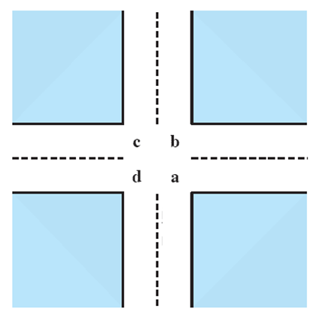
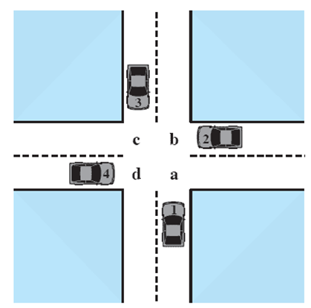



Potential Deadlock, Dining philosopher
I need quad C and B
I need quad B and C
I need quad A and B
I need quad D and A
Notes:
Animated Slide
Click 1 Cars approach intersection
Then Cars announce their resource needs
All deadlocks involve conflicting needs for resources by two or more processes. A common example is the traffic deadlock.
The typical rule of the road in the United States is that a car at a four-way stop should defer to a car immediately to its right.
This rule works if there are only two or three cars at the intersection.
If all four cars arrive at about the same time, each will refrain from entering the intersection, this causes a potential deadlock.
The deadlock is only potential, not actual, because the necessary resources are available for any of the cars to proceed.
If one car eventually does proceed, it can do so.

Slide 4
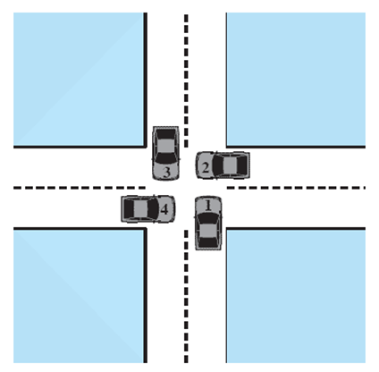
Actual Deadlock
HALT until D is free
HALT until C is free
HALT until B is free
HALT until A is free
Notes:
Animated Slide
Click 1 Cars move to deadlock
Then Cars announce their resource need
But if all four cars ignore the rules and proceed (cautiously) into the intersection at the same time, then each car seizes one resource (one quadrant) but cannot proceed because the required second resource has already been seized by another car.
This is an actual deadlock.

Slide 5
Characterization of Deadlock
Deadlock will occur if following four conditions hold simultaneously in a system
Mutual exclusion (at least one resource in sharable mode)
Hold and wait (holding a resource while along waiting for another hold by other)
No pre-emption (resource released voluntarily )
Circular wait {t0,t1…tn} t0 waiting for resource of t1, t1 waiting for t2…tn-1 waiting for tn and tn waiting for resource hold by t0.
Each condition is not significantly independent, hold and wait implies circular wait.
Dealing with Deadlock:
prevent deadlock
adopt a policy that eliminates one of the conditions (conditions 1 through 4).
avoid deadlock
by making the appropriate dynamic choices based on the current state of resource allocation.
Notes:
Three general approaches exist for dealing with deadlock.
prevent deadlock
adopt a policy that eliminates one of the conditions (conditions 1 through 4).
avoid deadlock
by making the appropriate dynamic choices based on the current state of resource allocation.
detect the presence of deadlock
(conditions 1 through 4 hold) and take action to recover.
We discuss each of these approaches in turn.

Slide 6
Resource Allocation Graphs of deadlock
Deadlocks can be described more precisely in terms of a directed graph called
a system resource-allocation graph
Graph has set of vertices and set of edges.
Vertices are of two types of nodes (Active Threads T={T1,T2…Tn}, resource R={R1, R2…Rn}) Edges
Request edge. Ti -> Rj
Assignment edge. Rj -> Ti

Slide 7
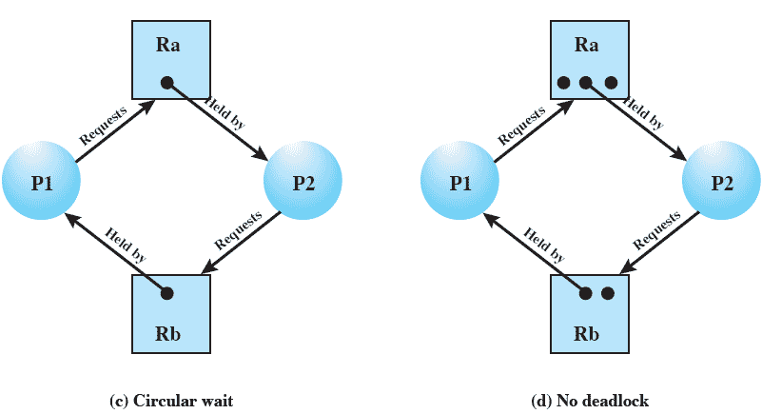
Resource Allocation Graphs of deadlock

Slide 8
Resource Allocation Graphs of deadlock
Resource instances:
◦ One instance of resource type R1
◦ Two instances of resource type R2
◦ One instance of resource type R3
◦ Three instances of resource type R4
Process states:
◦ Process P1 is holding an instance of resource
type R2 and is waiting for an instance of
resource type R1.
◦ Process P2 is holding an instance of R1 and an
instance of R2 and is waiting for an instance of R3.
◦ Process P3 is holding an instance of R3.

Slide 9
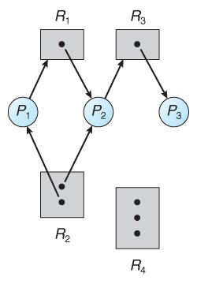
RAG
The sets P,R,E
P={P1,P2,P3}
R={R1,R2,R3,R4}
E={P1->R1, P2->R3, R2->P1, R1->P2, R2->P2, R3->P3}

Slide 10
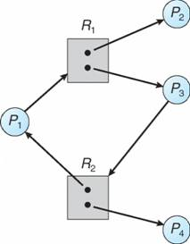
One instance of each resource= cycle graph, Deadlock?
More instance of resources= cycle graph, deadlock?
T1-> R1-> T2-> R3-> T3-> R2->T1
P2-> R3-> P3-> R2-> P2
T1-> R1-> T3-> R2->T1

Slide 11
Dealing with Deadlock
In simple way: (ignore, use protocol, allow) deadlock
Three general approaches exist for dealing with deadlock.
Prevent deadlock(M/E, H/W, N/P, C/W)
Avoid deadlock(Prior Information for resource)
Detect Deadlock(if no prevention or avoidance done)
Determine and recover from deadlock
Notes:
Three general approaches exist for dealing with deadlock.
prevent deadlock
adopt a policy that eliminates one of the conditions (conditions 1 through 4).
avoid deadlock
by making the appropriate dynamic choices based on the current state of resource allocation.
detect the presence of deadlock
(conditions 1 through 4 hold) and take action to recover.
We discuss each of these approaches in turn.

Slide 12
Deadlock Prevention Strategy
Design a system in such a way that the possibility of deadlock is excluded.
Two main methods
Indirect – prevent one of the three necessary conditions from occurring
Direct – prevent circular waits
Notes:
Deadlock prevention is strategy simply to design a system in such a way that the possibility of deadlock is excluded.
We can view deadlock prevention methods as falling into two classes.
indirect method of deadlock prevention is to prevent the occurrence of one of the three necessary conditions listed previously (items 1 through 3).
direct method of deadlock prevention is to prevent the occurrence of a circular wait (item 4).
We now examine techniques related to each of the four
conditions.

Slide 13
Deadlock Prevention Conditions
Mutual Exclusion
Hold and Wait
No Preemption
Circular Wait
Notes:
Mutual Exclusion
The first of the four listed conditions cannot be disallowed (in general).
If access to a resource requires mutual exclusion, then mutual exclusion must be supported by the OS.
Some resources, such as files, may allow multiple accesses for reads but only exclusive access for writes.
Even in this case, deadlock can occur if more than one process requires write permission.
Hold an Wait
Can be prevented by requiring that a process request all of its required resources at one time and blocking the process until all requests can be granted simultaneously.
This approach is inefficient in two ways.
1) a process may be held up for a long time waiting for all of its resource requests to be filled, when in fact it could have proceeded with only some of the resources.
resources allocated to a process may remain unused for a considerable period, during which time they are denied to other processes.
Another problem is that a process may not know in advance all of the resources that it will require.
There is also the practical problem created by the use of modular programming or a multithreaded structure for an application.
An application would need to be aware of all resources that will be requested at all levels or in all modules to make the simultaneous request.

Slide 14
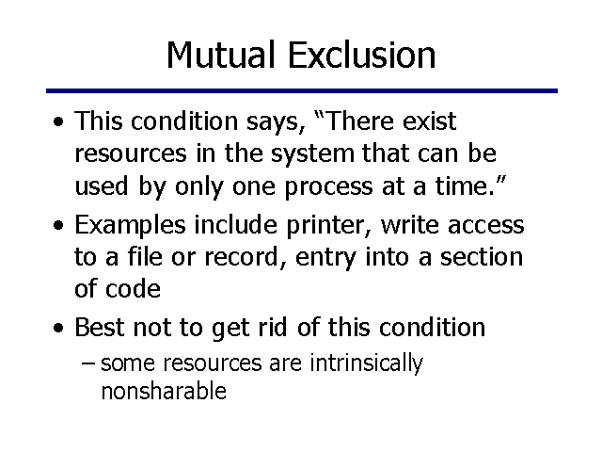
Deadlock Prevention Conditions

Slide 15
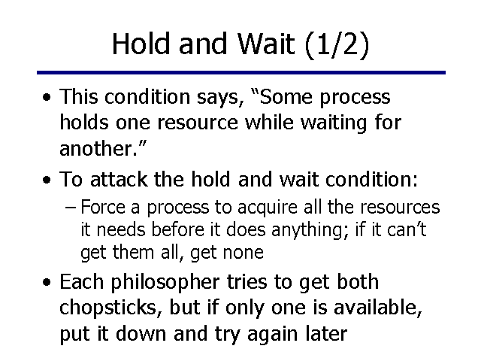
Deadlock Prevention Conditions

Slide 16
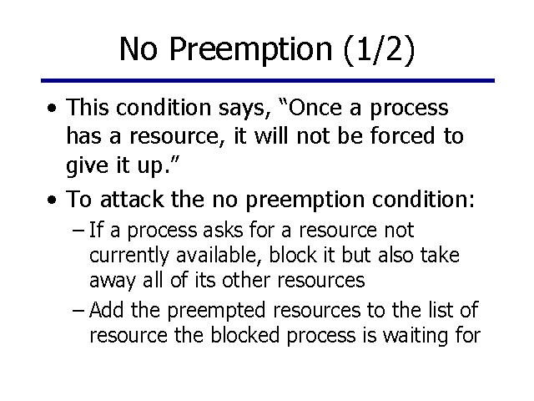
Deadlock Prevention Conditions

Slide 17
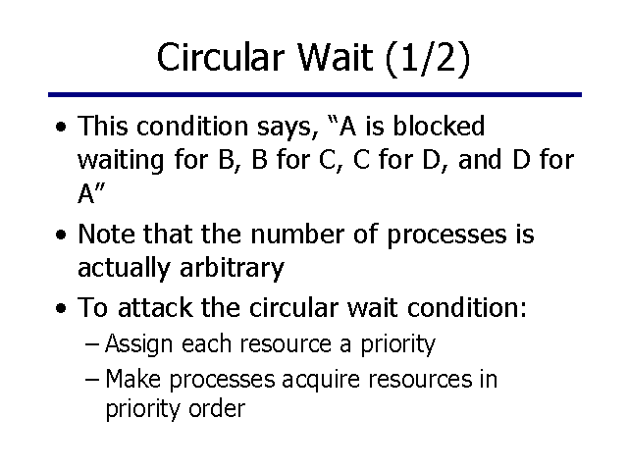
Deadlock Prevention Conditions

Slide 18
Deadlock Avoidance
A decision is made dynamically whether the current resource allocation request will, if granted, potentially lead to a deadlock
Requires knowledge of future process requests
Avoidance allows more concurrency than prevention.
Deadlock avoidance algorithm dynamically examines the resource-allocation state to ensure that a circular wait condition can never exist.
Notes:
Deadlock avoidance allows the three necessary conditions
but makes judicious choices to assure that the deadlock point is never reached.
Avoidance allows more concurrency than prevention.
With deadlock avoidance, a decision is made dynamically whether the current resource allocation request will, if granted, potentially lead to a deadlock.
Deadlock avoidance requires knowledge of future process resource requests.

Slide 19
Two Approaches to Deadlock Avoidance
The resource allocation State is defined by the number of available and allocated resources and the maximum demands of the threads.
Process Initiation Denial
Resource Allocation Denial

Slide 20
Process Initiation Denial
A process is only started if the maximum claim of all current processes plus those of the new process can be met.
Not optimal,
Assumes the worst: that all processes will make their maximum claims together.
Notes:
A process is only started if the maximum claim of all current processes plus those of the new process can be met.
This strategy is hardly optimal, because it assumes the worst:
that all processes will make their maximum claims together.

Slide 21
Resource Allocation Denial
Referred to as the banker’s algorithm
A strategy of resource allocation denial
Consider a system with fixed number of resources
State of the system is the current allocation of resources to process
Safe state is where there is at least one sequence that does not result in deadlock
Unsafe state is a state that is not safe
Notes:
Movie button goes to http://gaia.ecs.csus.edu/~zhangd/oscal/Banker/Banker.html

Slide 22
Basic Facts for deadlock avoidance
If a system is in safe state ⇒ no deadlocks
If a system is in unsafe state ⇒ possibility of deadlock
Avoidance ⇒ ensure that a system will never enter an unsafe state.

Slide 23
Banker’s Algorithm
Multiple instances
Each process must a priori claim maximum use
When a process requests a resource it may have to wait
When a process gets all its resources it must return them in a finite amount of time

Slide 24
Data Structures for the Banker’s Algorithm
Let n = number of processes, and m = number of resources types.
Available: Vector of length m, available resources. If available[j] = k, there are k instances of resource type R_{j} available
Max: n x m matrix (demand of process). If Max[i,j] = k, then process P_{i} may request at most k instances of resource type R_{j}
Allocation: n x m matrix. If Allocation[i,j] = k then P_{i} is currently allocated k instances of R_{j}
Need: n x m matrix. If Need[i,j] = k, then P_{i} may need k more instances of R_{j} to complete its task
Need [i,j] = Max[i,j] – Allocation [i,j]

Slide 25
Example of Banker’s Algorithm
Discussed in Class

Slide 26
Resource-Request Algorithm for Process P_{i}
old resource-allocatio Request_{i} = request vector for process P_{i}. If Request_{i} [j] = k then process P_{i} wants k instances of resource type R_{j}
1. If Request_{i} ≤ Need_{i} go to step 2. Otherwise, raise error condition, since process has exceeded its maximum claim
2. If Request_{i} ≤ Available, go to step 3. Otherwise P_{i} must wait, since resources are not available
3. Pretend to allocate requested resources to P_{i} by modifying the state as follows:
Available = Available – Request_{i};
Allocation_{i} = Allocation_{i} + Request_{i};
Need_{i} = Need_{i} – Request_{i};
If safe ⇒ the resources are allocated to P_{i}
If unsafe ⇒ P_{i} must wait, and the n state is restored

Slide 27
Example of Resource Request Algorithm
Discussed in Class

