Slide 1

Minimizing DFA’s
By Partitioning

Slide 2
Minimizing DFA’s
Lots of methods
All involve finding equivalent states:
  States that go to equivalent states under all inputs (sounds recursive)
We will use the Partitioning Method

Slide 3
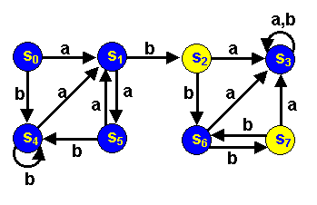
Minimizing DFA’s by Partitioning
Consider the following dfa (from Forbes Louis at U of KY):
Accepting states are yellow
Non-accepting states are blue
Are any states really the same?

Slide 4
S₂ and S₇ are really the same:
Both Final states
Both go to S6 under input b
Both go to S3 under an a
S0 and S5 really the same. Why?
We say each pair is equivalent
Are there any other equivalent states?
We can merge equivalent states into 1 state

Slide 5
0 Equivalence
 | a | b
S₀ | S₁ | S₄
S₁ | S₅ | S₂
S₃ | S₃ | S₃
S₄ | S₁ | S₄
S₅ | S₁ | S₄
S₆ | S₃ | S₇
+S₂ | S₃ | S₆
+S₇ | S₃ | S₆
P
I
P II
S0
S1
S3
S4
S5
S6
S2
S7
1 Equivalence
P
I
P II
P III
S0
S3
S4
S5
S2
S7
S1
S6
2 Equivalence
P
I
P II
P III
P
IV
S0
S4
S5
S2
S7
S1
S6
S3
3 Equivalence
P I
PII
P
P
P V
III
IV
S0
S4
S5
S2
S7
S1
S3
S6

Slide 6
 | a | b
S₀ | S₁ | S₄
S₁ | S₅ | S₂
S₃ | S₃ | S₃
S₄ | S₁ | S₄
S₅ | S₁ | S₄
S₆ | S₃ | S₇
+S₂ | S₃ | S₆
+S₇ | S₃ | S₆
a
b
S0
I
S1
III
S4
I
S5
I
S1
III
S4
I
S4
I
S1
III
S4
I
S3
S3
IV
S3
IV
IV
S1
S5
I
S2
II
III
S6
V
S3
IV
S7
II
+S2
II
S3
IV
S6
V
+S7
II
S3
IV
S6
V
2 Equivalence
P I
PII
P
P
P V
III
IV
S0
S4
S5
S2
S7
S1
S3
S6

Slide 7
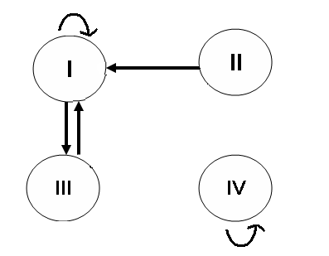
b
b
b
b
V
a
a
a
a
a
b
b
S0
I
S1
III
S4
I
S5
I
S1
III
S4
I
a
b
S4
S1
III
S4
I
 | a | b
I | III | I
*II | IV | V
III | I | II
IV | IV | IV
V | IV | II
I
S3
S3
IV
S3
IV
IV
S1
S5
I
S2
II
III
S6
V
S3
IV
S7
II
+S2
II
S3
IV
S6
V
+S7
II
S3
IV
S6
V

Slide 8
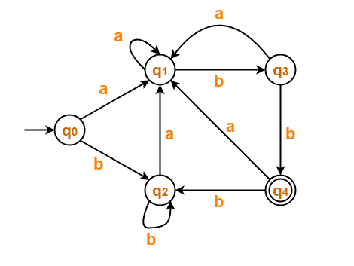
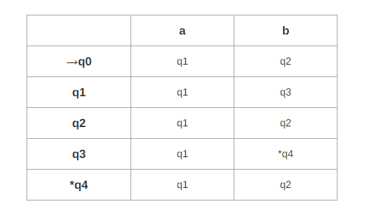
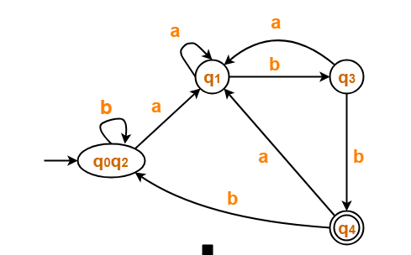




Courtesy Costas Busch - RPI

