Slide 1
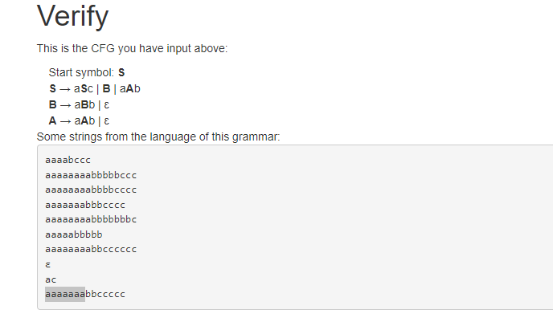
Courtesy Costas Busch - RPI
1

Slide 2

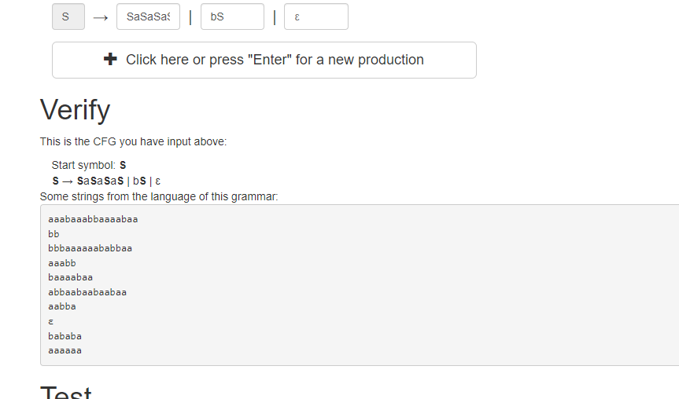
Courtesy Costas Busch - RPI

Slide 3

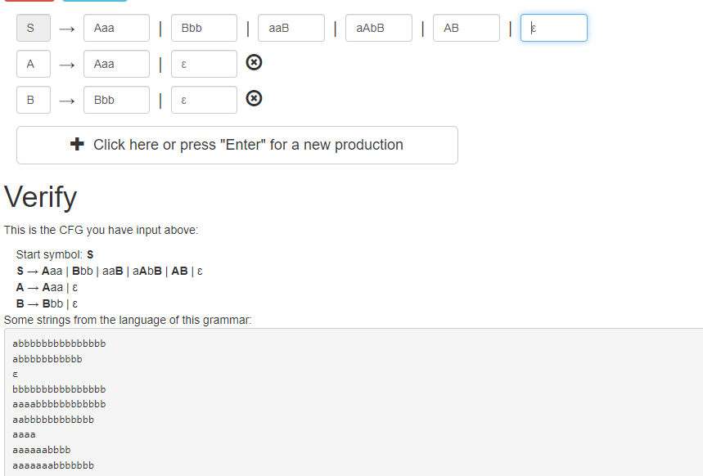
Courtesy Costas Busch - RPI

Slide 4
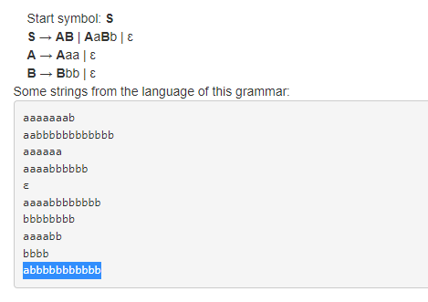
Simplified Version
Courtesy Costas Busch - RPI

Slide 5
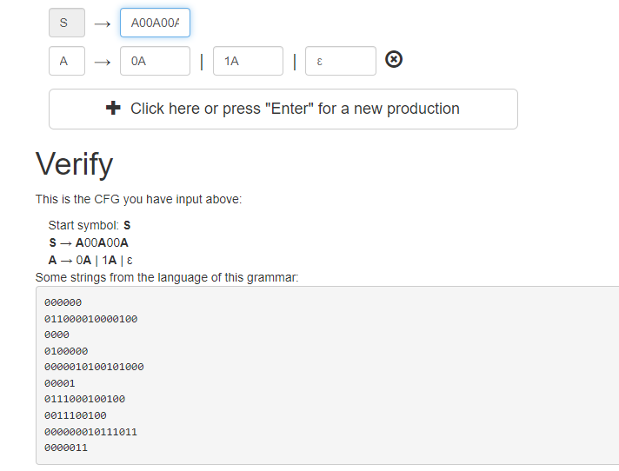
Courtesy Costas Busch - RPI

Slide 6

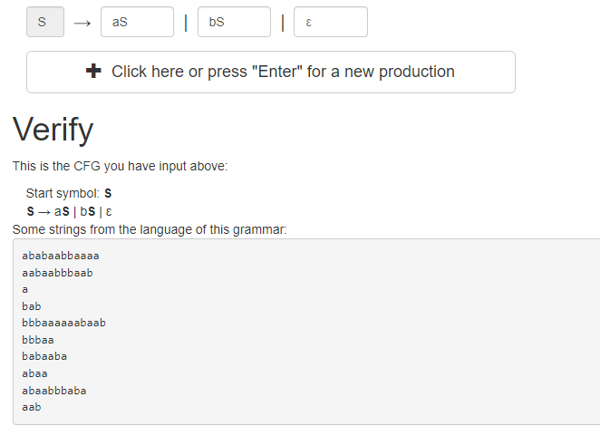
Courtesy Costas Busch - RPI

