Slide 1
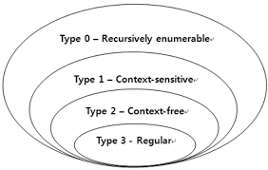

Slide 2
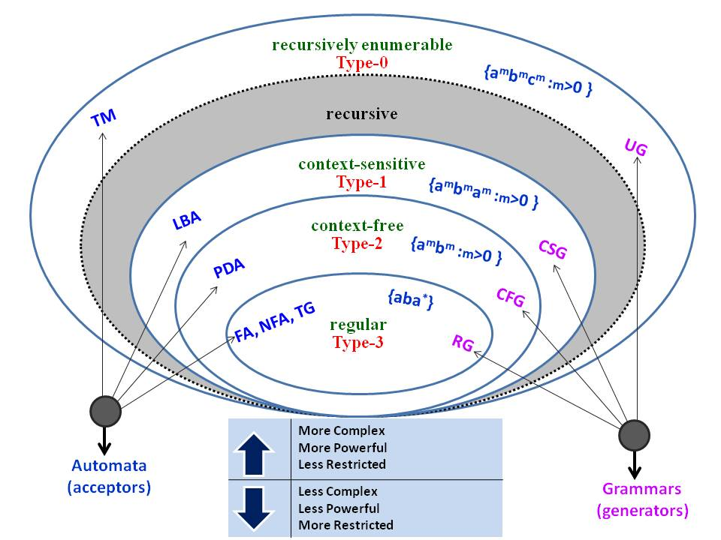

Slide 3
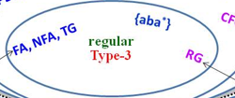

Slide 4
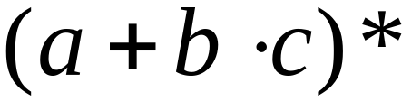
Regular Expressions
Regular expressions describe regular languages
Example:
describes the language
Courtesy Costas Busch - RPI

Slide 5



Regular Expressions
Given regular expressions and
Are regular expressions
Courtesy Costas Busch - RPI

Slide 6
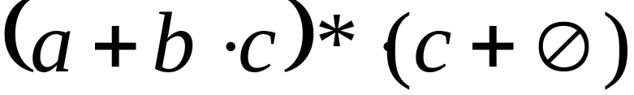
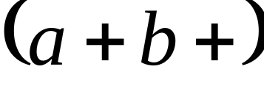
Examples
A regular expression:
Not a regular expression:
Courtesy Costas Busch - RPI

Slide 7
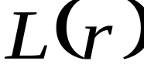

Languages of Regular Expressions
: language of regular expression
Example
Courtesy Costas Busch - RPI

Slide 8
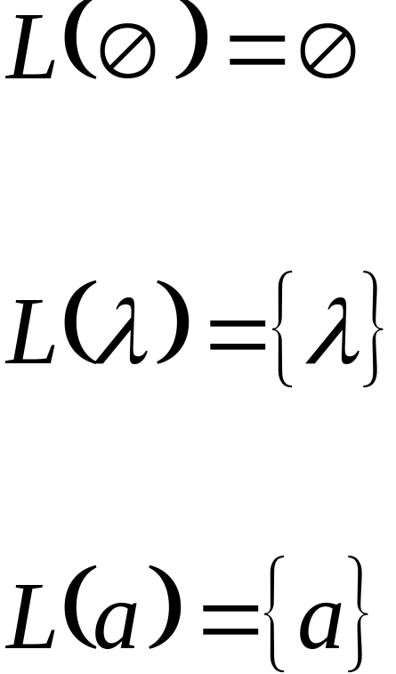
Definition
For primitive regular expressions:
Courtesy Costas Busch - RPI

Slide 9


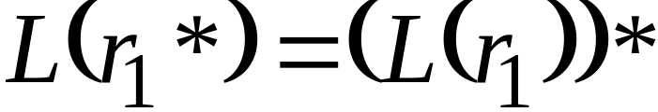

Definition (continued)
For regular expressions and
Courtesy Costas Busch - RPI

Slide 10

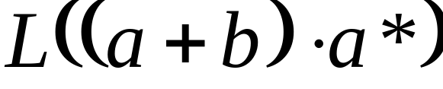


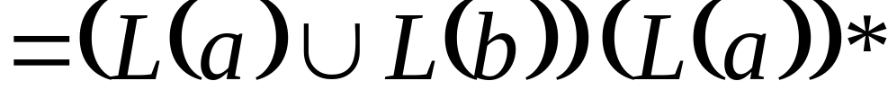
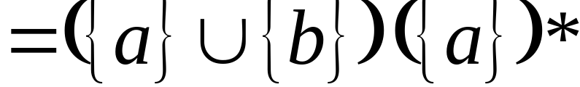
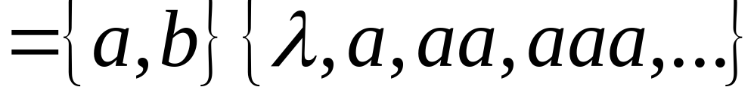
Example
Regular expression:
Courtesy Costas Busch - RPI

Slide 11

Example
Regular expression
Courtesy Costas Busch - RPI

Slide 12




Example
Regular expression
If n, m >= 1
Courtesy Costas Busch - RPI

Slide 13


Example
Regular expression
= { all strings with at least two consecutive 0 }
Courtesy Costas Busch - RPI

Slide 14
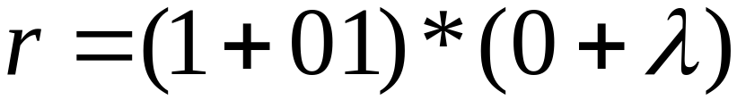
Example
Regular expression
= { all strings without two consecutive 0 }
Courtesy Costas Busch - RPI

Slide 15

Equivalent Regular Expressions
Definition:
Regular expressions and
are equivalent if
Courtesy Costas Busch - RPI

Slide 16

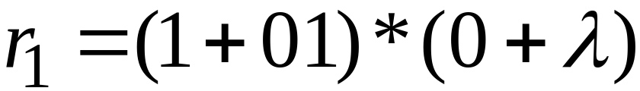

Example
= { all strings without two consecutive 0 }
and
are equivalent
regular expr.
Courtesy Costas Busch - RPI

