Slide 1
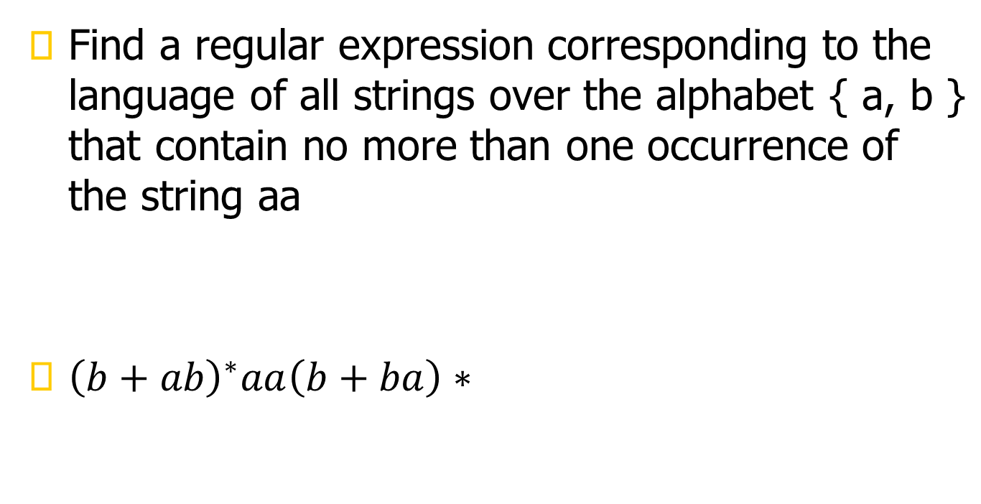

Slide 2
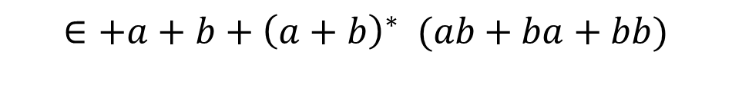
Language of the strings that do not end with aa.

Slide 3
All the strings that contain an even number of b’s.

Slide 4

Describe as simply as possible in English the language corresponding to the regular expression
The language of string having odd number of bs

Slide 5
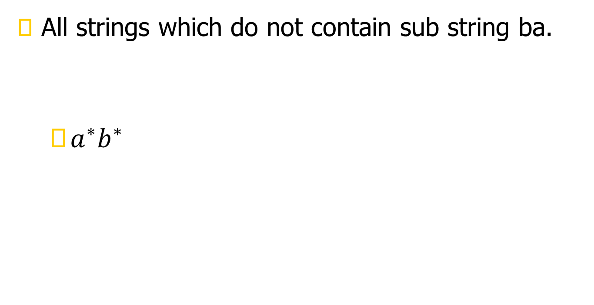

Slide 6

Regular expression for even even language

Slide 7
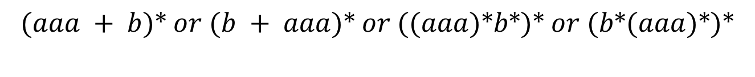
Construct a regular expression for all words in which a appears tripled, if at all. This means
that every clump of a’s contains 3 or 6 or 9 or 12… a’s.

Slide 8

4. Construct a regular expression for all words that contain exactly two b’s or exactly three b’s,
not more

Slide 9
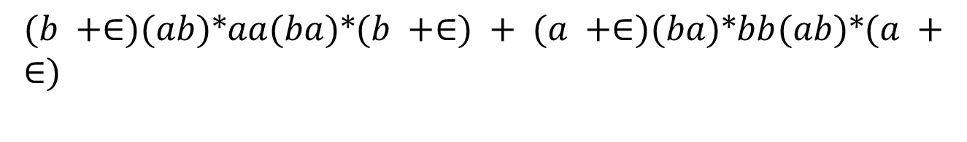
. Construct a regular expression for all strings that have exactly one double letter in them.

Slide 10
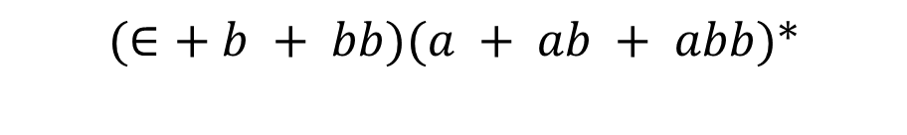
Construct a regular expression for all strings in which the letter b is never tripled. This means that no word contains the substring bbb.

Slide 11

Construct a regular expression for all strings in which the total number of a’s is divisible by
3 no matter how they are distributed, such as aabaabbaba

Slide 12
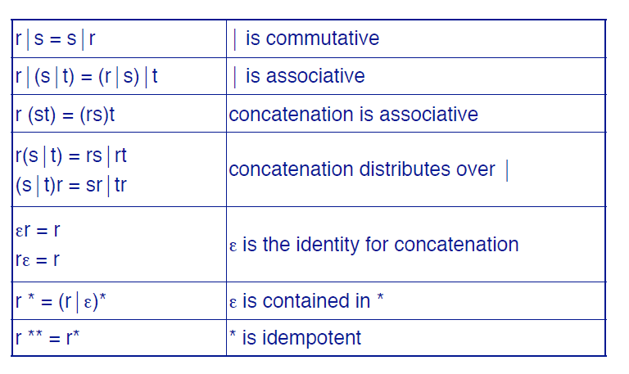
Algebraic Properties

Slide 13
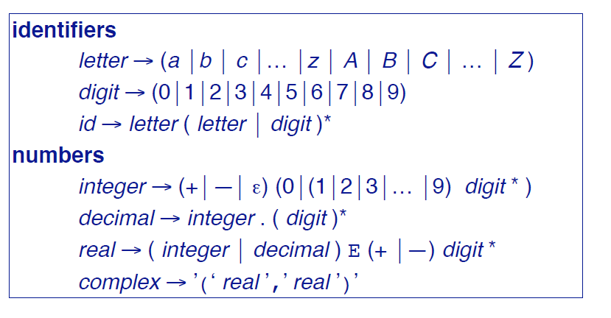
Using R.E for Tokenization

Slide 14
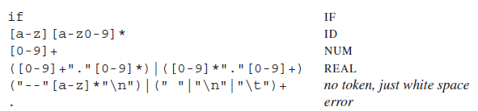
R.E. and Tokens – Our job
Assign a token type to a subset of input stream, based on its matching with a RE
The fifth line recognizes comments or white space but does not report back to the parser.
White space is discarded and the lexer resumed.
The comments for this lexer begin with two dashes, contain only alphabetic characters, and end with newline.

Slide 15
SummingUP Lecture 2
RE, Recursive definition of RE, defining languages by RE, { x}*, { x}⁺, {a+b}*, Language of strings having exactly one aa, Language of strings of even length, Language of strings of odd length, RE defines unique language (as Remark), Language of strings having at least one a, Language of strings havgin at least one a and one b, Language of strings starting with aa and ending in bb, Language of strings starting with and ending in different letters.

