Slide 1
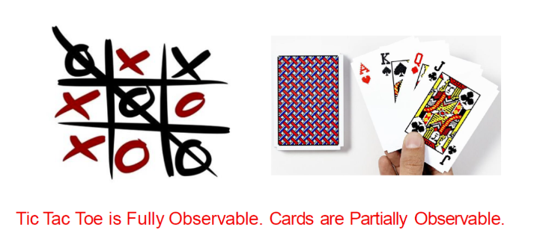
Fully Observable Vs Partially Observable
Fully: An agent sensors that can always always measure all relevant information in the environment.
Partially Observable(Memory Internal State): Cannot

Slide 2
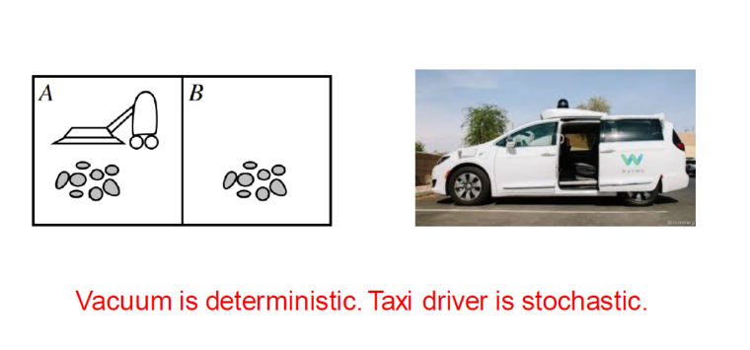
Deterministic Vs Stochastic
Deterministic: Determine the next state of an agent (No Uncertainty)
Stochastic: Cannot, there is Uncertainty

Slide 3
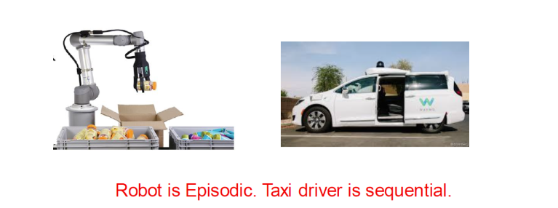
Episodic Vs Sequential
Sequential(Dependent): There could be a consequence/effect on the next state
Episodic(Independent): No there never will be

Slide 4
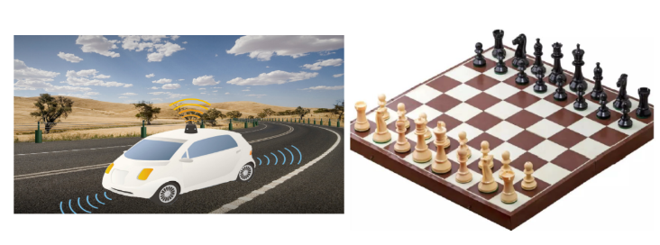
Dynamic Vs Static
Dynamic: It’s environment changes while the agent is thinking
Static: It doesn’t
Semi-Dynamic: The performance of the agent changes but not the environment

Slide 5
Continuous Vs Discrete
Continuous: Decimal, If the agent is being controlled continuously
Discrete: Whole Numbered, Fixed Data, Steps, Countable

Slide 6
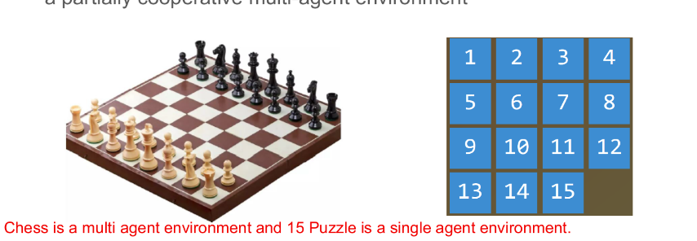
Single Agent Vs Multi Agent
Single Agent: 1 Agent
Multi Agent: > 1 Agent and Random Behavior

Slide 7
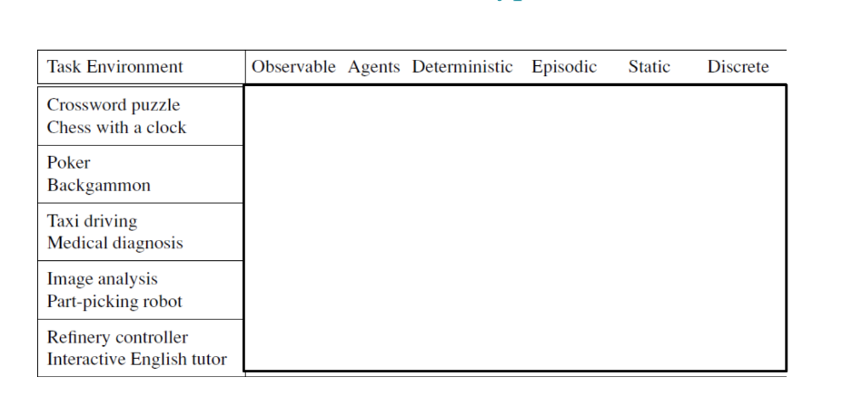
Exercise

Slide 8
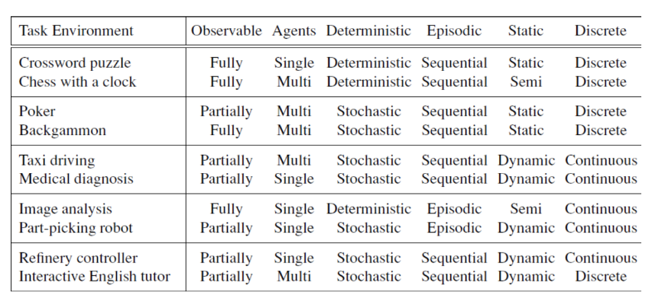
Answers

