Slide 1
CLUSTERING
K-Means

Slide 2
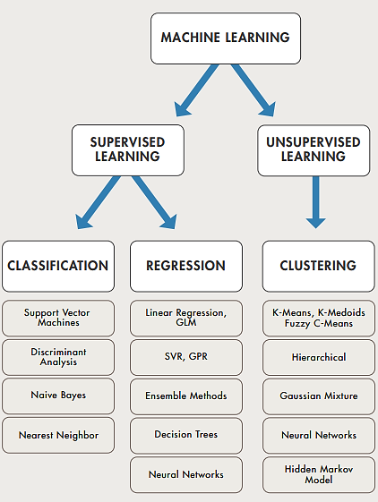
Learning

Slide 3
K-Means Clustering
K-means clustering is one of the simplest and popular unsupervised machine learning algorithms.
Typically, unsupervised algorithms make inferences from datasets using only input vectors without referring to known, or labelled, outcomes

Slide 4
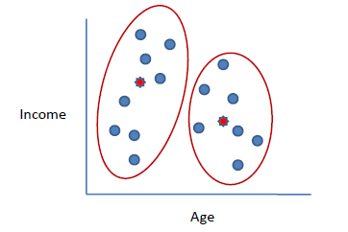
K-Means Algorithm
Clusters the data into k groups where k is predefined.
Select k points at random as cluster centers.
Assign objects to their closest cluster center according to the Euclidean distance function.
Calculate the centroid or mean of all objects in each cluster.
Repeat steps 2, 3 and 4 until the same points are assigned to each cluster in consecutive rounds.

Slide 5
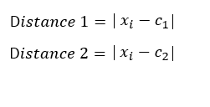
Example
Suppose we want to group the visitors to a website using just their age (one-dimensional space) as follows:
n = 19
15,15,16,19,19,20,20,21,22,28,35,40,41,42,43,44,60,61,65
Initial clusters (random centroid or average):
k = 2
c₁ = 16 c₂ = 22

Slide 6
Iteration 1: c₁ = 15.33 c₂ = 36.25
x_{i} | c₁ | c₂ | Distance 1 | Distance 2 | Nearest Cluster | New Centroid
15 | 16 | 22 | 1 | 7 | 1 | 15.33
15 | 16 | 22 | 1 | 7 | 1
16 | 16 | 22 | 0 | 6 | 1
19 | 16 | 22 | 3 | 3 | 2 | 36.25
19 | 16 | 22 | 3 | 3 | 2
20 | 16 | 22 | 4 | 2 | 2
20 | 16 | 22 | 4 | 2 | 2
21 | 16 | 22 | 5 | 1 | 2
22 | 16 | 22 | 6 | 0 | 2
28 | 16 | 22 | 12 | 6 | 2
35 | 16 | 22 | 19 | 13 | 2
40 | 16 | 22 | 24 | 18 | 2
41 | 16 | 22 | 25 | 19 | 2
42 | 16 | 22 | 26 | 20 | 2
43 | 16 | 22 | 27 | 21 | 2
44 | 16 | 22 | 28 | 22 | 2
60 | 16 | 22 | 44 | 38 | 2
61 | 16 | 22 | 45 | 39 | 2
65 | 16 | 22 | 49 | 43 | 2

Slide 7
Iteration 2: c₁ = 18.56 c₂ = 45.90
x_{i} | c₁ | c₂ | Distance 1 | Distance 2 | Nearest Cluster | New Centroid
15 | 15.33 | 36.25 | 0.33 | 21.25 | 1 | 18.56
15 | 15.33 | 36.25 | 0.33 | 21.25 | 1
16 | 15.33 | 36.25 | 0.67 | 20.25 | 1
19 | 15.33 | 36.25 | 3.67 | 17.25 | 1
19 | 15.33 | 36.25 | 3.67 | 17.25 | 1
20 | 15.33 | 36.25 | 4.67 | 16.25 | 1
20 | 15.33 | 36.25 | 4.67 | 16.25 | 1
21 | 15.33 | 36.25 | 5.67 | 15.25 | 1
22 | 15.33 | 36.25 | 6.67 | 14.25 | 1
28 | 15.33 | 36.25 | 12.67 | 8.25 | 2 | 45.9
35 | 15.33 | 36.25 | 19.67 | 1.25 | 2
40 | 15.33 | 36.25 | 24.67 | 3.75 | 2
41 | 15.33 | 36.25 | 25.67 | 4.75 | 2
42 | 15.33 | 36.25 | 26.67 | 5.75 | 2
43 | 15.33 | 36.25 | 27.67 | 6.75 | 2
44 | 15.33 | 36.25 | 28.67 | 7.75 | 2
60 | 15.33 | 36.25 | 44.67 | 23.75 | 2
61 | 15.33 | 36.25 | 45.67 | 24.75 | 2
65 | 15.33 | 36.25 | 49.67 | 28.75 | 2

Slide 8
Iteration 3: c₁ = 19.50 c₂ = 47.89
x_{i} | c₁ | c₂ | Distance 1 | Distance 2 | Nearest Cluster | New Centroid
15 | 18.56 | 45.9 | 3.56 | 30.9 | 1 | 19.50
15 | 18.56 | 45.9 | 3.56 | 30.9 | 1
16 | 18.56 | 45.9 | 2.56 | 29.9 | 1
19 | 18.56 | 45.9 | 0.44 | 26.9 | 1
19 | 18.56 | 45.9 | 0.44 | 26.9 | 1
20 | 18.56 | 45.9 | 1.44 | 25.9 | 1
20 | 18.56 | 45.9 | 1.44 | 25.9 | 1
21 | 18.56 | 45.9 | 2.44 | 24.9 | 1
22 | 18.56 | 45.9 | 3.44 | 23.9 | 1
28 | 18.56 | 45.9 | 9.44 | 17.9 | 1
35 | 18.56 | 45.9 | 16.44 | 10.9 | 2 | 47.89
40 | 18.56 | 45.9 | 21.44 | 5.9 | 2
41 | 18.56 | 45.9 | 22.44 | 4.9 | 2
42 | 18.56 | 45.9 | 23.44 | 3.9 | 2
43 | 18.56 | 45.9 | 24.44 | 2.9 | 2
44 | 18.56 | 45.9 | 25.44 | 1.9 | 2
60 | 18.56 | 45.9 | 41.44 | 14.1 | 2
61 | 18.56 | 45.9 | 42.44 | 15.1 | 2
65 | 18.56 | 45.9 | 46.44 | 19.1 | 2

Slide 9
Iteration 4: c₁ = 19.50 c₂ = 47.89
x_{i} | c₁ | c₂ | Distance 1 | Distance 2 | Nearest Cluster | New Centroid
15 | 19.5 | 47.89 | 4.50 | 32.89 | 1 | 19.50
15 | 19.5 | 47.89 | 4.50 | 32.89 | 1
16 | 19.5 | 47.89 | 3.50 | 31.89 | 1
19 | 19.5 | 47.89 | 0.50 | 28.89 | 1
19 | 19.5 | 47.89 | 0.50 | 28.89 | 1
20 | 19.5 | 47.89 | 0.50 | 27.89 | 1
20 | 19.5 | 47.89 | 0.50 | 27.89 | 1
21 | 19.5 | 47.89 | 1.50 | 26.89 | 1
22 | 19.5 | 47.89 | 2.50 | 25.89 | 1
28 | 19.5 | 47.89 | 8.50 | 19.89 | 1
35 | 19.5 | 47.89 | 15.50 | 12.89 | 2 | 47.89
40 | 19.5 | 47.89 | 20.50 | 7.89 | 2
41 | 19.5 | 47.89 | 21.50 | 6.89 | 2
42 | 19.5 | 47.89 | 22.50 | 5.89 | 2
43 | 19.5 | 47.89 | 23.50 | 4.89 | 2
44 | 19.5 | 47.89 | 24.50 | 3.89 | 2
60 | 19.5 | 47.89 | 40.50 | 12.11 | 2
61 | 19.5 | 47.89 | 41.50 | 13.11 | 2
65 | 19.5 | 47.89 | 45.50 | 17.11 | 2
No change between iterations 3 and 4 has been noted. By using clustering, 2 groups have been identified 15-28 and 35-65.

Slide 10
K-Means Clustering for 2 attributes
subject | A | B
1 | 1 | 1
2 | 1.5 | 2
3 | 3 | 4
4 | 5 | 7
5 | 3.5 | 5
6 | 4.5 | 5
7 | 3.5 | 4.5

Slide 11
Algorithm
Choose the number of clusters you want to create
As per the number of clusters, choose initial seeds to start.
Calculate distance of every value now from the initial seeds.
Now every row will be assigned to one cluster as per its minimum distance.
After one iteration, mean is calculated of each cluster and again same steps are performed until convergence.

Slide 12
First iteration
 | Seed 1 | Seed 2
1 | 0 | 7.21
2 | 1.12 | 6.10
3 | 3.61 | 3.61
4 | 7.21 | 0
5 | 4.72 | 2.5
6 | 5.32 | 2.06
7 | 4.30 | 2.92
Initial seeds had been (1,1) and (5,7)
Now using these distances calculated we will put each instance into one cluster

Slide 13
1 complete cycle
subject | A | B | Seed 1 | Seed 2 | Group
1 | 1 | 1 | 0 | 7.21 | C1
2 | 1.5 | 2 | 1.12 | 6.10 | C1
3 | 3 | 4 | 3.61 | 3.61 | C1
4 | 5 | 7 | 7.21 | 0 | C2
5 | 3.5 | 5 | 4.72 | 2.5 | C2
6 | 4.5 | 5 | 5.32 | 2.06 | C2
7 | 3.5 | 4.5 | 4.30 | 2.92 | C2

Slide 14
Now instance 1,2,3 will be in cluster 1 and the rest will be in cluster 2
1,2,3
4,5,6,7

Slide 15
Second iteration
Now calculate centroid of each cluster and then re calculate everything done in iteration 1.
This will be done until no change happens.
After iteration 3 you will observe that no changes will occur from iteration 2 to 3 thereby we stop.
In iteration 2 instance 3 will move to cluster 2.

Slide 16
2: Self-Organizing Map (SOM)
A self-organizing map is a type of artificial neural network that attempts to build a two-dimensional map of some problem space.
It follows an unsupervised learning approach and trained its network through a competitive learning algorithm.
SOM is used for clustering and mapping (or dimensionality reduction) techniques to map multidimensional data onto lower-dimensional which allows people to reduce complex problems for easy interpretation.
SOM has two layers, one is the Input layer and the other one is the Output layer.

Slide 17
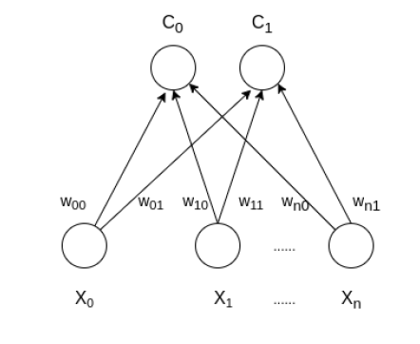
Architecture of the Self Organizing Map with two clusters

Slide 18
Steps
1. Each node’s weights are initialized.
2. A vector is chosen at random from the set of training data and presented to the lattice.
3. Every node is examined to calculate which ones weights are most like the input vector. The winning node is commonly known as the Best Matching Unit (BMU).
4. The radius of the neighborhood of the BMU is now calculated. This is a value that starts large, typically set to the ‘radius’ of the lattice, but diminishes each time-step. Any nodes found within this radius are deemed to be inside the BMU’s neighborhood.
5. Each neighboring node’s (the nodes found in step 4) weights are adjusted to make them more like the input vector. The closer a node is to the BMU; the more its weights get altered.
6. Repeat step 2 for N iterations.

Slide 19

Best matching unit
To determine the best matching unit, one method is to iterate through all the nodes and calculate the Euclidean distance between each node’s weight vector and the current input vector. The node with a weight vector closest to the input vector is tagged as the BMU.
The Euclidean distance is given as:
Where X is the current input vector and W is the node’s weight vector.

