Slide 1
Transformers in Deep Neural Networks
Dr. Jawwad A Shamsi

Slide 2
Problems with RNNs/LSTM/GHRU
Slow to Train
Vanishing Gradient
Incapable of Storing Long Sequence State

Slide 3

Transformers
Encoder Decoder Model
In the Original Paper
6 Units of Encoders and Decoders are stacked together

Slide 4
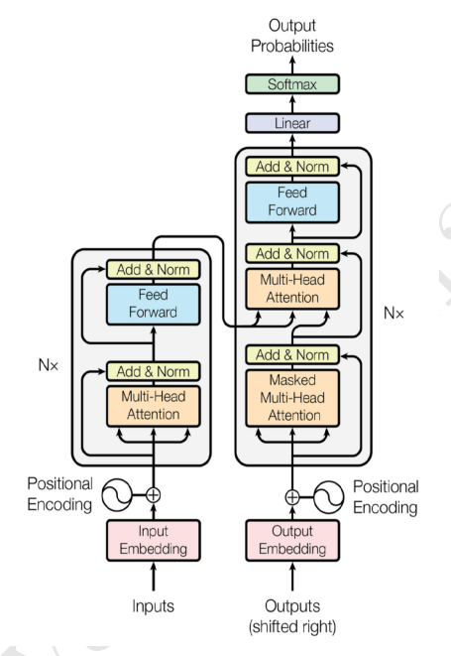
Three Distinctive Features
Self Attention
Positional Encoding
Scaled Dot Product

Slide 5
Lets take an Example
Machine Translation
Translation from English to German

Slide 6

Input to the Encoder
Embeddings
e.g. Word2vec
All the Words are sent together
i.e. Unlike RNN they are not sent one by one

Slide 7

Problem
How to cater context w.r.t position of the words

Slide 8
Positional Encoding
Two Sentences
AJ’s dog is a cutie
AJ looks like a dog
Position of the dog matters
Add context

Slide 9
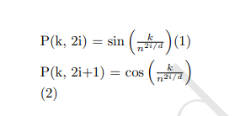
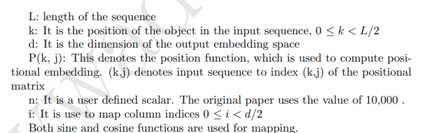
Positional Encoding

Slide 10
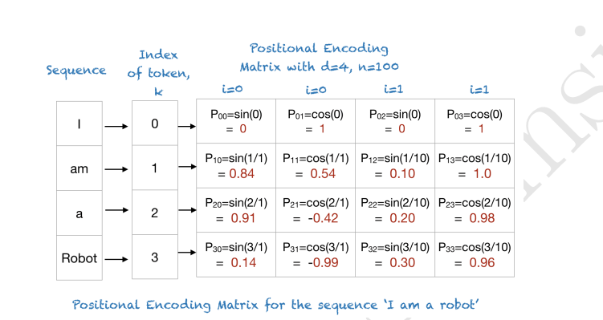
Example Sentence
I am a robot
d=4 n=100

Slide 11
Attention Mechanism

Slide 12
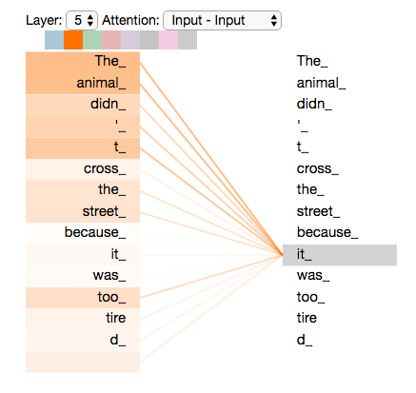
Self Attention
Learn Weights from the input sequence

Slide 13
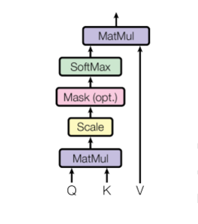
Transformer (Attention)
Three Vectors
Query, Key, and Value
1. Input sentence vector (Embedding)+ Positional Encoding yields
Vector Query.
2. This is replicated as Q, K, V
3. Three set of random weights W initialized

Slide 14

How to compute
Similarity between two matrices Q and K

Slide 15
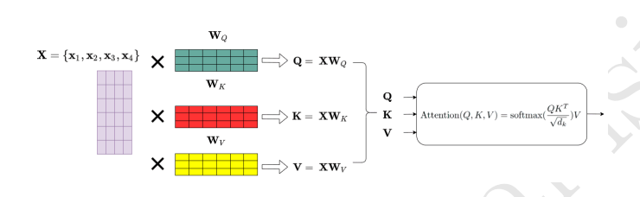
Scaled Dot Attention

Slide 16
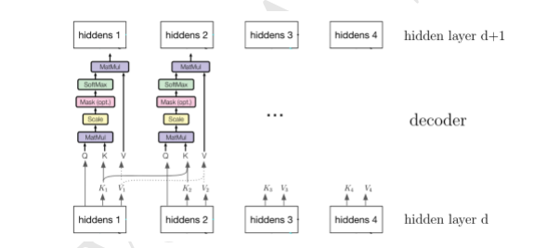
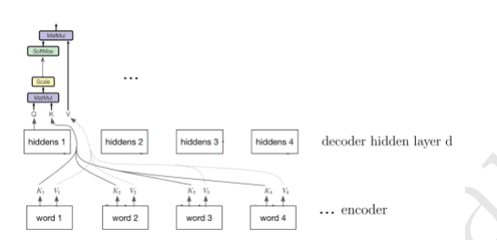
Combining Layers

Slide 17
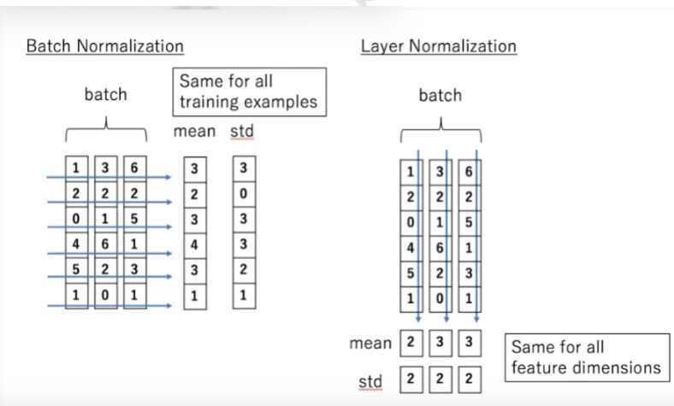
Difference between Layer Normalization and Batch Normalization

Slide 18
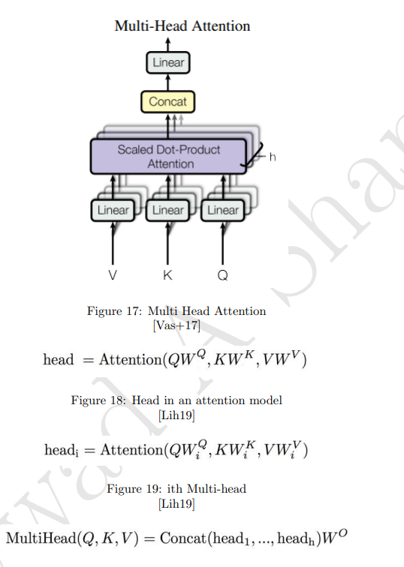
Multi Head Attention
Why Multi head

Slide 19
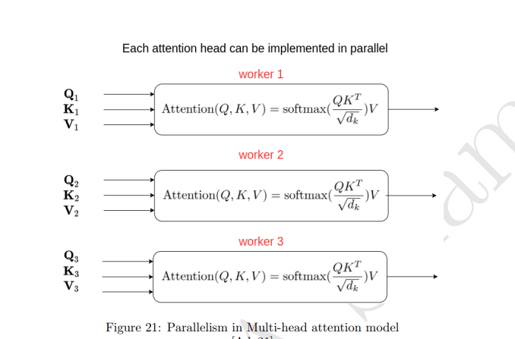
Parallelism in Multi-head

Slide 20
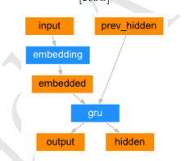
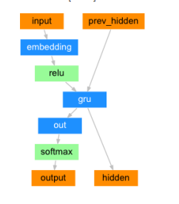

Slide 21
Transformers
6 units of Encoder/Decoder Stacked Together

Slide 22
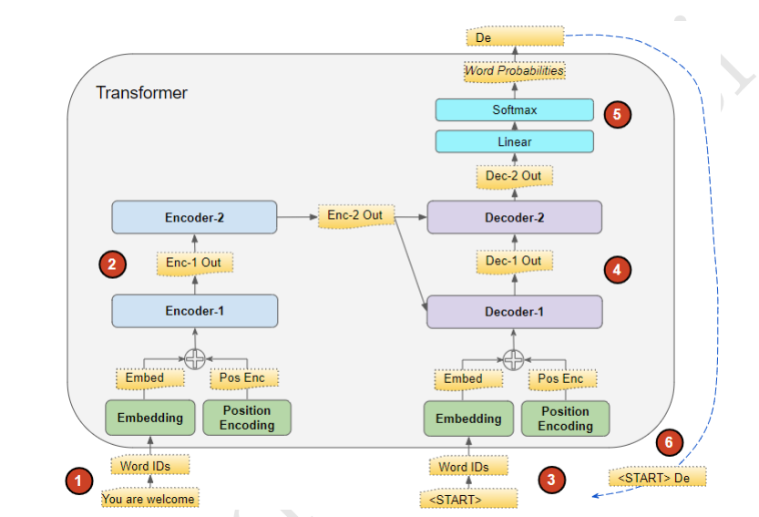
Transformer Training
Masking Input
Forced Learning

Slide 23
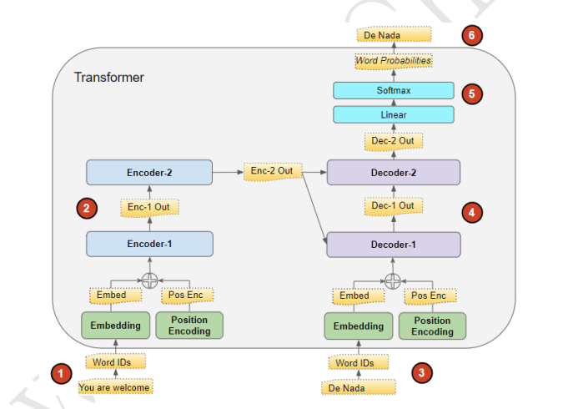
Inference

Slide 24
Transformer Steps
1.Input Sentence
2. Convert into embedding
3. add positional encoding
4. Creates attention vectors. Multiple Self Attention
5. The attention vector is passed through a network , one vector at a time.
Since each vector is independent, we can use parallelization.
6. On the decoder side, we obtain the embedding of the Urdu word to obtain meaning.
7. Add positional embedding to compute the context.
8. Mask Attention
9. Encoder Decoder Attention
10. Feed Froward

Slide 25
Why Residual Connection
Vanishing Gradient Problem
Knowledge Preservation

Slide 26
Why Linearity
Change dimensions
Map previous layer to the next layer

Slide 27
Positional Encoding
Why do we need it?

Slide 28
Conclusion

