Slide 1

Card Picking Game - Blackjack
This game is a simplified version of Blackjack, where the goal is to draw cards and get as close to 21 points as possible without exceeding it.
Contributors: Mohsin Rasul Rana Rameez Mushtaq

Slide 2
Introduction to the C++ Card Picking Game
A simplified version of Blackjack Implemented in C++
It includes two game modes :
1.Player vs .Computer
2.Player vs Player
Players Draw Cards to achieve the Highest score without exceeding 21 points.

Slide 3

Objective of the Card Picking Game
1
Goal
2
Winning
Player aim to score as close to 21 points ,they “bust” and lose the game.
You win by getting closer to 21 than the dealer, or by the dealer busting (going over 21).
3
Losing
You lose by going over 21 or having a hand total lower than the dealer's.

Slide 4

Key Features of the Blackjack Game
Interactive Gameplay:
Two Modes:
Player choose cards by entering numbers from 1 to 52.
1.Player against a Computer.
2.Player Against Another player.
Card Display and Real Time Decision Making:
Result Saving:
Game results saved in a structural format in a text file
Visual Representation of Cards and Players can choose to stop drawing cards after each turn.

Slide 5
Implementation Details and Approach
Deck contains 52 Cards (4 Suits, 13 ranks each).
Randomized card order to ensure fairness.
Players draw cards, and the game dynamically updates score
Results saved as:
Game 1:
Player 1 | Win
Player 2 | Lose

Slide 6
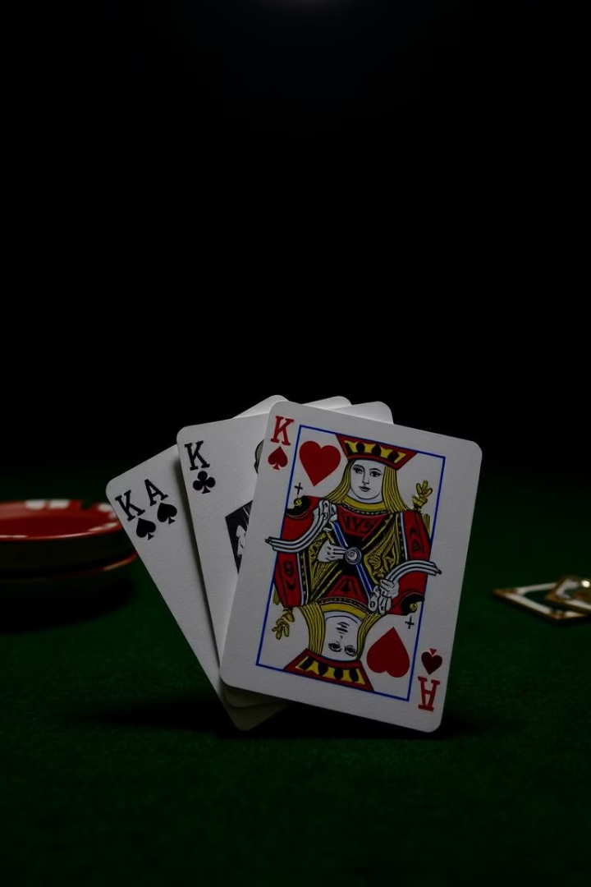



Rules and Mechanics of the Blackjack Game
Card Values
Winning Conditions
Numbered cards are worth their face value. Face cards (J, Q, K) are worth 10. An ace can be worth 1 or 11.
The player closest to 21 without exceeding wins. A "bust" (score > 21) results in an automatic loss.
Tie: Both players have the same score <= 21.
Player's Turn
Players can choose to hit or stand. Players lose if their hand total exceeds 21.

Slide 7
Gameplay Flow and User Interaction
Players choose a game mode: Player vs. Computer
Player vs. Player
1
2
Turn-based Gameplay:
Each player draws cards until they decide to stop or bust.
The computer draws cards automatically in its turn..
Scoring: Player scores are updated dynamically. The game ends if:
Both players stop drawing cards. A player busts..
3
4
If the player bust the Computer wins.
If the Computer Bust the player wins..
5
6
The winner is determined based on the final hand totals.

Slide 8
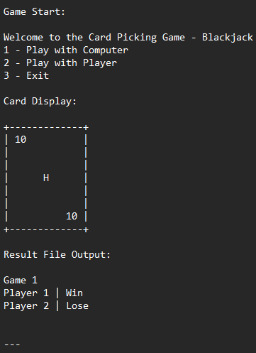




Example Output and Demonstration
Welcome to Blackjack
Player 1 hand: [Ace, 10] - Total: 21
Player 2 hand: [King, 7] - Total: 17
You win!

Slide 9



Advantages of the Blackjack Program
Learning Opportunity
1
Demonstrates basic and advanced C++ concepts.
Includes arrays, functions, and conditionals.
Interactive Experience
2
Engaging for players with real-time choices and feedback.
Expandable Design
3
Can be enhanced with additional features like: Multiplayer over a network. Graphical User Interface (GUI).

Slide 10
Future Improvements and Enhancements
Timer for Computer Moves
1
Introduce delays for more realistic gameplay..
Better Result Handling
2
Store Game History In a database or CSV file.
Enhanced Gameplay
3
Add Additional Blackjack rules (Splitting, Betting, etc.)

Slide 11
Conclusion:
Summary:
A fun and interactive card game in C++.Combines learning and entertainment. Key Takeaways:
Implementation of arrays, structures, and file handling. Practical use of conditionals and loops. Thank You!

Slide 12
THANK YOU!

