Slide 1
Design and Analysis of An OMNeT++ based Simulation Framework for Optical Burst Switching
Project Proposal Defense
Group Members:
Mohsin Sajjad 22PWCSE2149
Sawaira Haq 22PWCSE2172
Sana Zahir 22PWCSE2151
Muhammad Shafique Qureshi 22PWCSE2189
Supervisor:
Engr. Ihsan ul haq

Slide 2
Presentation Outline
1. Introduction
2. Problem Statement
3. Objectives
4. Introduction of omnet++
5. Linkage of FYP with UN SDGs
6. Mapping and Justification of FYP with 5 Courses
7. Moral and Ethical Considerations
8. Societal Impact
9. Expected Outcome

Slide 3
Introduction
“Can today’s internet keep up with tomorrow’s needs?”
Internet demand is growing fast
Current optical methods have limits:
OCS: Reliable but wastes bandwidth
OPS: Efficient but too costly & complex
Key question:
How to make networks fast and efficient?

Slide 4
Optical Burst Switching
What is Optical Burst Switching (OBS)?
Future-ready high-speed switching for internet networks
Able to efficiently utilize extremely high capacity links
Groups many small packets into a larger “burst” before sending
Control packet goes first to set up the path, then the burst follows
At intermediate nodes:
  Bursts are switched directly (no need for conversion)
At the destination:
  Bursts are split back into packets and delivered

Slide 5
Problem Statement
Previous studies used older OMNeT++ versions (4.x)
These versions are now obsolete and not compatible with modern operating systems
Our work uses the latest stable release, OMNeT++ 6.2
Slide # 5

Slide 6
Objectives
To study the limitations of existing optical switching methods (OCS and OPS).
To design and implement a framework for Optical Burst Switching (OBS) using OMNeT++ 6.2.
To analyze the results obtained from the simulation framework.

Slide 7
Omnet++
INTRODUCTION:
OMNeT++ is a simulation framework used for modeling and simulating computer networks and other communication systems.
It is modular meaning you build networks using small pieces (modules) and connect them.

Slide 8
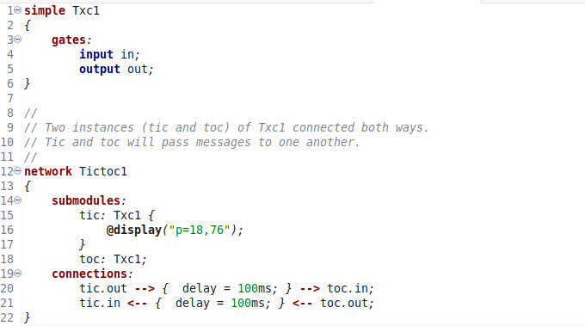
Core Files for Building a Network in OMNeT++
.ned file (Network Description)
Defines the structure of the network. Tells what modules exist. Example: Tic and Toc modules connected to each other.

Slide 9
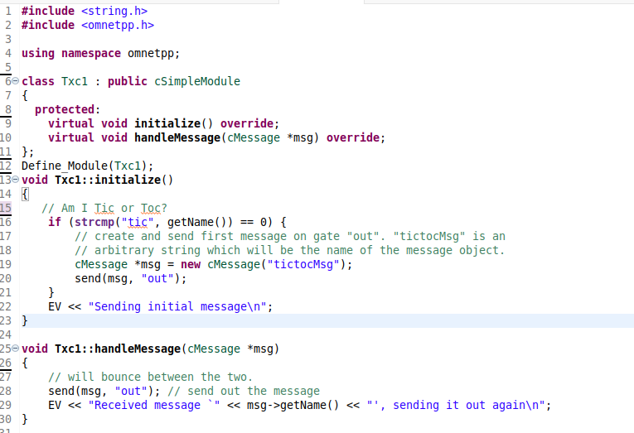
Core Files for Building a Network in OMNeT++
.cc file (C++ Source Code)
Defines the behavior of modules. Contains logic like sending, receiving messages etc.

Slide 10
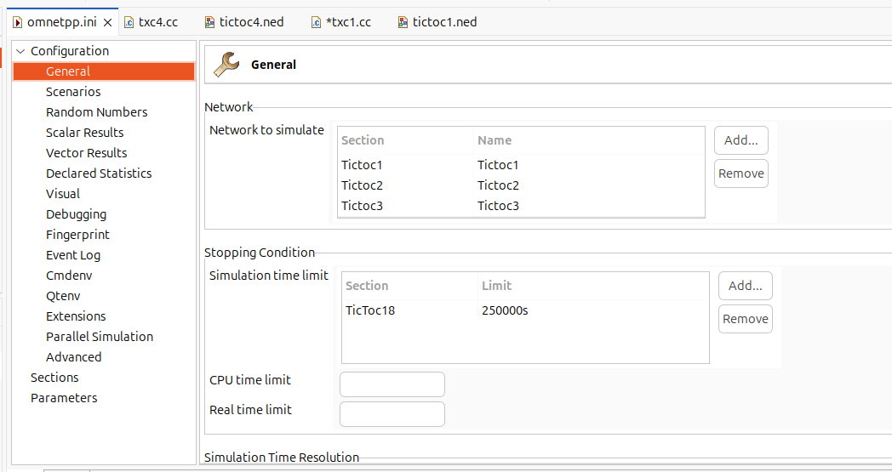
Core Files for Building a Network in OMNeT++
.ini file (Configuration)
Defines the simulation setup. Tells which network to run, simulation time, parameters.

Slide 11
Linkage of FYP with UN SDGs
Selected Goal:
SDG 9 – Industry, Innovation and Infrastructure
“Build resilient infrastructure, promote sustainable industrialization, and foster innovation.”
Relevance to Project:
The framework contribute to innovation in future network technologies.
By analyzing high-speed optical networks, it helps enhance technological capacity and supports reliable communication for future demands.

Slide 12
Mapping of FYP with 5 DCSE Courses
S. No. | Course Code | Course Name | Justify the linkage with FYP
1. | CSE-102 | Computer Programming | Computer programming enables OBS simulation in OMNeT++.
2. | CSE-209 | Probability Methods in Engineering | Probability methods will help to do statistical analysis.
3. | CSE-302 | Systems Programming | Systems programming is required to design and manage processes essential for OBS simulation.
4. | CSE-303 | Data Communication and Networks | Data Communication and Net works explains burst transmission across optical links in OBS.
5. | CSE-309 | Communication Systems | Provide the foundation for un derstanding signal transmission in OBS networks.

Slide 13
Moral and Ethical Considerations
The project is based on a simulation framework, so it does not involve personal data.
Focus is on improving communication technology in a responsible and fair way.
Ethical principles followed:
  Transparency: Clear reporting of methods and results.
  Integrity: Ensuring the honesty in analysis.
  Responsible Innovation: Developing solutions that benefit society without causing harm.
Overall, the project supports fair, safe, and sustainable technological progress.

Slide 14
Societal Impact
Who benefits?
Researchers, telecom industry, and internet users.
Broader impact:
Faster and more reliable networks → stronger digital society.
Real-World Application:
Can be developed as a simulation tool for research and industry.

Slide 15
Expected Outcome
End Product:
A working simulation framework for Optical Burst Switching (OBS) built on OMNeT++ 6.2.
Deliverables:
  Software tool to test and analyze OBS performance.
Impact:
Provides a practical platform for researchers and industry to explore and improve future high-speed network technologies.

