Slide 1

Design and Analysis of An OMNeT++ based Simulation Framework for Optical Burst Switching
Group Members:
Mohsin Sajjad 22PWCSE2149
Sawaira Haq 22PWCSE2172
Sana Zahir 22PWCSE2151
Muhammad Shafique Qureshi 22PWCSE2189
Supervisor: ENGR. IHSAN UL HAQ
Department of Computer Systems Engineering
University of Engineering & Technology Peshawar
2 Oct 2025

Slide 2
Presentation Outline
1. Introduction
2. Problem Statement
3. Objectives
4. Introduction of omnet++
5. Linkage of FYP with UN SDGs
6. Mapping and Justification of FYP with 5 Courses
7. Moral and Ethical Considerations
8. Societal Impact
9. Expected Outcome

Slide 3
Introduction
“Can today’s internet keep up with tomorrow’s needs?”
Internet demand is growing fast
Current optical methods have limits:
OCS: Reliable but wastes bandwidth
OPS: due to lack of optical processor it is not implemented
Key question:
How to make networks fast and efficient?

Slide 4
Optical Burst Switching
What is Optical Burst Switching (OBS)?
Optical high speed switching networks
Able to efficiently utilize extremely high capacity links
Groups many small packets into a larger “burst” before sending
Control packet goes first to set up the path, then the burst follows
At intermediate nodes:
  Bursts are switched directly (no need for O/E conversion)
At the destination:
  Bursts are split back into packets and delivered

Slide 5
Problem Statement
Optical Burst Switching (OBS) is still in the research domain, and currently, there is no experimental test bed available. To work on this technology, a test bed is essential, which can be provided in the form of a software-based simulation framework. Previous research was carried out by the Public University of Navarre, Spain, and the University of Algarve, Portugal, where an OBS network model for OMNeT++ was developed and evaluated. However, that work was implemented on older versions of OMNeT++, which are now obsolete and incompatible with modern operating systems, thus further research/evaluation seems difficult. Therefore, our work focuses on using the latest stable release, OMNeT++ 6.2, to develop an updated simulation environment for OBS.

Slide 6
Objectives
To study the limitations of existing optical switching methods (OCS and OPS).
To design and implement a framework for Optical Burst Switching (OBS) using OMNeT++ 6.2 frame work.
To analyze the results obtained from the simulation framework.

Slide 7
OMNET++
INTRODUCTION:
OMNeT++ is a simulation framework used for modeling and simulating systems including (computer networks ).
It is modular meaning you build networks using modules/sub module and connect them.

Slide 8
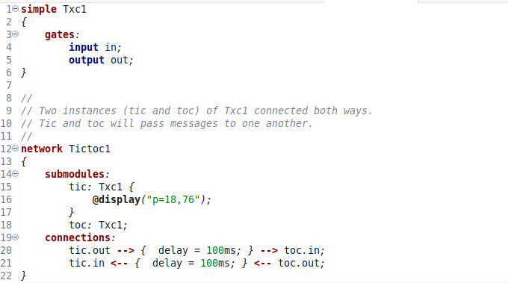
Core Files for Building a Network in OMNeT++
.ned file (Network Description)
Defines the topology of the network. Tells what modules exist. Example: Tic and Toc modules connected to each other.

Slide 9
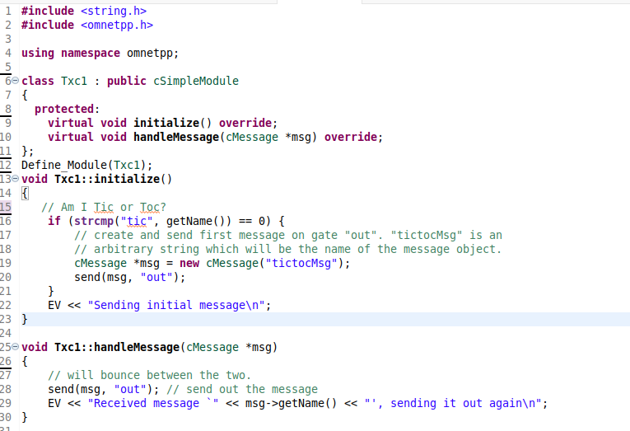
Core Files for Building a Network in OMNeT++
.cc file (C++ Source Code)
Defines the behavior of modules. Contains logic like sending, receiving messages etc.

Slide 10
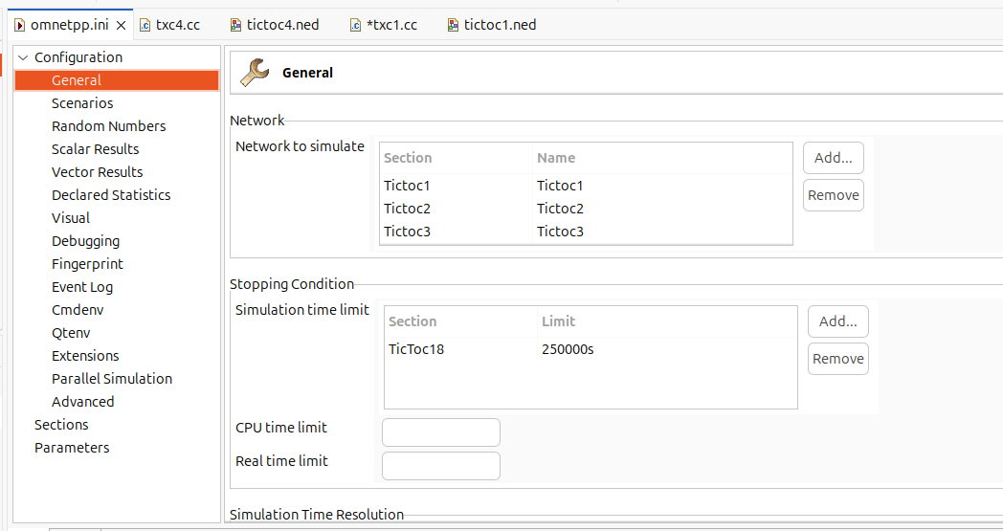
Core Files for Building a Network in OMNeT++
.ini file (Configuration)
Defines the simulation setup. Tells which network to run, simulation time, parameters.

Slide 11
Linkage of FYP with UN SDGs
Selected Goal:
SDG 9 – Industry, Innovation and Infrastructure
“Build resilient infrastructure, promote sustainable industrialization, and foster innovation.”
Relevance to Project:
The framework contribute to innovation in future network technology.
By analyzing high-speed optical networks, it helps enhance technological capacity for future demands.

Slide 12
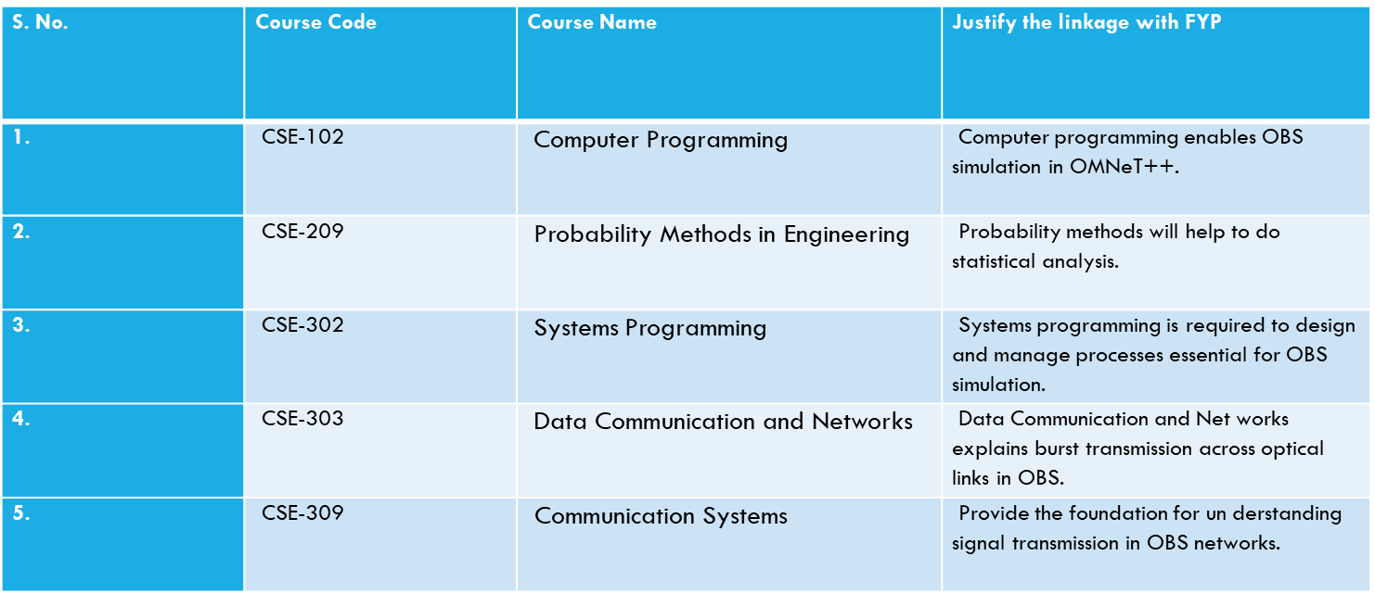
Mapping of FYP with 5 DCSE Courses

Slide 13
Moral and Ethical Considerations
The project is based on a simulation framework.
Focus is on improving communication technology in a responsible way.
Ethical principles followed:
  Transparency: Clear reporting of methods and results.
  Integrity: Ensuring the honesty in analysis.
  Responsible Innovation: Developing solutions that benefit society without causing harm.
Overall, the project supports safe and sustainable technological progress.

Slide 14
Societal Impact
Who benefits?
Researchers, telecom industry, and internet users.
Broader impact:
Faster and more reliable networks → stronger digital society.
Real-World Application:
Can be developed as a simulation tool for research and industry.

Slide 15
Expected Outcome
End Product:
A working simulation framework for Optical Burst Switching (OBS) built on OMNeT++ 6.2.
Deliverables:
  Software tool to test and analyze OBS performance.
Impact:
Provides a practical platform for researchers and industry to explore and improve future high-speed network technologies.

Slide 16
Thank You!

