Slide 1
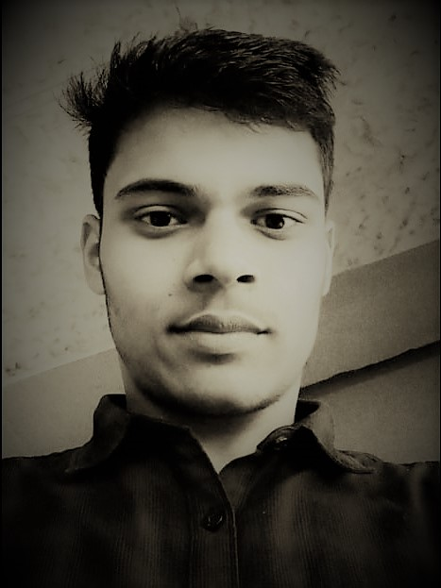
All my details …
Name : Muhammad Mohsin Raja
D O B : 30 / 01 / 2002
Profession : Student
Course : 4 year B. Tech
Dept. : Computer Science and Engineering
Skills : MERN Developer, Problem Solving,
well known in C++, Java, Python
Experiences : I have made many projects and eager
To Develop awesome application for my clients

