Slide 1
Employee Data Analysis using Excel
STUDENT NAME: MOHSINA ASMA.G
REGISTER NO: 312212895 [unm1512022g06]
DEPARTMENT: B.COM (GENERAL)
COLLEGE: MAHALASHMI WOMEN’S COLLEGE OF ARTS AND SCIENCE

Slide 2
PROJECT TITLE
Employee Performance Analysis using Excel

Slide 3


AGENDA
Problem Statement
Project Overview
End Users
Our Solution and Proposition
Dataset Description
Modelling Approach
Results and Discussion
Conclusion
3/21/2024 Annual Review

Slide 4

PROBLEM STATEMENT
Employee performance analysis is made to identify the performance level of an employee in each levelIt helps to teach the activities and growth of the employees in wholly by department wiseIt helps to grant remuneration or appreciation for the respected one.

Slide 5

PROJECT OVERVIEW
1. Consolidate and standardize employee performance data
2. Apply conditional formatting, pivot tables, and pivot charts for intuitive analysis and visualization
3. Enable data-driven decision-making for talent development, growth, and performance improvement
4. Standardize performance evaluations and Identify development need
5. Inform data-driven decisions

Slide 6

WHO ARE THE END USERS?
The end users are likely to be: 1. HR Professionals 2. Managers/Supervisors 3. Team Leads 4. Department Heads 5. Senior Leadership

Slide 7

OUR SOLUTION AND ITS VALUE PROPOSITION
Improved engagement: Encourages employees to perform .
2. Enhanced performance: Identifies areas for improvement.
3. Better decision-making: Data-driven insights for informed decisions.
4. Training and development: Addresses skill gaps and needs.
5. Fair evaluation: Reduces bias and ensures transparency.
6. Goal alignment: Ensures individual goals support organizational objectives.
7. Accountability: Encourages employees to take ownership.
8. Data-driven insights: Informed decisions with accurate data.
9. Improved communication: Regular feedback and coaching.
10. Increased retention: Reduces turnover and improves job satisfaction.

Slide 8
Dataset Description
This dataset contains employee performance data, including demographic information, performance evaluations, and job-specific metrics.
Data Points:
Employee ID (unique identifier)
Name
Department
Job Title
Performance Evaluation Rating (e.g., 1-5 scale)
Evaluation Period (date)
Job-Specific Metrics (e.g., salary, performance)
Data Source:
HR Information Systems, Performance Management Software, Employee Surveys.

Slide 9

THE "WOW" IN OUR SOLUTION
The WOW! In our solution is use of formula=IFS(Z8>=5,"VERY HIGH",Z8>=4,"HIGH",Z8>=3,"MED",TRUE,"LOW")
3/21/2024 Annual Review
9

Slide 10
MODELLING
Data Collection :
The data was downloaded from Edunet Dashboard.
Feature Collection :
Highlighted the features required from the given data.
Data Cleaning :
Identifying the blank missing data and filtering it by colour.
Performance level :
Performance level on basis of the department type.
Summary :
Pivot Table is created with row as Department type, column as performance level, filter as in gender, and count value as First name of the employees.
Data Visualization :
By using the graph chart to visualize the data shown in the Pivot Table
10

Slide 11
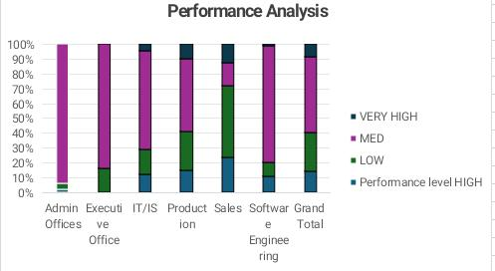
RESULTS
11

Slide 12
conclusion
In conclusion, the production department has performed well higher as when compared to other departments and the Admin Offices has performed the lowest.
According to the given data, the production department has the most efficient performance level in work than other department

