Slide 1
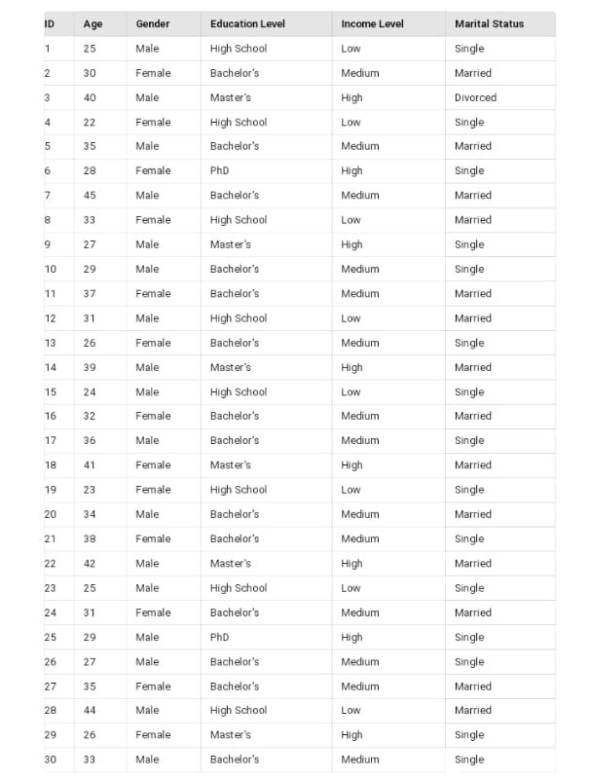
Table

Slide 2
Presentation of Data
1. Introduction with brief description
2.Analysis and Results
3. Conclusion

Slide 3
Introduction: Presenting a dataset consisting of 30 samples reflecting various sociological attributes such as age, gender ,educational level, income level ,marital status.

Slide 4
Brief Discription: Each sample is assigned a unique Id and includes Information on age , gender and so on .

Slide 5
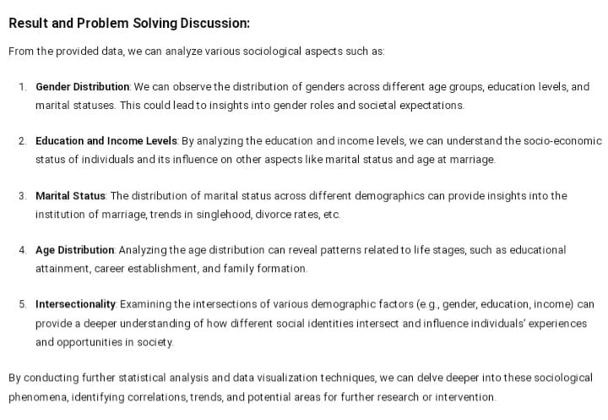
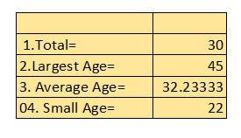
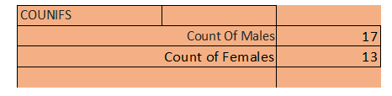


Slide 6
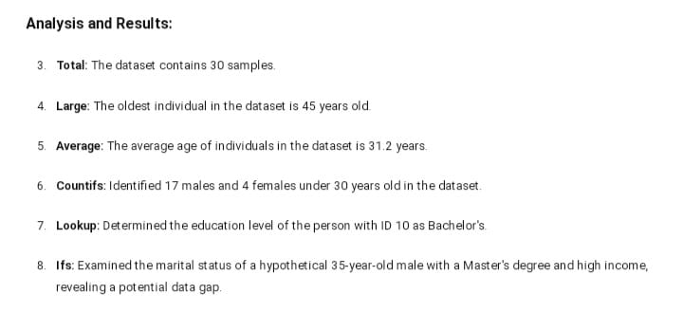

Slide 7
Conclusion : The analysis of the provided dataset offers valuable insights into various sociological aspects . By utilizing Xcel functions such as TOTAL, AVERAGE, LARGE, COUNTIFS, SMALL, LOOKUP we are able to extract

