Slide 1
SIH 2020
Team member names:
Monalisha Mishra(Leader)
Rajashree Parhi
Subham Mishra
Rahul Mishra
Md Mohsin Siddiqui
Ankit Singh
Team name: Access_denied
PS: SS45
Organisation :Ministry of Health and Family Welfare

Slide 2

PROJECT TITLE
ELECTRONIC
HEALTH
RECORD

Slide 3

PROBLEM STATEMENT
EHR generally contain highly-sensitive and critical data related to patients, which is frequently shared among clinicians, radiologists, healthcare providers, pharmacists, and researchers, for effective diagnosis and treatment. Hence may use blockchain technology for accessing and managing the privacy and security of patient data and history in clinical practices.

Slide 4
PROBLEM OVERVIEW
Highest level of security breaches in 2015.
Cyber hacking of sensitive data.
Outdated traditional software system.
Misplacement of patient’s data
Centralized data storage.
Costly architecture.
The data handled are vulnerable.
Consequences may cost up to Rs. 15,000 per patient record

Slide 5
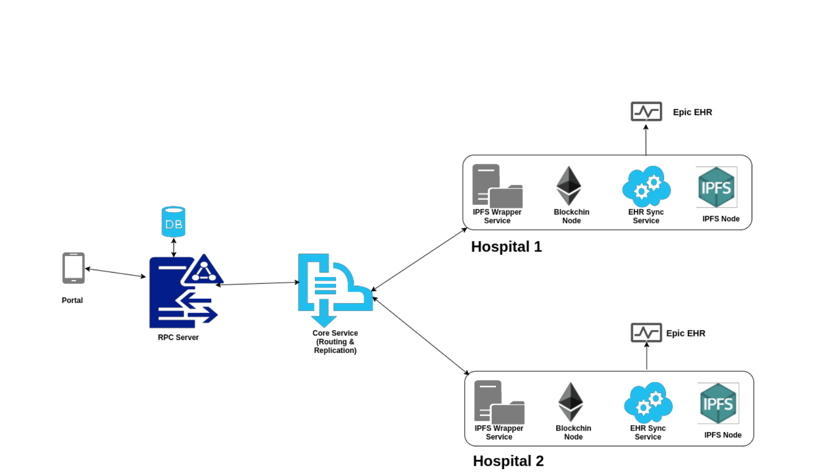
APPROACH
We aim to build blockchain based decentralised web application which will provide privacy and security to the patients’ health record using AES encryption ,Access Control and IPFS. The system gives appropriate scope over a health record only on patient’s permission.

Slide 6
THREE-DAY JOURNEY SO FAR
Built a blockchain-based decentralized web app
- Provides privacy
- Cost reduction compared to current EHR models
- No third-party involvement
Our application secures the initial stage of registration
- Access Control using Open Zeppelin to maintain hierarchy similar to current system.
- Private network
- Track of records
We have an one-click login
- Metamask Wallet
- QR code for a user-friendly experience.

Slide 7
Our second stage of security:
- Strong cryptography of ethereum
- Multi-level AES encryption(report is encrypted and stored in IPFS)
- Control lies in the hands of the patient
- View reports in the app itself
- Screenshot can’t be taken so as to prevent breach of data
User friendly and easy to use:
- User is unaware of the background encryption/decryption
- Normal web app interface
- Demo bot to explain the functionalities to the first time users
- QR code scanner
- Segregated data for both doctor and lab
Our third stage of security
- IPFS (decentralised ,content addressing) (for storing encrypted report)
- Encrypted AES key (decrypted only by unique private key) stored on blockchain

Slide 8
USE CASE
The public key is the identification of every user in the network.
Registered by Admin
One-click login using Metamask
Doctor or Lab Technician uploads the report
Only patient has the access to it
Can see the encrypted report if not permitted.
Report can only be viewed in the web app itself if patient gives permission.
Patient can revoke permission at any time.

Slide 9
OUTCOME
Patient centric system
A single place for all the parts of the healthcare system
No third-party involvement
Cost-effectiveness
User friendly interface
Transparent and highly secure ledger: Decentralised
Peer to peer sharing
Global Unique Identifiers (address)
Data integrity and traceability

Slide 10
UNIQUE FEATURES
Similar to the existing hospital architecture
Access Control
Super admin has supreme control
User friendly front-end
Demo Bot to give a guided tutorial to the novice users.
QR code for seamless login verification
One-click Metamask login system
Multilevel encryption

Slide 11

TECHNOLOGICAL STACK
ReactJS
Bootstrap
Web3js
Blockchain (Ethereum)
IPFS for decentralised file storage
AES for symmetric encryption
OpenZeppelin for Access Control
Selenium for Demo Bot
Truffle-react framework.
Metamask Wallet

Slide 12
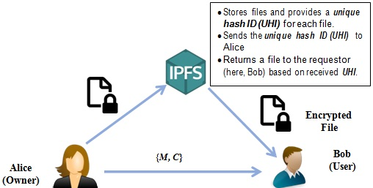
ENCRYPTION-DECRYPTION FLOW

Slide 13
FUTURE SCOPE
Complete healthcare app on blockchain technology.
Hospital supply chain management
A mobile app using cloud storage
Storing user data (.json file) on RFID patient cards.
Shift to gasless second layer blockchain network.

Slide 14


Slide 15
THANK YOU

