Slide 1
LONG SHORT-TERM MEMORY
By Muhammad Abdullah

Slide 2
WHAT ARE NEURAL NETWORKS?
A neural network is a series of algorithms that endeavors to recognize underlying relationships in a set of data through a process that mimics the way the human brain operates
Two types of neural networks
Feedforward
Recurrent
Notes:
These deep learning algorithms are commonly used for ordinal or temporal problems, such as language translation, natural language processing (nlp), speech recognition, and image captioning

Slide 3
RECURRENT NEURAL NETWORK (RNN)
Recurrent since they receive inputs, update the hidden states
RNNs are a neural network with memory
RNNs are very powerful dynamic system
Notes:
Recurrent since they receive inputs, update the hidden states depending on the previous computations, and make predictions for every element of a sequence.
RNNs are a neural network with memory.
RNNs are very powerful dynamic system for sequence tasks such as speech recognition or handwritten recognition since they maintain a state vector that implicitly contains information about the history of all the past elements of a sequence.

Slide 4

Backpropagation Trough Time
The backpropagation algorithm can be extended to BPTT by unfolding RNN in time and stacking identical copies of the RNN.
In RNNs, a common choice for the loss function is the cross-entropy loss which is given by:
$L\left(y_{l},y\right)=−\frac{1}{N}\sum_{n∈N}{y_{ln}\log{y_{n}}}$
$N:$the number of training examples
$y:$ the prediction of the network
$y_{l}$: the true label

Slide 5
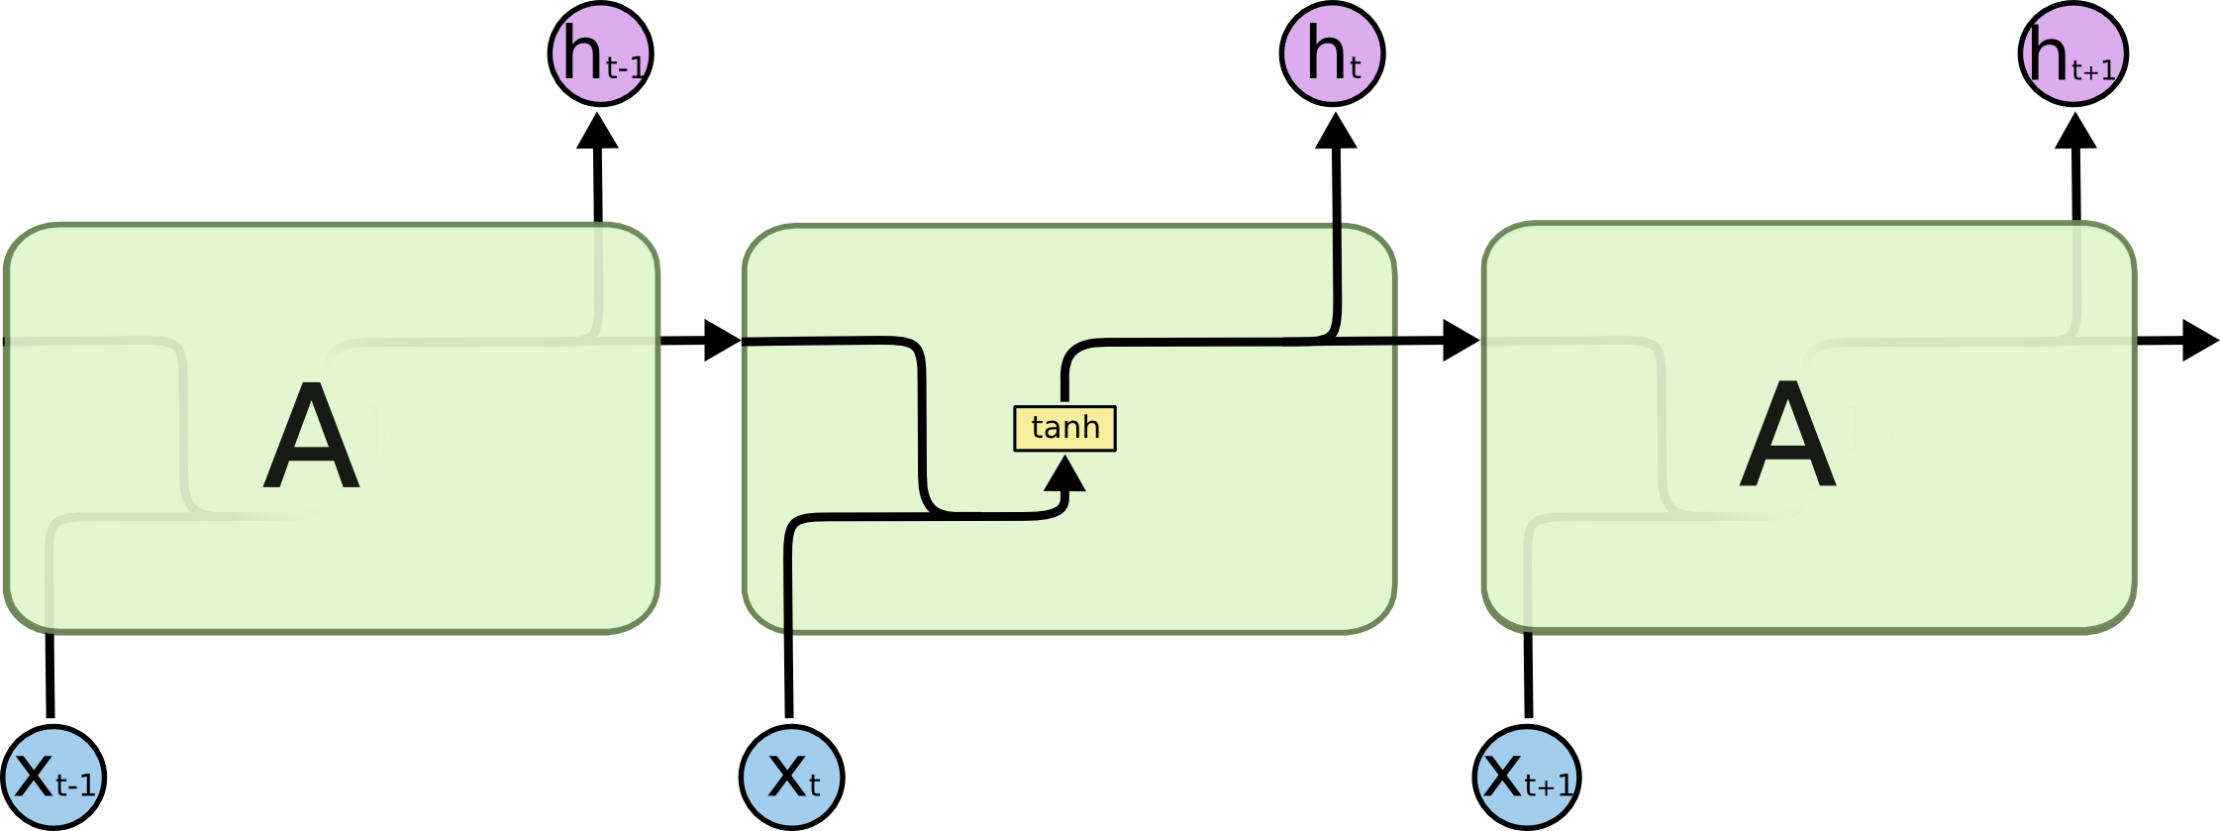
VISULIZATION OF RNN
Notes:
X is the input
H is the output
Hyperbolic Tangent Function (Tanh) The biggest advantage of the tanh function is that it produces a zero-centered output, thereby supporting the backpropagation process.

Slide 6
HOLD ON WE HAVE A PROBLEM!
The Vanishing Gradient Problem.
An RNN can learn to bridge time intervals in the limit of 10 steps
Example
The Tree color is “Green”.
I live in Salisbury, Maryland that’s on the eastern shore….. The weather here is “unpredictable”.
Notes:
Definition: The influence of a given input on the hidden layer, and therefore on the network output, either decays or grows exponentially as it propagates through an RNN

Slide 7
SOLUTION = LSTM
LONG SHORT-TERM MEMORY.
An LSTM is a special kind of RNN.
An LSTM can learn to bridge time intervals in excess of 1000 steps
This is achieved by multiplicative gate units

Slide 8
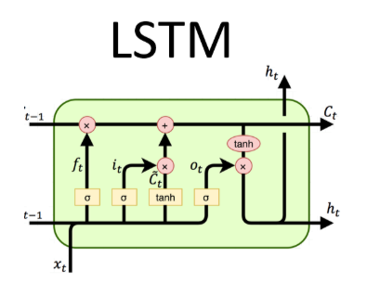
MEMORY IN LSTM.
INPUT GATE
FORGET GATE
OUTPUT GATE

Slide 9

LSTM EQUATIONS
$i= σ\left(x_{t}U^{i}+s_{t−1}W^{i}\right)$
$f= σ\left(x_{t}U^{f}+s_{t−1}W^{f}\right)$
$o= σ\left(x_{t}U^{o}+s_{t−1}W^{o}\right)$
$g= \tanh\left(x_{t}U^{g}+s_{t−1}W^{g}\right)$
$c_{t}=c_{t−1}∘f+g ∘i$
$s_{t}= \tanh\left(c_{t}\right)∘o$
$y= softmax\left(Vs_{t}\right)$
Notes:
$i:$input gate, how much of the new information will be let through the memory cell.
$f$: forget gate, responsible for information should be thrown away from memory cell.
$o:$output gate, how much of the information will be passed to expose to the next time step.
$g:$self-recurrent which is equal to standard RNN
$c_{t}$: internal memory of the memory cell
$s_{t}$: hidden state
$y$: final output

Slide 10

VISULIZATION OF LSTM
Notes:
The sigmoid activation function, also called the logistic function, is traditionally a very popular activation function for neural networks. The input to the function is transformed into a value between 0.0 and 1.0.

Slide 11
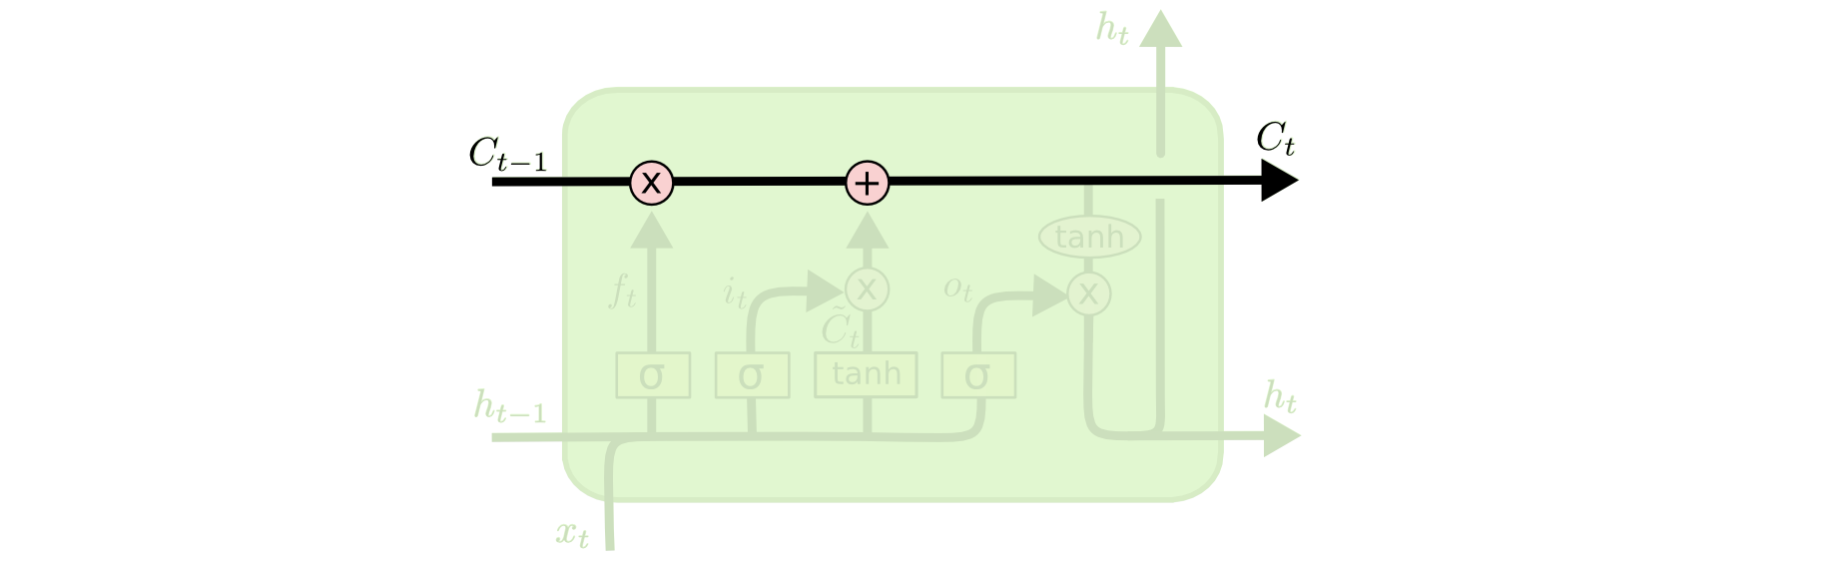
WHY IS LSTM SUPERIOR ?
Notes:
C line the the carried memory that rnn doesn’t have

Slide 12

DEMO

Slide 14
LIBRARIES USED
PANDAS
NUMPY
PLOTLY
SKLEARN.METRICS
TENSORFLOW
KERAS

Slide 15
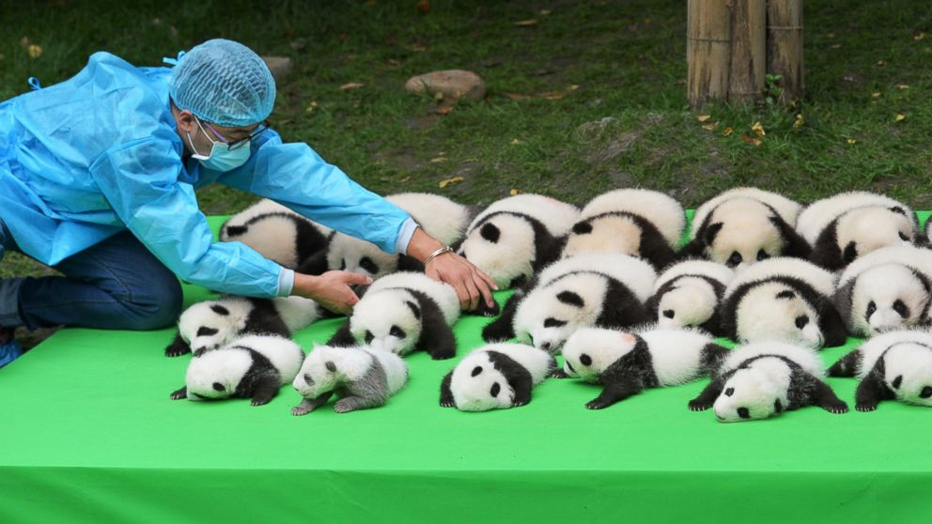
WHAT ARE PANDAS AND NUMPY?
Notes:
NumPy stands for ‘Numerical Python’ or ‘Numeric Python’. It is an open source module of Python which provides fast mathematical computation on arrays and matrices. Since, arrays and matrices are an essential part of the Machine Learning ecosystem, NumPy along with Machine Learning modules like Scikit-learn, Pandas, Matplotlib, TensorFlow, etc. complete the Python Machine Learning Ecosystem.
Similar to NumPy, Pandas is one of the most widely used python libraries in data science. It provides high-performance, easy to use structures and data analysis tools. Unlike NumPy library which provides objects for multi-dimensional arrays, Pandas provides in-memory 2d table object called Dataframe. It is like a spreadsheet with column names and row labels.

Slide 16
WHAT IS TENSORFLOW AND KERAS MODEL?
Essentially just APIs created by google to implement LSTM
Notes:
Created by the Google Brain team, TensorFlow is an open source library for numerical computation and large-scale machine learning. TensorFlow bundles together a slew of machine learning and deep learning (aka neural networking) models and algorithms and makes them useful by way of a common metaphor. It uses Python to provide a convenient front-end API for building applications with the framework, while executing those applications in high-performance C++.

