Slide 1
AWS Microservices
Hands-on

Slide 2


Main Components
GitHub
Amazon ECS
Application
Pipeline

Slide 3
Development
Let’s assume:
Video-to-Us Project
Scrum – Sprint
Feature: Landing page
enables Search and browsing videos
Technology
Node.js

Slide 4
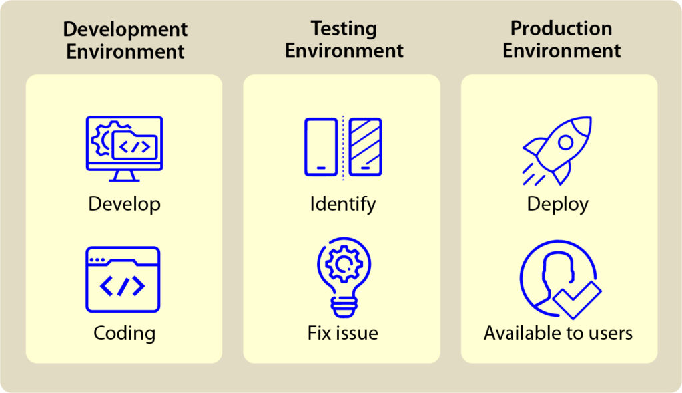
From Development to Production

Slide 5
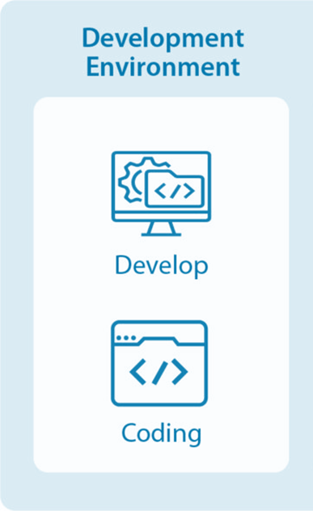
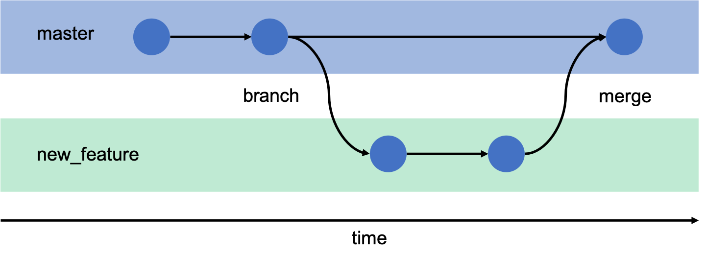
Development Environment
CI Pipeline
GitHub

Slide 6

Development Environment
GitHub

Slide 7

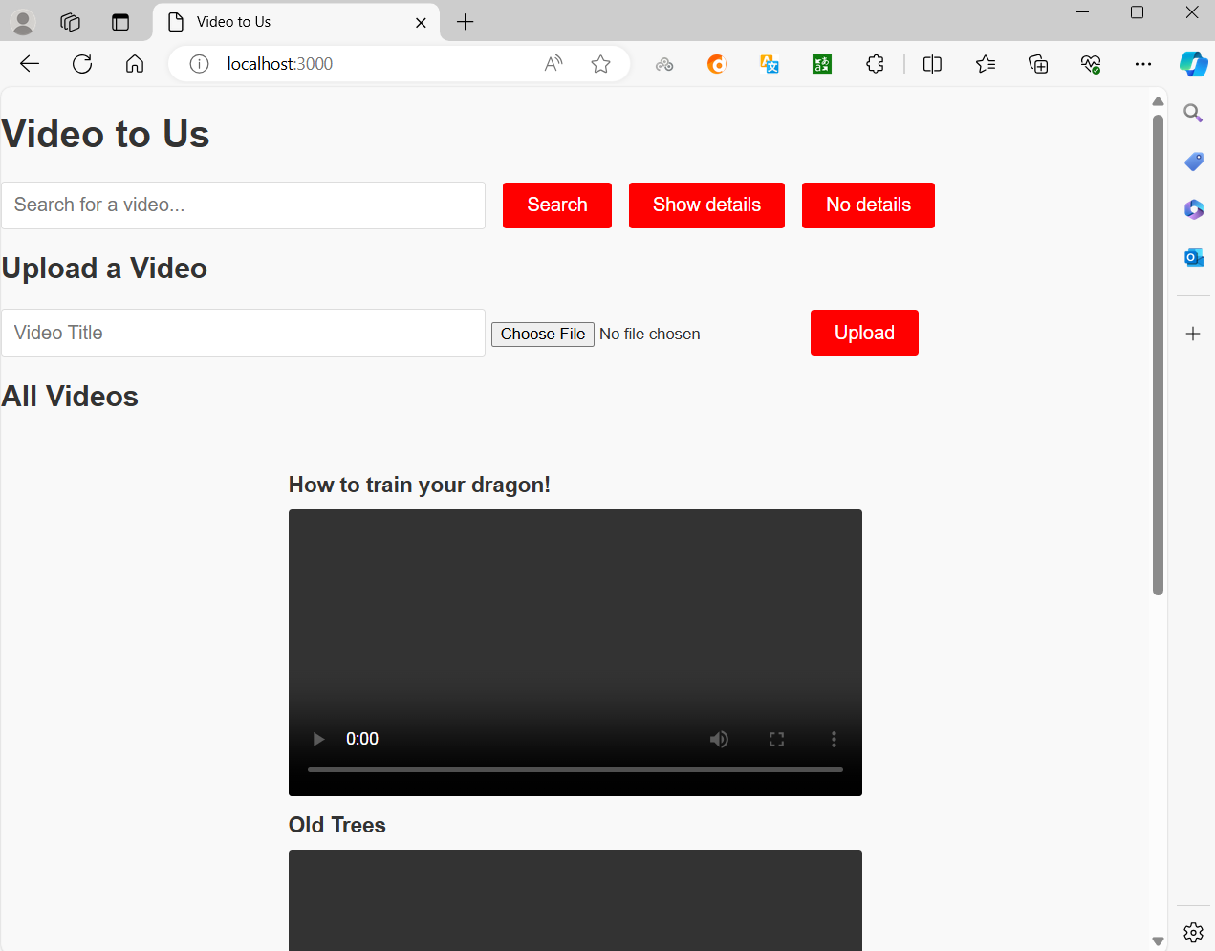

Development Environment
Node.js
The landing page is up and running in the development environment

Slide 8
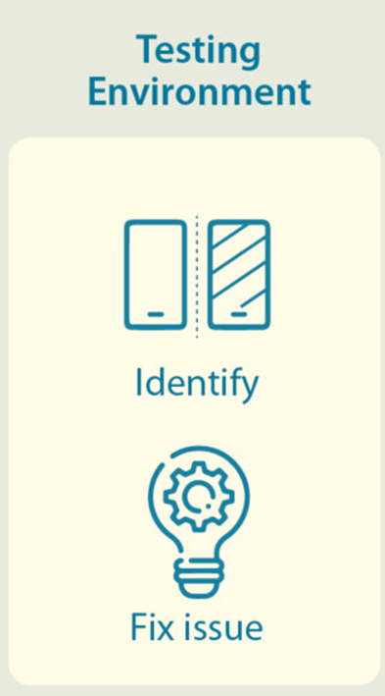
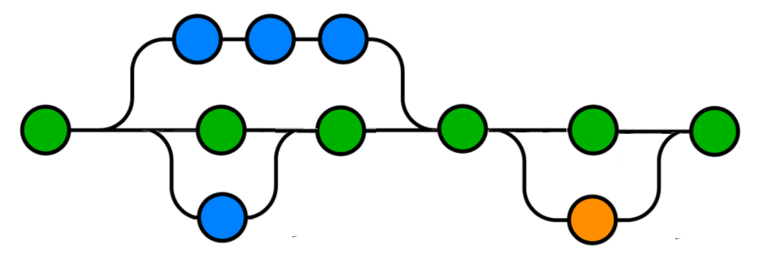
Testing Environment
Branch
Main
Branch
Testing branch
Not included in this hands-on

Slide 9
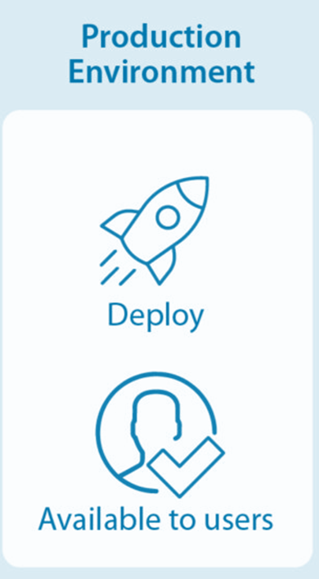
Production Environment
Commit on main branch
GitHub
Project
Amazon ECS
CI Pipeline
Amazon CD Pipeline

Slide 10
Amazon CD Pipeline
Application
Environment
Pipeline
Production Environment
CD Integration
Amazon CD Pipeline

