Slide 1
CA
CareAgent AI
Stroke Monitoring
ASSISTIVE IOT • CASE STUDY
CareAgent AI
Local elderly safety monitoring using Raspberry Pi 5, MediaPipe pose landmarks, OpenCV, scikit-learn, and a local Llama/Ollama summarizer.
Developer • Architect • Team Leader
Paper & Academic Research Lead
Final branch
Mohie Eldean Badawy
Mohammed Alomari
GitHub V3.0
Architecture, RPi agent, AI integration, dashboard flow, and final branch coordination.
Responsible for paper writing, literature review, bibliography, and academic research framing.
Local-first system; future_cloud kept isolated for later work.
CareAgent AI • Topic and team introduction
01
Notes:
Introduce the project as a local-first elderly monitoring prototype. Emphasize that Mohie Eldean Badawy is presenting as developer, architect, and team leader, with Mohamed Alomarry responsible for the paper and academic research. State the core goal: detect concerning posture and movement patterns from camera landmarks and simulated room sensors, then display the evidence in a dashboard and trigger caregiver checks. Clarify from the beginning that this is a monitoring aid and not a certified medical diagnosis system.

Slide 2
BACKGROUND / HISTORY
Background: why an elder-care monitor is useful
A caregiver monitor is valuable because falls, sudden collapse, and stroke-like warning signs need fast awareness when an elder is alone.
Falls are a major elder-safety problem
Conceptual evolution
WHO describes falls as the second leading cause of unintentional injury deaths worldwide; adults older than 60 have the greatest number of fatal falls. A fall can leave the person unable to call for help.
1
2
3
4
Traditional caregiving
IoT room sensing
Computer vision assistance
AI-supported summarization
Stroke warning signs are time-sensitive
CDC stroke guidance highlights B.E.F.A.S.T.: balance, eyes, face, arms, speech, and time. A camera cannot measure all of these, but it can support visual cues such as posture, arm asymmetry, and collapse.
Human checks, phone calls, and manual alarms.
Temperature, humidity, PIR motion, and local telemetry.
Camera pose landmarks turn images into measurable posture features.
Local Llama/Ollama converts structured evidence into readable caregiver context.
Case-study position: provide early warning and visual confirmation, then involve the caregiver quickly.
Caregiver gap at home
Many older adults spend hours alone. A local monitor can provide passive, continuous observation without requiring the person to press a button during distress.
Sources: WHO Falls fact sheet; CDC Signs and Symptoms of Stroke.
Background / history
02
Notes:
Explain the real-world motivation. Falls are a public-health issue and especially serious for adults over 60. Stroke symptoms also require fast attention, but the system should not claim to diagnose stroke. It monitors visual and sensor evidence that can justify checking the elder. This context makes the project useful: it reduces the delay between an incident and caregiver awareness while preserving a local, low-cost architecture.

Slide 3
CARE MONITOR CONCEPT
Conceptual view: caregiver monitor, not a doctor
The system focuses on observation, evidence gathering, risk flagging, and caregiver notification.
📷
∑
SOS
Observe
Interpret
Escalate
Camera frames, pose landmarks, room temperature, humidity, and PIR motion are collected locally.
Math features normalize body scale, posture angle, motion velocity, drop distance, and visual asymmetry.
The webapp shows the latest snapshot, risk reasons, history, and SOS/email action for caregiver response.
Important boundary: it is a camera/sensor safety aid. It does not replace direct assessment, speech testing, clinical history, or emergency services.
Conceptual caregiver monitor
03
Notes:
This slide frames the project ethically. It observes the person and the room, interprets structured evidence, and escalates when evidence is concerning. The system can help answer “should I check on this person now?” It should not answer “does this person medically have a stroke?” That distinction is important for the case study and for any future deployment.

Slide 4
PROJECT OVERVIEW
General overview: local-first system architecture
The Raspberry Pi performs camera/sensor analysis and sends structured readings to a local Flask dashboard. Cloud is optional and isolated.
1
2
3
4
5
Camera + sensors
RPi 5 agent
Feature math
Decision layer
Local webapp
Logitech camera
DHT22 + PIR
(simulated now)
Python 3.11
OpenCV capture
MediaPipe landmarks
Body scale
Angles
Velocity/drop
visibility quality
pose classifier
stroke warning
emergency engine
Llama summary
Flask API
SQLite
dashboard
SOS/email audit
Runtime target
AI model
future_cloud/
kept separate for later Azure / IoT Hub experiments
Dashboard
Local
Llama
Flask
no public cloud needed
local summary only
same Wi‑Fi / port 5000
Source: final GitHub V3.0 README describes the Flask webapp, Raspberry Pi 5 agent, telemetry forwarding, MediaPipe pipeline, emergency engine, training workflow, and isolated future_cloud module.
General overview / architecture
04
Notes:
Walk from left to right. Camera and simulated sensors feed the Raspberry Pi 5 agent. The agent reads frames with OpenCV, estimates body landmarks with MediaPipe, computes normalized mathematical features, classifies posture and risk, asks the local Llama module only to summarize evidence, and uploads JSON plus a snapshot to the local Flask dashboard. The project intentionally stays local for this case study; the future_cloud folder is separated so cloud work can be resumed later without changing the main prototype.

Slide 5
DEVELOPMENT PROCESS
Development process: from prototype branches to V3.0
The work evolved through GitHub branches and modular refactoring until the final V3.0 branch became the case-study version.
GitHub branch progression
Final branch file structure
V1.0
Initial assistive IoT concept
▸
rpi_agent/
camera + pose + sensor + AI + upload
Basic sensor/camera simulation and early control flow.
▸
webapp/
Flask dashboard, API, SQLite, alerts
V2.0
Dashboard + cloud experiment
▸
future_cloud/
placeholder only, isolated for later
Web display, telemetry concepts, and Azure proof-of-concept.
▸
CASE_STUDY/
report material / final presentation
V3.0
Final local-first release
Stable module split, pose fixes, training samples, local dashboard, and isolated future_cloud.
▸
HighLevel_Design/
system design artifacts
Active final branch: V3.0
Repository shows 18 commits
Repository: Mohyeldean11/Assistive_IOT_PROJ/tree/V3.0
Development process / GitHub branches
05
Notes:
Explain the branch history as the project matured. V1.0 captured the early concept, V2.0 introduced stronger dashboard/cloud experimentation, and V3.0 is the final case-study branch. GitHub shows active V1.0, V2.0, and V3.0 branches; the final branch also has folders for rpi_agent, webapp, future_cloud, high-level design, and case-study material. Use this slide to prove organized development rather than one single script.

Slide 6
MODULE DESIGN
Development process: module responsibilities
The final code is organized around small modules so camera analysis, pose math, risk logic, upload, and UI are separable.
camera_pipeline.py
pose_features.py
pose_classifier.py
stroke_detector.py
Keeps camera open, analyzes frames, returns landmarks + latest snapshot.
Computes normalized geometry: scale, angles, horizontal score, drop and velocity.
Combines deterministic rules and trained scikit model with hysteresis.
Detects persistent facial/arm asymmetry, collapse, freezing, deterioration.
emergency_engine.py
telemetry_client.py
ai_module.py
webapp/app.py
Turns pose + risk + sensor state into conservative emergency reasons.
Uploads readings with X-API-Key and retry spool when webapp is offline.
Local Llama/Ollama summarizes evidence; it does not override decisions.
Receives readings, stores SQLite records, shows dashboard, audit, SOS.
Flow: capture → landmarks → normalized features → pose/risk engines → local JSON API → dashboard history + caregiver action.
Development process / modules
06
Notes:
Use this slide to walk through the responsibilities of each module. The design is not just a web page; it is a complete pipeline. A key engineering choice is that Llama/Ollama summarizes structured evidence but cannot change the decision. Another key choice is the retry spool, because a local network can temporarily fail. This modular design makes the prototype easier to test and explain.

Slide 7
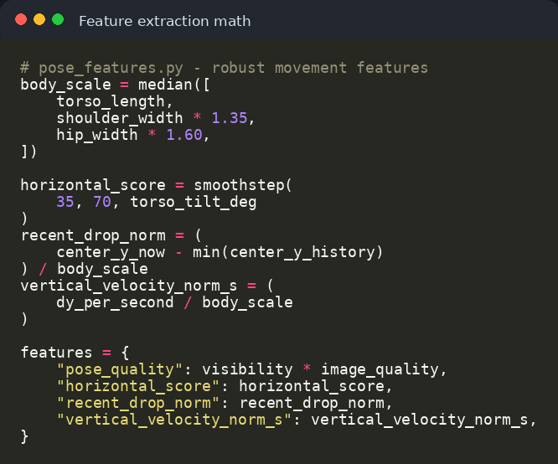
MATHS + AI METHOD
Enhanced maths: body-normalized pose and movement evidence
Raw image coordinates are unreliable across camera distance, height, and body size; the final branch uses normalized geometry and persistence.
Core feature extraction idea
Why the math was improved
Body-scale normalization reduces false alarms when the person stands nearer or farther from the camera.
Visibility and pose-quality checks reject weak frames instead of forcing a label.
Temporal history measures a real drop or freeze rather than relying on a single frame.
Face and arm asymmetry are made conservative by requiring visible landmarks and persistence.
Final decision uses a rule/model ensemble; local Llama only summarizes evidence.
torso tilt
horizontal score
recent drop
pose quality
Reference basis: MediaPipe returns 33 pose landmarks with normalized image coordinates and world coordinates; scikit-learn RandomForestClassifier is used for the trained bootstrap model.
Maths and AI method
07
Notes:
This slide explains the main technical improvement. MediaPipe returns landmarks, but landmarks alone are not enough. The project converts them into robust features: body scale, torso tilt, horizontal score, knee and hip angles, movement, recent drop, and normalized vertical velocity. Then the pose classifier and emergency engine use persistence, confidence, and conservative thresholds. This prevents the system from guessing when landmarks are poor or when the camera angle is difficult.

Slide 8
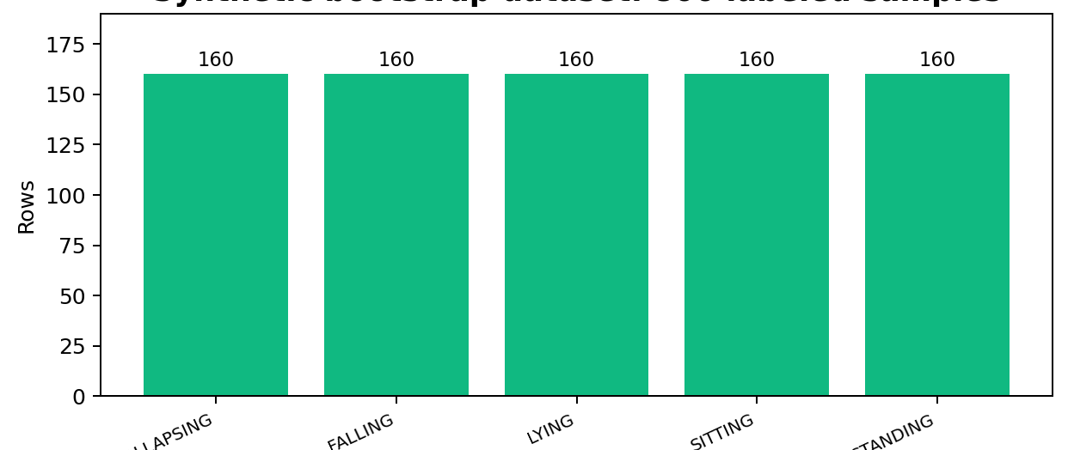
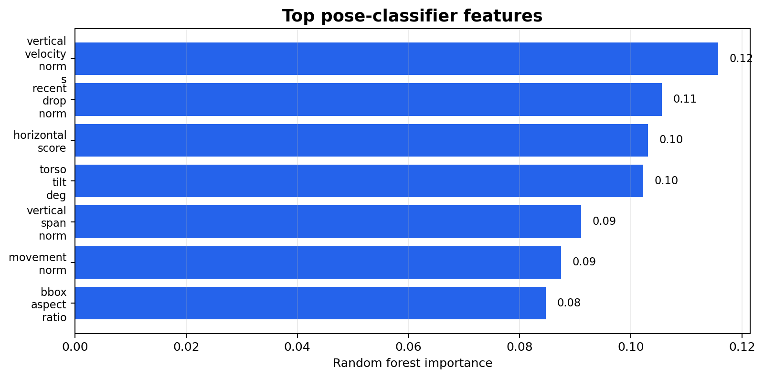
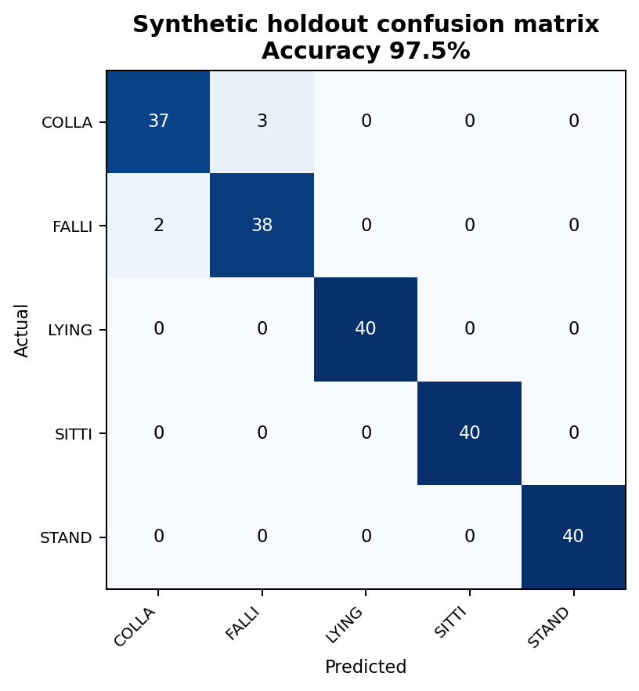
TRAINING MODULE
Training module: learning samples for the pose classifier
V3.0 includes a synthetic bootstrap dataset and training workflow so the scikit model can be tested and replaced with real RPi captures later.
Learning samples generated
Most useful features
Holdout result
Dataset content
Important training warning
800 synthetic rows: 160 per class for STANDING, SITTING, LYING, FALLING, COLLAPSING.
Synthetic data is for pipeline demonstration and unit testing, not medical reliability.
Feature version 2.1; generated with session bias and session-stratified split.
Real data should include multiple people, clothes, lighting, camera positions, and sessions.
Starter model saved as pose_classifier.joblib and report JSON.
Dangerous fall classes should be staged only with safe padding/supervision.
Training module and learning samples
08
Notes:
Describe the training module as a proof that the system can learn from labeled examples. The included data has five balanced classes and is useful for checking the training pipeline. The report shows a high synthetic holdout accuracy, but the presenter should be honest: synthetic data is not enough. Real RPi captures are required before claiming reliability. This honesty improves the academic quality of the case study.

Slide 9
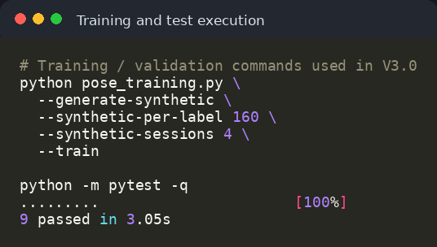
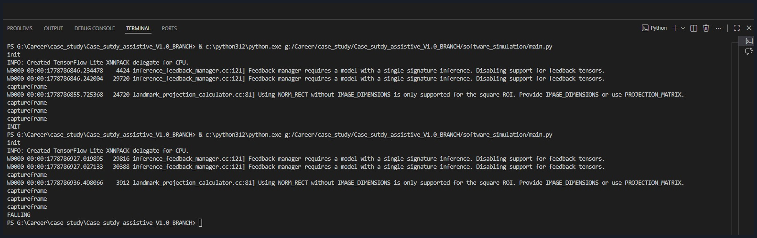
CODE EXECUTION
Code execution: local prototype and validation
The project was executed locally, with camera capture, pose state output, training commands, and unit tests.
Training and test commands
Terminal output during pose test
RPi logic tests
Classes trained
Input source
Deployment style
Security
9 passed
5 states
Camera + sensors
Local Wi‑Fi
API key
pytest -q
standing, sitting, lying, falling, collapsing
sensors simulated now
RPi → PC webapp API
X-API-Key header
Code execution and validation
09
Notes:
Show that the project actually runs. The terminal screenshot shows MediaPipe/TensorFlow Lite initialization, frame capture, and pose output such as FALLING. The training commands generate the bootstrap dataset and train the model. The pytest result is important because it demonstrates that core RPi logic has tests. Mention that webapp tests were not executed in the current environment unless Flask is installed, but the live dashboard screenshots show the webapp running during prototype testing.

Slide 10
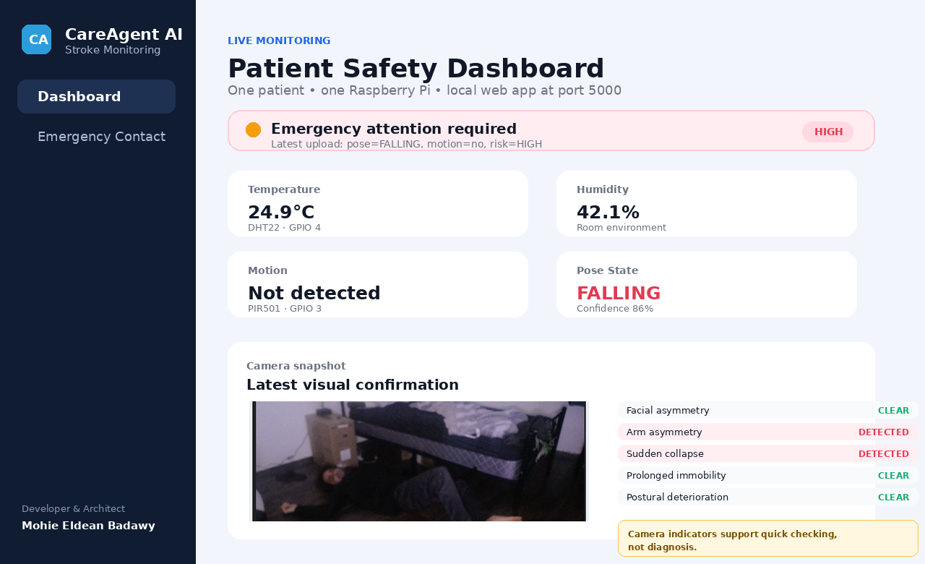
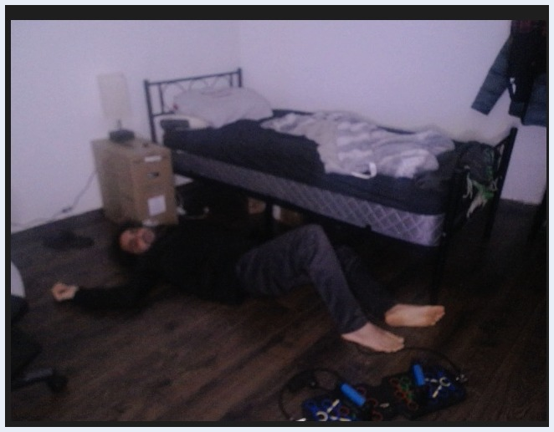
PROTOTYPE TEST
Prototype test: dashboard, snapshot, and emergency workflow
The test demonstrates camera evidence, pose state, risk indicators, and caregiver-facing dashboard updates.
Local dashboard view
Camera test snapshot
Observed during demo
Standing and sitting states appeared normally in the dashboard.
Falling state raised HIGH risk and showed sudden collapse.
Snapshot upload provides visual confirmation for the caregiver.
Alert audit records automatic and manual SOS attempts.
Medical note: dashboard snapshots are for confirmation only; suspected stroke or danger still requires direct assessment and emergency services.
Prototype test
10
Notes:
Use the prototype evidence. The dashboard shows the core idea: latest telemetry, pose state, snapshot, stroke-risk indicators, and emergency action. The screenshots show that the system can move through sitting, standing, and falling states during testing. The automatic monitor can record alert attempts; email failures such as SMTP authentication errors become visible in the audit trail, which is useful for debugging and for a future production setup.

Slide 11
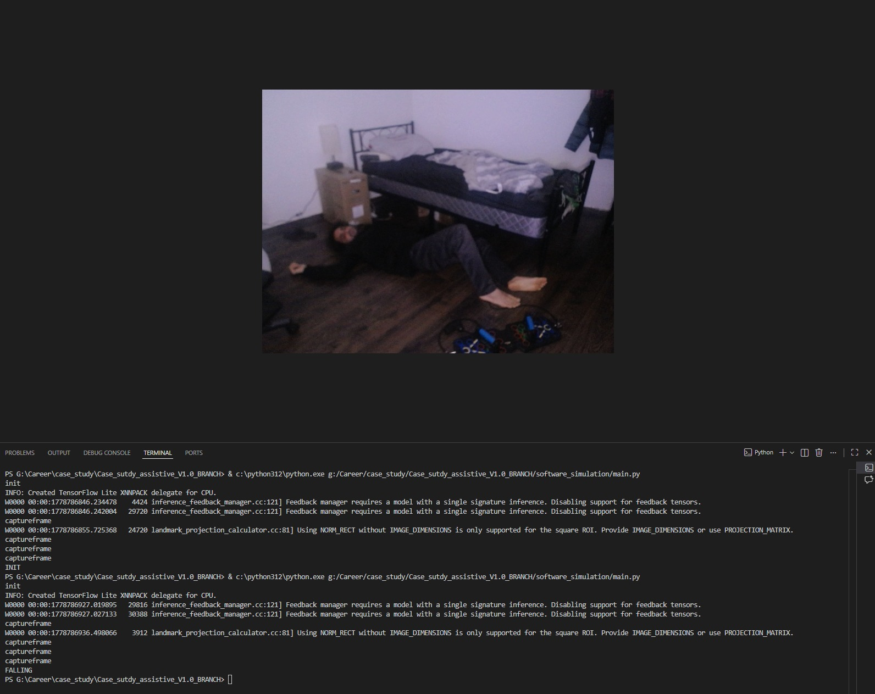
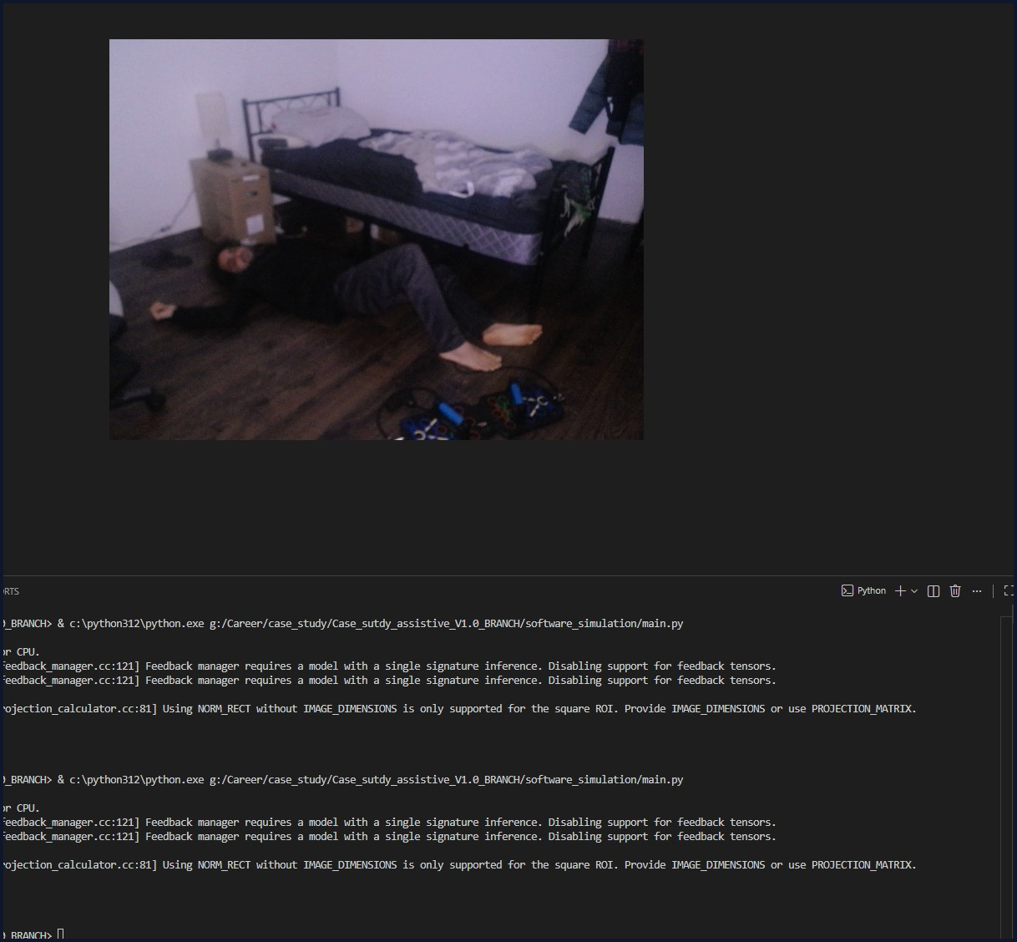
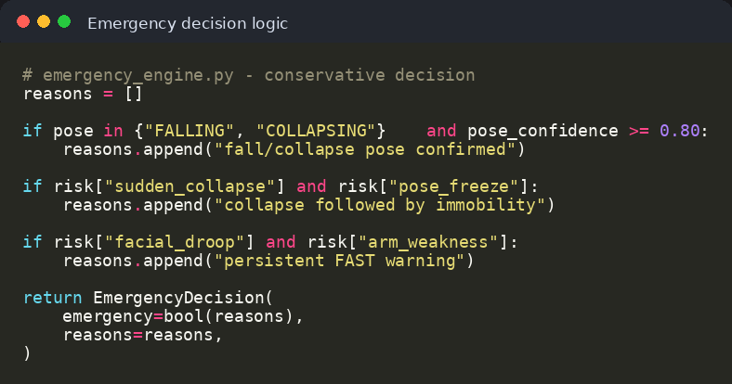
ADDITIONAL PICTURES
More prototype evidence: posture states and runtime proof
Additional screenshots from testing show the camera scene, terminal feedback, and code execution used to validate the local prototype.
Full falling test in VS Code
Camera frame: FALLING
Terminal state output
Runtime evidence
Alert logic code
How these pictures support the case study
They show the complete prototype loop during testing: a real camera frame is captured, MediaPipe/OpenCV processing runs locally, the terminal prints pose state feedback, and the final evidence is used by the web dashboard.
camera evidence
terminal feedback
local execution
prototype validation
Additional prototype pictures
11
Notes:
This added slide includes more of the pictures from the prototype testing. Explain that the falling image is not only a visual mock-up; it is connected to terminal output and local code execution. The purpose is to show that the prototype was tested end-to-end: capture, detection, pose label, and feedback to the system.

Slide 12
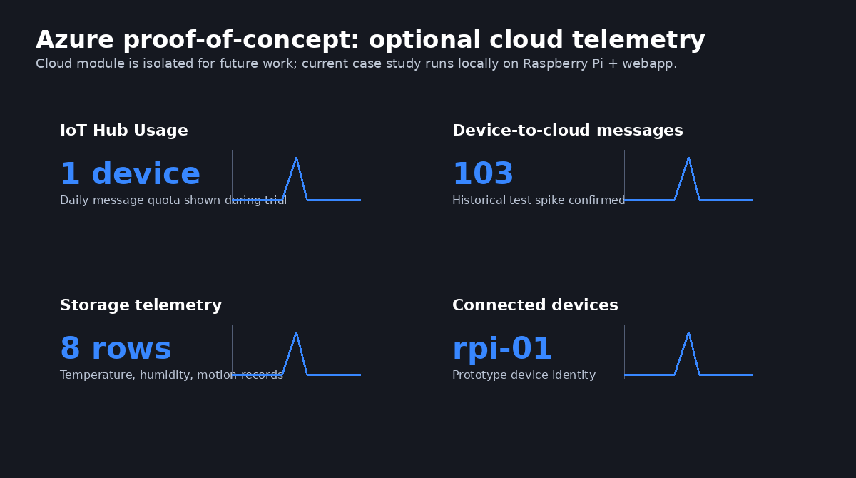
ADDITIONAL PICTURES
More system evidence: dashboard, alert logic, and cloud proof-of-concept
The final demo is local, but the project history also includes dashboard screenshots, alert logic, and an Azure proof-of-concept kept for future work.
Dashboard after FALLING reading
Emergency decision logic
Training/test command proof
Earlier Azure IoT + storage telemetry proof-of-concept
What the extra screenshots prove
Dashboard view confirms risk indicators, latest snapshot, telemetry cards, and caregiver-facing status.
Emergency logic shows how pose and risk reasons become a conservative alert decision.
Azure pictures document previous cloud experiments, but V3.0 keeps the working demo local-first.
Additional system pictures
12
Notes:
Use this slide to connect the extra screenshots to the implementation. The dashboard screenshot proves the webapp side. The emergency code screenshot proves the rule logic. The Azure picture proves that cloud telemetry was explored, but repeat that cloud is not required for the final demo and is intentionally left for future work.

Slide 13
RESULTS + DISCUSSION
Results and discussion
The prototype successfully demonstrates a complete local monitoring loop, while also showing the limits of camera-only medical inference.
Working local loop
Pose states detected
1
RPi-style agent → local API → Flask dashboard → visual snapshot + history.
2
Standing, sitting, falling/collapsing, lying/unknown handling with confidence.
Training pipeline ready
Emergency workflow
3
800 bootstrap rows, starter model, report JSON, and real-data collection commands.
4
Risk reasons, alert audit, SOS email path, phone-call action on mobile dashboard.
What worked well
Limitations / next work
Responsive dashboard is understandable on mobile.
Replace synthetic data with real, ethically collected RPi samples.
Local deployment reduces cloud dependency and latency.
Configure production email credentials and emergency contact phone.
Math normalization improves consistency across camera distance.
Add privacy policy, device hardening, and optional cloud reporting later.
Results and discussion
13
Notes:
Summarize the outcome. The case study is successful because it demonstrates an end-to-end assistive IoT pipeline running locally: capture, pose analysis, risk decision, local upload, dashboard, and alert audit. Be transparent about limitations. The synthetic model proves the pipeline, not medical reliability. The next step is real-world data collection, production email/contact configuration, and privacy/security preparation before any elder-care trial.

Slide 14
BIBLIOGRAPHY REPORT
Final bibliography report and project boundary
The case study uses clinical-awareness sources for motivation and technical documentation for implementation choices.
Main references
Conclusion statement
WHO — Falls fact sheet
CareAgent AI demonstrates how a low-cost Raspberry Pi device can combine local sensors, camera pose landmarks, mathematical feature extraction, a trained classifier, and a caregiver dashboard to support faster awareness of elder-safety risks.
https://www.who.int/news-room/fact-sheets/detail/falls
CDC — Signs and Symptoms of Stroke / B.E.F.A.S.T.
https://www.cdc.gov/stroke/signs-symptoms/index.html
Google MediaPipe — Pose Landmarker Python guide
https://developers.google.com/edge/mediapipe/solutions/vision/pose_landmarker/python
OpenCV — VideoCapture reference
https://docs.opencv.org/4.x/d8/dfe/classcv_1_1VideoCapture.html
Boundary for the final report
scikit-learn — RandomForestClassifier
Experimental prototype only.
https://scikit-learn.org/stable/modules/generated/sklearn.ensemble.RandomForestClassifier.html
Raspberry Pi — Raspberry Pi 5 product information
Camera-only stroke signs are incomplete.
https://www.raspberrypi.com/products/raspberry-pi-5/
Real-world validation is future work.
Project repository — final branch V3.0
Cloud remains out of scope for current local demo.
https://github.com/Mohyeldean11/Assistive_IOT_PROJ/tree/V3.0
Final bibliography report
14
Notes:
Close with the bibliography and the ethical boundary. Sources include WHO and CDC for why the monitor is useful, and MediaPipe, OpenCV, scikit-learn, Raspberry Pi, and the GitHub repository for the technical implementation. End by saying that the project is successful as a case-study prototype, but it still needs real data, safety procedures, privacy hardening, and clinical oversight before any real elder-care use.

