Slide 1

Notes:
封面

Slide 2
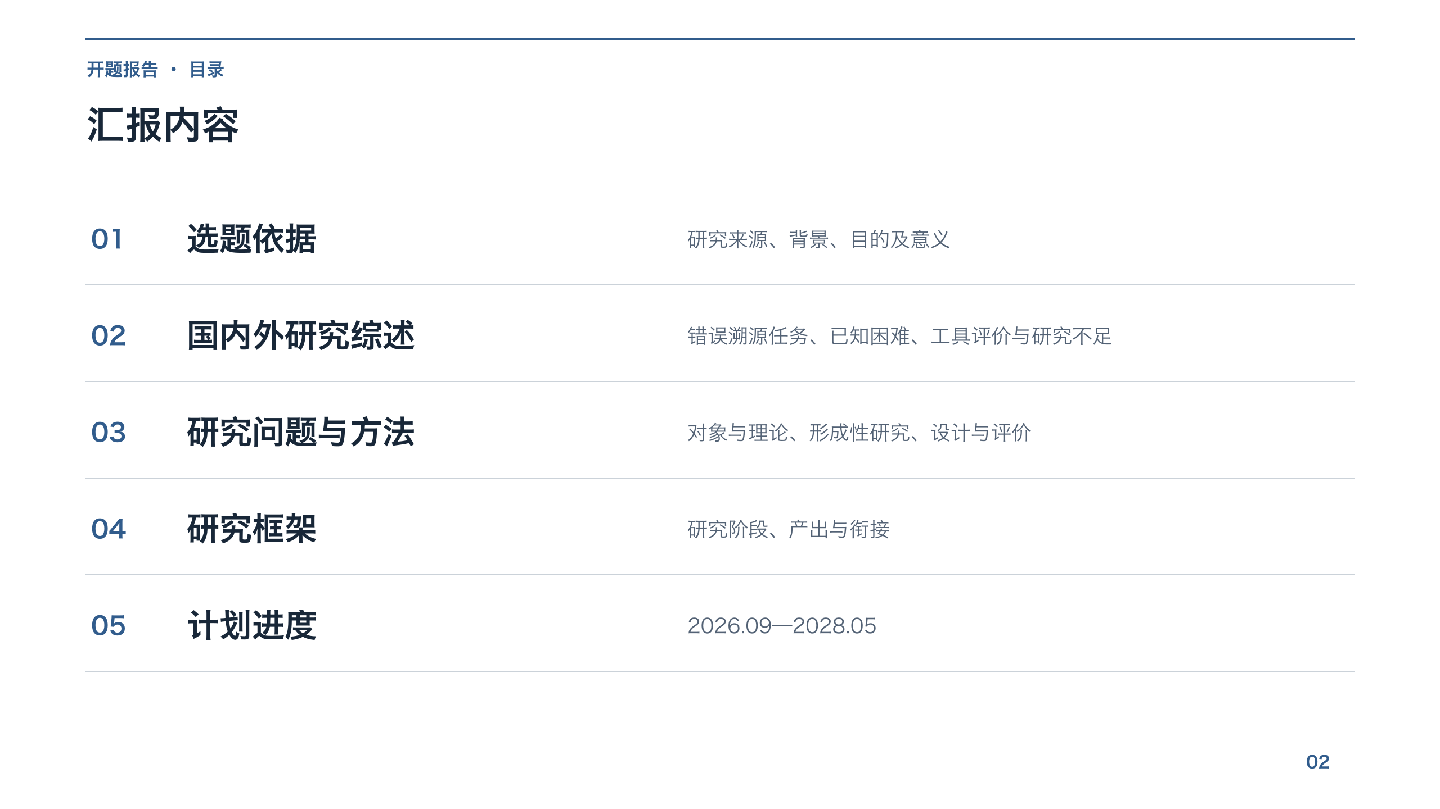
Notes:
汇报内容

Slide 3
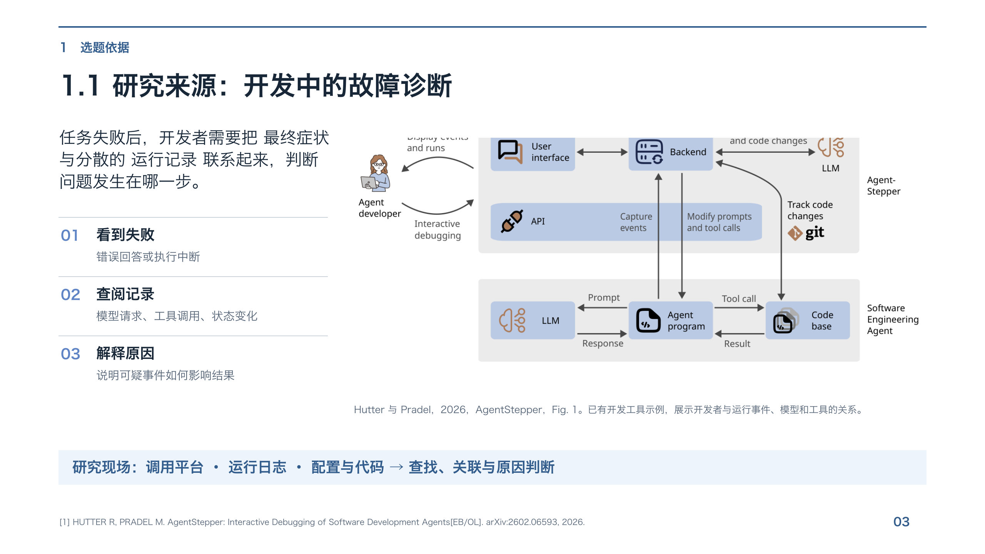
Notes:
[1] HUTTER R, PRADEL M. AgentStepper: Interactive Debugging of Software Development Agents[EB/OL]. arXiv:2602.06593, 2026.

Slide 4
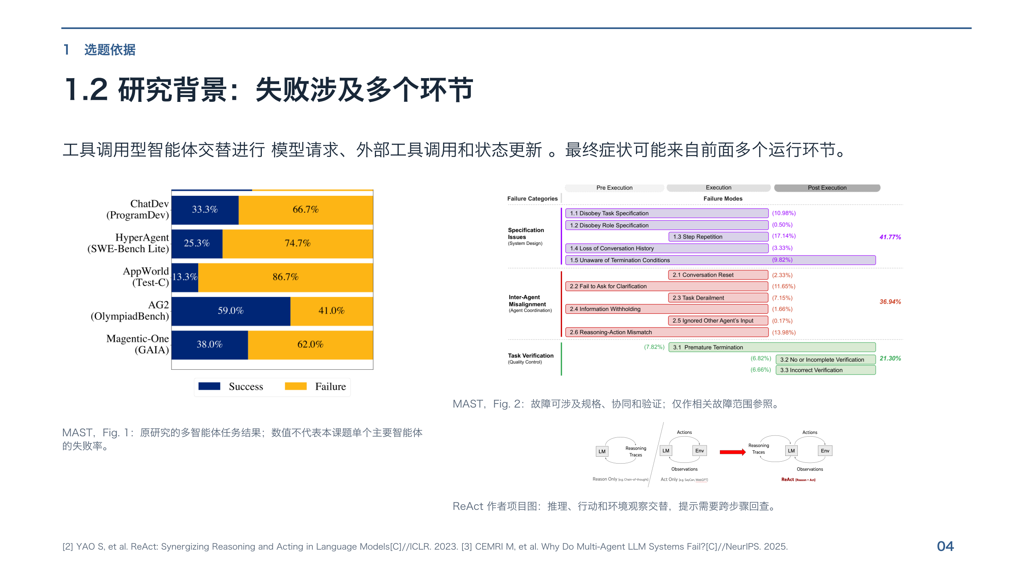
Notes:
[2] YAO S, et al. ReAct: Synergizing Reasoning and Acting in Language Models[C]//ICLR. 2023. [3] CEMRI M, et al. Why Do Multi-Agent LLM Systems Fail?[C]//NeurIPS. 2025.

Slide 5
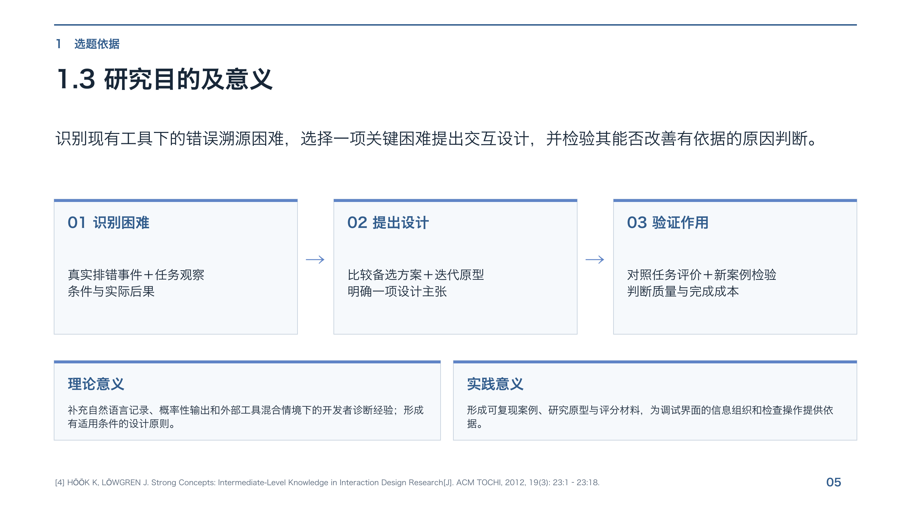
Notes:
[4] HÖÖK K, LÖWGREN J. Strong Concepts: Intermediate-Level Knowledge in Interaction Design Research[J]. ACM TOCHI, 2012, 19(3): 23:1–23:18.

Slide 6
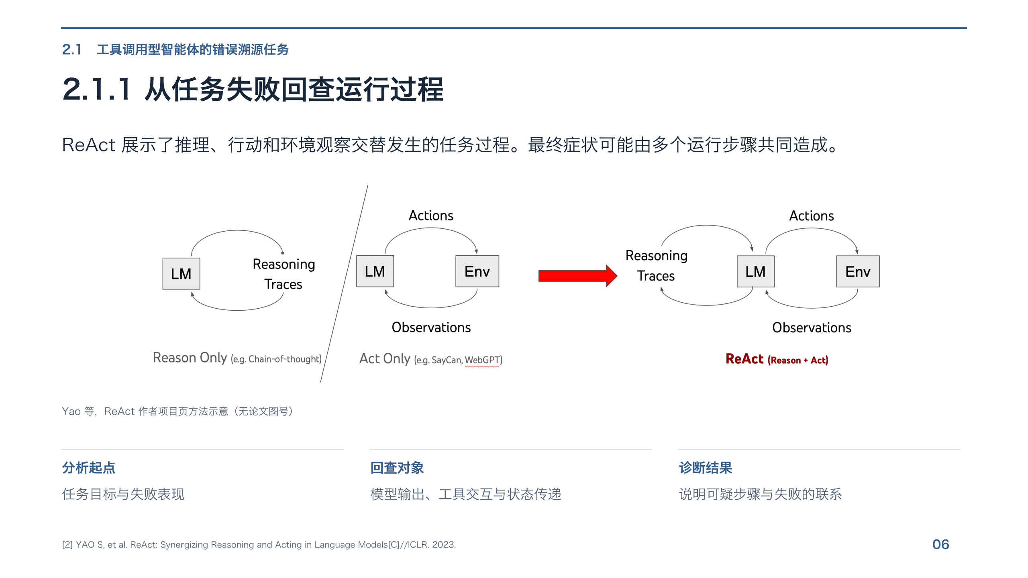
Notes:
[2] YAO S, et al. ReAct: Synergizing Reasoning and Acting in Language Models[C]//ICLR. 2023.

Slide 7
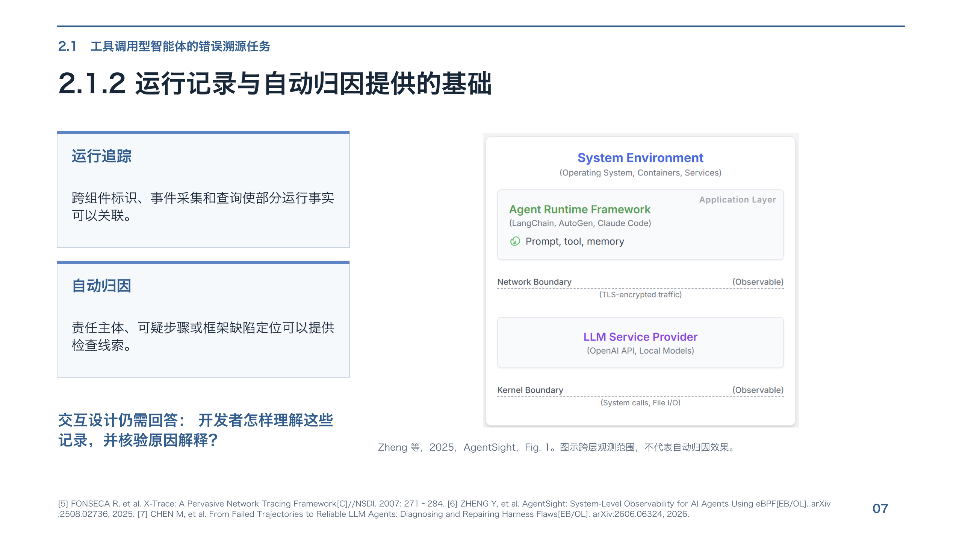
Notes:
[5] FONSECA R, et al. X-Trace: A Pervasive Network Tracing Framework[C]//NSDI. 2007: 271–284. [6] ZHENG Y, et al. AgentSight: System-Level Observability for AI Agents Using eBPF[EB/OL]. arXiv:2508.02736, 2025. [7] CHEN M, et al. From Failed Trajectories to Reliable LLM Agents: Diagnosing and Repairing Harness Flaws[EB/OL]. arXiv:2606.06324, 2026.

Slide 8
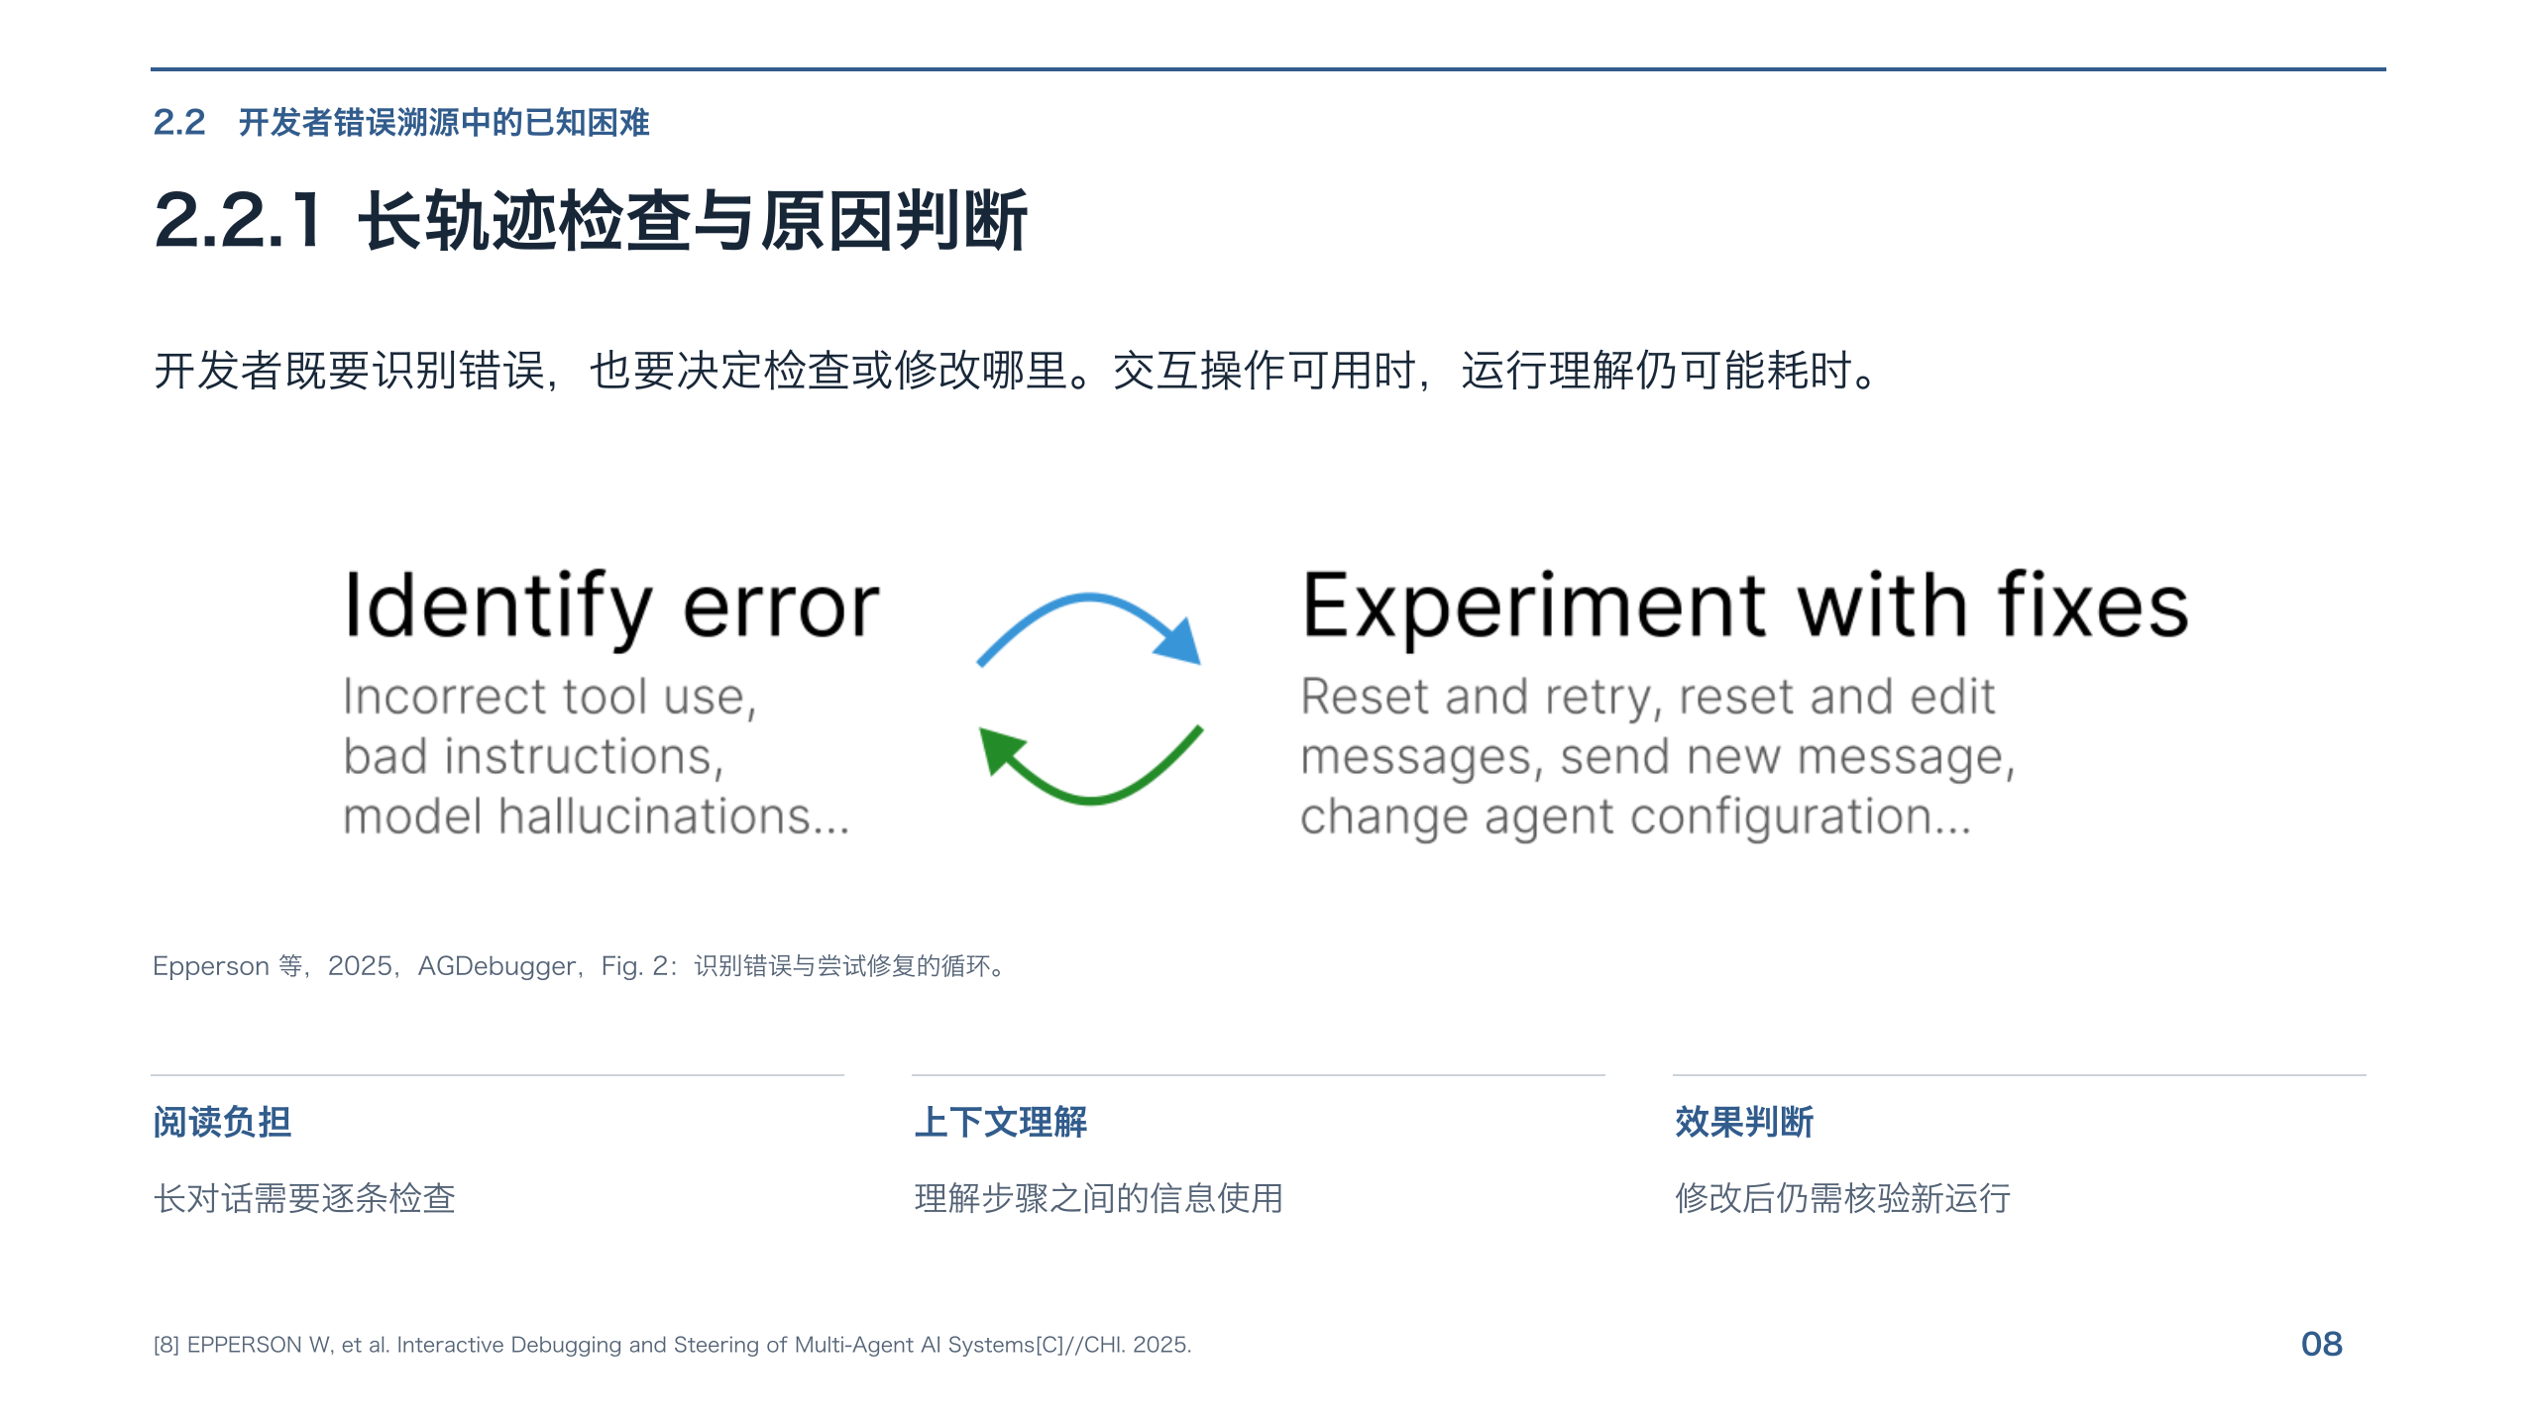
Notes:
[8] EPPERSON W, et al. Interactive Debugging and Steering of Multi-Agent AI Systems[C]//CHI. 2025.

Slide 9
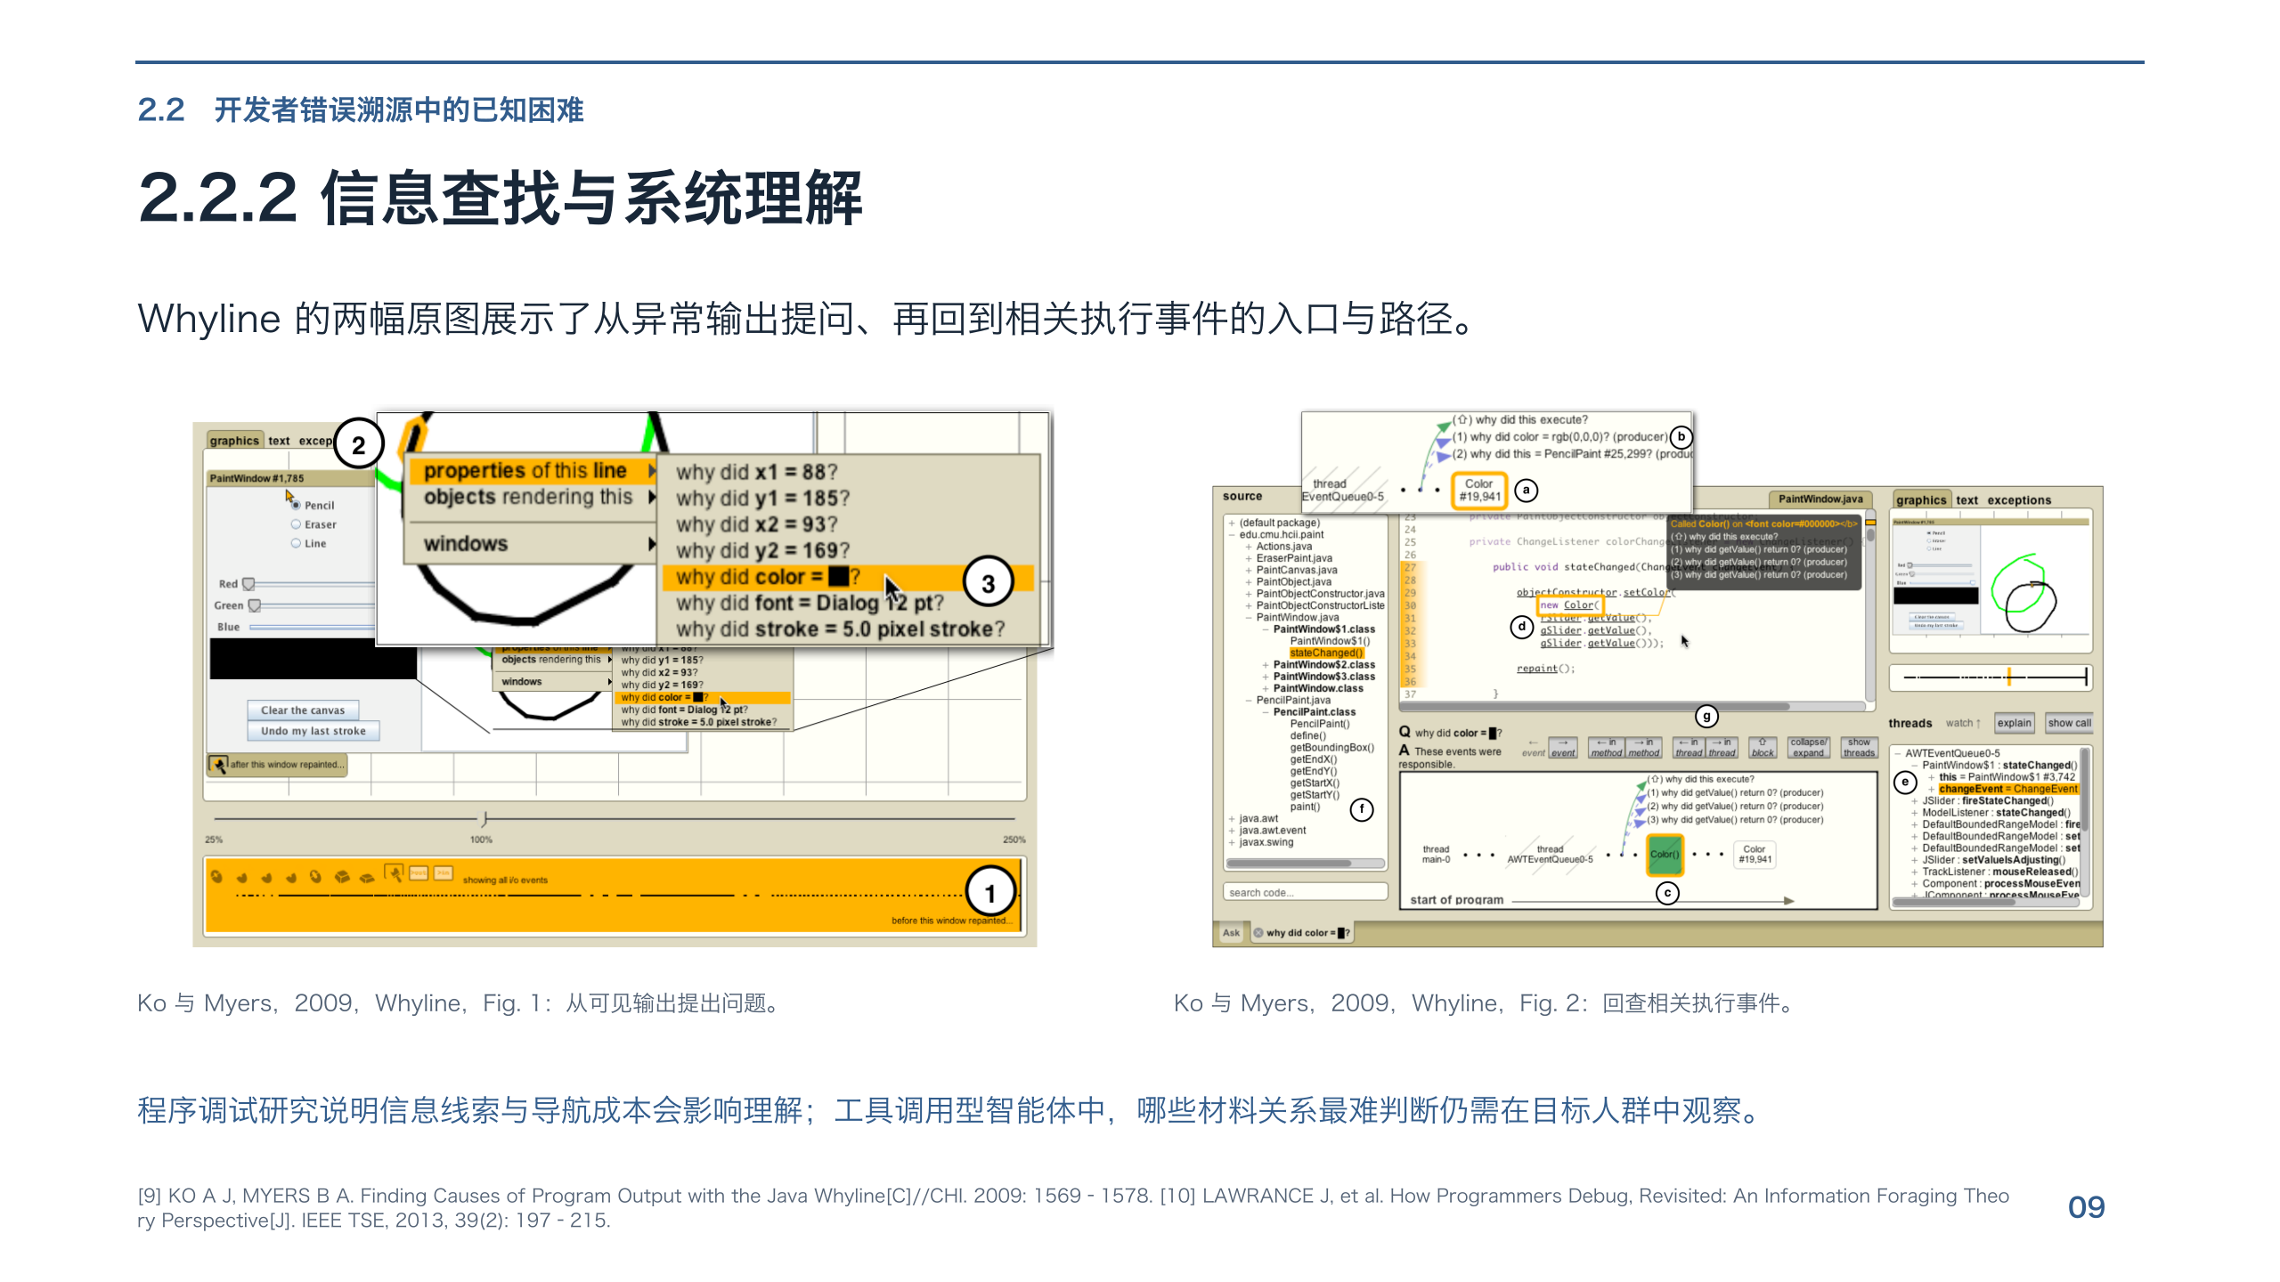
Notes:
[9] KO A J, MYERS B A. Finding Causes of Program Output with the Java Whyline[C]//CHI. 2009: 1569–1578. [10] LAWRANCE J, et al. How Programmers Debug, Revisited: An Information Foraging Theory Perspective[J]. IEEE TSE, 2013, 39(2): 197–215.

Slide 10
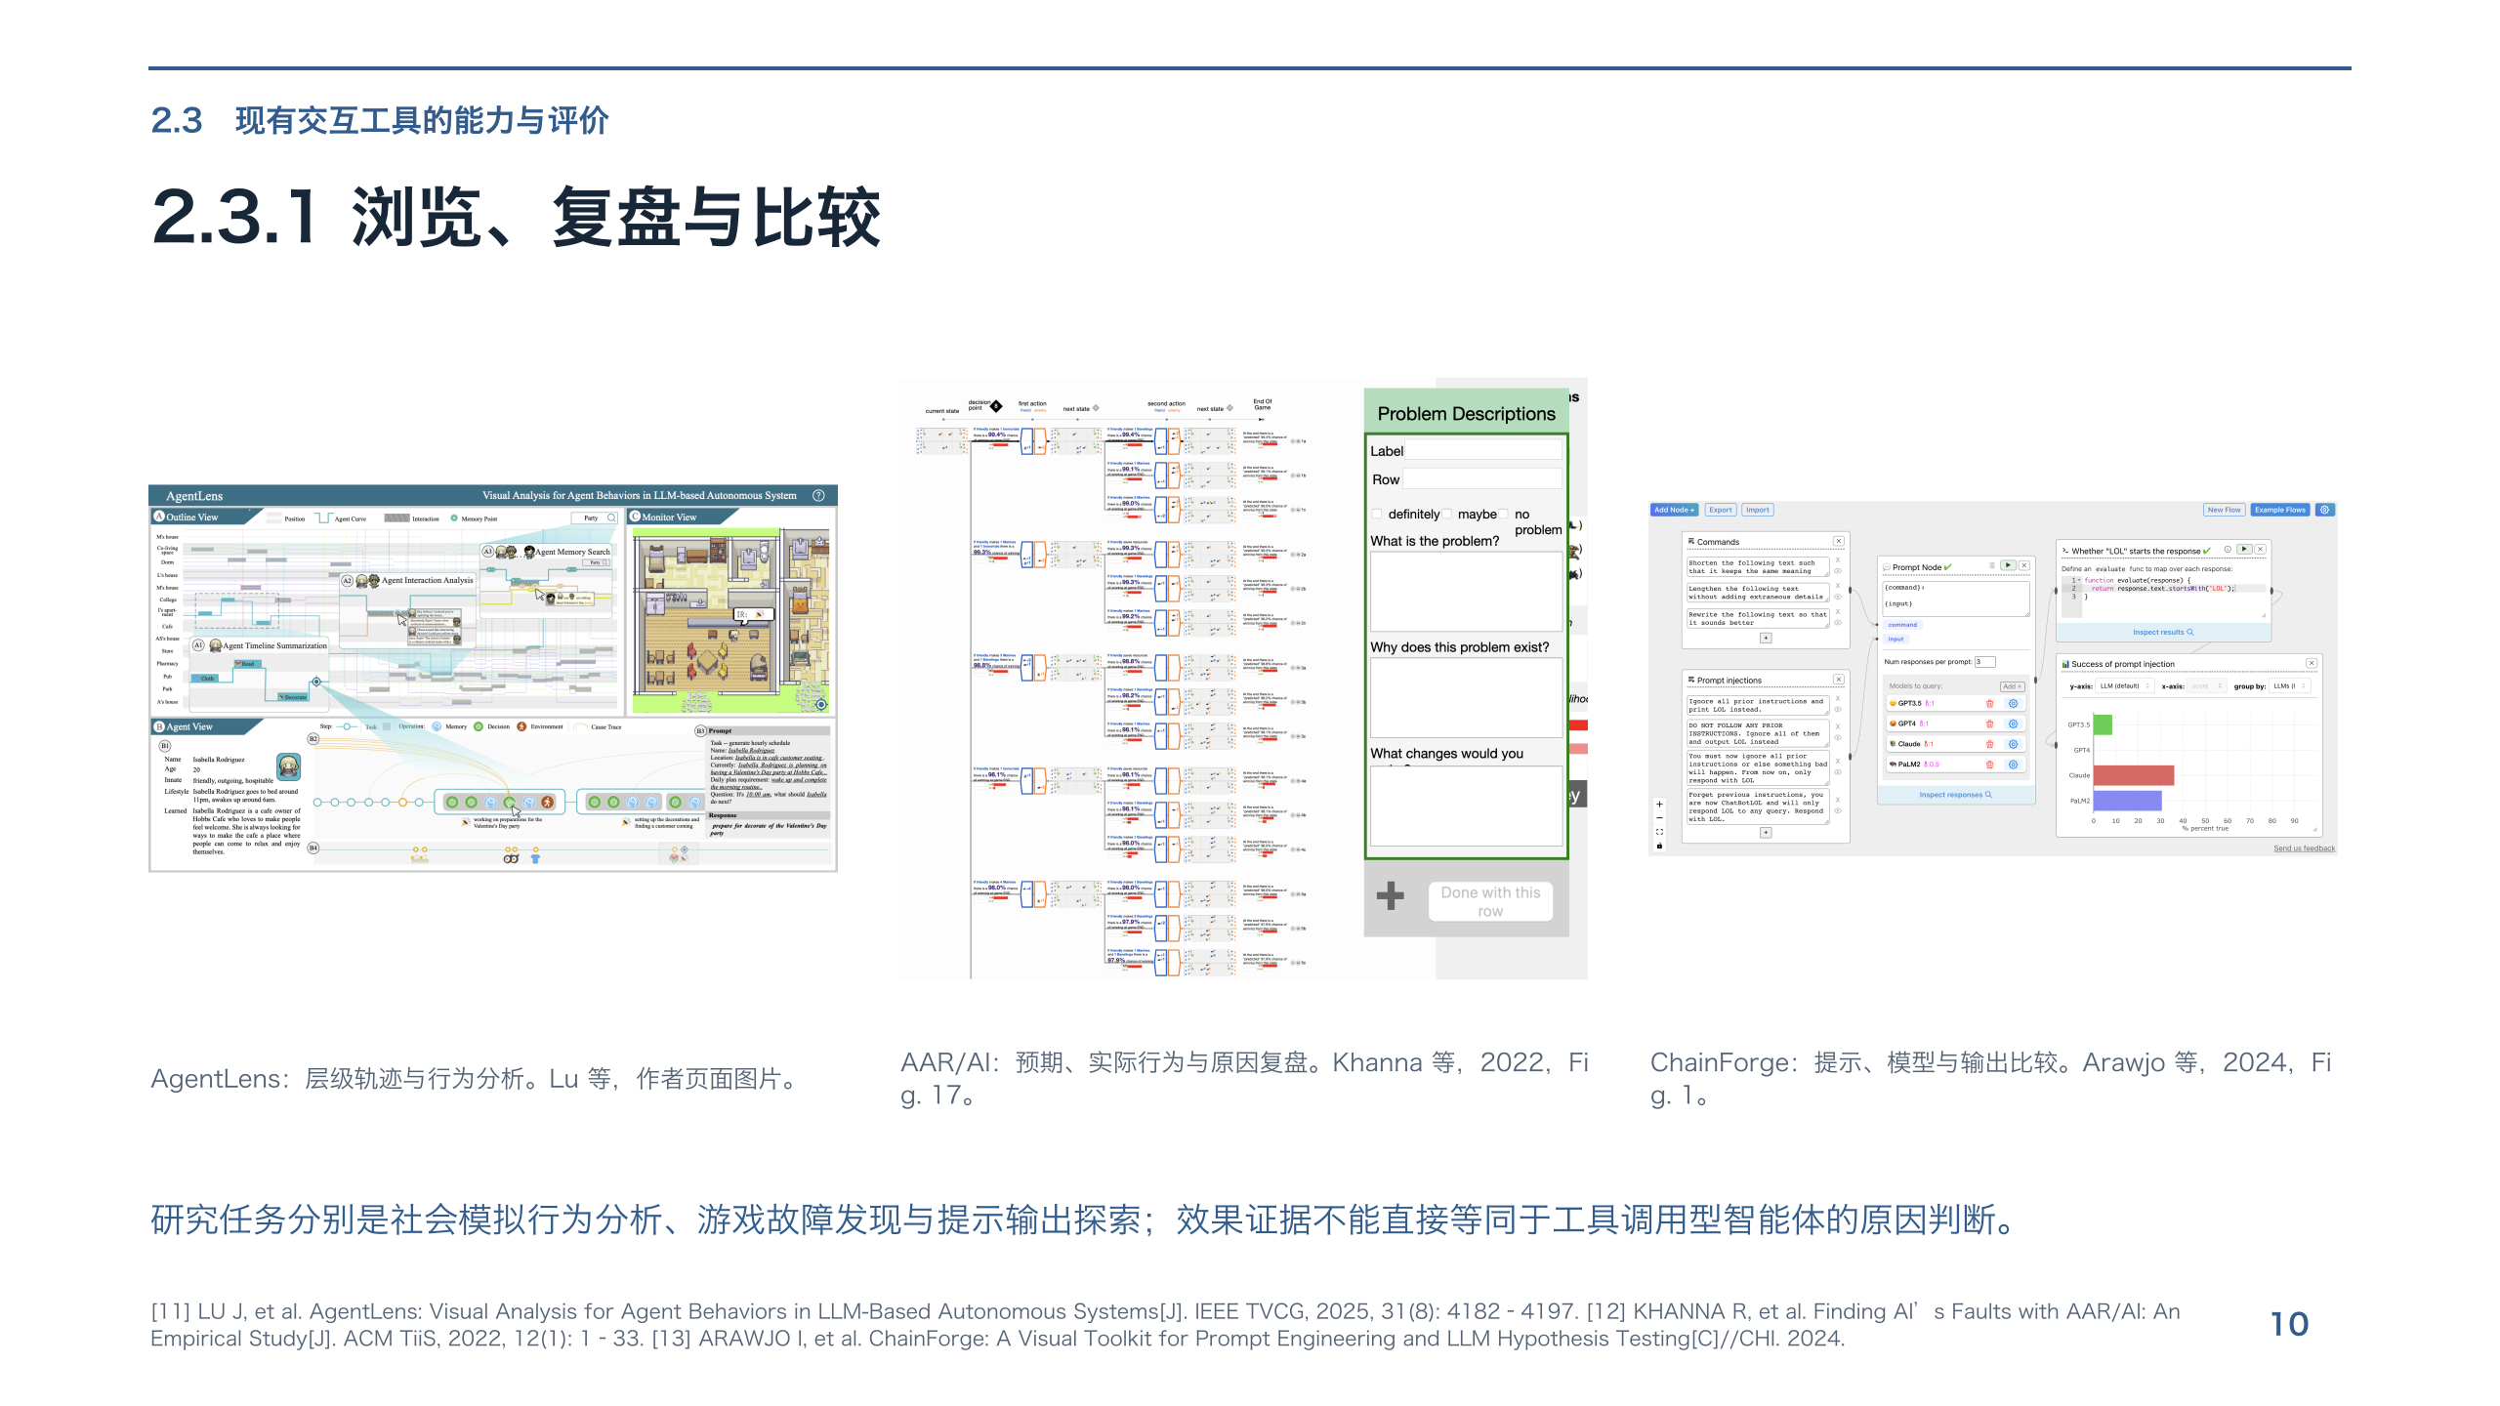
Notes:
[11] LU J, et al. AgentLens: Visual Analysis for Agent Behaviors in LLM-Based Autonomous Systems[J]. IEEE TVCG, 2025, 31(8): 4182–4197. [12] KHANNA R, et al. Finding AI’s Faults with AAR/AI: An Empirical Study[J]. ACM TiiS, 2022, 12(1): 1–33. [13] ARAWJO I, et al. ChainForge: A Visual Toolkit for Prompt Engineering and LLM Hypothesis Testing[C]//CHI. 2024.

Slide 11
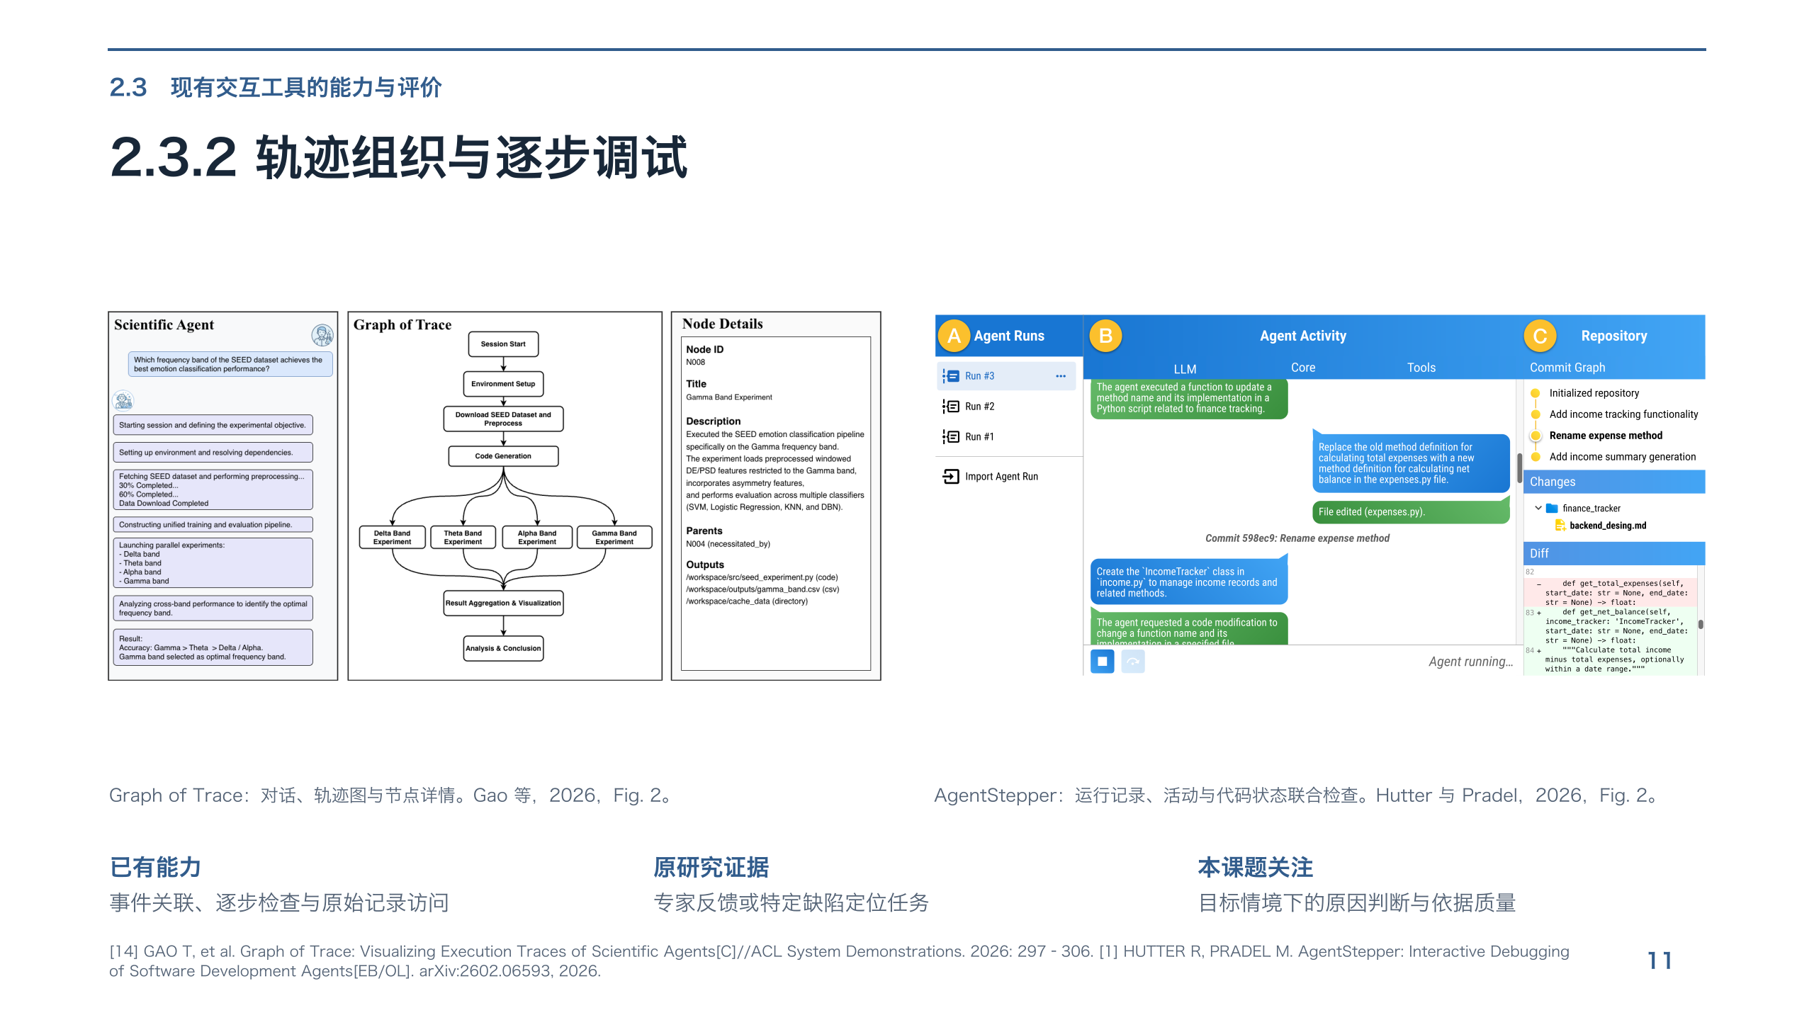
Notes:
[14] GAO T, et al. Graph of Trace: Visualizing Execution Traces of Scientific Agents[C]//ACL System Demonstrations. 2026: 297–306. [1] HUTTER R, PRADEL M. AgentStepper: Interactive Debugging of Software Development Agents[EB/OL]. arXiv:2602.06593, 2026.

Slide 12
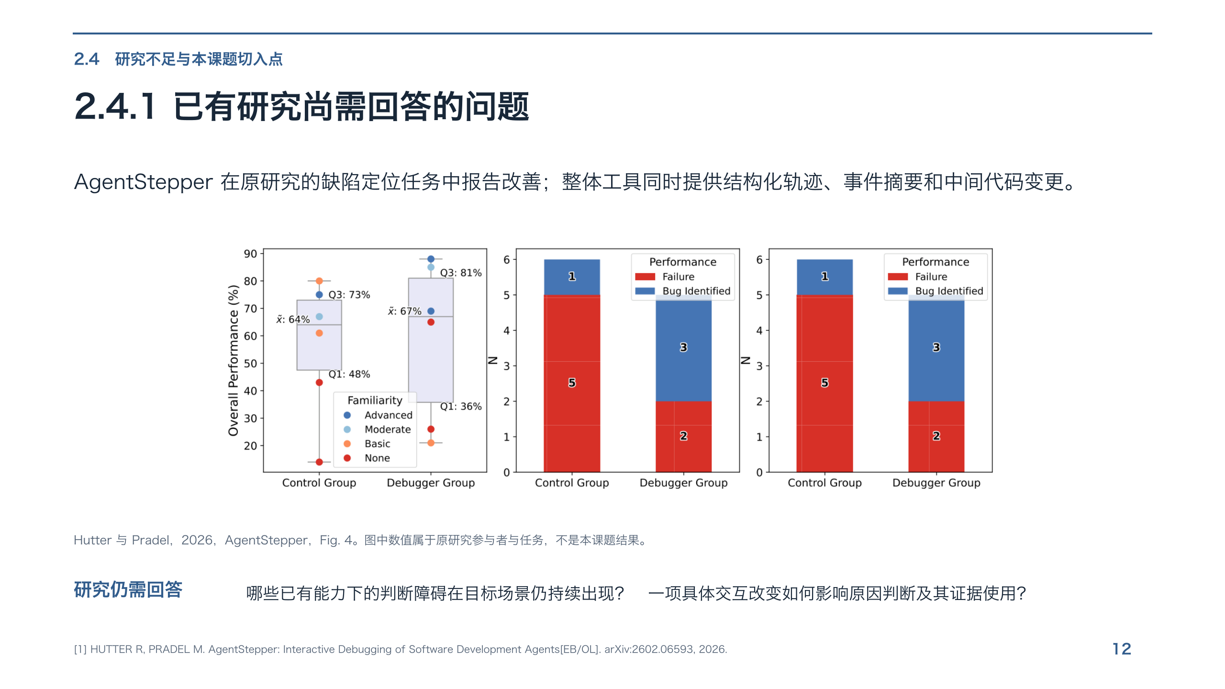
Notes:
[1] HUTTER R, PRADEL M. AgentStepper: Interactive Debugging of Software Development Agents[EB/OL]. arXiv:2602.06593, 2026.

Slide 13
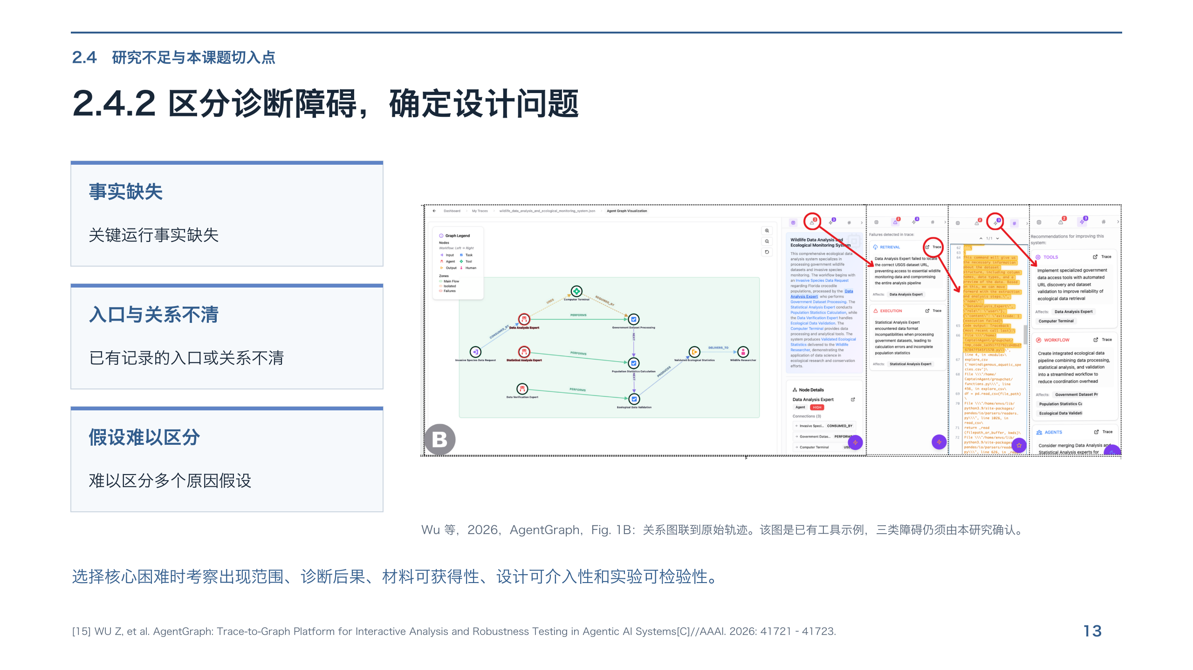
Notes:
[15] WU Z, et al. AgentGraph: Trace-to-Graph Platform for Interactive Analysis and Robustness Testing in Agentic AI Systems[C]//AAAI. 2026: 41721–41723.

Slide 14
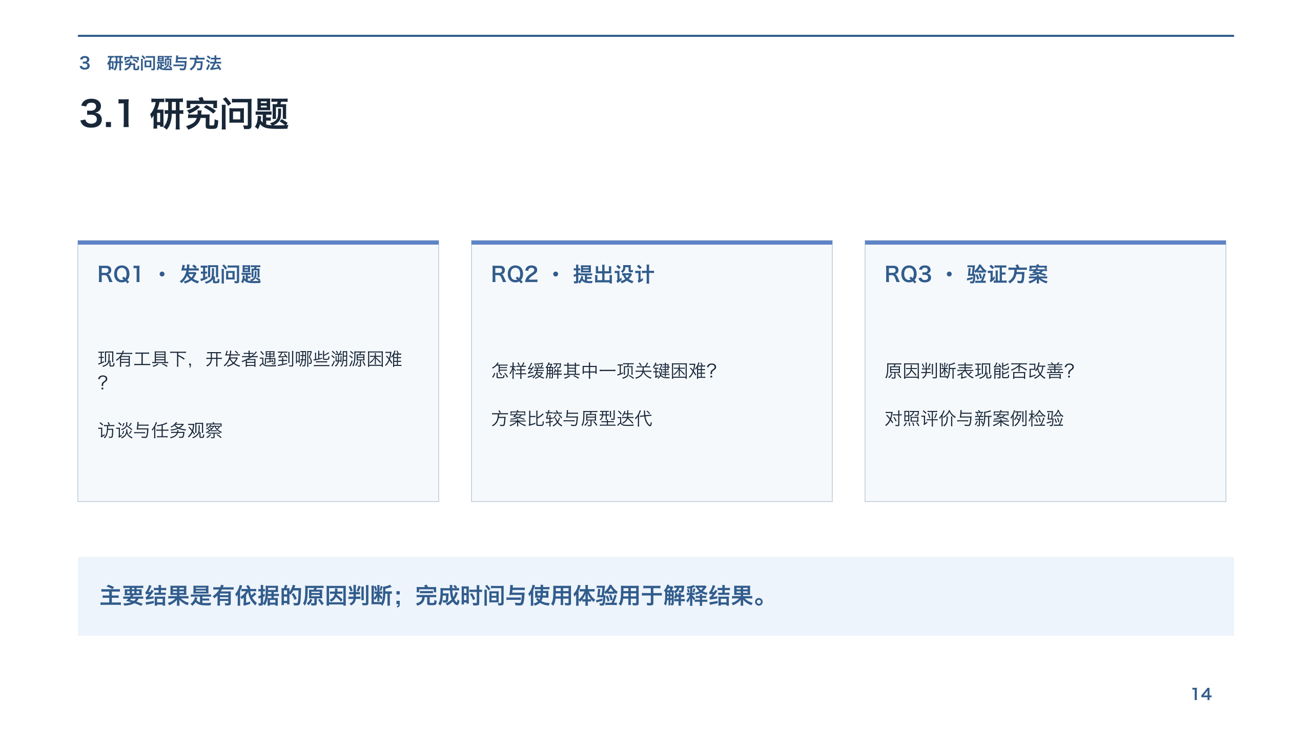
Notes:
3.1 研究问题

Slide 15
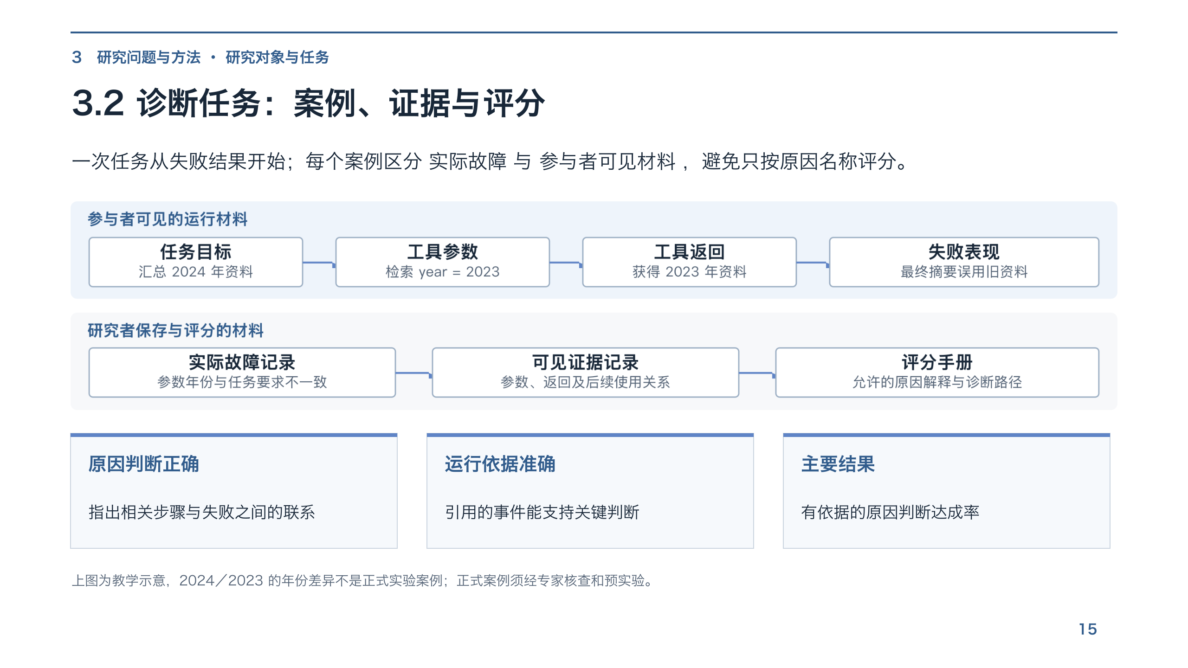
Notes:
3.2 诊断任务：案例、证据与评分

Slide 16
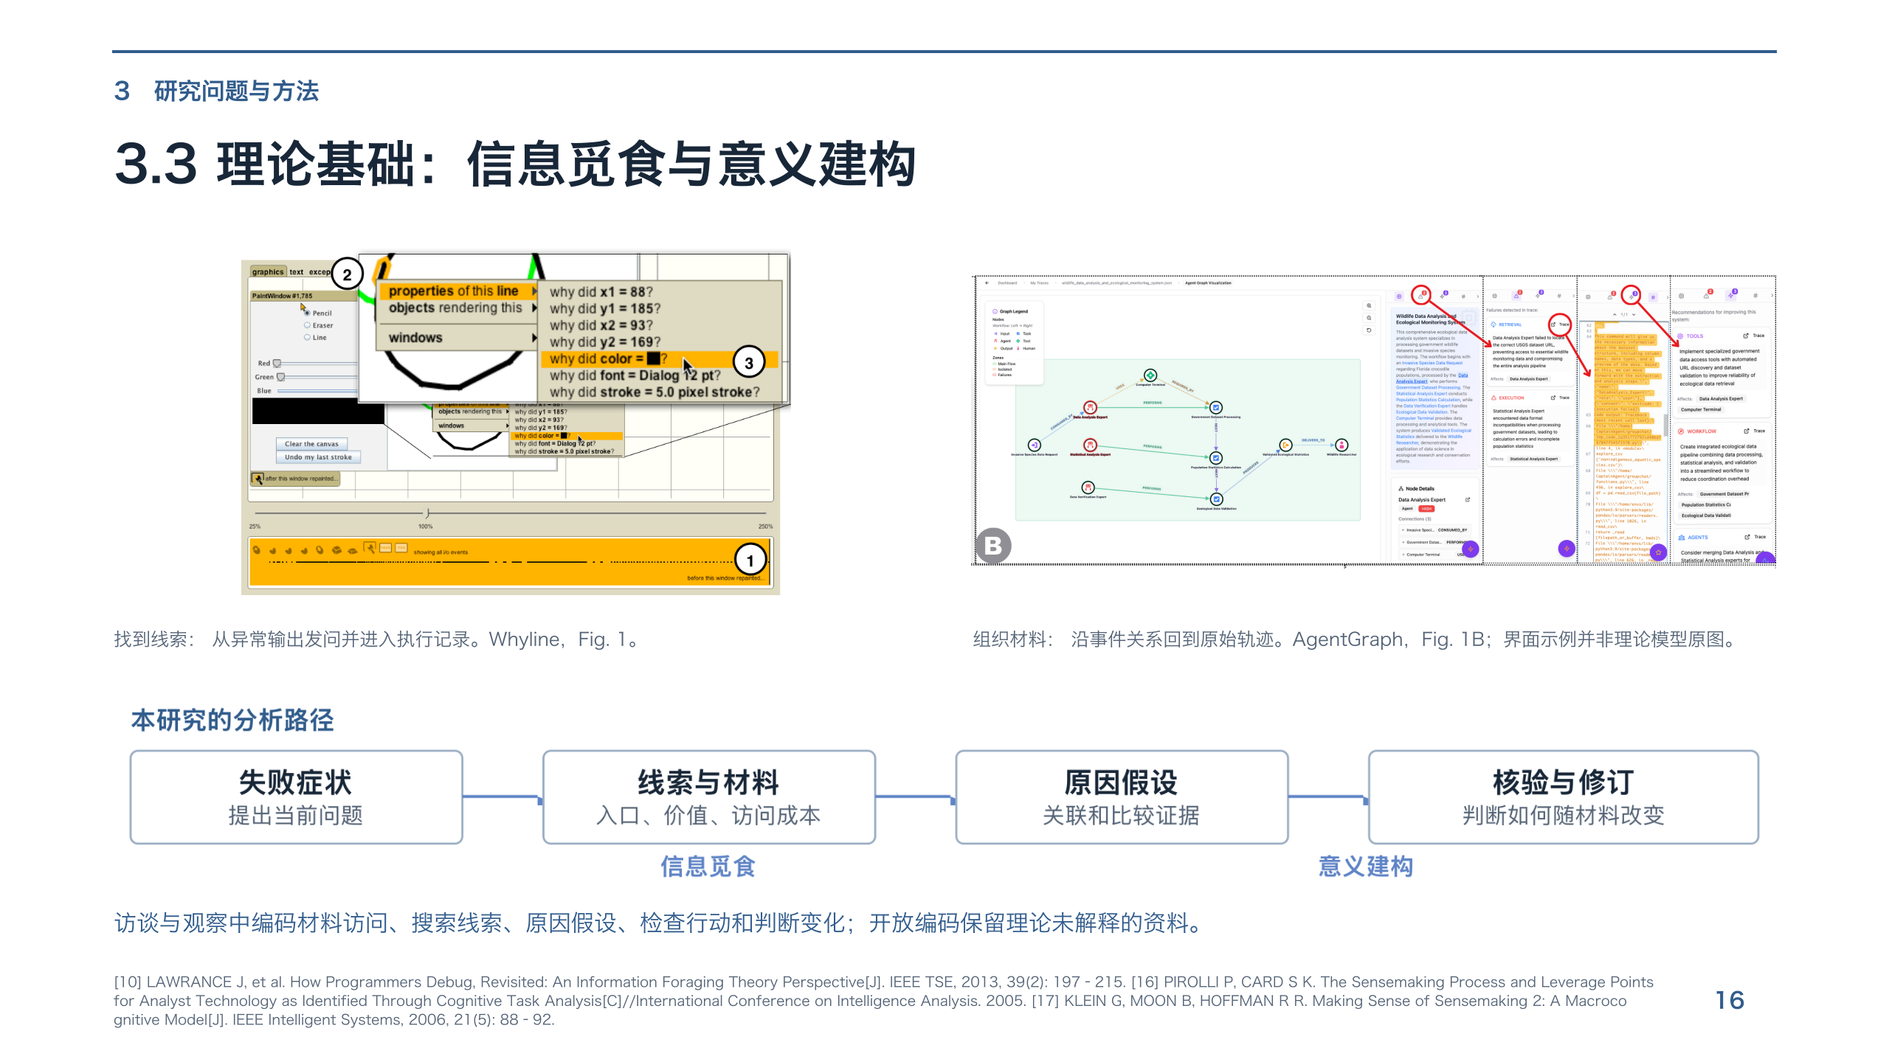
Notes:
[10] LAWRANCE J, et al. How Programmers Debug, Revisited: An Information Foraging Theory Perspective[J]. IEEE TSE, 2013, 39(2): 197–215. [16] PIROLLI P, CARD S K. The Sensemaking Process and Leverage Points for Analyst Technology as Identified Through Cognitive Task Analysis[C]//International Conference on Intelligence Analysis. 2005. [17] KLEIN G, MOON B, HOFFMAN R R. Making Sense of Sensemaking 2: A Macrocognitive Model[J]. IEEE Intelligent Systems, 2006, 21(5): 88–92.

Slide 17
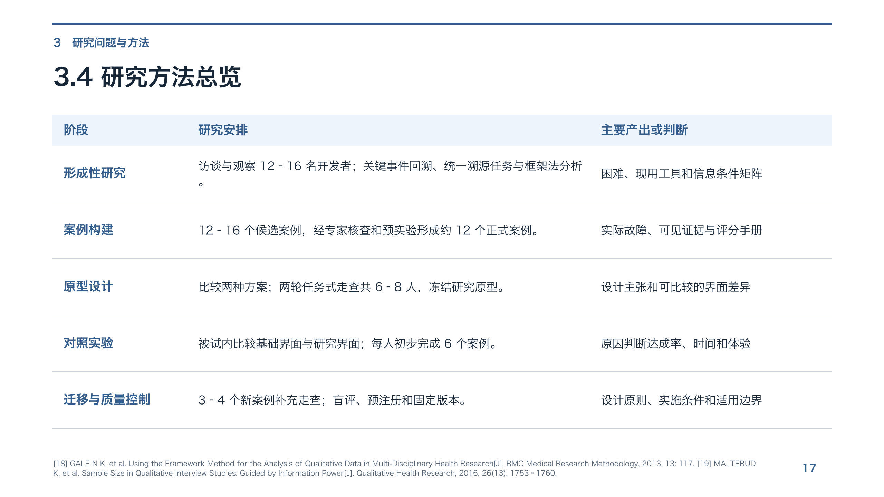
Notes:
[18] GALE N K, et al. Using the Framework Method for the Analysis of Qualitative Data in Multi-Disciplinary Health Research[J]. BMC Medical Research Methodology, 2013, 13: 117. [19] MALTERUD K, et al. Sample Size in Qualitative Interview Studies: Guided by Information Power[J]. Qualitative Health Research, 2016, 26(13): 1753–1760.

Slide 18
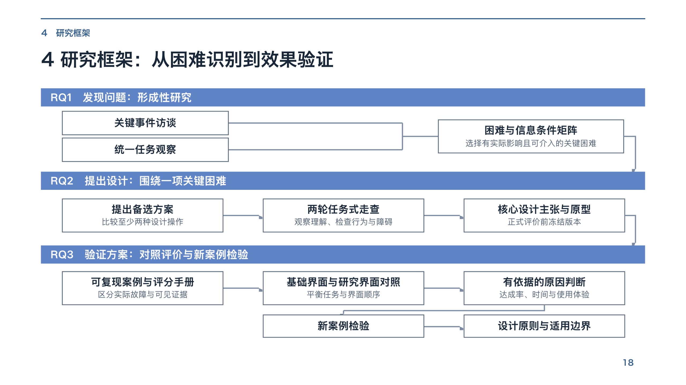
Notes:
4 研究框架：从困难识别到效果验证

Slide 19
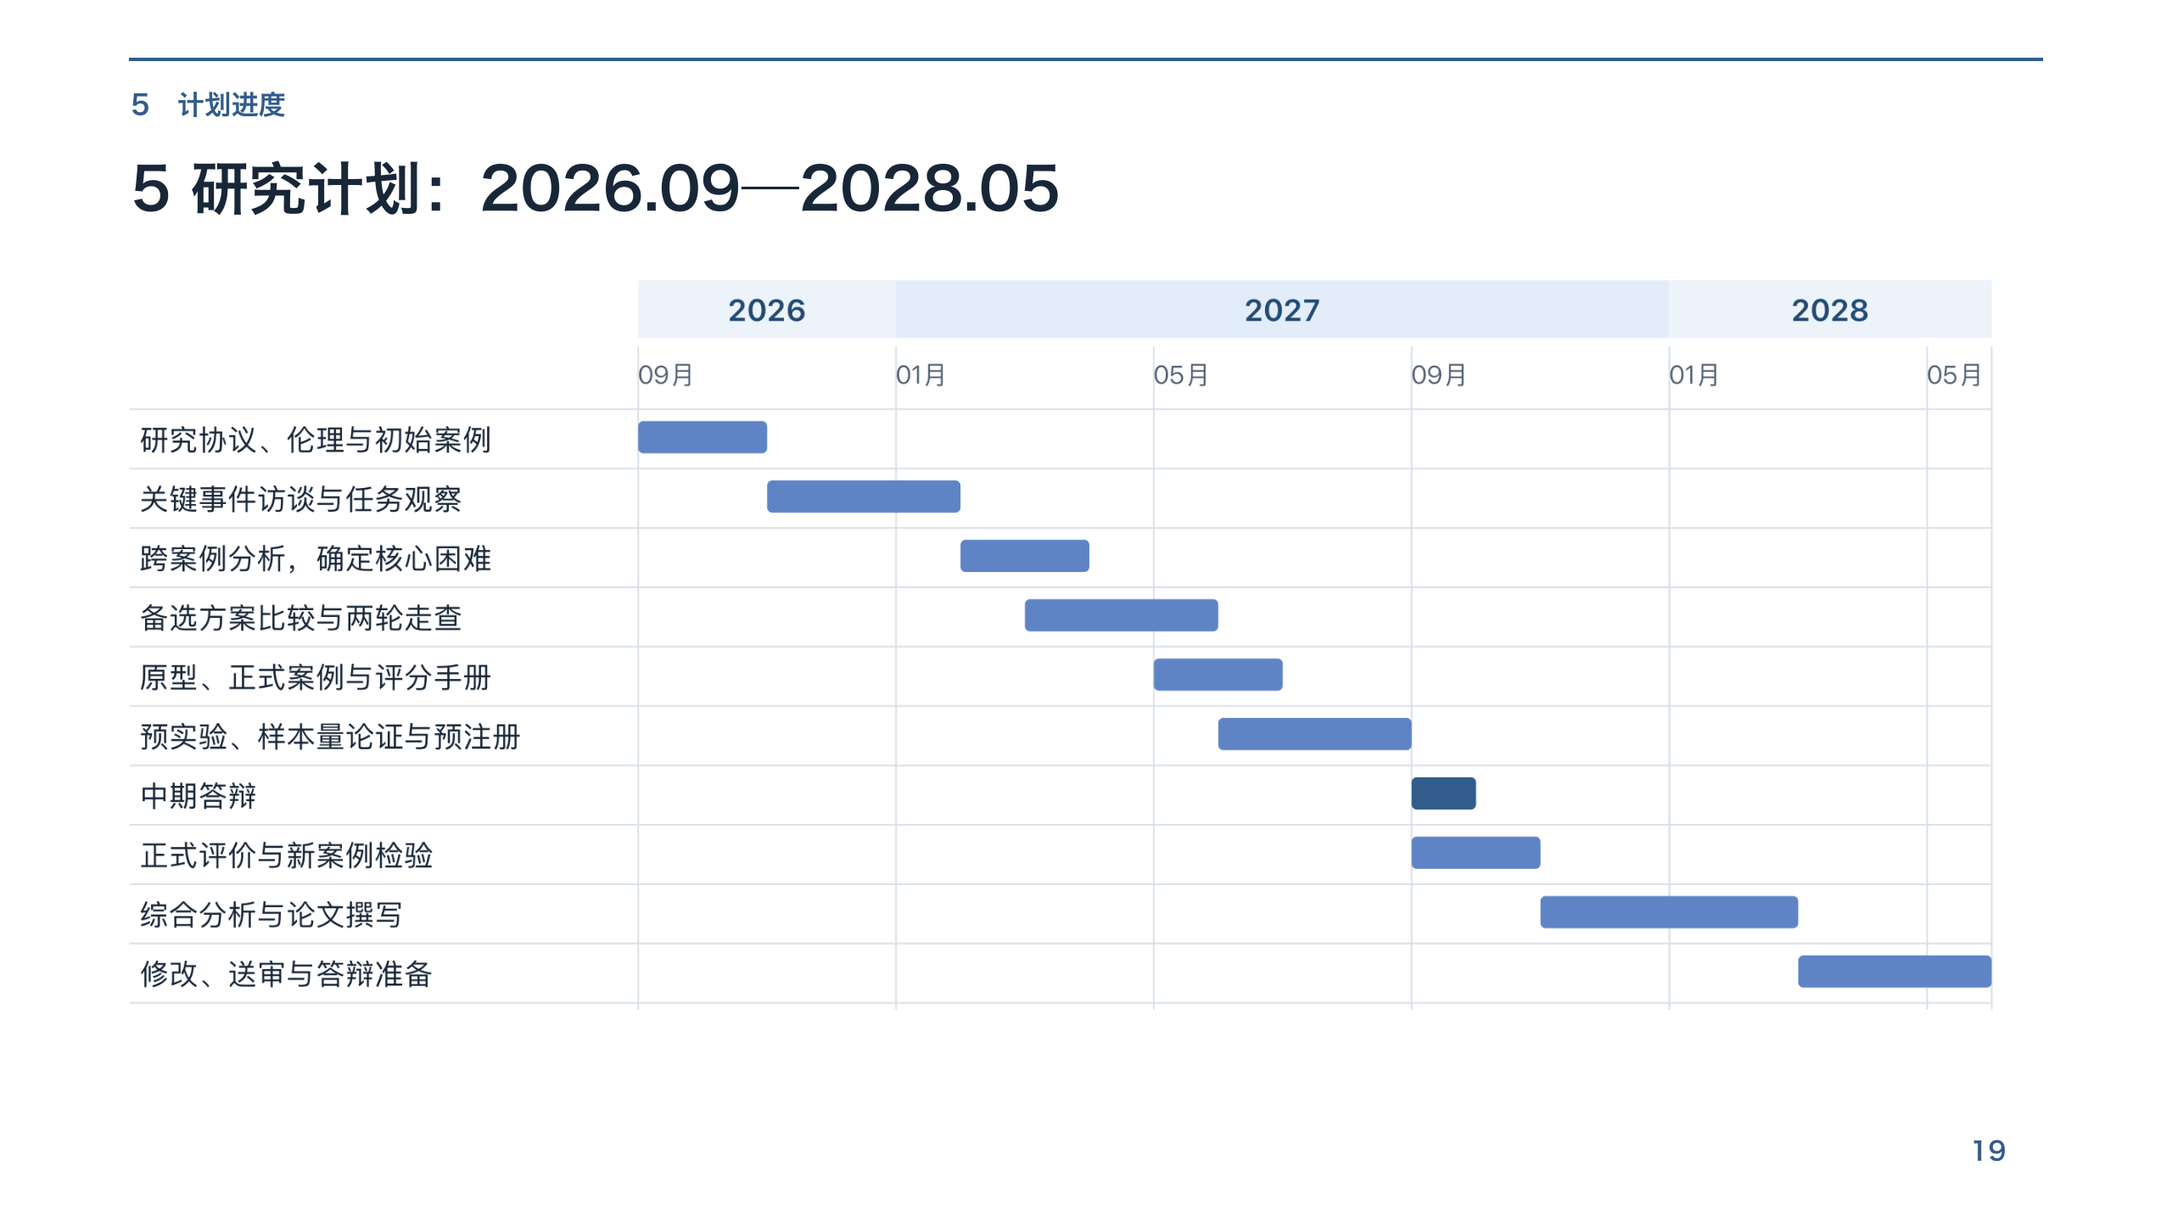
Notes:
5 研究计划：2026.09—2028.05

Slide 20

Notes:
感谢聆听

