Slide 1
Digital Image Processing
Introduction

Slide 2
“One picture is worth more than ten thousand words”
Anonymous

Slide 3
Prerequisites
  Signals and systems
  Matlab

Slide 4
  R. Gonzalez, R. Woods. Digital Ιmage Processing, Prentice Hall, 2008.
  A. Jain. Fundamentals of Digital Image Processing, Prentice Hall, 1988.
  J. Lim, Two Dimensional Signal and Image Processing, Prentice Hall, 1989.
  Chanda and Majumder, Digital Image Processing and Analysis, PHI

Slide 5
This lecture will cover:
  What is a digital image?
  What is digital image processing?
  Fundamental staps in digital image processing
  Application of digital image processing
  Different components of digital image processing

Slide 6

What is a Digital Image?
A digital image is a representation of a two-dimensional image as a finite set of digital values, called picture elements or pixels
Notes:
Real world is continuous – an image is simply a digital approximation of this.

Slide 7

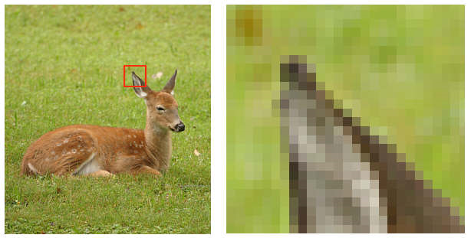
What is a Digital Image? (contd..)
Pixel values typically represent gray levels, colours, heights, opacities etc
Remember digitization implies that a digital image is an approximation of a real scene
1 pixel

Slide 8

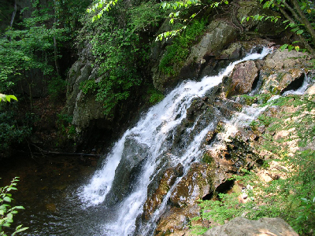
What is a Digital Image? (contd..)
Types of digital image:
  Binary image ( 1 bit)
  Gray-scale image (8 bits)
  Color image (Red, Green, Blue component (24bits))

Slide 9
What is a Digital Image Processing?
Digital image processing focuses on two major tasks
  Improvement of pictorial information for human interpretation
  Processing of image data for storage, transmission and representation for autonomous machine perception

Slide 10
What is a Digital Image Processing?
The continuum from image processing to computer vision can be broken up into low-, mid- and high-level processes
Low Level Process
Mid Level Process
High Level Process
Input: Image
Output: Image
Examples: Noise removal, image sharpening
Input: Image
Output: Attributes
Examples: Object recognition, segmentation
Input: Attributes Output: Understanding
Examples: Scene understanding, autonomous navigation
In this course we will stop here
Notes:
Give the analogy of the character recognition system.
Low Level: Cleaning up the image of some text
Mid level: Segmenting the text from the background and recognising individual characters
High level: Understanding what the text says

Slide 11
Fundamental Steps in Digital Image Processing
Image Restoration
Morphological Processing
Image Enhancement
Segmentation
Image Acquisition
Representation & Description
Object Recognition
Problem Domain
Colour Image Processing
Image Compression

Slide 12
Image Acquisition
Image Restoration
Morphological Processing
Image Enhancement
Segmentation
Image Acquisition
Representation & Description
Object Recognition
Problem Domain
Colour Image Processing
Image Compression

Slide 13

Image Enhancement
Image Restoration
Morphological Processing
Image Enhancement
Segmentation
Image Acquisition
Representation & Description
Object Recognition
Problem Domain
Colour Image Processing
Image Compression

Slide 14
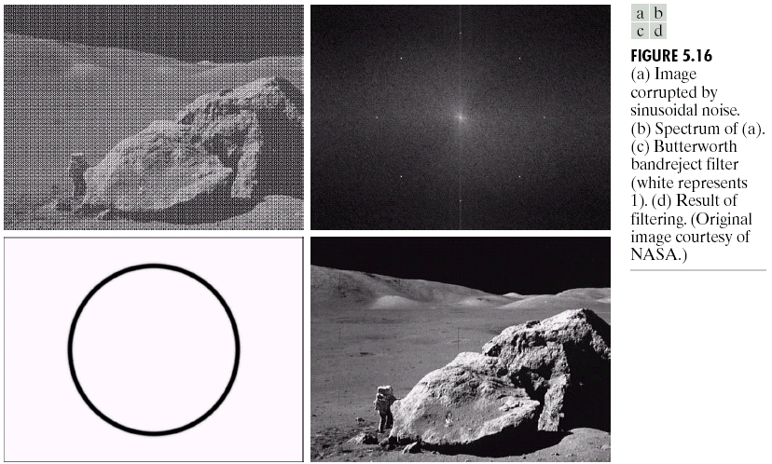
Image Restoration
Image Restoration
Morphological Processing
Image Enhancement
Segmentation
Image Acquisition
Representation & Description
Object Recognition
Problem Domain
Colour Image Processing
Image Compression

Slide 15
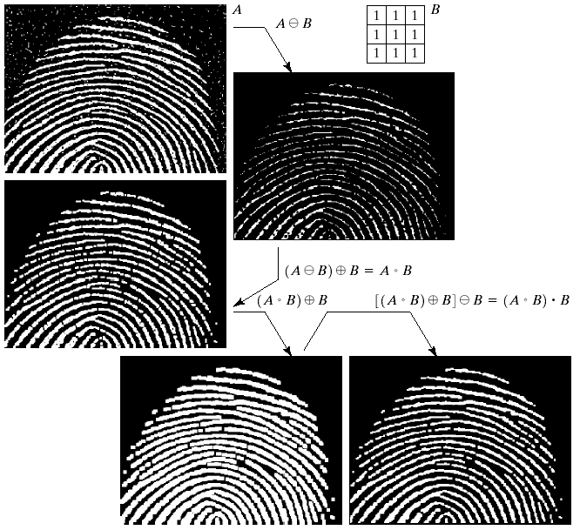
Morphological Processing
Image Restoration
Morphological Processing
Image Enhancement
Segmentation
Image Acquisition
Representation & Description
Object Recognition
Problem Domain
Colour Image Processing
Image Compression

Slide 16
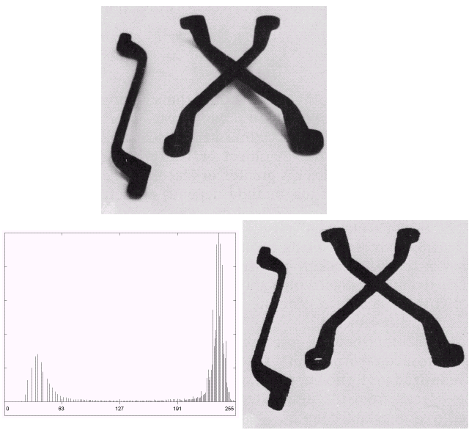
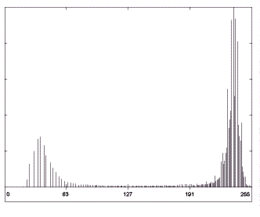
Segmentation
Image Restoration
Morphological Processing
Image Enhancement
Segmentation
Image Acquisition
Representation & Description
Object Recognition
Problem Domain
Colour Image Processing
Image Compression

Slide 17
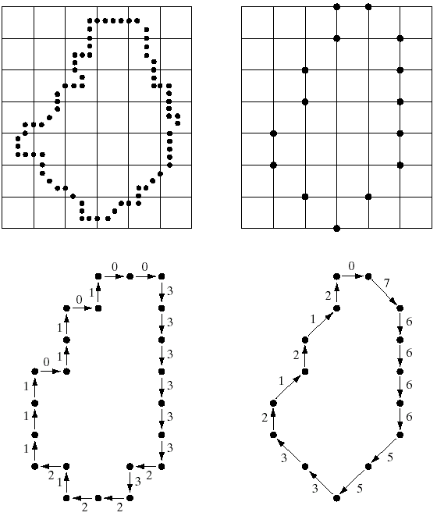
Object Recognition
Image Restoration
Morphological Processing
Image Enhancement
Segmentation
Image Acquisition
Representation & Description
Object Recognition
Problem Domain
Colour Image Processing
Image Compression

Slide 18
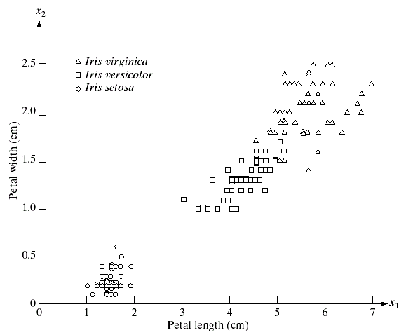
Representation & Description
Image Restoration
Morphological Processing
Image Enhancement
Segmentation
Image Acquisition
Representation & Description
Object Recognition
Problem Domain
Colour Image Processing
Image Compression

Slide 19
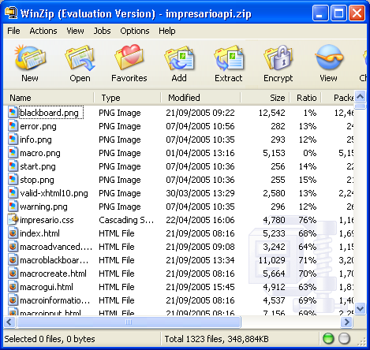
Image Compression
Image Restoration
Morphological Processing
Image Enhancement
Segmentation
Image Acquisition
Representation & Description
Object Recognition
Problem Domain
Colour Image Processing
Image Compression

Slide 20
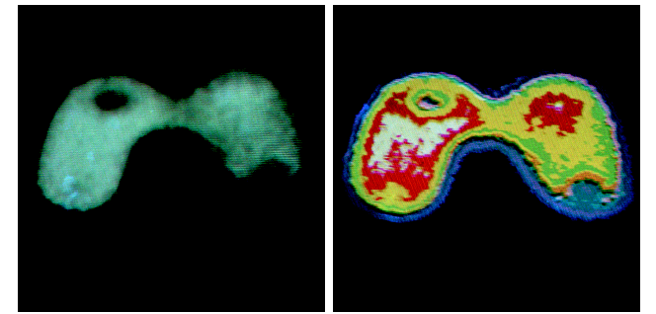
Colour Image Processing
Image Restoration
Morphological Processing
Image Enhancement
Segmentation
Image Acquisition
Representation & Description
Object Recognition
Problem Domain
Colour Image Processing
Image Compression

Slide 21
Applications
&
Research Topics

Slide 22
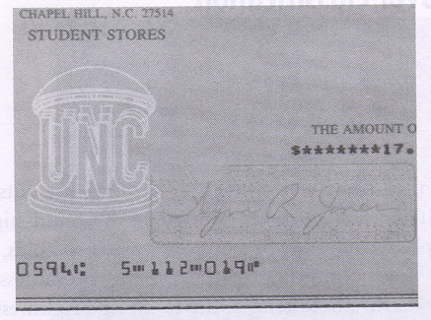
Document Handling

Slide 23

Signature Varification

Slide 24
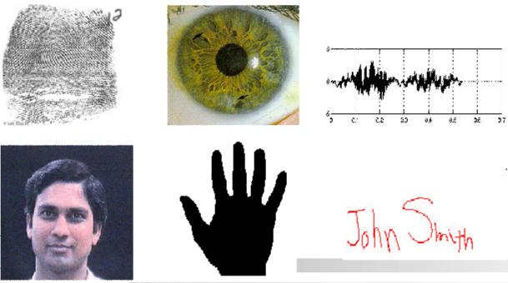
Biometrics

Slide 25
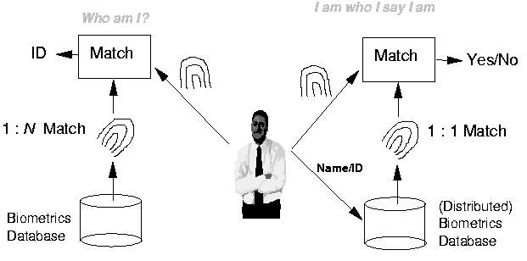
Fingerprint Verification/Identification

Slide 26

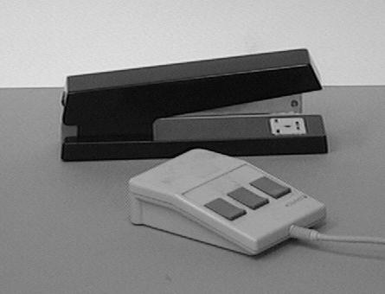
Object Recognition

Slide 27
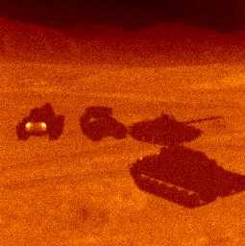
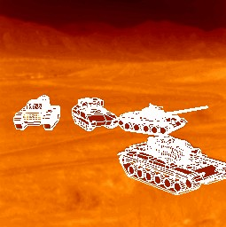
Target Recognition
Department of Defense (Army, Airforce, Navy)

Slide 28
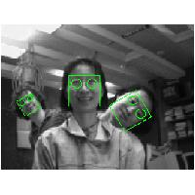
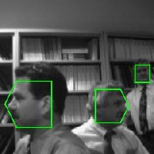
Face Detection

Slide 29
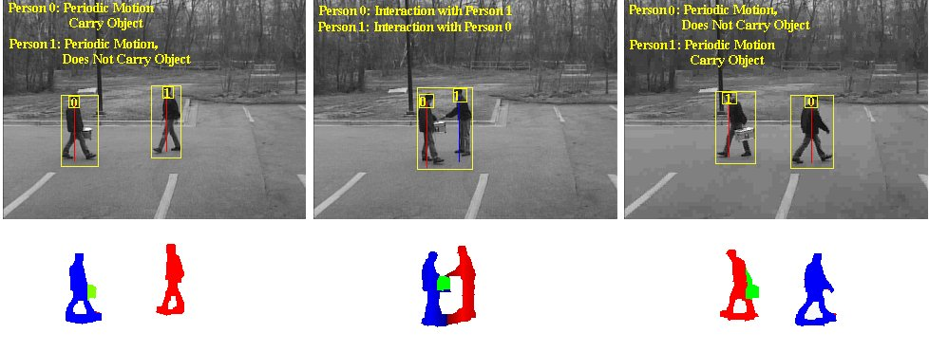
Human Activity Recognition

Slide 30
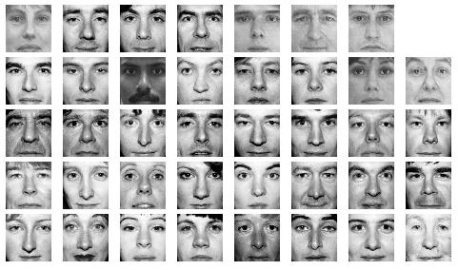
Face Recognition

Slide 31
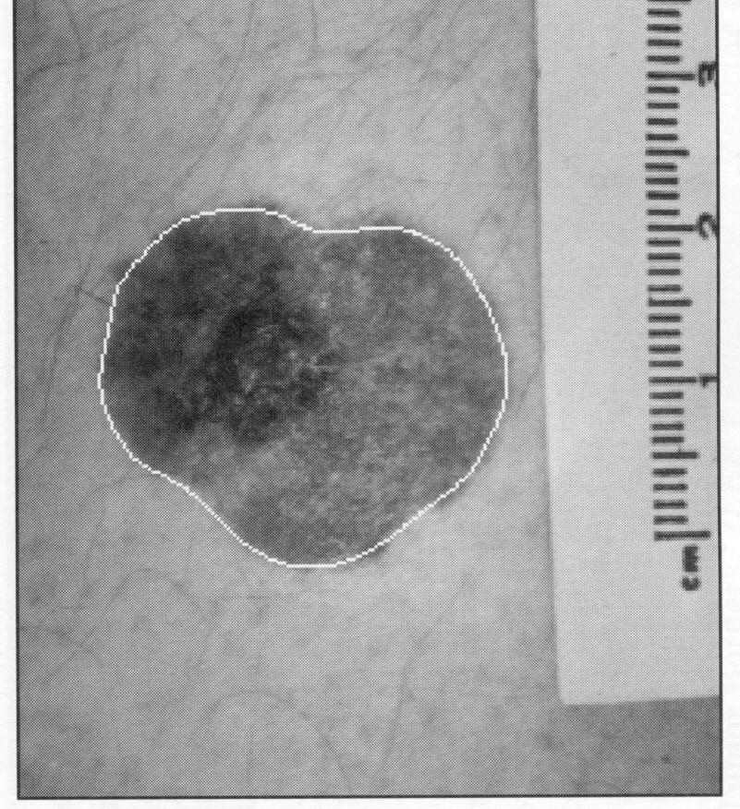
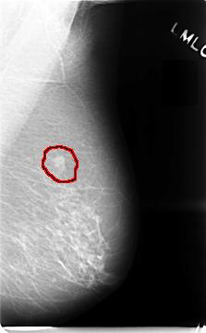
Medical Applications
skin cancer breast cancer

Slide 32
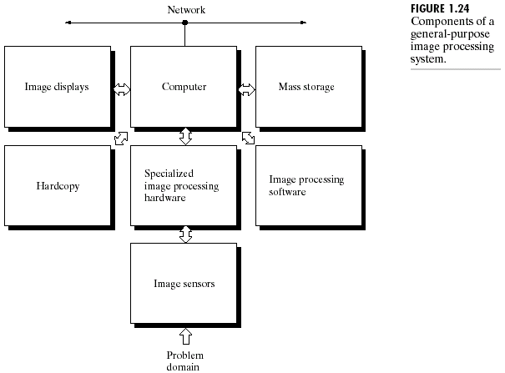
Components of Image Processing

Slide 33
Summary
We have looked at:
  What is a digital image?
  What is digital image processing?
  Fundamental steps in digital image processing
  Application of digital image processing
  Different components of digital image processing
  Important: Acquire some experience with Matlab.

