Slide 1
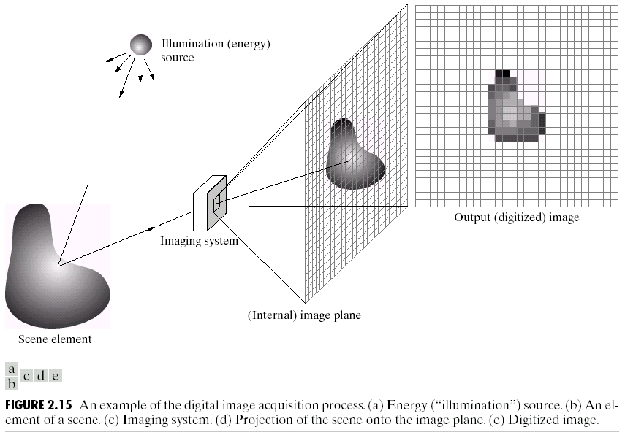
Image Acquisition Process

Slide 2
What is Digital Image Processing?
Digital Image
— a two-dimensional function
x and y are spatial coordinates
The amplitude of f is called intensity or gray level at the point (x, y)
Digital Image Processing
— process digital images by means of computer, it covers low-, mid-, and high-level processes
low-level: inputs and outputs are images
mid-level: outputs are attributes extracted from input images
high-level: an ensemble of recognition of individual objects
Pixel
— the elements of a digital image

Slide 3
A Simple Image Formation Model

Slide 4
Some Typical Ranges of Reflectance
Reflectance
0.01 for black velvet
0.65 for stainless steel
0.80 for flat-white wall paint
0.90 for silver-plated metal
0.93 for snow

Slide 5
Image Sampling and Quantization
Digitizing the coordinate values
Digitizing the amplitude values

Slide 6
Image Sampling and Quantization

Slide 7
Representing Digital Images
The representation of an M×N numerical array as

Slide 8
Representing Digital Images
The representation of an M×N numerical array as

Slide 9
Representing Digital Images
The representation of an M×N numerical array in MATLAB

Slide 10
Representing Digital Images
Discrete intensity interval [0, L-1], L=2^{k}
The number b of bits required to store a M × N digitized image
b = M × N × k

Slide 11
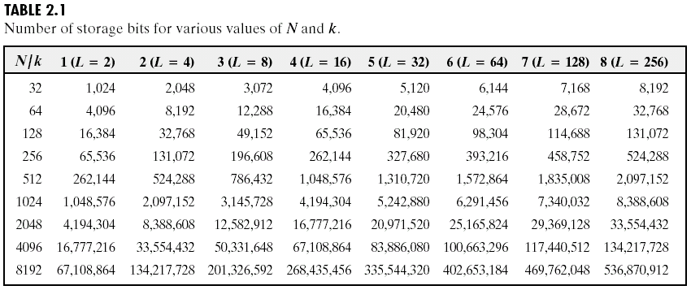
Representing Digital Images

Slide 12
Neighborhood Operations in Images

Slide 13
Basic Relationships Between Pixels
Neighborhood
Adjacency
Connectivity
Paths
Regions and boundaries

Slide 14
Basic Relationships Between Pixels
Neighbors of a pixel p at coordinates (x,y)
4-neighbors of p, denoted by N₄(p):
(x-1, y), (x+1, y), (x,y-1), and (x, y+1).
4 diagonal neighbors of p, denoted by N_{D}(p):
(x-1, y-1), (x+1, y+1), (x+1,y-1), and (x-1, y+1).
8 neighbors of p, denoted N₈(p)
N₈(p) = N₄(p) U N_{D}(p)

Slide 15
Basic Relationships Between Pixels
Adjacency
Let V be the set of intensity values
4-adjacency: Two pixels p and q with values from V are 4-adjacent if q is in the set N₄(p).
8-adjacency: Two pixels p and q with values from V are 8-adjacent if q is in the set N₈(p).

Slide 16
Basic Relationships Between Pixels
Adjacency
Let V be the set of intensity values
m-adjacency: Two pixels p and q with values from V are m-adjacent if
(i) q is in the set N₄(p), or
(ii) q is in the set N_{D}(p) and the set N₄(p) ∩ N₄(q) has no pixels whose values are from V.

Slide 17
Basic Relationships Between Pixels
Path
A (digital) path (or curve) from pixel p with coordinates (x₀, y₀) to pixel q with coordinates (x_{n}, y_{n}) is a sequence of distinct pixels with coordinates
(x₀, y₀), (x₁, y₁), …, (x_{n}, y_{n})
Where (x_{i}, y_{i}) and (x_{i-1}, y_{i-1}) are adjacent for 1 ≤ i ≤ n.
Here n is the length of the path.
If (x₀, y₀) = (x_{n}, y_{n}), the path is closed path.
We can define 4-, 8-, and m-paths based on the type of adjacency used.

Slide 18
Examples: Adjacency and Path
V = {1, 2}
0 1 1 0 1 1 0 1 1
0 2 0 0 2 0 0 2 0
0 0 1 0 0 1 0 0 1

Slide 19
Examples: Adjacency and Path
V = {1, 2}
0 1 1 0 1 1 0 1 1
0 2 0 0 2 0 0 2 0
0 0 1 0 0 1 0 0 1
8-adjacent

Slide 20
Examples: Adjacency and Path
V = {1, 2}
0 1 1 0 1 1 0 1 1
0 2 0 0 2 0 0 2 0
0 0 1 0 0 1 0 0 1
8-adjacent
m-adjacent

Slide 21
Examples: Adjacency and Path
V = {1, 2}
01,1 11,2 11,3 0 1 1 0 1 1
02,1 22,2 02,3 0 2 0 0 2 0
03,1 03,2 13,3 0 0 1 0 0 1
8-adjacent
m-adjacent
The 8-path from (1,3) to (3,3):
(1,3), (1,2), (2,2), (3,3)
(1,3), (2,2), (3,3)
The m-path from (1,3) to (3,3):
(1,3), (1,2), (2,2), (3,3)

Slide 22
Basic Relationships Between Pixels
Connected in S
Let S represent a subset of pixels in an image. Two pixels p with coordinates (x₀, y₀) and q with coordinates (x_{n}, y_{n}) are said to be connected in S if there exists a path
(x₀, y₀), (x₁, y₁), …, (x_{n}, y_{n})
Where

Slide 23
Basic Relationships Between Pixels
Let S represent a subset of pixels in an image
For every pixel p in S, the set of pixels in S that are connected to p is called a connected component of S.
If S has only one connected component, then S is called Connected Set.
We call R a region of the image if R is a connected set
Two regions, R_{i} and R_{j} are said to be adjacent if their union forms a connected set.
Regions that are not to be adjacent are said to be disjoint.

Slide 24
Question 1
In the following arrangement of pixels, are the two regions (of 1s) adjacent? (if 8-adjacency is used)
1 1 1
1 0 1
0 1 0
0 0 1
1 1 1
1 1 1
Region 1
Region 2

Slide 25
Question 2
In the following arrangement of pixels, are the two parts (of 1s) adjacent? (if 4-adjacency is used)
1 1 1
1 0 1
0 1 0
0 0 1
1 1 1
1 1 1
Part 1
Part 2

Slide 26
In the following arrangement of pixels, the two regions (of 1s) are disjoint (if 4-adjacency is used)
1 1 1
1 0 1
0 1 0
0 0 1
1 1 1
1 1 1
Region 1
Region 2

Slide 27
In the following arrangement of pixels, the two regions (of 1s) are disjoint (if 4-adjacency is used)
1 1 1
1 0 1
0 1 0
0 0 1
1 1 1
1 1 1
foreground
background

Slide 28
Distance Measures
Given pixels p, q and z with coordinates (x, y), (s, t), (u, v) respectively, the distance function D has following properties:
D(p, q) ≥ 0 [D(p, q) = 0, iff p = q]
D(p, q) = D(q, p)
D(p, z) ≤ D(p, q) + D(q, z)

Slide 29
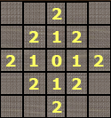
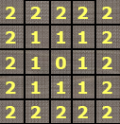
Distance Measures
The following are the different Distance measures:
a. Euclidean Distance :
D_{e}(p, q) = [(x-s)² + (y-t)²]^{1/2}
b. City Block Distance:
D₄(p, q) = |x-s| + |y-t|
c. Chess Board Distance:
D₈(p, q) = max(|x-s|, |y-t|)

Slide 30
Question 5
In the following arrangement of pixels, what’s the value of the chessboard distance between the circled two points?
0 0 0 0 0
0 0 1 1 0
0 1 1 0 0
0 1 0 0 0
0 0 0 0 0
0 0 0 0 0

Slide 31
Question 6
In the following arrangement of pixels, what’s the value of the city-block distance between the circled two points?
0 0 0 0 0
0 0 1 1 0
0 1 1 0 0
0 1 0 0 0
0 0 0 0 0
0 0 0 0 0

