Slide 1
Storage Systems
Operating System Concepts

Slide 2
Disk Structure
Disk drives are addressed as large 1-dimensional arrays of logical blocks, where the logical block is the smallest unit of transfer.
The 1-dimensional array of logical blocks is mapped into the sectors of the disk sequentially.
  Sector 0 is the first sector of the first track on the outermost cylinder.
  Mapping proceeds in order through that track, then the rest of the tracks in that cylinder, and then through the rest of the cylinders from outermost to innermost.
Operating System Concepts

Slide 3
Disk Scheduling
The operating system is responsible for using hardware efficiently — for the disk drives, this means having a fast access time and disk bandwidth.
Access time has two major components
  Seek time is the time for the disk are to move the heads to the cylinder containing the desired sector.
  Rotational latency is the additional time waiting for the disk to rotate the desired sector to the disk head.
Minimize seek time
Seek time ≈ seek distance
Disk bandwidth is the total number of bytes transferred, divided by the total time between the first request for service and the completion of the last transfer.
Operating System Concepts

Slide 4
Disk Scheduling (Cont.)
Several algorithms exist to schedule the servicing of disk I/O requests.
We illustrate them with a request queue (0-199).
98, 183, 37, 122, 14, 124, 65, 67
Head pointer 53
Operating System Concepts

Slide 5

FCFS
Illustration shows total head movement of 640 cylinders.
Operating System Concepts

Slide 6
SSTF
Selects the request with the minimum seek time from the current head position.
SSTF scheduling is a form of SJF scheduling; may cause starvation of some requests.
Illustration shows total head movement of 236 cylinders.
Operating System Concepts

Slide 7

SSTF (Cont.)
Operating System Concepts

Slide 8
SCAN
The disk arm starts at one end of the disk, and moves toward the other end, servicing requests until it gets to the other end of the disk, where the head movement is reversed and servicing continues.
Sometimes called the elevator algorithm.
Illustration shows total head movement of 208 cylinders.
Operating System Concepts

Slide 9
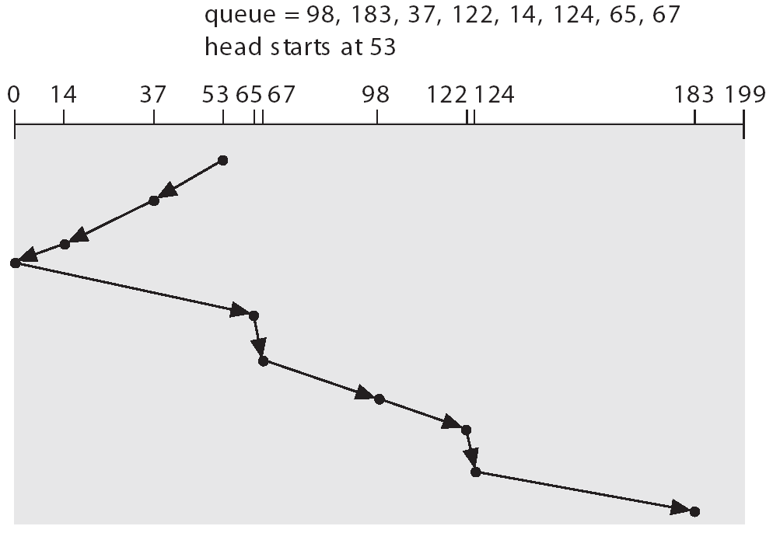
SCAN (Cont.)
Operating System Concepts

Slide 10
C-SCAN
Provides a more uniform wait time than SCAN.
The head moves from one end of the disk to the other. servicing requests as it goes. When it reaches the other end, however, it immediately returns to the beginning of the disk, without servicing any requests on the return trip.
Treats the cylinders as a circular list that wraps around from the last cylinder to the first one.
Operating System Concepts

Slide 11

C-SCAN (Cont.)
Operating System Concepts

Slide 12
C-LOOK
Version of C-SCAN
Arm only goes as far as the last request in each direction, then reverses direction immediately, without first going all the way to the end of the disk.
Operating System Concepts

Slide 13

C-LOOK (Cont.)
Operating System Concepts

Slide 14
Selecting a Disk-Scheduling Algorithm
SSTF is common and has a natural appeal
SCAN and C-SCAN perform better for systems that place a heavy load on the disk.
Performance depends on the number and types of requests.
Requests for disk service can be influenced by the file-allocation method.
The disk-scheduling algorithm should be written as a separate module of the operating system, allowing it to be replaced with a different algorithm if necessary.
Either SSTF or LOOK is a reasonable choice for the default algorithm.
Operating System Concepts

Slide 15
Disk Management
Low-level formatting, or physical formatting — Dividing a disk into sectors that the disk controller can read and write.
To use a disk to hold files, the operating system still needs to record its own data structures on the disk.
  Partition the disk into one or more groups of cylinders.
  Logical formatting or “making a file system”.
Boot block initializes system.
  The bootstrap is stored in ROM.
  Bootstrap loader program.
Methods such as sector sparing used to handle bad blocks.
Operating System Concepts

Slide 16

MS-DOS Disk Layout
Operating System Concepts

Slide 17
Swap-Space Management
Swap-space — Virtual memory uses disk space as an extension of main memory.
Swap-space can be carved out of the normal file system,or, more commonly, it can be in a separate disk partition.
Operating System Concepts

Slide 18
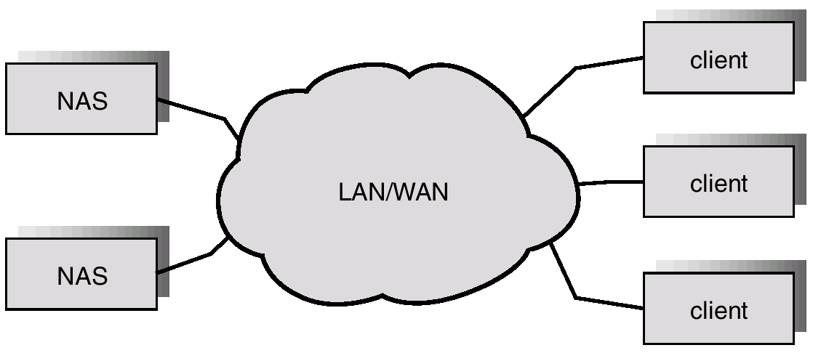
Network-Attached Storage
Operating System Concepts

Slide 19
Speed
Two aspects of speed in tertiary storage are bandwidth and latency.
Bandwidth is measured in bytes per second.
  Sustained bandwidth – average data rate during a large transfer; # of bytes/transfer time.
  Data rate when the data stream is actually flowing.
  Effective bandwidth – average over the entire I/O time, including seek or locate, and cartridge switching.
  Drive’s overall data rate.
Operating System Concepts

Slide 20
Speed (Cont.)
Access latency – amount of time needed to locate data.
  Access time for a disk – move the arm to the selected cylinder and wait for the rotational latency; < 35 milliseconds.
  Access on tape requires winding the tape reels until the selected block reaches the tape head; tens or hundreds of seconds.
  Generally say that random access within a tape cartridge is about a thousand times slower than random access on disk.
The low cost of tertiary storage is a result of having many cheap cartridges share a few expensive drives.
A removable library is best devoted to the storage of infrequently used data, because the library can only satisfy a relatively small number of I/O requests per hour.
Operating System Concepts

