Slide 1
Processes Synchronization
2.1 Processes
2.2 Inter process communication
2.3 Classical IPC problems

Slide 2

Interprocess Communication
Race Conditions
Two processes want to access shared memory at same time

Slide 3
Critical Regions (1)
Four conditions to provide mutual exclusion
No two processes simultaneously in critical region
No assumptions made about speeds or numbers of CPUs
No process running outside its critical region may block another process
No process must wait forever to enter its critical region

Slide 4

Critical Regions (2)
Mutual exclusion using critical regions

Slide 5
Cooperating Processes
Independent process cannot affect or be affected by the execution of another process.
Cooperating process can affect or be affected by the execution of another process
Advantages of process cooperation
  Information sharing
  Computation speed-up
  Modularity
  Convenience

Slide 6
Producer-Consumer Problem
Paradigm for cooperating processes, producer process produces information that is consumed by a consumer process.
  unbounded-buffer places no practical limit on the size of the buffer.
  bounded-buffer assumes that there is a fixed buffer size.

Slide 7
Bounded-Buffer – Shared-Memory Solution
      Producer stores
      Consumer consumes
54 | 83 | 42
0
N-1
Buffer[count]<-item
Count++
Item<-Buffer{count}
Count- -

Slide 8
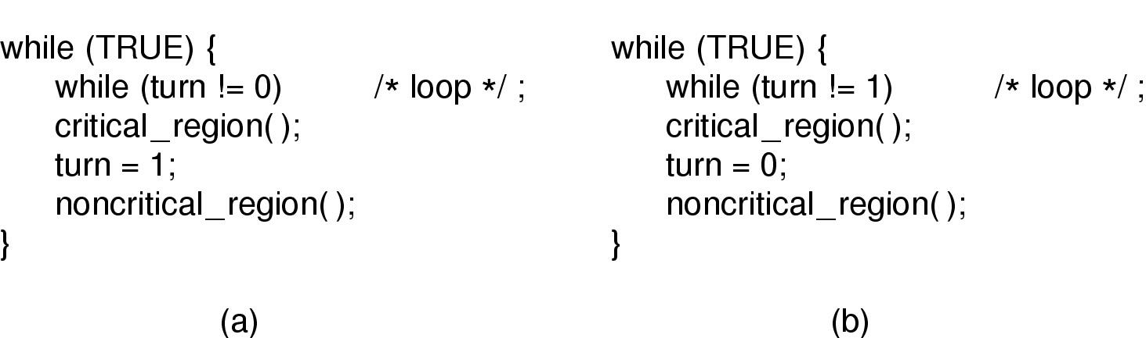
Mutual Exclusion with Busy Waiting (1)
Proposed solution to critical region problem
  (a) Process 0. (b) Process 1.

Slide 9
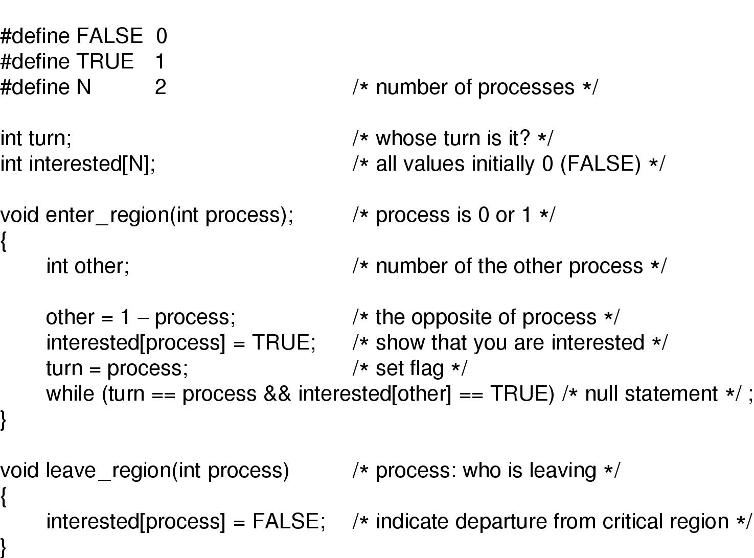
Mutual Exclusion with Busy Waiting (2)
Peterson's solution for achieving mutual exclusion

Slide 10
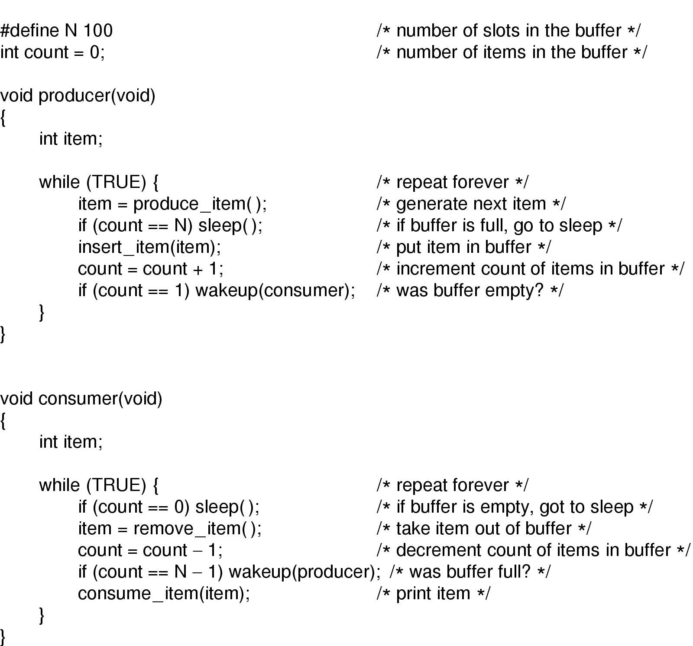
Sleep and Wakeup
Producer-consumer problem with fatal race condition

Slide 11
Semaphore
Semaphore is a variable or abstract data type used to control access to a common resource by multiple processes.
A semaphore is simply a variable.
This variable is used to solve critical section problems and to achieve process
A semaphore is a plain variable that is changed (for example, incremented or decremented, or toggled) depending on programmer-defined conditions.

Slide 12
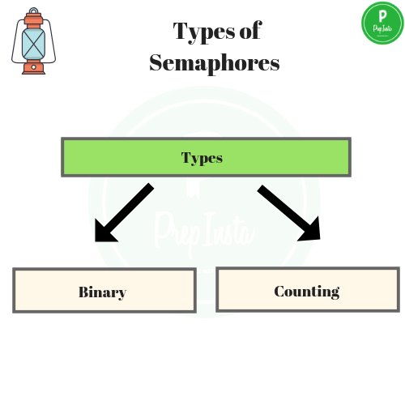

Slide 13
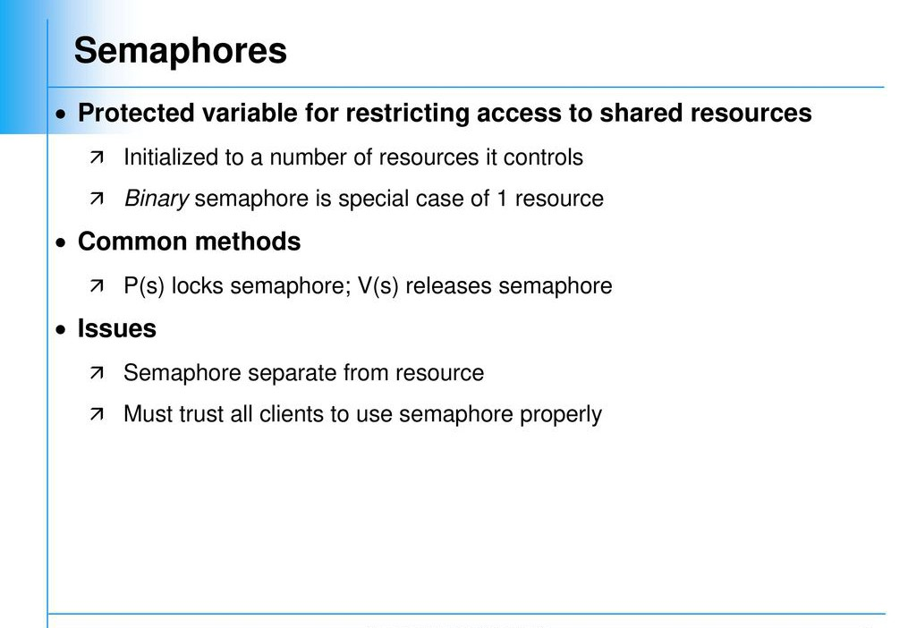

Slide 14
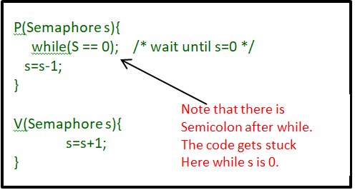

Slide 15
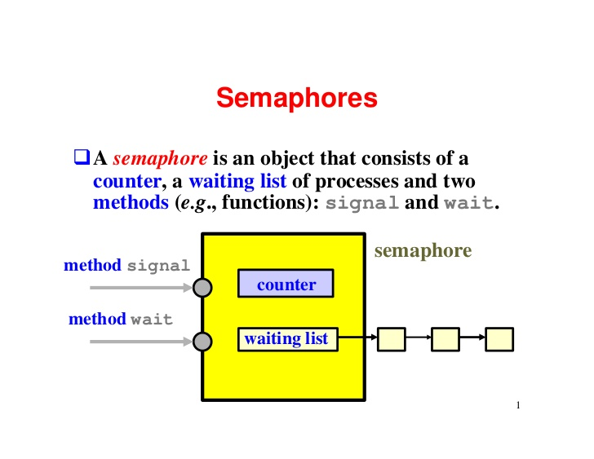

Slide 16
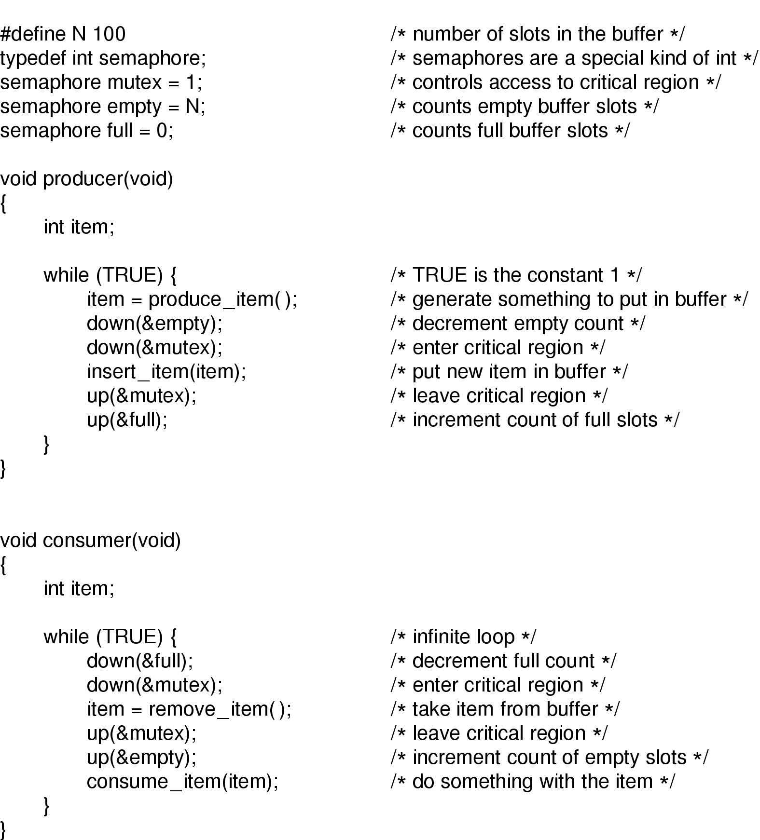
Semaphores
The producer-consumer problem using semaphores

Slide 17
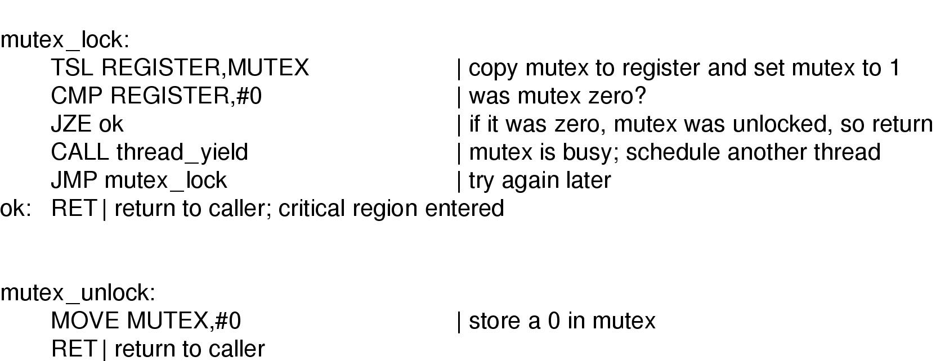
Mutexes
Implementation of mutex_lock and mutex_unlock

Slide 18
Monitor
A monitor is a synchronization construct that allows processes to have both mutual exclusion and the ability to wait (block) for a certain condition to become false.
Monitors also have a mechanism for signaling other processes that their condition has been met.
A monitor consists of a lock object and condition variables.
A condition variable essentially is a container that are waiting for a certain condition.

Slide 19
Monitor Example
monitor class Account {
private int balance := 0
invariant balance >= 0
public method boolean withdraw(int amount)
precondition amount >= 0
{
if balance < amount {
return false
} else {
balance := balance - amount
return true
}
}
public method deposit(int amount)
precondition amount >= 0
{
balance := balance + amount
}
}

Slide 20
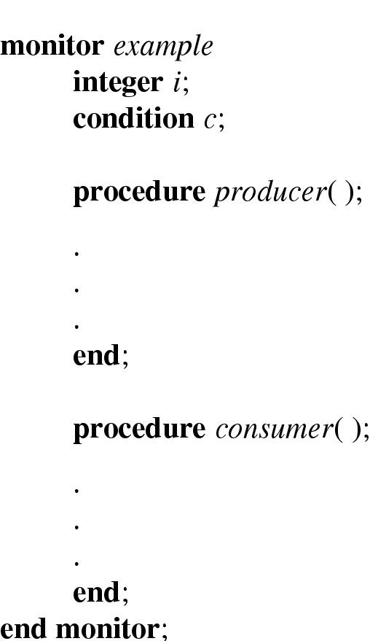
Monitors (1)
Example of a monitor

Slide 21
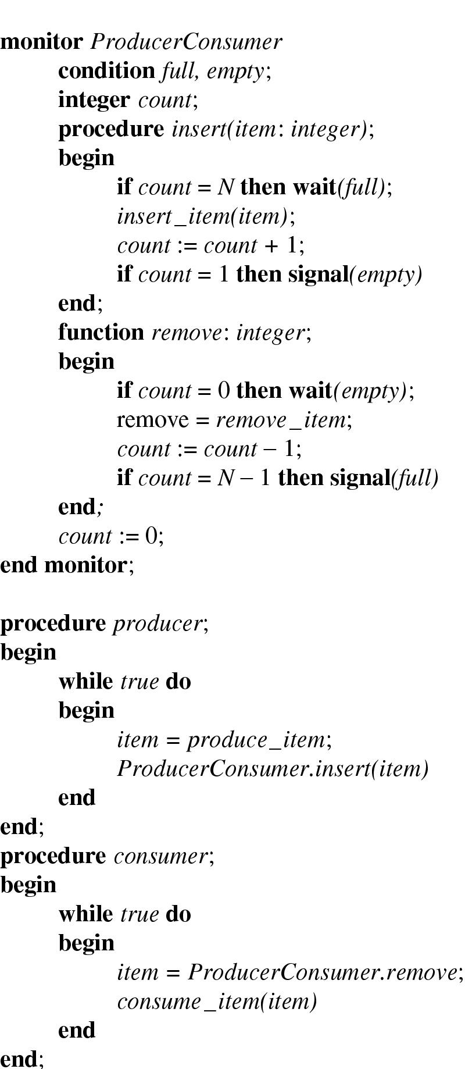
Monitors (2)
Outline of producer-consumer problem with monitors
  only one monitor procedure active at one time
  buffer has N slots

Slide 22
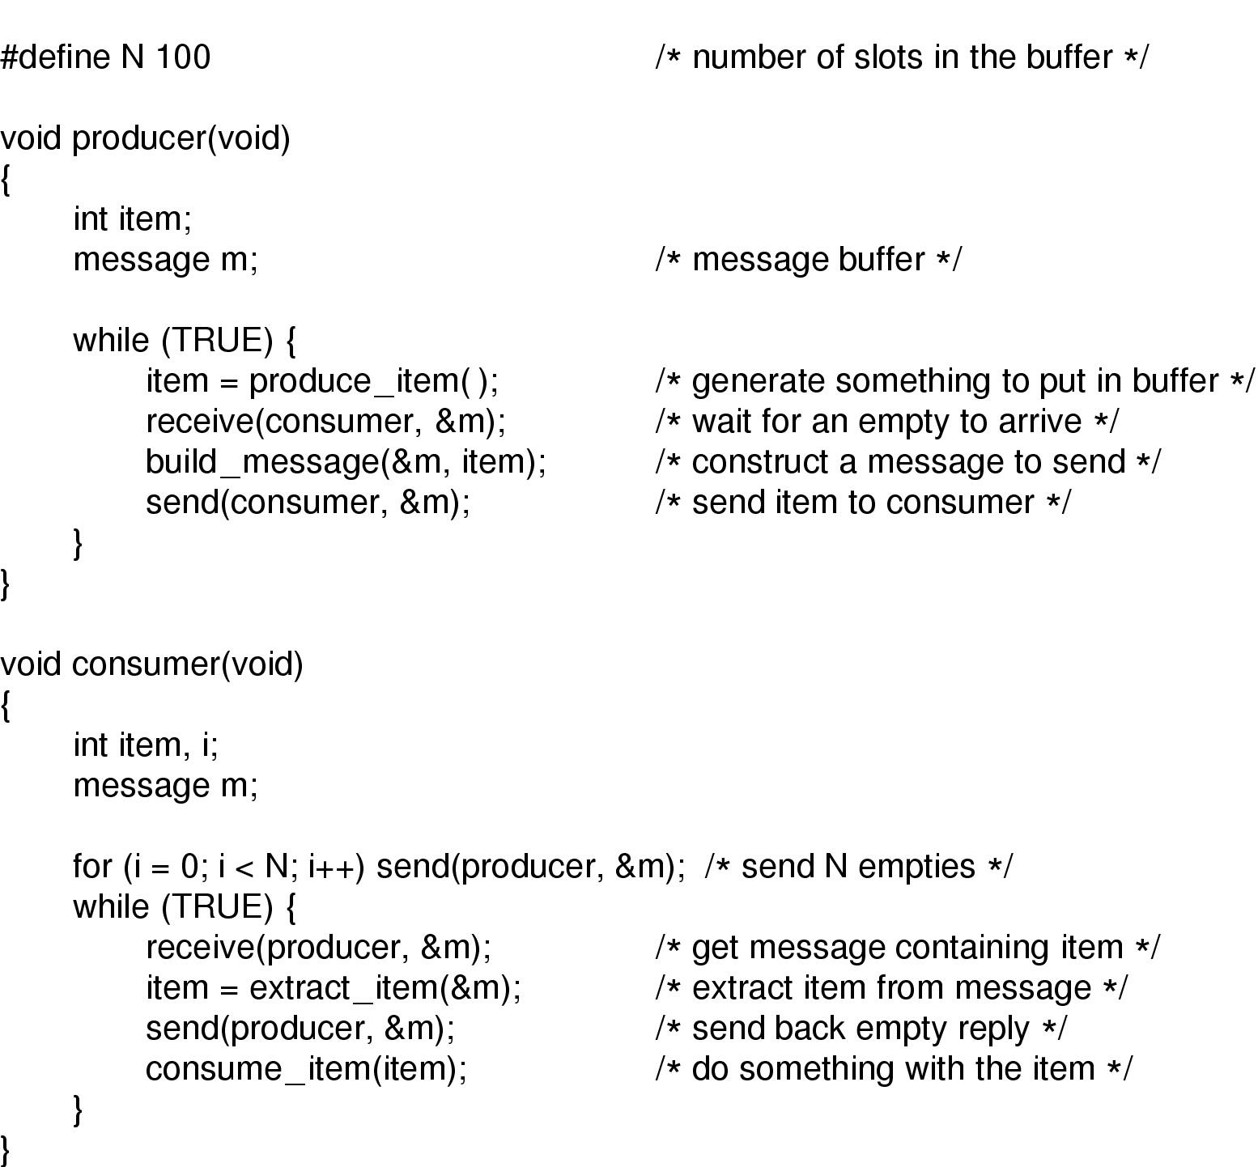
Message Passing
The producer-consumer problem with N messages

Slide 23

Dining Philosophers (1)
Philosophers eat/think
Eating needs 2 forks
Pick one fork at a time
How to prevent deadlock

Slide 24
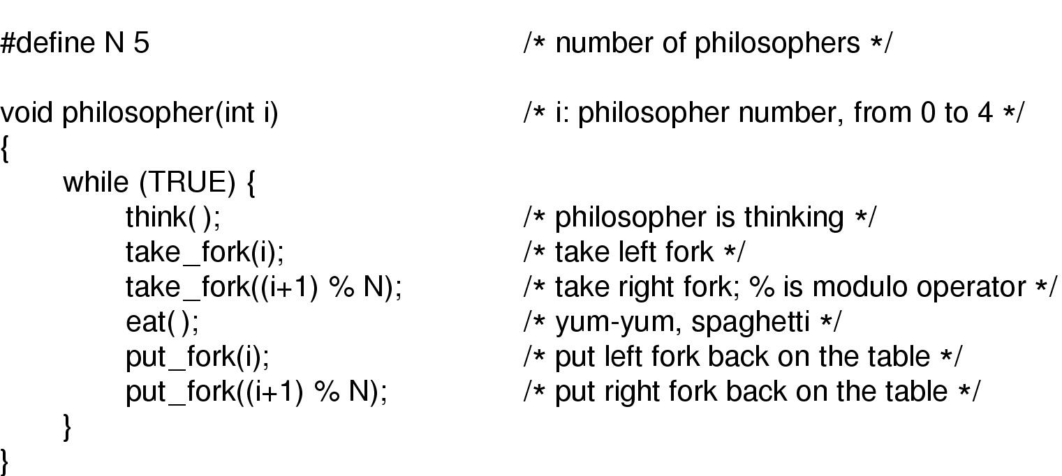
Dining Philosophers (2)
A nonsolution to the dining philosophers problem

Slide 25
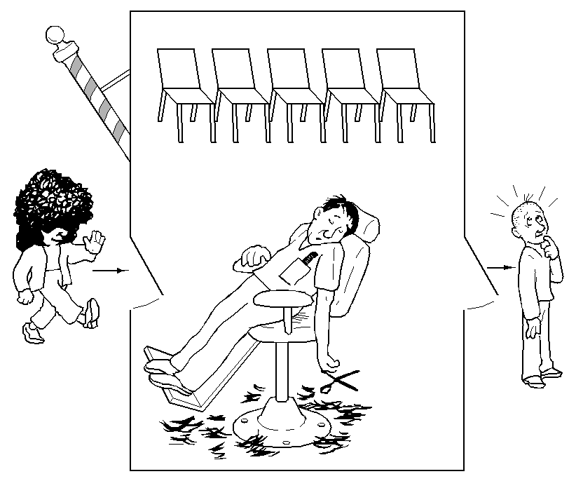
The Sleeping Barber Problem (1)

