Slide 1
Virtual Memory
Operating System Concepts

Slide 2
Background
Virtual memory – separation of user logical memory from physical memory.
  Only part of the program needs to be in memory for execution.
  Logical address space can therefore be much larger than physical address space.
  Allows address spaces to be shared by several processes.
  Allows for more efficient process creation.
Virtual memory can be implemented via:
  Demand paging
  Demand segmentation
Operating System Concepts

Slide 3
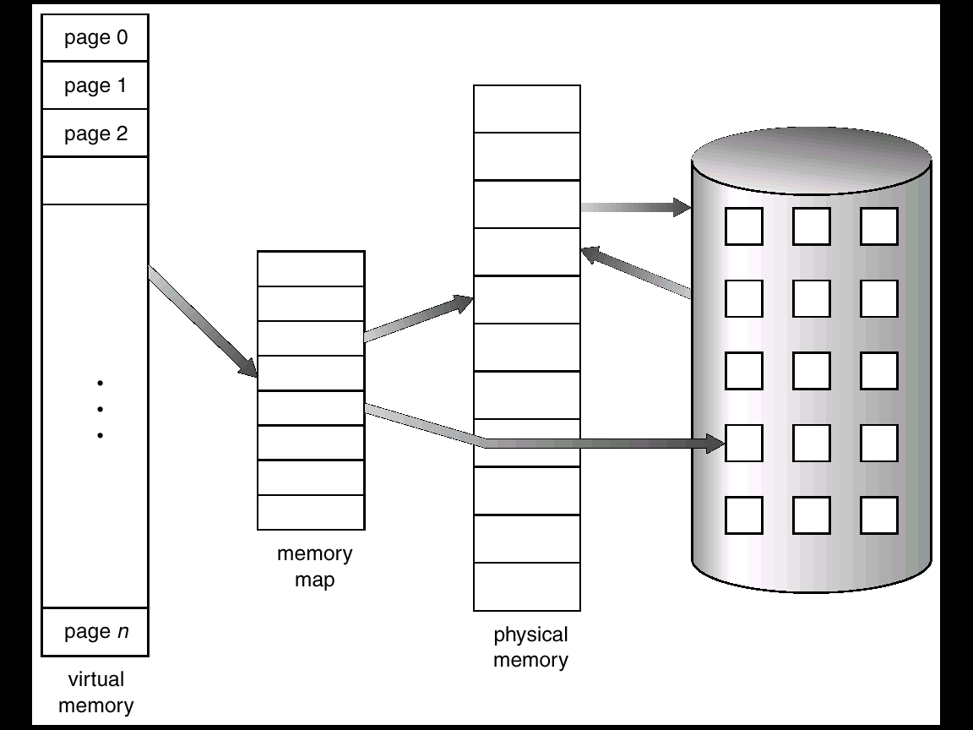
Virtual Memory That is Larger Than Physical Memory
Operating System Concepts

Slide 4
Demand Paging
Bring a page into memory only when it is needed.
  Less I/O needed
  Less memory needed
  Faster response
  More users
Page is needed ⇒ reference to it
  invalid reference ⇒ abort
  not-in-memory ⇒ bring to memory
Operating System Concepts

Slide 5
Valid-Invalid Bit
With each page table entry a valid–invalid bit is associated
(1 ⇒ in-memory, 0 ⇒ not-in-memory)
Initially valid–invalid but is set to 0 on all entries.
Example of a page table snapshot.
During address translation, if valid–invalid bit in page table entry is 0 ⇒ page fault.
Frame #
valid-invalid bit
1
1
1
1
0

0
0
page table
Operating System Concepts

Slide 6
Page Fault
If there is ever a reference to a page, first reference will trap to
OS ⇒ page fault
OS looks at another table to decide:
  Invalid reference ⇒ abort.
  Just not in memory.
Get empty frame.
Swap page into frame.
Reset tables, validation bit = 1.
Restart instruction: Least Recently Used
  block move
  auto increment/decrement location
Operating System Concepts

Slide 7
What happens if there is no free frame?
Page replacement – find some page in memory, but not really in use, swap it out.
  algorithm
  performance – want an algorithm which will result in minimum number of page faults.
Same page may be brought into memory several times.
Operating System Concepts

Slide 8
Performance of Demand Paging
Page Fault Rate 0 ≤ p ≤ 1.0
  if p = 0 no page faults
  if p = 1, every reference is a fault
Effective Access Time (EAT)
EAT = (1 – p) x memory access
+ p (page fault overhead
+ [swap page out ]
+ swap page in
+ restart overhead)
Operating System Concepts

Slide 9
Memory-Mapped Files
Memory-mapped file I/O allows file I/O to be treated as routine memory access by mapping a disk block to a page in memory.
A file is initially read using demand paging. A page-sized portion of the file is read from the file system into a physical page. Subsequent reads/writes to/from the file are treated as ordinary memory accesses.
Simplifies file access by treating file I/O through memory rather than read() write() system calls.
Also allows several processes to map the same file allowing the pages in memory to be shared.
Operating System Concepts

Slide 10
Page Replacement
Prevent over-allocation of memory by modifying page-fault service routine to include page replacement.
Use modify (dirty) bit to reduce overhead of page transfers – only modified pages are written to disk.
Page replacement completes separation between logical memory and physical memory – large virtual memory can be provided on a smaller physical memory.
Operating System Concepts

Slide 11
Basic Page Replacement
Find the location of the desired page on disk.
Find a free frame:
- If there is a free frame, use it.
- If there is no free frame, use a page replacement algorithm to select a victim frame.
Read the desired page into the (newly) free frame. Update the page and frame tables.
Restart the process.
Operating System Concepts

Slide 12
Page Replacement Algorithms
Want lowest page-fault rate.
Evaluate algorithm by running it on a particular string of memory references (reference string) and computing the number of page faults on that string.
In all our examples, the reference string is
1, 2, 3, 4, 1, 2, 5, 1, 2, 3, 4, 5.
Operating System Concepts

Slide 13
First-In-First-Out (FIFO) Algorithm
Reference string: 1, 2, 3, 4, 1, 2, 5, 1, 2, 3, 4, 5
3 frames (3 pages can be in memory at a time per process)
4 frames
FIFO Replacement – Belady’s Anomaly
  more frames ⇒ less page faults
1
1
4
5
2
2
1
3
9 page faults
3
3
2
4
1
1
5
4
2
2
1
5
10 page faults
3
3
2
4
4
3
Operating System Concepts

Slide 14
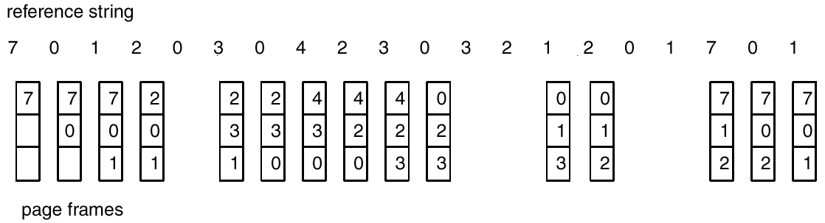
FIFO Page Replacement
Operating System Concepts

Slide 15

FIFO Illustrating Belady’s Anamoly
Operating System Concepts

Slide 16
Optimal Algorithm
Replace page that will not be used for longest period of time.
4 frames example
1, 2, 3, 4, 1, 2, 5, 1, 2, 3, 4, 5
How do you know this?
Used for measuring how well your algorithm performs.
1
4
2
6 page faults
3
4
5
Operating System Concepts

Slide 17
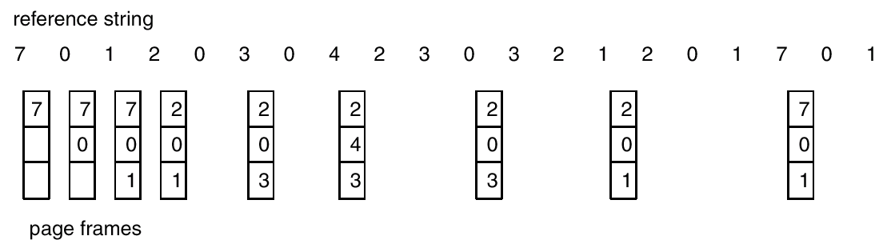
Optimal Page Replacement
Operating System Concepts

Slide 18
Least Recently Used (LRU) Algorithm
Reference string: 1, 2, 3, 4, 1, 2, 5, 1, 2, 3, 4, 5
Counter implementation
  Every page entry has a counter; every time page is referenced through this entry, copy the clock into the counter.
  When a page needs to be changed, look at the counters to determine which are to change.
1
5
2
3
5
4
4
3
Operating System Concepts

Slide 19
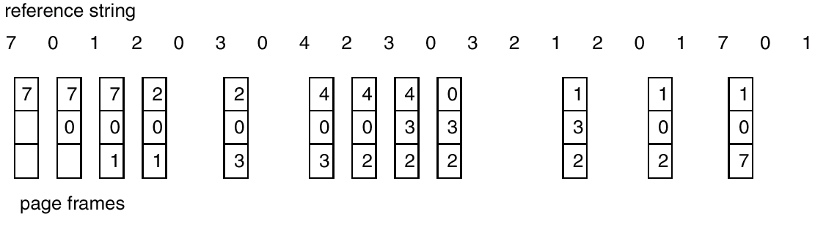
LRU Page Replacement
Operating System Concepts

Slide 20
LRU Algorithm (Cont.)
Stack implementation – keep a stack of page numbers in a double link form:
  Page referenced:
    move it to the top
    requires 6 pointers to be changed
  No search for replacement
Operating System Concepts

Slide 21
LRU Approximation Algorithms
Reference bit
  With each page associate a bit, initially = 0
  When page is referenced bit set to 1.
  Replace the one which is 0 (if one exists). We do not know the order, however.
Second chance
  Need reference bit.
  Clock replacement.
  If page to be replaced (in clock order) has reference bit = 1. then:
    set reference bit 0.
    leave page in memory.
    replace next page (in clock order), subject to same rules.
Operating System Concepts

Slide 22
Counting Algorithms
Keep a counter of the number of references that have been made to each page.
LFU Algorithm: replaces page with smallest count.
MFU Algorithm: based on the argument that the page with the smallest count was probably just brought in and has yet to be used.
Operating System Concepts

Slide 23
Thrashing
If a process does not have “enough” pages, the page-fault rate is very high. This leads to:
  low CPU utilization.
  operating system thinks that it needs to increase the degree of multiprogramming.
  another process added to the system.
Thrashing ≡ a process is busy swapping pages in and out.
Operating System Concepts

Slide 24

Thrashing
Why does paging work?
Locality model
  Process migrates from one locality to another.
  Localities may overlap.
Why does thrashing occur?
Σ size of locality > total memory size
Operating System Concepts

Slide 25
Working-Set Model
Δ ≡ working-set window ≡ a fixed number of page references
Example: 10,000 instruction
WSS_{i} (working set of Process P_{i}) =
total number of pages referenced in the most recent Δ (varies in time)
  if Δ too small will not encompass entire locality.
  if Δ too large will encompass several localities.
  if Δ = ∞ ⇒ will encompass entire program.
D = Σ WSS_{i} ≡ total demand frames
if D > m ⇒ Thrashing
Policy if D > m, then suspend one of the processes.
Operating System Concepts

Slide 26
Other Considerations
Prepaging
Page size selection
  fragmentation
  table size
  I/O overhead
  locality
Operating System Concepts

