Slide 1
Introduction to Pattern Recognition
- Slides compiled by Sanghamitra De

Slide 2
Definition
Our ability to recognize a face, to understand spoken words, to read handwritten characters… all these abilities belong to the complex processes of pattern recognition.
Pattern recognition — the act of taking in raw data and taking an action based on the “category” of the pattern.
From automated speech recognition, fingerprint identification, optical character recognition, DNA sequence identification and much more, it is clear that reliable, accurate pattern recognition by machine would be immensely useful.

Slide 3
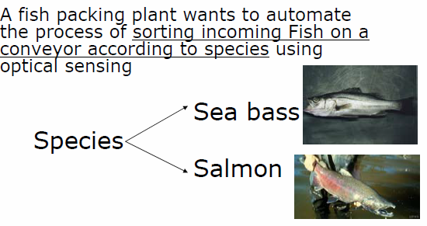
Example

Slide 4
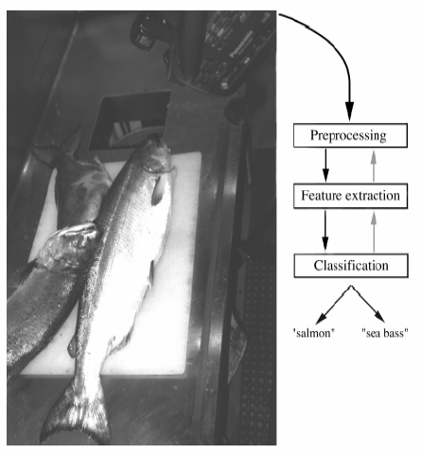
Problem analysis

Slide 5
Problem analysis
We set up a camera and take some sample images to extract features that could help us to distinguish between the two species of fish
Features:
Length
Lightness
Width
Number and shape of fins
Position of the mouth, etc…
This is the set of all suggested features to explore for use in our classifier!

Slide 6
Problem analysis
The camera captures an image of the fish
The image is preprocessed to simplify subsequent operations without loosing relevant information.
Use a segmentation operation to isolate fishes from one another and from the background
The information from a single fish is sent to a feature extractor whose purpose is to reduce the data by measuring certain features
At the end, the features are passed to a classifier that evaluates the evidence presented and makes a final decision.

Slide 7
Problem analysis
Classification
A sea bass is generally longer than a salmon.
Sea bass has some typical length and this is greater than the salmon one. It gives us a preliminary model for the fish.
Select the length of the fish as a possible feature for discrimination.
We can classify the fish seeing whether or not the length l of the fish exceeds some critical value l*.

Slide 8
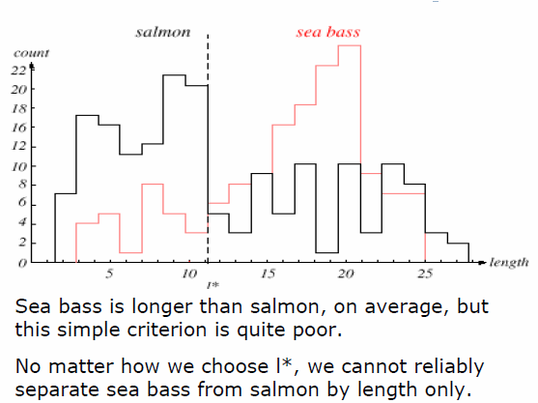
Problem analysis

Slide 9
Problem analysis
The length is a poor feature alone!
Select the lightness as a possible feature (being careful to eliminate variations in illumination).

Slide 10
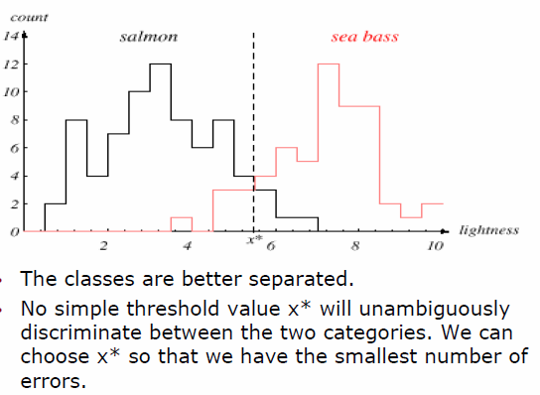
Problem analysis

Slide 11
Problem analysis
Threshold decision boundary and cost relationship
There is an overall cost associated with our decision and our true task is to make a decision rule that minimizes this cost. This is the central task of decision theory.
As a fish packing company, our customers will easily accept occasional pieces of salmon in the boxes of sea bass, but they will object if a piece of sea bass appears in a box of salmon.
Move our decision boundary toward smaller values of lightness in order to minimize the cost (reduce the number of sea bass that are classified salmon!)
THIS IS THE TASK OF DECISION THEORY

Slide 12
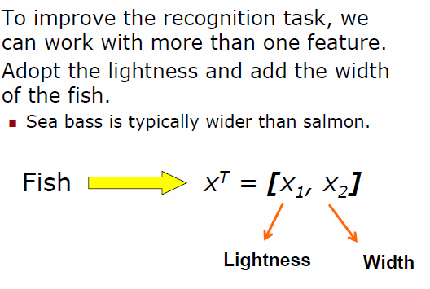
Problem analysis

Slide 13
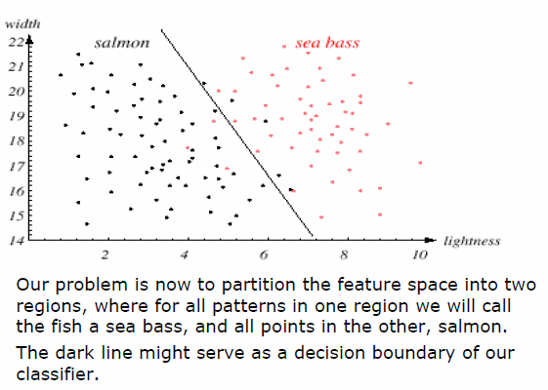
Problem analysis

Slide 14
Problem analysis
We might add other features that are not correlated with the ones we already have.
A precaution should be taken not to reduce the performance by adding such “noisy features”
Ideally, the best decision boundary should be the one which provides an optimal performance such as in the following figure:

Slide 15
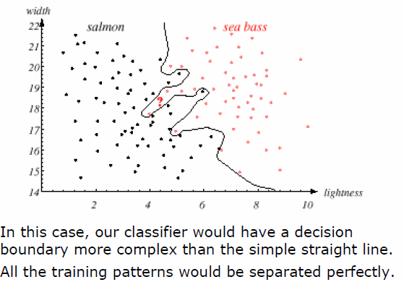
Problem analysis

Slide 16
Problem analysis
However, our satisfaction is premature because the central aim of designing a classifier is to correctly classify novel input
THIS IS AN ISSUE OF GENERALIZATION
The boundary has been tuned to the particular training samples but it is unlikely that it provides good generalization for future patterns.

Slide 17
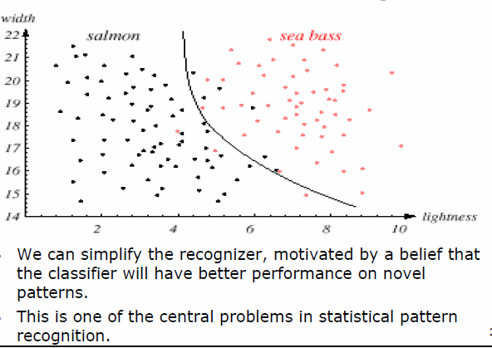
Problem analysis

Slide 18
Pattern Recognition Systems
Sensing
Use of a transducer (camera or microphone)
PR system depends of the bandwidth, the resolution, the sensitivity and the distortion of the transducer
Segmentation and grouping
Patterns should be well separated and should not overlap

Slide 19
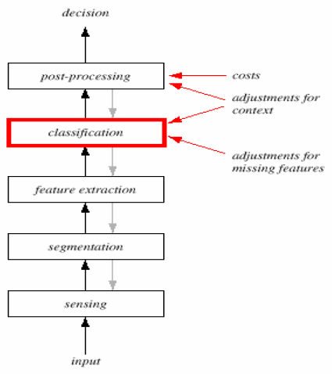
Pattern Recognition Systems

Slide 20
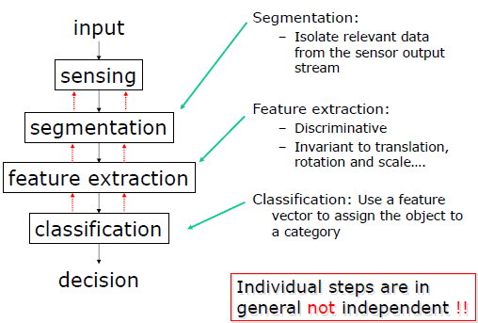
Pattern Recognition Systems

Slide 21
Pattern Recognition Systems
Feature extraction
Discriminative features
Invariant features with respect to translation, rotation and scale.
Classification
Use a feature vector provided by a feature extractor to assign the object to a category
Post Processing
Exploit context: input dependent information other than from the target pattern itself to improve performance

Slide 22
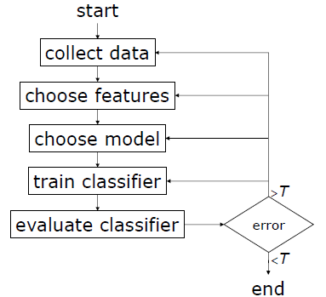
The Design Cycle

Slide 23
The Design Cycle
Data Collection:
What type of sensor?
How do we know when we have collected an adequately large and representative set of examples for training and testing the system?
Feature Choice: Depends on the characteristics of the problem domain.
simple to extract,
invariant to irrelevant transformation,
insensitive to noise and
best discrimination power.

Slide 24
The Design Cycle
Model Choice:
e.g. should we use a linear or a quadratic decision function?
Can we estimate the probability distribution function that models the features?
Training:
Depends on the model chosen.
Use data to determine the parameters of a classifier.
There are many different procedures for training classifiers and choosing models.

Slide 25
The Design Cycle
Evaluation:
Measure the error rate on the validation set of examples that is different from the training set.
This tests the generalization performance.
If not good enough, go back to either of the design step.

Slide 26
The Design Cycle
Computational Complexity:
More complex classifier are more computationally expensive.
What is the optimal trade-off between computational ease and performance?
(How does an algorithm scale as a function of the number of features, patterns or categories?)

Slide 27
Learning
Supervised learning
A teacher provides a category label or cost for each pattern in the training set.
Unsupervised learning
The system forms clusters or “natural groupings” of the input patterns.
Difficult: still the focus of intense research.

Slide 28
Thank You..

