Slide 1
Pharmacy Management System

Slide 2
Existing System
Used for describing something that exists now, especially when it might be changed or replaced. The existing system needs to be change.
In existing system, there is lots of paper work and calculation. So, its may occur an error.
The existing System consume lot of time.
he data which is store on paper exclusively therefore maybe lost, stolen and destroyed due to some situation.

Slide 3
Proposed System
We can utilization of time and workforce.
We can achieve high accuracy in calculation.
We can store our shortage of data till long term.
we get efficiency in modification, sorting and retrieval of data.

Slide 4
Scope of System
With the development of specific and potent synthetic drugs, the emphasis of the pharmacist responsibility has moved substantially towards the utilization of scientific knowledge in the proper use of modern medicines and the protection of the public against dangers that are inherent in their use.
Our system manages the stock of Medicine.
Do Operation like insert medicine, Delete Medicine Update Medicine.
In our System make generate report for selling, expensive.
Make bill for Customer on buying medicine.
Manage The company details.

Slide 5
Objectives System
The "Pharmacy Management & Billing System" that will be used for maintaining the records in an organized manner and to replace all paper work system.
It is the User friendly application for Pharmacist. Which reduces the burden and help to Manage all sections of pharmacy like Medicine Management and Billing etc.
It deals with the automating tasks of maintaining of Bills.
In Pharmacy, Bill Management is the process, Including safe data store about medicine as well as fast searching , Delete and Update of medicines.

Slide 6
Stackholder of System
Admin :-
  Admin observe day to day activity of the shop at every level. Admin maintain the whole system.
  Admin Can Manage The stock of Medicine, Admin can Add the Medicine, Remove the Medicine and Update The Medicine.
  Admin Generate Bill for Customer On buying Medicine.
  Admin can also generate the report of profit.

Slide 7
PROJECT DEFINITION
User-Friendly :
  Is the way the built System tem is not ambiguous which is clear for using the created software interface for manipulating actions or tasks. In the other way the proposed System is designed for human likable components in color, font and other related things.
Manual based System :
  The system that uses was paper based and arranged on the shelf through functionality of documents. Everything that is arranged, searched, updated and deleted is through humans only. In general manual based system.

Slide 8
PROJECT DEFINITION
Pharmacist :
  The profession who have knowledge on the medicine usage, instruction for use those medicines for the particular diseases and other related things.
Management System :
  A System in which manage, organize, formulate data’s through a technical data structure arrangement.

Slide 9
PROJECT DEFINITION
Billing :
  The way in which generating paper which store information about some specific data containing details explanation.
  In this System only Admin module.

Slide 10
Feasibility Study
Technical feasibility :
  The technical feasibility study compares the level of technology available in the software development form and the level of technology required for the development of the product. Here, the level of technology consists of the programming language, the hardware resources, other software tools, etc.

Slide 11
Feasibility Study
ECONOMIC FEASIBILITY :
  The economic feasibility study evaluates the cost of the software development against the ultimate income or benefits gets from the developed system. There must be scope for profit after the successful completion of the project

Slide 12
Feasibility Study
Operational feasibility :
  Operational feasibility study tests the operational scope of the software developed. It is checked that if the system is actually can be usefull when implemented and how it satisfies the requirements identified in the requirements analysis phase of system development.

Slide 13
Hardware-Software Requirement
Software Configuration :
Requirement
Operating System | Windows, Linux, Mac
DataBase | Java DB
Runtime Environment | NetBean
Back-end Tool | java
Front-end Tool | Java

Slide 14
System Planning
Work Breakdown Structure:
  Dividing complex projects to simpler and manageable tasks is the process identified as Work Breakdown Structure.
  Usually, the project managers use this method for simplifying the project execution. In WBS, much Larger tasks are broken down to manageable chunks of work. These chunks can be easily supervised and estimated.

Slide 15
SYSTEM ANALYSIS AND DESIGN

Slide 16
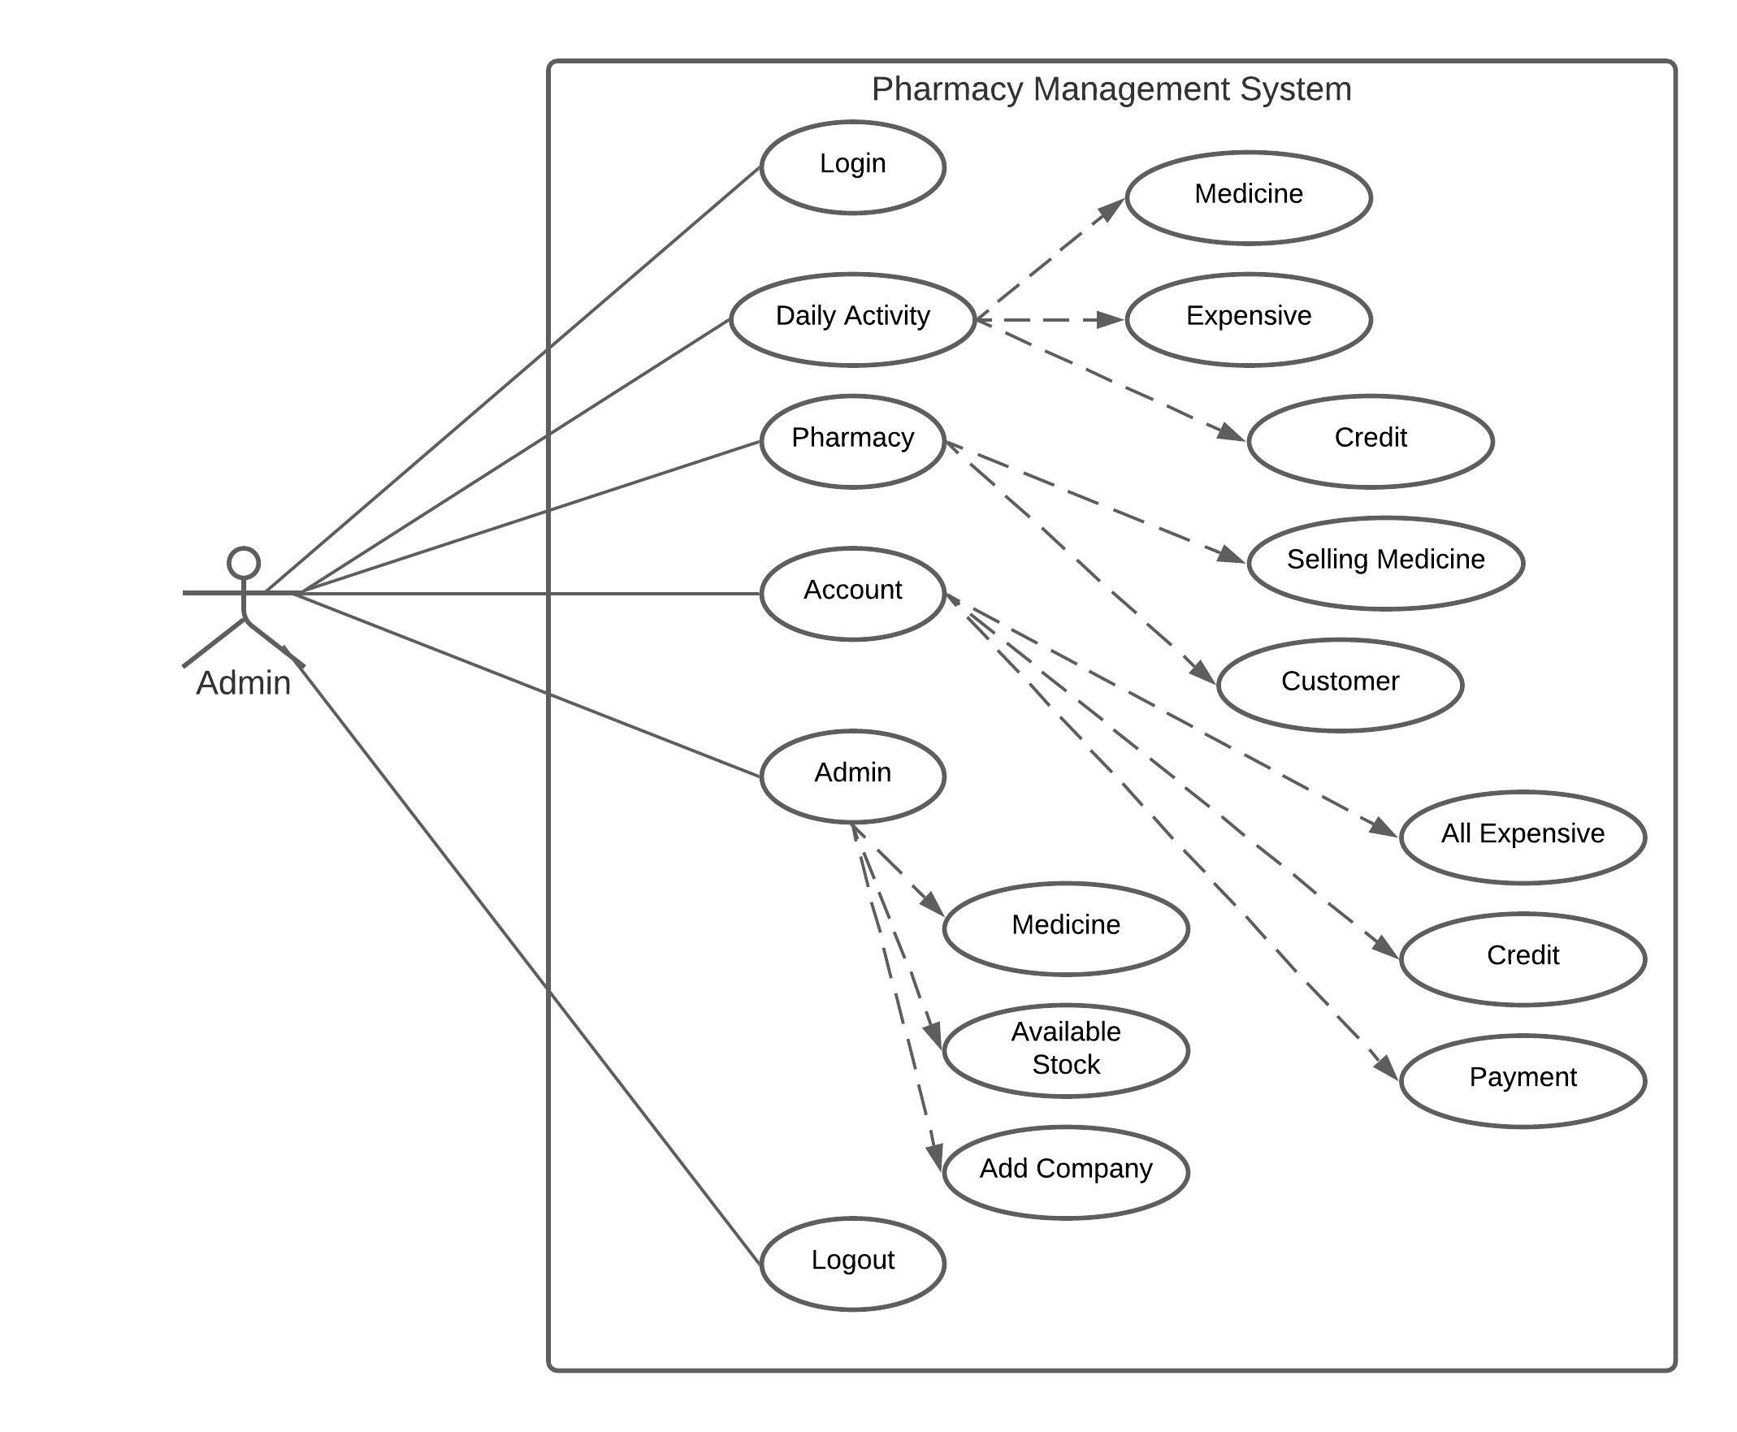
Use case Diagram :

Slide 17
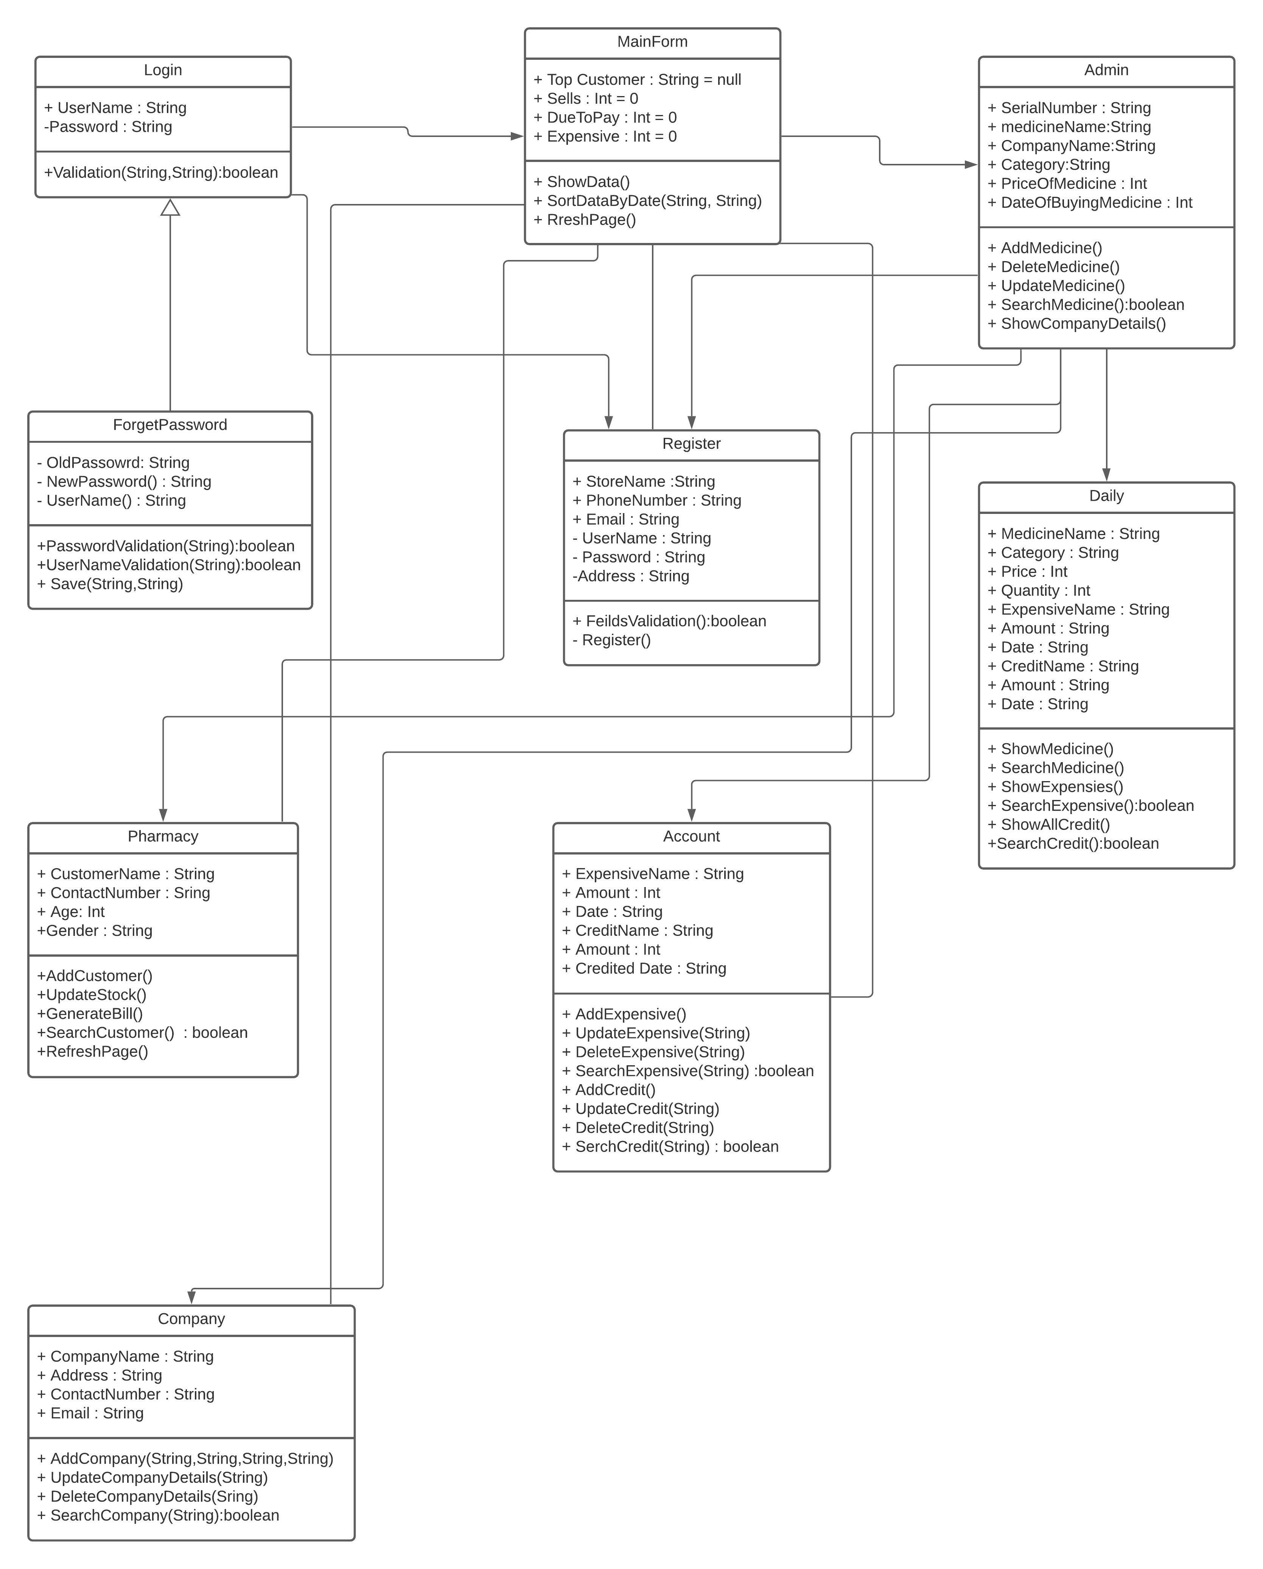
Class diagram :

Slide 18
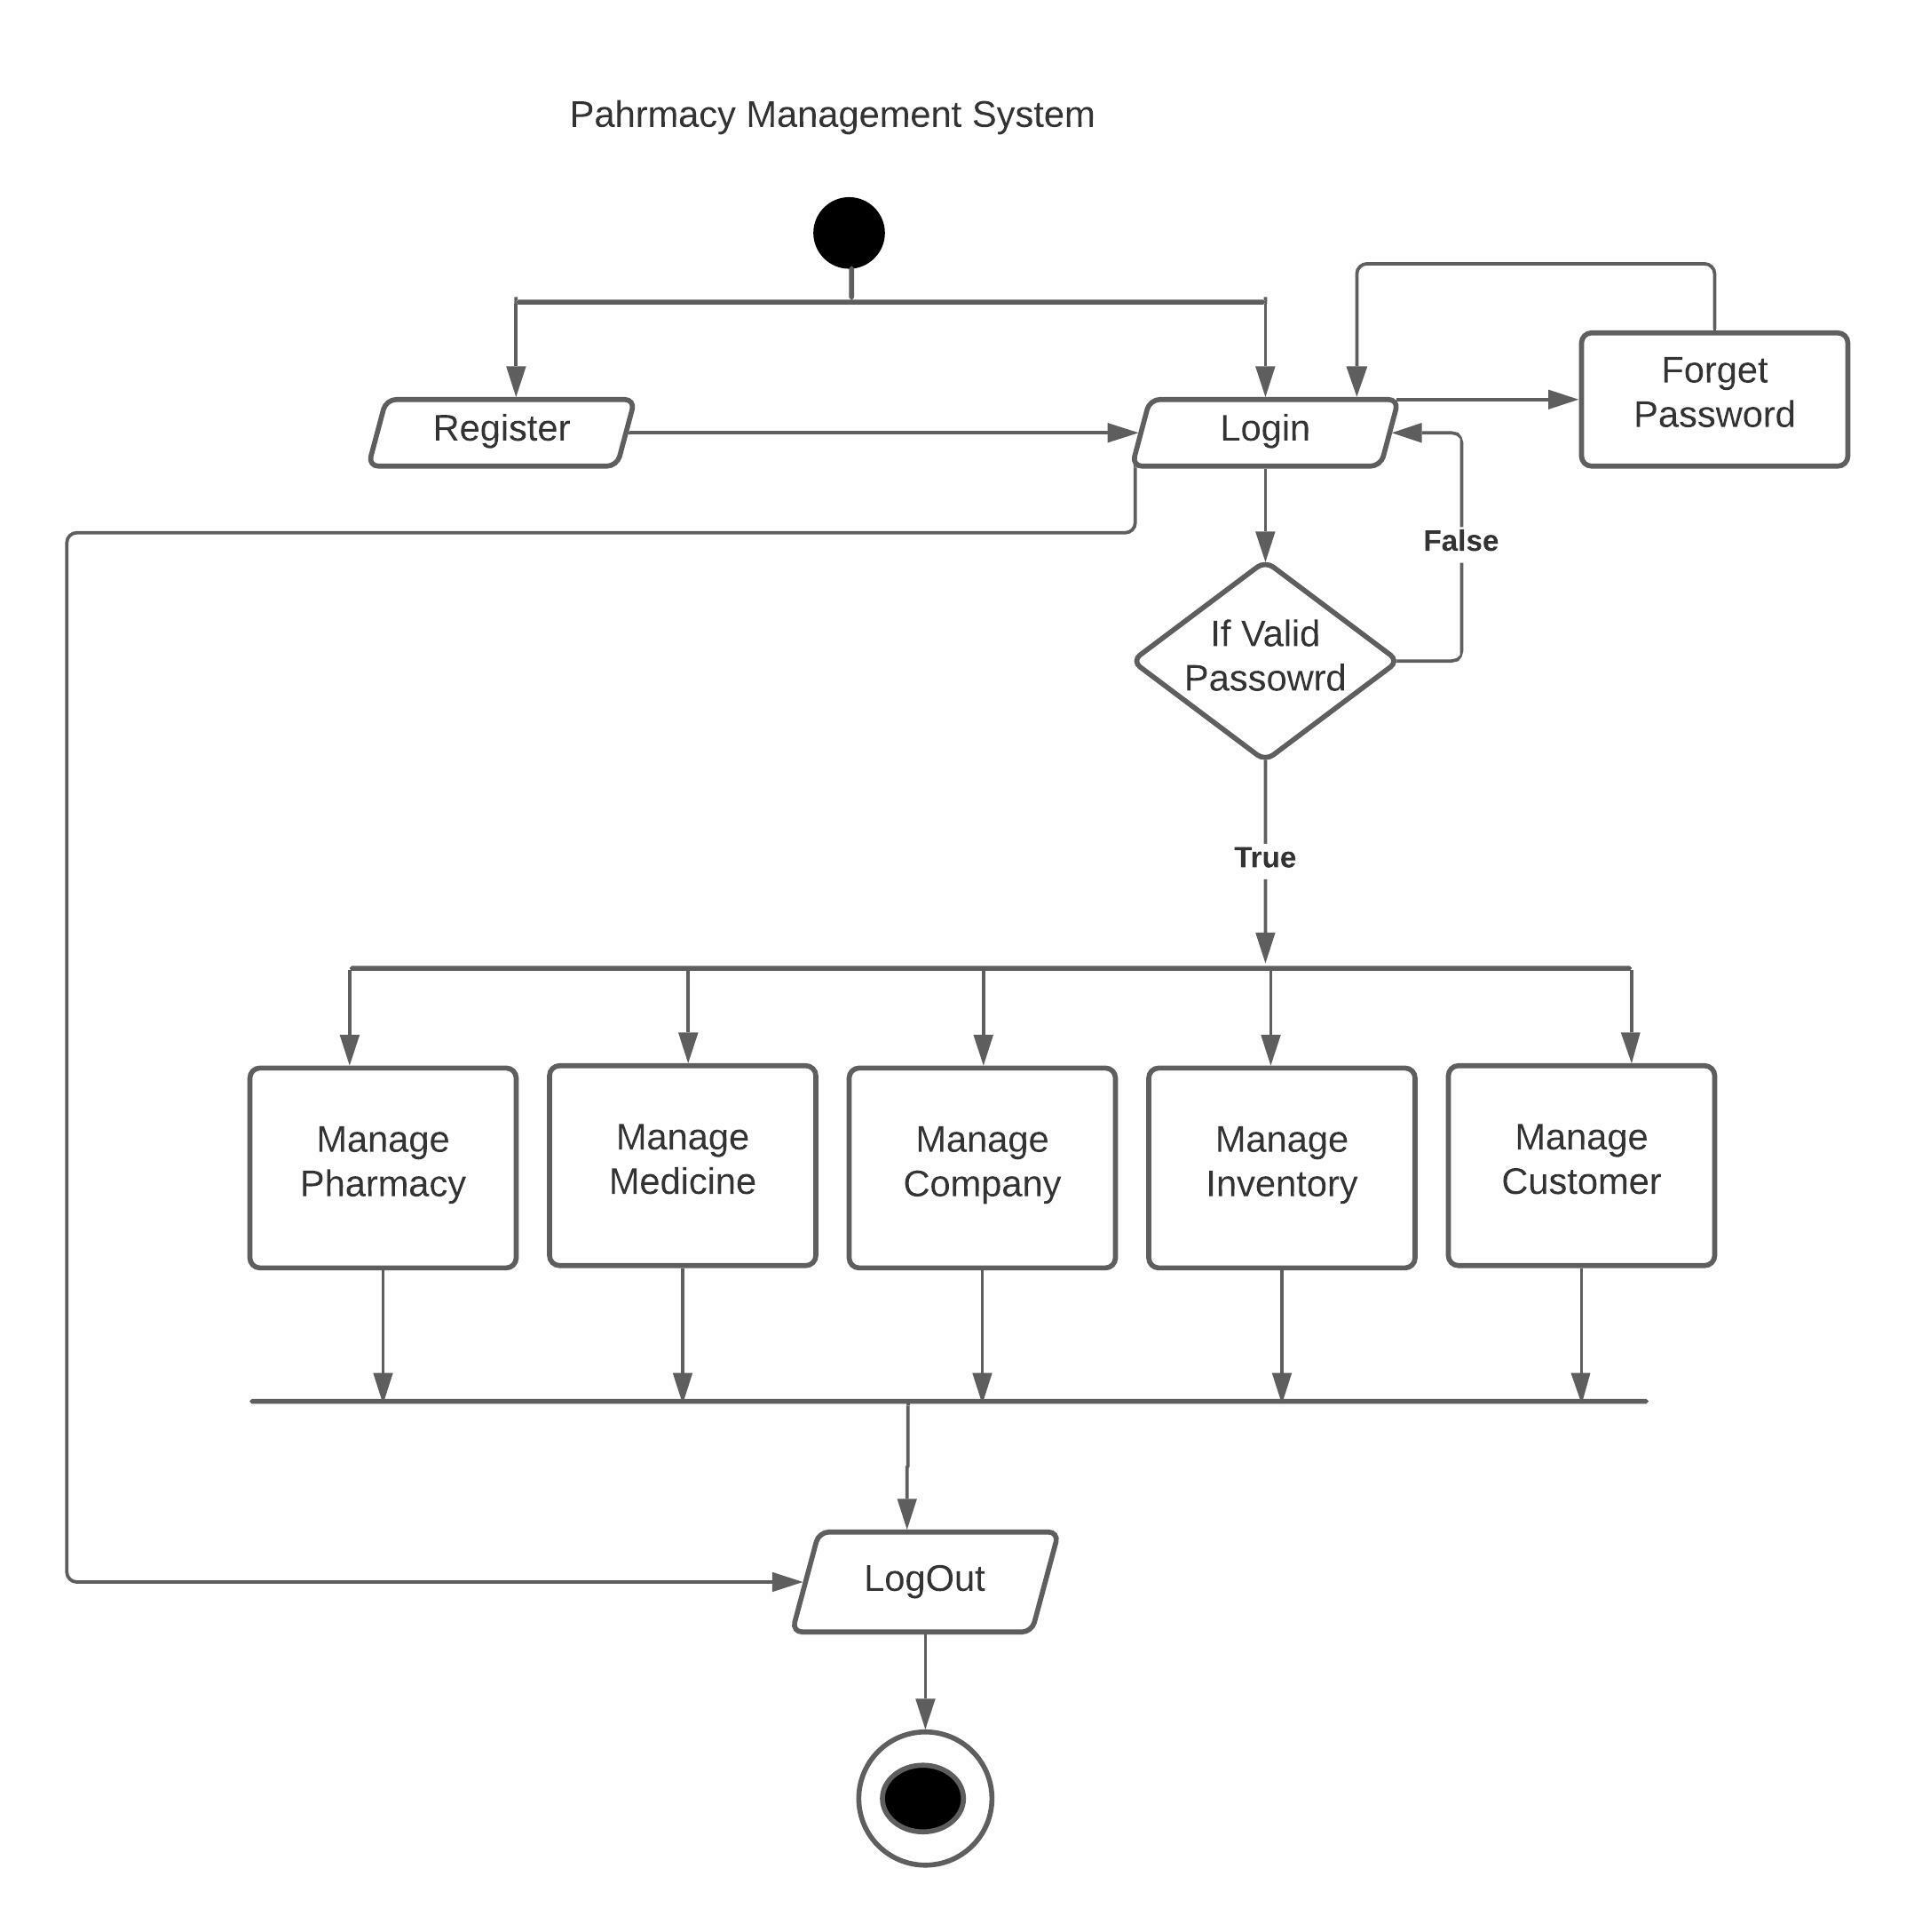
Activity Diagram :

Slide 19
Data Dictionary : Medicine Table :
Sr No. | Field Name | Data Type | Length | Constraint | Description
1 | ID | Int | 5 | Primary Key | Stores unique id for user master
2 | Name | Varchar | 100 | Not Null | Name of Medicine
3 | Company | Varchar | 100 | Not Null | Name of Company
4 | Selling Price | Float | 5 | Not Null | Selling price of Medicine
5 | Buying Price | Float | 5 | Not Null | Buying Price of Medicine
6 | Quantity | Int | 5 | Not Null | Quantity of Medicine
7 | Date | Date | 50 | Not Null | Date of Buying Medicine

Slide 20
Company Table :
Sr No. | Field Name | Data Type | Length | Constraint | Description
1 | ID | Int | 5 | Primary Key | Stores unique id for user master
2 | Name | Varchar | 100 | Not Null | Name of Company
3 | Phone Number | String | 10 | Not Null | Phone Number of Company
4 | Address | Varchar | 100 | Not Null | Address of Company

Slide 21
Customer Table :
Sr No. | Field Name | Data Type | Length | Constraint | Description
1 | ID | Int | 5 | Primary Key | Stores unique id for user master
2 | Name | Varchar | 100 | Not Null | Name Of Customer
3 | Age | Int | 3 | Not Null | Age of Customer
4 | Gender | Varchar | 10 | Not null | Gender Of Customer
5 | Amont | Double | 5 | Not Null | Amount of Medicine
6 | Quantity | Int | 5 | Not Null | Quantity Of Medicine
7 | Date | Date | 20 | Not Null | Date of Selling Medicine
8

Slide 22
Expensive Table :
Sr No. | Field Name. | Data Type | Length | Constraint | Description
1 | Name | Varchar | 100 | Not Null | Name of Expensive
2 | Amount | Double | 5 | Not null | Amount of Expensive
3 | Date | Date | 20 | Not Null | Date Of Expensive
4 | Category | Varchar | 20 | Not Null | Category of Expensive
5 | Type | Varchar | 20 | Nto null | Expense is Paid Or Not

Slide 23
Credit Table :
Sr No. | Field Name. | Data Type | Length | Constraint | Description
1 | Name | Varchar | 100 | Not Null | Name of Credit
2 | Amount | Double | 5 | Not null | Amount of Credit
3 | Date | Date | 20 | Not Null | Date Of Credit
4 | Category | Varchar | 20 | Not Null | Category of Credit

Slide 24
Selling Medicine Table :
Sr No. | Field Name. | Data Type | Length | Constraint | Description
1 | Name | Varchar | 100 | Not Null | Name of Medicine
2 | Amount | Double | 5 | Not null | Amount Of Medicine Qty
3 | Selling Price | Double | 5 | Not Null | Selling price of Medicine
4 | Qty | Int | 5 | Not Null | Qty of Selling Medicine
5 | Date | Date | 20 | Not Null | 24

Slide 25
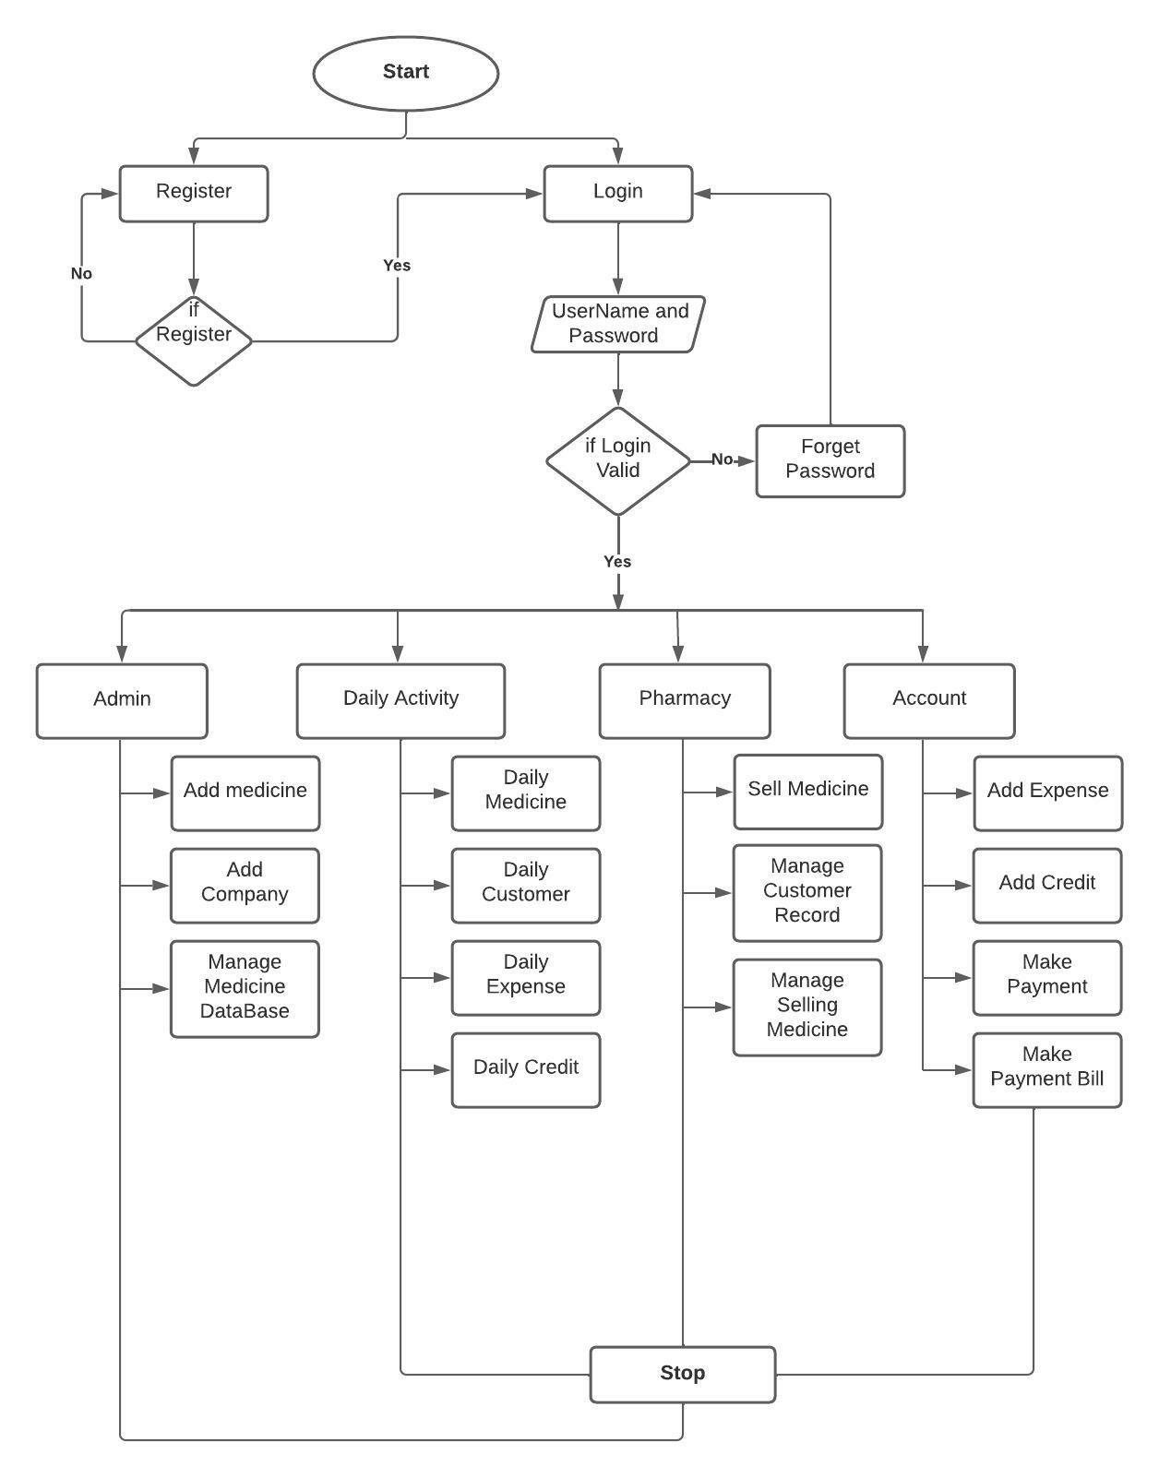
System flow Diagram :

Slide 26
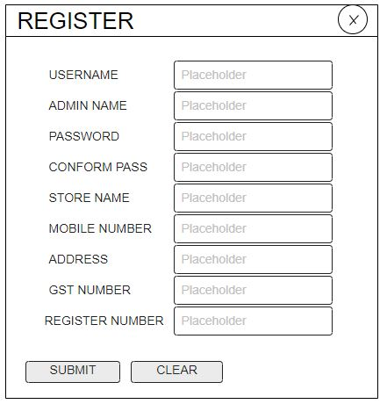
User Interface :
Register :

Slide 27
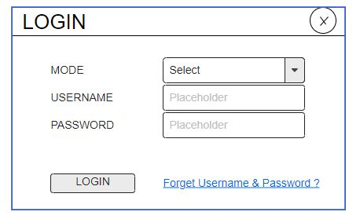
Login :

Slide 28
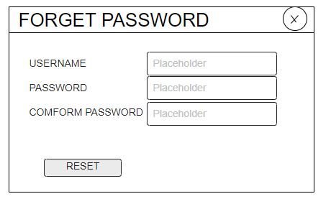
Forget Password:

Slide 29
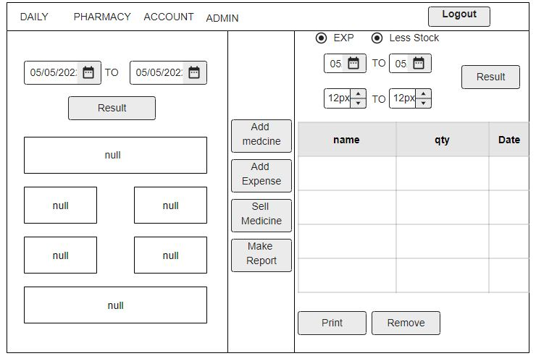
Dashboard :

Slide 30
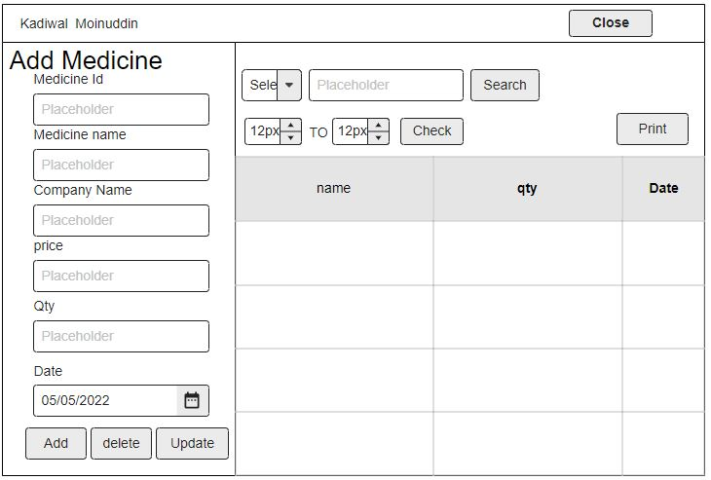
Add medicine:

Slide 31
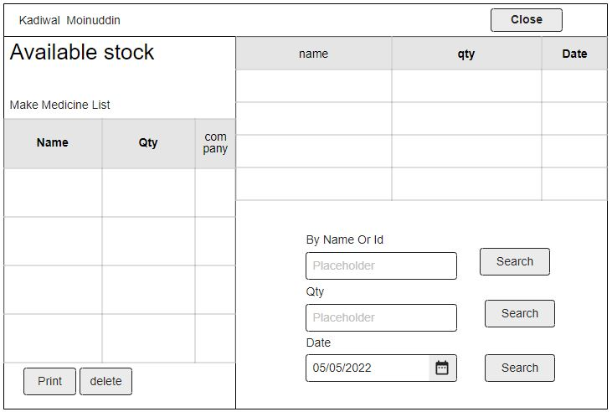
Available Stock:

Slide 32
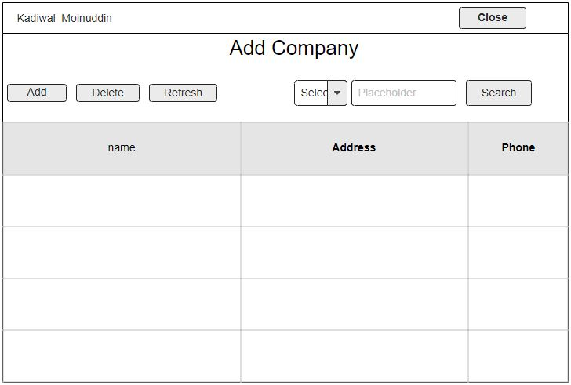
Add Company:

Slide 33
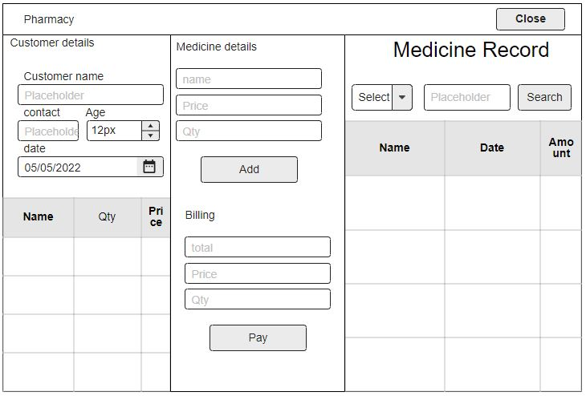
Sell Medicine:

Slide 34
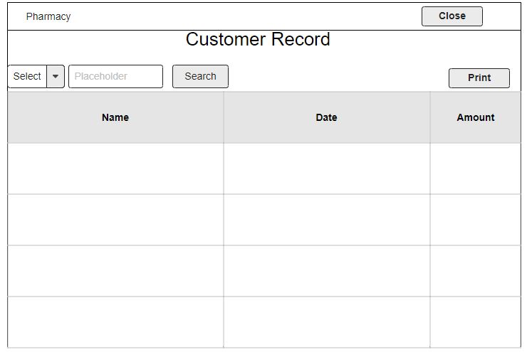
Customer Record:

Slide 35
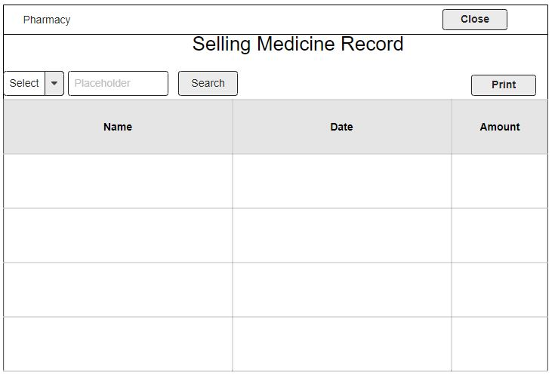
Selling Medicine Record:

Slide 36
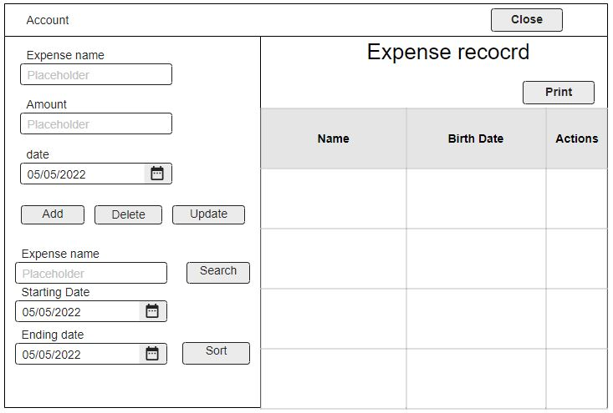
Expense Record:

Slide 37
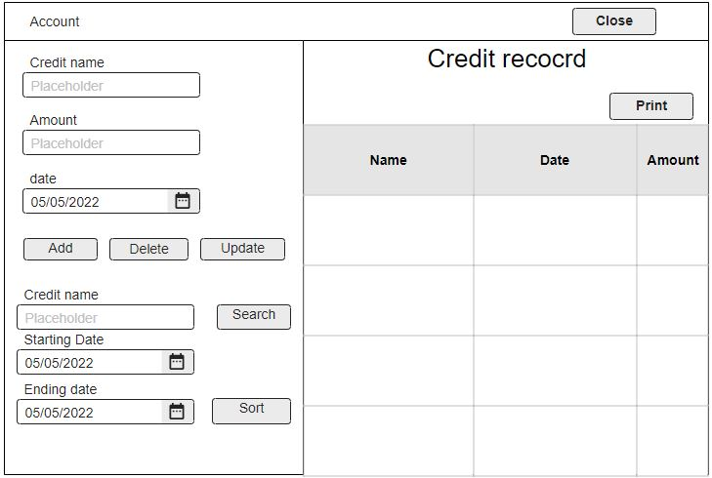
Credit Record:

Slide 38
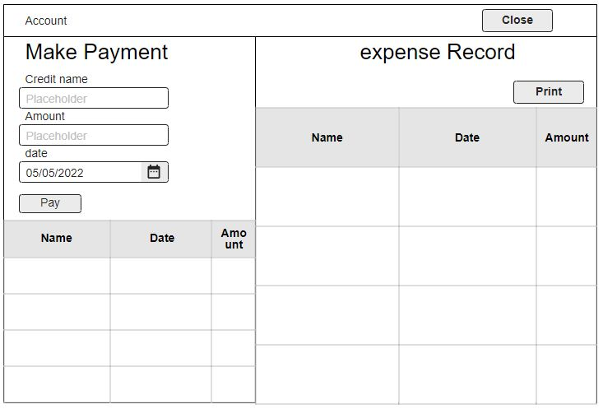
Make Payment:

Slide 39
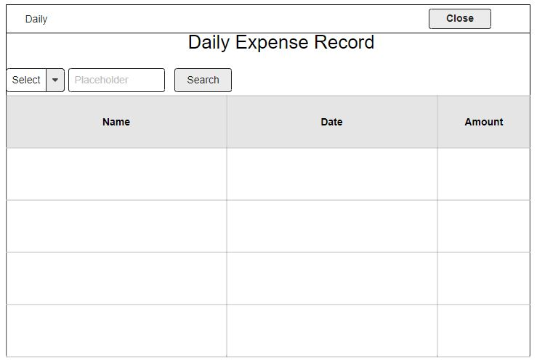
Daily Expense:

Slide 40
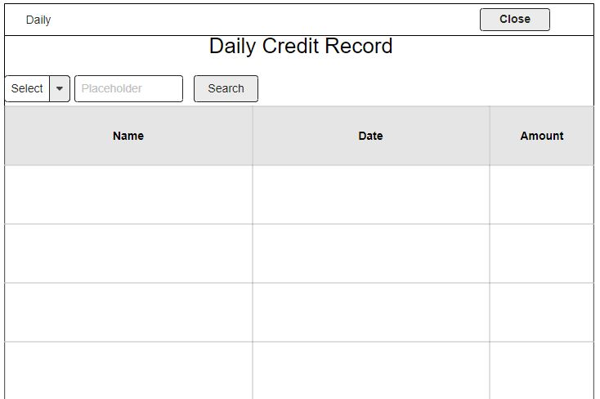
Daily Credit:

Slide 41
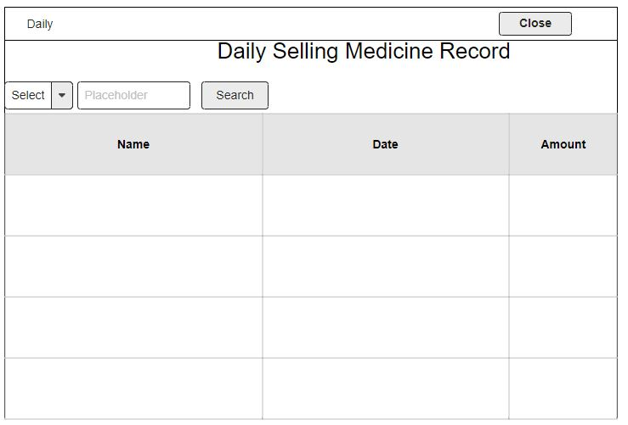
Daily Sells:

Slide 42
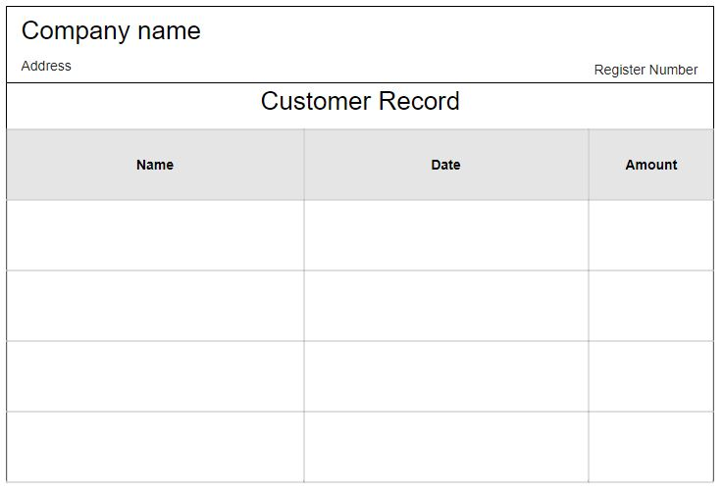
Statement Format:

Slide 43
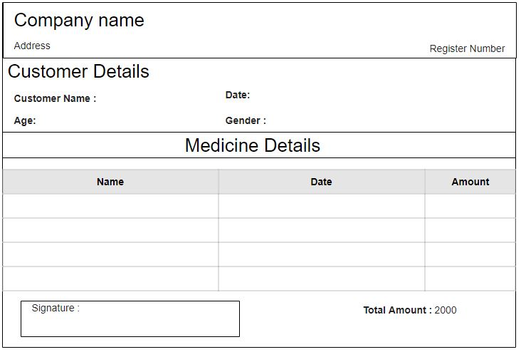
Customer Invoice:

Slide 44
Limitation :
This system will work On Offline.
System is crash then all data are erase.
Only Admin can manage this system there is no employee panel.

