Slide 1

Process Mining Virtual Internship
by
S.Khaja Moinuddin
Roll No. 224G1A3242
Department of Computer Science and Engineering (Data Science)
Srinivasa Ramanujan Institute of Technology
(Affiliated to JNTUA & Approved by AICTE) (Accredited by NAAC with ‘A’ Grade & Accredited by NBA (EEE, ECE & CSE)
Rotarypuram Village, B K Samudram Mandal, Ananthapuramu – 515701.
2024 - 2025

Slide 2
Contents
Course Objective
Introduction
Technology
Applications
Phases of process mining
Modules
Learning outcomes
GitHub Link
Queries

Slide 3
Course Objective
Learn about the different types of process mining, such as discovery, conformance checking, and enhancement. They could also learn about the process mining lifecycle, which includes the steps of collecting event data, cleaning event data, creating a process model, and analyzing the process model.
Learn about the syntax of PQL queries and how to use them to extract insights from event data. They could also learn about the different types of PQL queries, such as event queries, activity queries, and trace queries.
Learn how to import event data into EMS using a variety of methods and also learn how to configure EMS to analyze the event data.

Slide 4
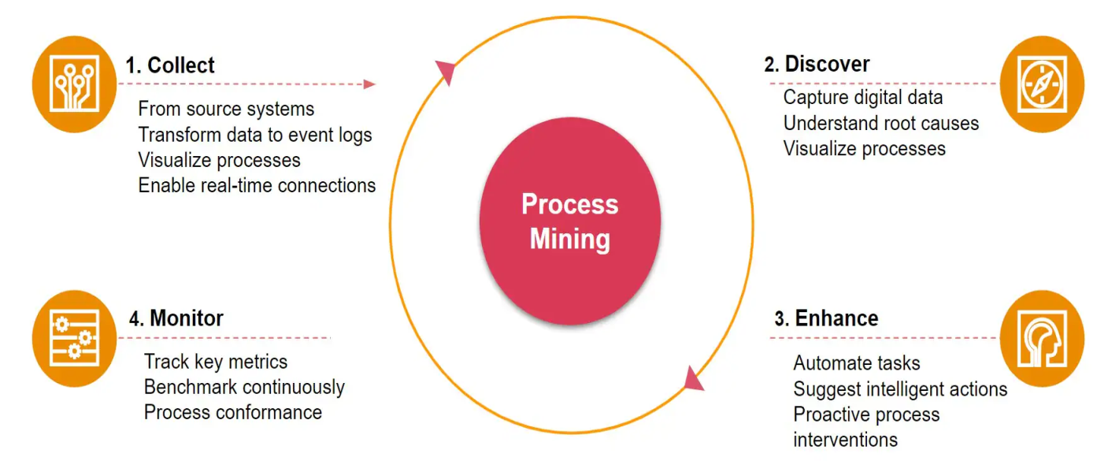
Introduction
Process mining is a technique designed to discover, monitor and improve real processes by extracting readily available knowledge from the event logs of information systems.
Process mining is mainly the combination of two disciplines: Data Science and Business Process Management, Process mining essentially uses Data Science techniques such as Big data and AI .
The goal of process mining is to turn event data into insights and actions.

Slide 5
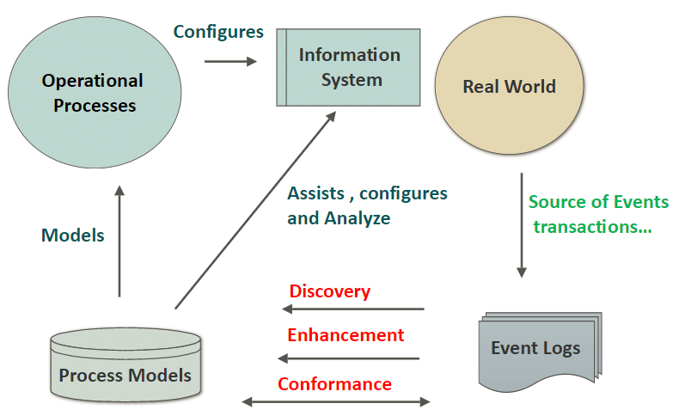
Introduction
Process Mining helps the organizations to identify where their plans went haywire or flawed to begin with and how to get things not just back on track but also in fast lane.
Log data is the records of all the events occurring in a system, in an application, or on a network device.

Slide 6
Process mining Technology
Event Log Data:
An event is any significant action or occurrence that’s recognized by a software system
An event log can be seen as collection of cases whereas a case can be defined as a sequence of events
SOURCE OF EVENT DATA
a database system (e.g., patient data in a hospital),
a comma-separated values (CSV) file or spreadsheet,
a transaction log (e.g., a trading system)
a message log (e.g., from IBM middleware).
an open API providing data from websites or social media .

Slide 7
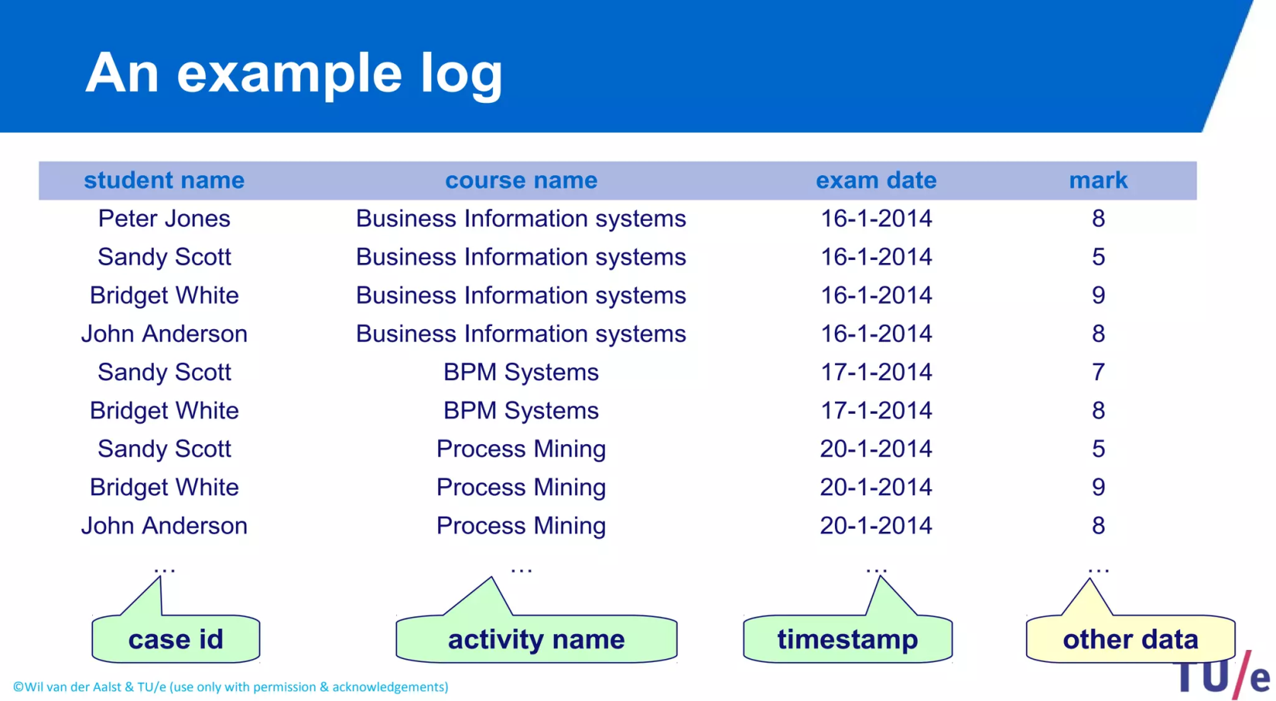
Continued...
The event log data structure mainly shows activities, each activity’s ID, and the timestamp. Therefore, process mining brings visibility to the execution of a process by showing steps taken, duration of activities or deviations that occur.

Slide 8
Applications
Financial Services:
Because of the rise in transaction volume and the digitization of more industries, aberrant activity is harder to detect using manual methods. Companies in the financial services sector have the chance to continually and thoroughly identify issues within high-volume processes thanks to process mining, which is a solution to the increased regulatory and audit requirements.
2.Healthcare:
Process mining supports the delivery of effective and high-quality end-to-end patient journeys for healthcare organizations dealing with the exponential growth of data, from before a first doctor appointment through treatment regimens to closed treatment cases.
3.Customer Support Process:
Process mining can be employed to analyze real –time data for customer interactions.By understanding
How support requests are handled,businesses can improve response times,agent performance , and customer satisfaction.

Slide 9
Phases of process mining
Process Mining mainly divided into three phases as follows :
1. Discovery.
2. Monitoring.
3. Optimization.
Discovery:
Discovery mainly solves the major problems for organization . It searches for hidden impediments that could be impacting customer relationships ,cost,and ultimately, a business bottom line.
Discovery is a technique to understand and document everything about the organization’s current business processes. This technique can be performed to construct a representation of an organization’s current business processes and its major process variations.

Slide 10
Phases of process mining
Monitoring
It is also known as predictive process monitoring, is a process mining method that combines predictive analytics with process mining to predict the time and outcomes of ongoing cases by analyzing historical data.
For example, in continuous sales processes, the result would be either finalizing the purchase or not..
Optimization
Process optimization is the discipline of continuously adapting processes to improve them. The goal of business process optimization is to increase efficiency by improving processes through better resource use.
Generally, the objective is to minimize costs and maximize performance, productivity, and efficiency.

Slide 11
Modules
PROCESS MINING FUNDAMENTALS
Set of techniques used for obtaining Knowledge and extracting insights from processes by means of analyzing the event data generated during the execution of process.
Main Stages Involved in Process Mining :
Process Model
Data Visualization.
Data Analysis.
Data Pre-processing
Celonis Analysis:
Celonis Analysis uses the Celonis platform to understand how a business operates. It starts by collecting data from different parts of the company, like sales and customer service. This data is organized and turned into a timeline of activities called event logs. Celonis then uses these logs to create pictures of how the business works, showing how things happen and where there might be problems.

Slide 12
Continued...
Data Pre-Processing
It refers to the cleaning, transforming, and integrating of data in order to make it ready for analysis. The goal of data preprocessing is to improve the quality of the data and to make it more suitable for the specific data mining task.
Data Analysis
Data analysis refers to the process of inspecting, cleaning, transforming, and interpreting data to discover valuable insights, draw conclusions, and support decision-making.
Data visualization
It is the graphical representation of information and data. By using visual elements like charts, graphs, and maps, data visualization tools provide an accessible way to see and understand trends, outliers, and patterns in data.
Process Model
A software process model is an abstraction of the software development process. The models specify the stages and order of a process.
A model will define the following:
The tasks to be performed
The input and output of each task
The pre and post-conditions for each task
The flow and sequence of each task

Slide 13
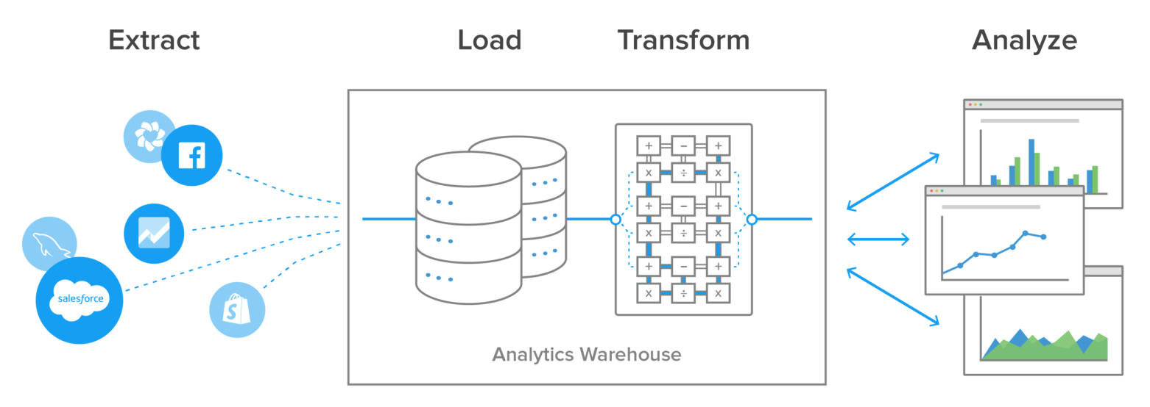
Get Data into EMS
Data Extraction: Data extraction is the process of obtaining raw data from a source and replicating that data somewhere else. The raw data can come from various sources, such as a database, Excel spreadsheet, an SaaS platform, web scraping, or others. It can then be replicated to a destination, such as a data warehouse, designed to support online analytical processing (OLAP). This can include unstructured data, disparate types of data, or simply data that is poorly organized. Once the data has been consolidated, processed, and refined, it can be stored in a central location on-site, in cloud storage, or a hybrid of both to await transformation or further processing.

Slide 14
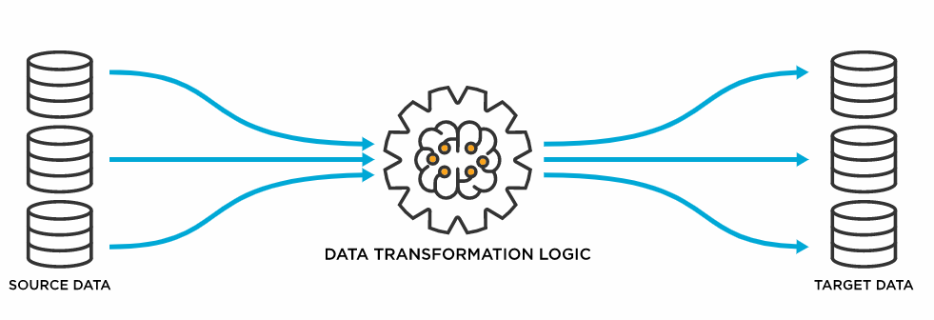
Get Data into EMS
Data Transformation: Data transformation is used when data needs to be converted to match that of the destination system. This can occur at two places of the data pipeline. First, organizations with on-site data storage use an extract, transform, load, with the data transformation taking place during the middle ‘transform’ step. Organizations today mostly use cloud-based data warehouses because they can scale their computing and storage resources in seconds. Cloud based organizations, with this huge scalability available, can skip the ETL process. Instead, they use a transformation process that converts the data as the raw data is uploaded, a process called extract, load, and transform. The process of data transformation can be handled manually, automated or a combination of both

Slide 15
Get Data into EMS
Data Integration: Data integration is the process of bringing data from disparate sources together to provide users with a unified view. The premise of data integration is to make data more freely available and easier to consume and process by systems and users. Data integration done right can reduce IT costs, free-up resources, improve data quality, and foster innovation all without sweeping changes to existing applications or data structures. And though IT organizations have always had to integrate, the payoff for doing so has potentially never been as great as it is right now
Data Loading: Data loading defines the LOAD component of the ETL process. ETL stands for Extraction, Transformation, and Load. Extraction deals with the retrieval and combining of data from multiple sources. Transformation deals with cleaning and formatting of the Extracted Data. Data Loading deals with data getting loaded into a storage system, such as a cloud data warehouse. ETL aids in the data integration process that standardizes diverse data types to make them available for querying, manipulation, or reporting for many different individuals and teams. Because today’s organizations are increasingly dependent upon their own data to make smarter, faster business decisions, ETL needs to be scalable and streamlined to provide the most benefit.

Slide 16
Learning outcomes
An understanding of the different types of process mining
An understanding of the different tools and techniques that can be used for process mining
The ability to identify potential applications for process mining in your organization
The ability to import data into Celonis
The ability to create process models in Celonis
The ability to analyze process data in Celonis
The ability to identify and improve process bottlenecks in Celonis

Slide 17
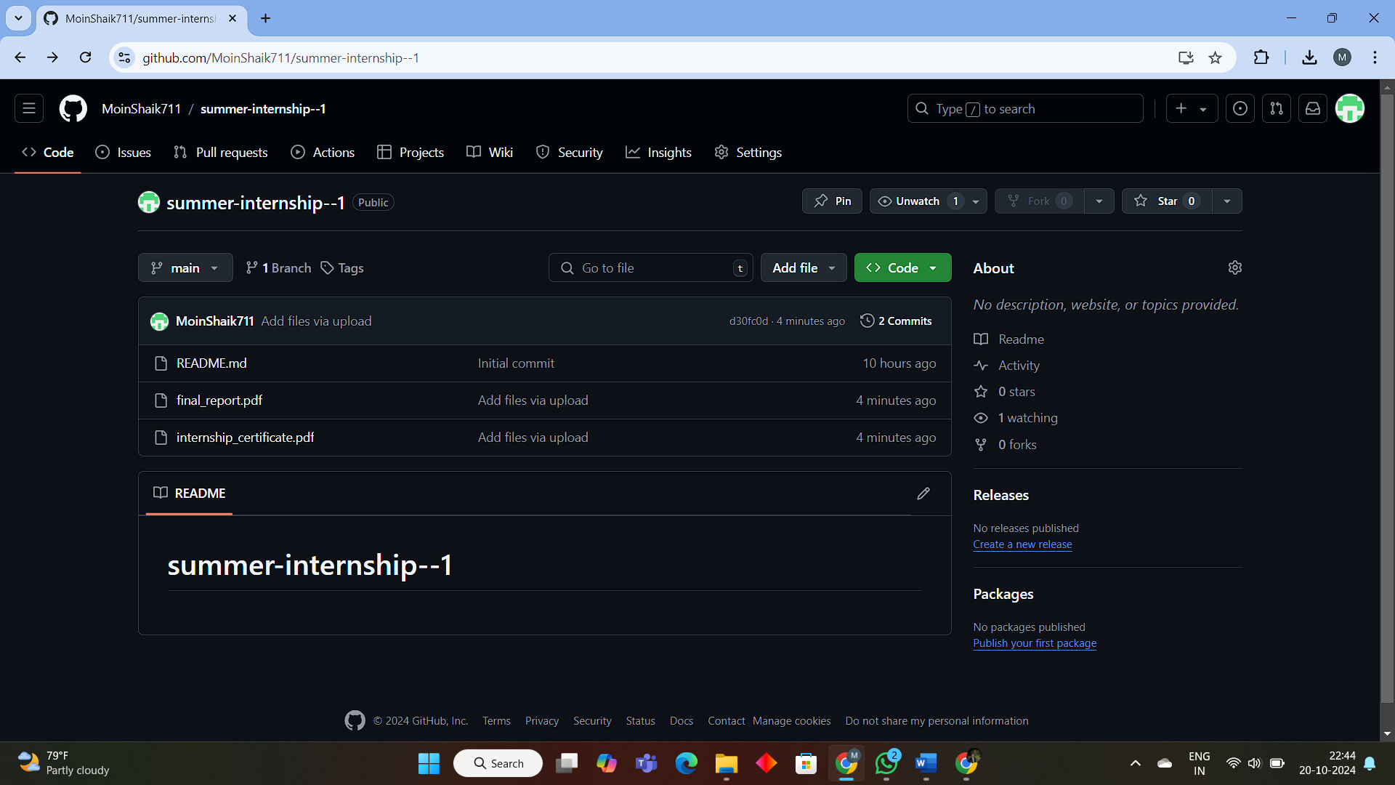
Git Hub Dashboard
Repository Name:Summer Internship-1
Git HubLink:https://github.com/MoinShaik711/summer-internship--1

Slide 18
Any Queries?

Slide 19
Thank You!!!

