Slide 1

Project: Google Solution
Challenge : Quality Education
Team : Radar Droids

Slide 2



What is Quality Education?
Whatever progress our society has made over the centuries is because of education. The importance of quality education cannot be undermined in a society, which is why great personalities have extensively written on its need in a civilized society. It is because of education, that humans have been able to explore the vastness of the universe and the mystery of its existence in atoms. In the 21st century, some countries are lagging in the race for quality education.

Slide 3


Understanding Quality Education
Education International (EI), a Belgium-based organization, defines quality education as one that focuses on the social, emotional, mental, physical, and cognitive development of each student regardless of gender, race, ethnicity, socioeconomic status, or geographic location. It prepares the child for life and not just for testing.
.
In 2012, the United Nations for the first time included ‘Quality Education’ in their Sustainable Development Goals (SDG). Further, education in modern times is highly influenced and dependent on Information and Communication Technology which has paved the way for students to attain school or higher-level education. Quality education not only prepares a student for a job but also develops the overall personality of an individual

Slide 4
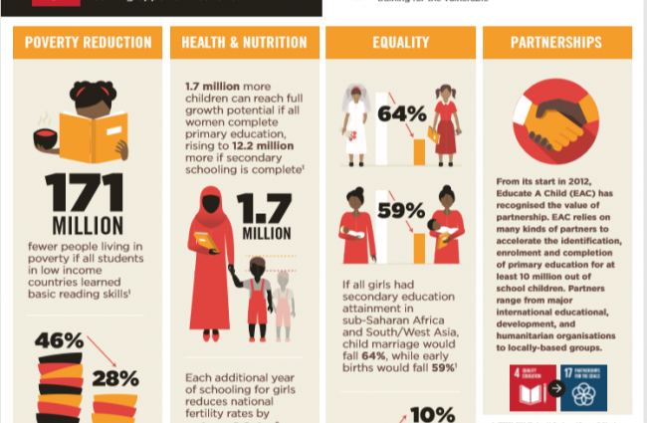
United Nations on Quality Education:

Slide 5

The United Nations understand the supremacy of education for a brighter and prosperous future and is therefore of the consensus that quality education and not merely education should be a reality for all. In its Sustainable Development Goals, the UN has identified quality education as a major goal to ensure the ‘transformation of the world’ by 2030. By quality education, the UN implies equitable and standard education for all that will promote lifelong learning and the urge to gather knowledge. Inclusivity and equitability are the foundations to be upheld in quality education and not a greater literacy rate. This is a revolutionary approach to understanding education and making it the means of changing the world.

Slide 6
Education must fully assume its central role in helping people to forge more just, peaceful and tolerant societies. – Ban Ki-Moon, Secretary-General of the United Nations

Slide 7

Why is it Important?
We all are aware of how technology changing the face of education. Not only has the mode of receiving education changed but the methods of teaching students have also evolved. Earlier, education was more of a monologue, but nowadays, teachers encourage students to maintain a two-way flow of information in classrooms. United Nations has identified a multitude of problems at the global level that if not addressed can lead to serious problems. To tackle such issues, the need for leaders and experienced professionals who are adept in their respective fields has grown. To encourage leadership and power to influence among the students, it has become imperative to employ a refined way of teaching practices. In the age of technology, information can be accessed from anywhere in the world. Even though providing quality education demands great efforts to shape the personality of a student, with the advent of new technologies. Students can avail benefits of online career counselling, and access a great volume of resources from free online libraries.

Slide 8


COVID Response Towards Quality Education
In 2020, Covid-19 hit the world and education was one of the most important factors that were adversely affected. A majority of countries announced the temporary closure of schools impacting more than 91% of students in the world.
As per the UN, by April 2020, approximately 1.6 billion students were out of school and nearly 369 million children depend upon school meals. To ensure that education doesn’t stop at this time, UNESCO has created the following aims:
Help countries mobilize resources and implement new and context-appropriate solutions to offer remote education by leveraging hi-tech, low-tech and no-tech methods
Seek equitable solutions and universal access
Make sure that there are coordinated responses that avoid overlapping efforts
Facilitate the return of students to school when they reopen to avoid an increase in dropout rates

Slide 9
Statistics Around Quality Education
Here are some of the details about quality education that you must learn:
Before the pandemic, projections showed that more than 200 million students would be out of school and only 60% of young people will reach upper secondary education in 2030
More than half of the students that have not enrolled in school live in Sub-Saharan Africa
617 million youth worldwide lack basic mathematics and literacy skills
In 10 low and middle-income countries, children with disabilities were 19% less likely to achieve minimum proficiency in reading

Slide 10
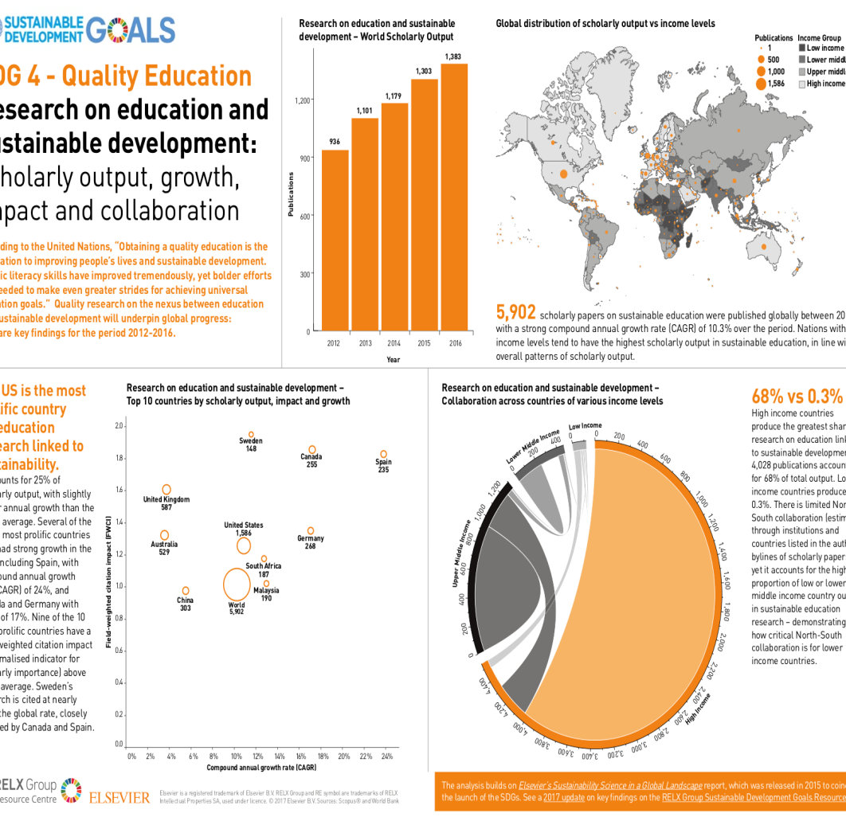

Slide 11

How this Goal can be Achieved?
The increasing number of crimes, wars, disease outbreaks, drastic economic downfalls, climate change, and many other factors have led to unexpected changes in societies around the globe. Due to this, the educationists and developmental organizations around the world emphasize the need for quality education and are stressing the need and uniting people towards achieving the goal. From educating a smaller group of people within their community to spreading awareness about the rising global issues, the educated people can work in an array of ways to achieve the goals.

Slide 12

The Targets of Quality Education
Everyone can participate in their ways to provide quality education around the world. Here are some of the targets that the UN has set for 2030 in this section:
By 2030, ensure that there is free primary and secondary education for girls and boys for effective learning outcomes
By 2030, ensure that both girls and boys have access to quality early development and pre-primary education
Ensure equal access to affordable and quality technical, vocational and tertiary education
Increase the number of people, both youth and adults who have relevant skills for employment, jobs and entrepreneurship
Eliminate all discrimination in education
Ensure universal literacy and numeracy
Ensure education for sustainable development and global citizenship
Ensure building and upgrading inclusive and safe schools
Expand higher education scholarships for developing countries
Increase the supply of qualified teachers in developing countries

Slide 13
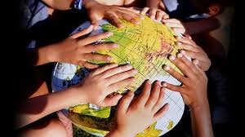
How can you Promote Quality Education?
Here is how you can promote quality education around the world:
Find a charity that works for quality education, donate or get involved in other ways
Donate the books that you have used to those who need it
Promote and take free online courses
Visit local schools, see what school supplies they need and start a drive to provide it to them
Mentor young children and help them with their homework or projects

Slide 14


Dimensions of a Quality Education
Here are some of the important dimensions of quality education that every organization should meet:
Equity
Sustainability
Contextualization and Relevance
Balanced Approach
Child-friendly Teaching and Learning
Learning Outcomes

Slide 15
The End!

