Slide 1
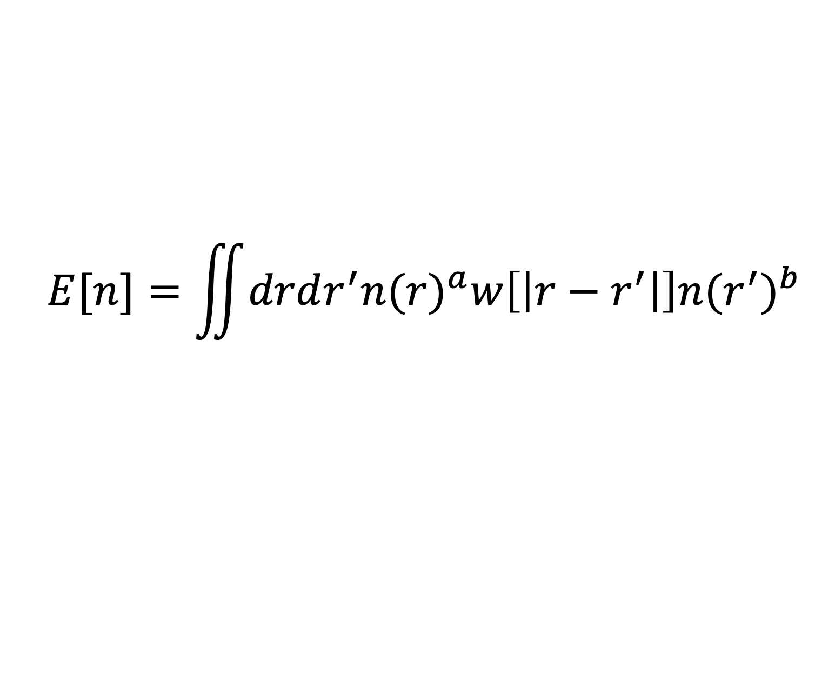

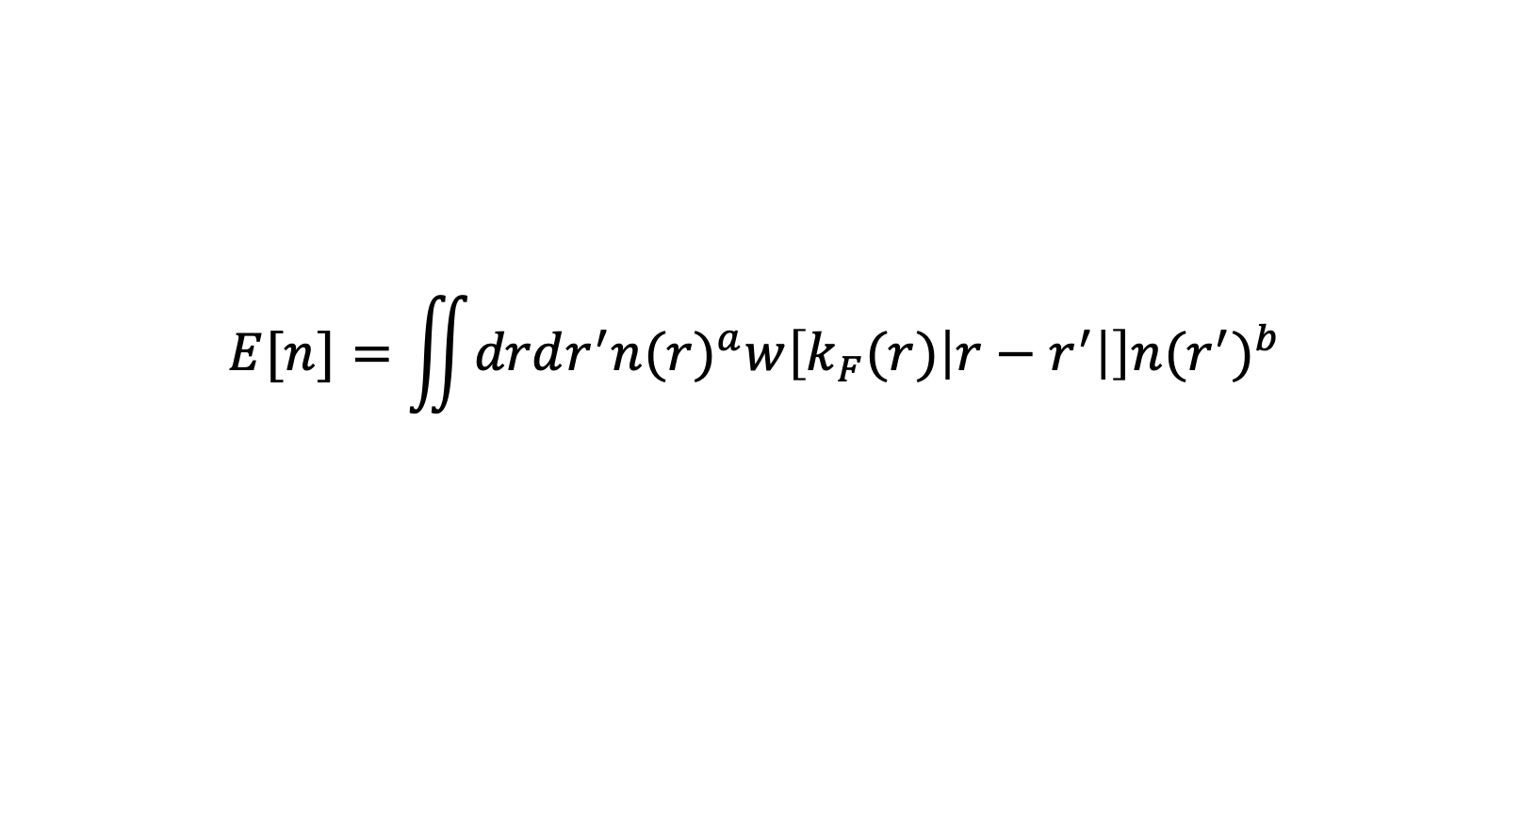

$$E[n]=\iint{drdr^{′}{n(r)}^{a}w\left[\left|r−r^{′}\right|\right]{n(r^{′})}^{b}}$$
$n(r)$ is the electron density in the space $r$.
$$E[n]=\iint{drdr^{′}{n(r)}^{a}w\left[k_{F}(r)\left|r−r^{′}\right|\right]{n(r^{′})}^{b}}$$
$$k_{F}\left(r\right)={\left(3π^{2}n\left(r\right)\right)}^{\frac{1}{3}}$$
$$k_{F}\left(r\right)={\left(3π^{2}n\left(r\right)\right)}^{\frac{1}{3}}⇒\frac{dk_{F}(r)}{dn(r_{1})}={\left[3π^{2}\right]}^{\frac{1}{3}}\frac{1}{3} n{\left(r\right)}^{−\frac{2}{3}} δ\left(r−r_{1}\right)$$

Slide 2
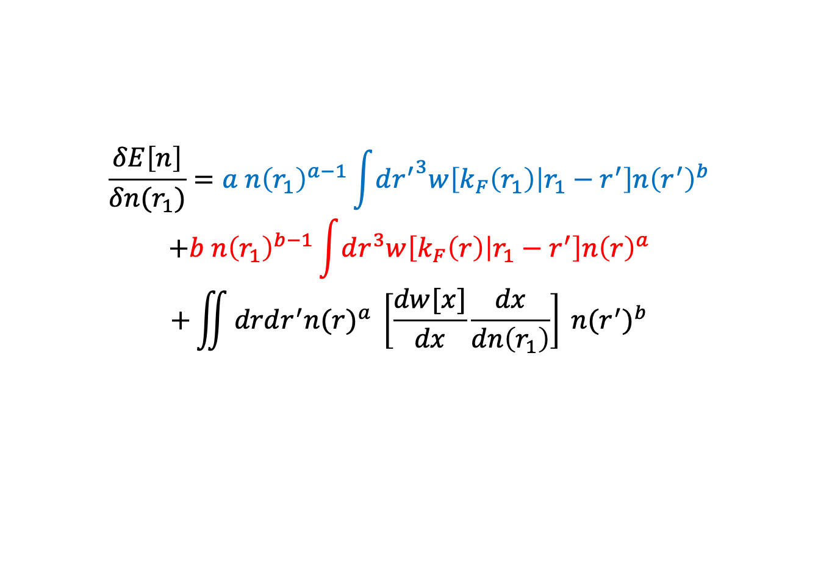
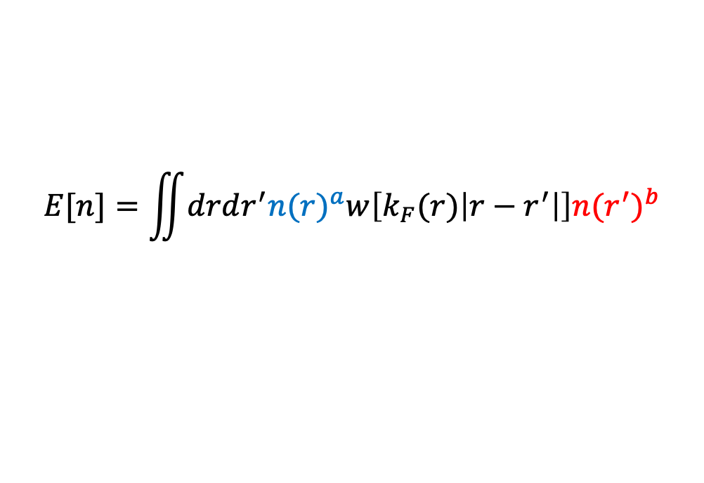

$$E[n]=\iint{drdr^{′}{n(r)}^{a}w\left[k_{F}(r)\left|r−r^{′}\right|\right]{n(r^{′})}^{b}}$$
Let’s denote $x=k_{F}(r)\left|r−r^{′}\right|$
$$\frac{δE\left[n\right]}{δn(r_{1})}=a n{\left(r_{1}\right)}^{a−1}\int{d{r^{′}}^{3}w\left[k_{F}\left(r_{1}\right) | r_{1}−r^{′}\right]n{\left(r^{′}\right)}^{b}}$$
$$+b n{\left(r_{1}\right)}^{b−1}\int{dr^{3}w\left[k_{F}\left(r\right) | r_{1}−r^{′}\right]n{\left(r\right)}^{a}}$$
$$+\iint{drdr^{′}{n(r)}^{a} \left[\frac{dw[x]}{dx}\frac{dx}{dn\left(r_{1}\right)}\right] {n(r^{′})}^{b}}$$
$$\frac{dx}{dn\left(r_{1}\right)}=\frac{dk_{F}(r)\left|r−r^{′}\right|}{dn(r_{1})}=\left|r−r^{′}\right|\frac{dk_{F}\left(r\right)}{dn\left(r_{1}\right)}=|r−r′|{\left[3π^{2}\right]}^{\frac{1}{3}}\frac{1}{3} n{\left(r\right)}^{−\frac{2}{3}} δ\left(r−r_{1}\right)$$

Slide 3
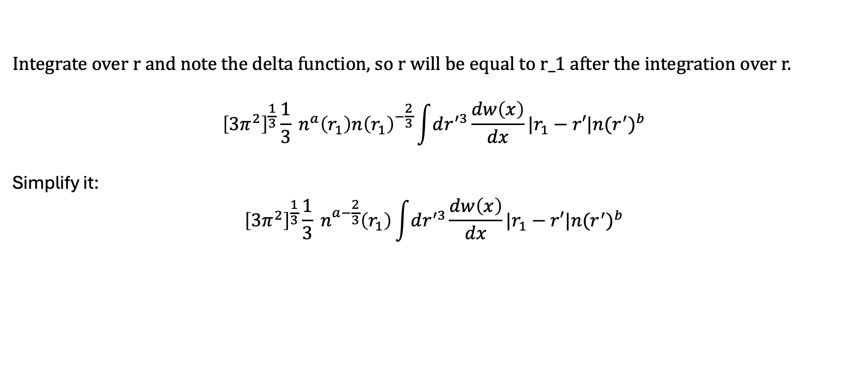
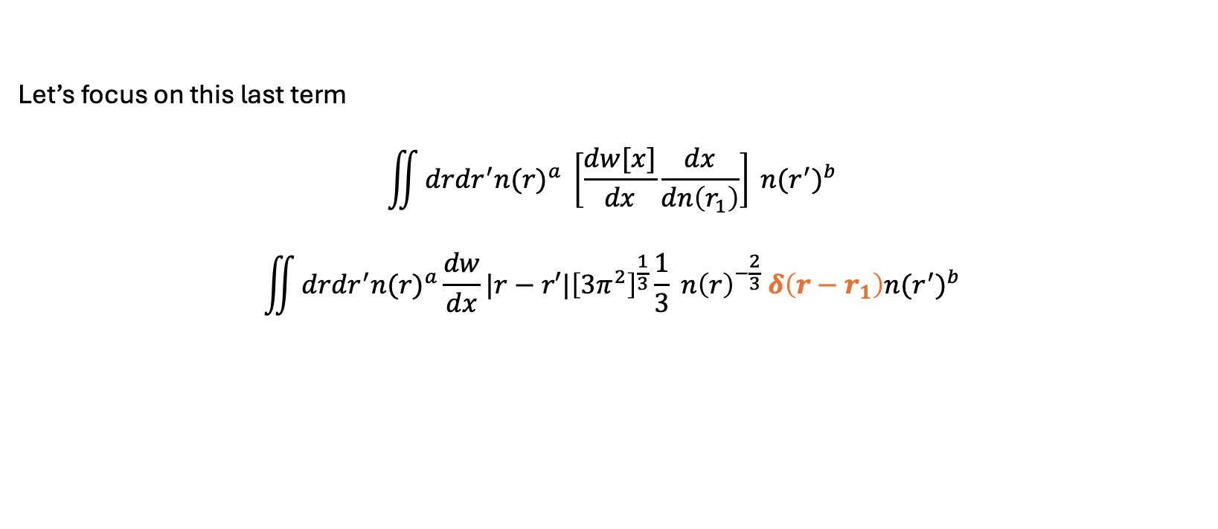
Let’s focus on this last term
$$\iint{drdr^{′}{n(r)}^{a} \left[\frac{dw[x]}{dx}\frac{dx}{dn\left(r_{1}\right)}\right] {n(r^{′})}^{b}}$$
$$\iint{drdr^{′}{n(r)}^{a}\frac{dw}{dx}|r−r′|{\left[3π^{2}\right]}^{\frac{1}{3}}\frac{1}{3} n{\left(r\right)}^{−\frac{2}{3}} δ\left(r−r_{1}\right){n(r^{′})}^{b}}$$
Integrate over r and note the delta function, so r will be equal to r_1 after the integration over r.
$${\left[3π^{2}\right]}^{\frac{1}{3}}\frac{1}{3} n^{a}\left(r_{1}\right)n{\left(r_{1}\right)}^{−\frac{2}{3}}\int{dr^{′3}}\frac{dw\left(x\right)}{dx}|r_{1}−r′|{n(r^{′})}^{b}$$
Simplify it:
$${\left[3π^{2}\right]}^{\frac{1}{3}}\frac{1}{3} n^{a−\frac{2}{3}}\left(r_{1}\right)\int{dr^{′3}}\frac{dw\left(x\right)}{dx}|r_{1}−r′|{n(r^{′})}^{b}$$
$$x=k_{F}(r_{1})|r_{1}−r^{′}|$$

