Slide 1
Outline
Introduction
Objectives
Exiting System
Proposed System
E-R Diagram
User Interface
Limitation
Future Goals
Conclusion

Slide 2
Introduction
The pharmacy management system can handle all the details about a medicine.
Medicine details, search, update ,delete etc.
It is an automated version of manual pharmacy management system.
It also facilitate keeping all the records of medicine, such as medicine name, medicine id, category , price etc.
So all the information about medicine will be available in a law seconds.

Slide 3
Objectives
To design a system that can keep and track of user.
To design a system that is useful to handling medicine.
To design a system that is much better than manual data recording system.
To design a system that is easy to search medicine

Slide 4
Proposed System
From the problems listed in the existing system, the implementation of the proposed system shall focus on:
Pharmacists having access to the proposed system at any time.
Improving the efficiency of the system by ensuring effective monitoring of services and activities.
Generating report within a specified period of time.
Reducing the employee’s workload.

Slide 5
Proposed system
By developing the system can attain the following features:
Easy to handle and feasible
Easy to search any medicine information .
Admin also edit any medicine information
Add new medicine information,update,search,view and delete options.
Fast and Convenient

Slide 6
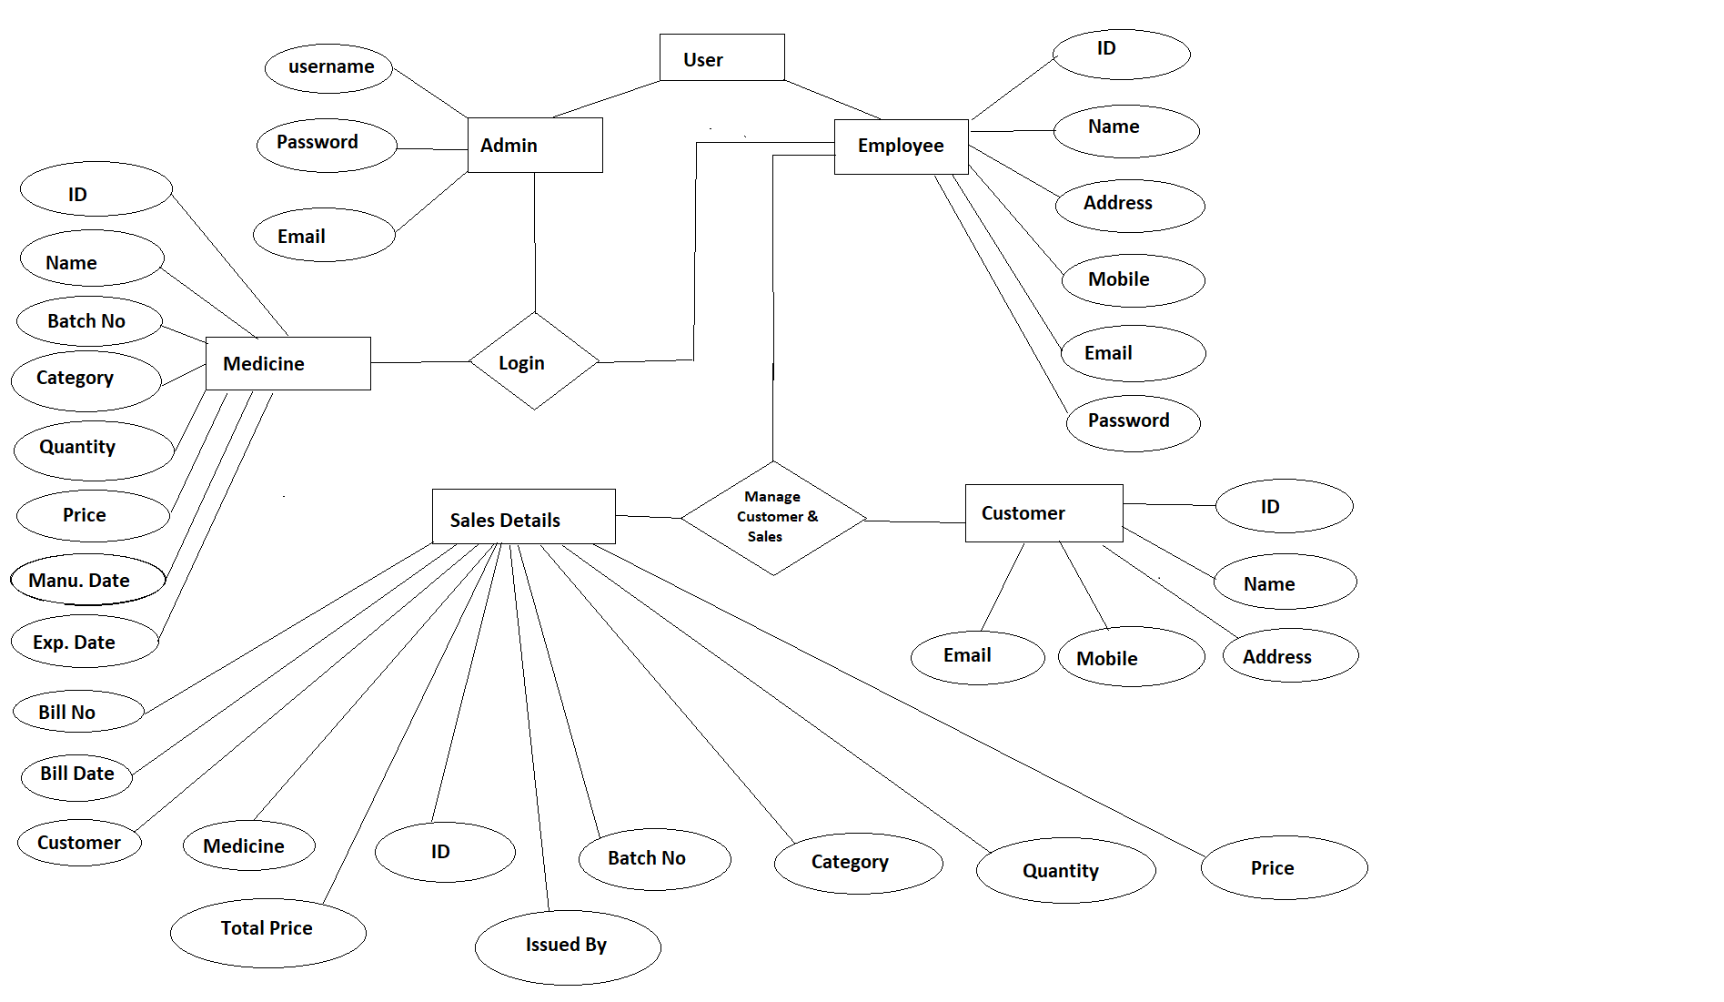
E-R Diagram

Slide 7
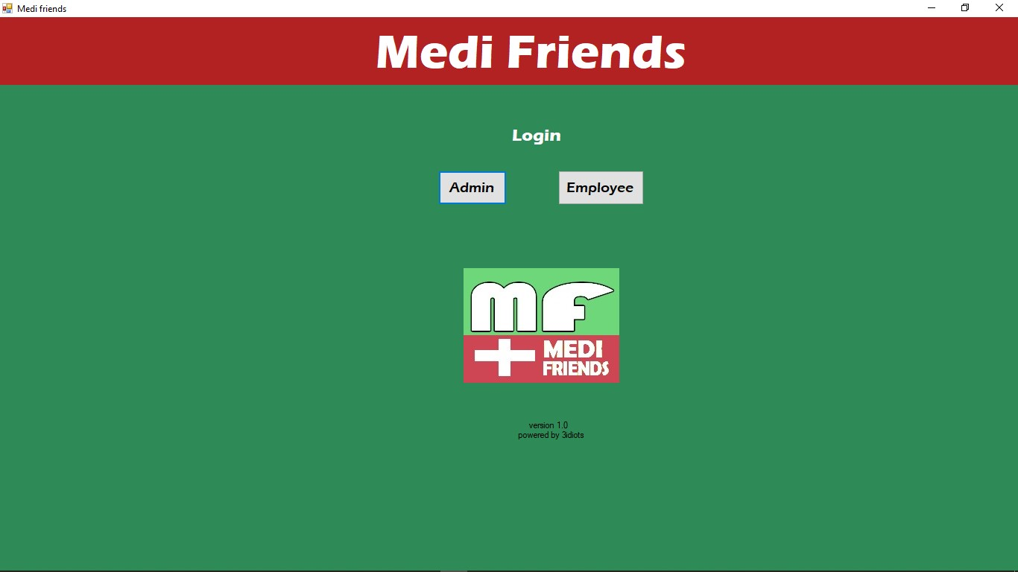
.
Login Page

Slide 8
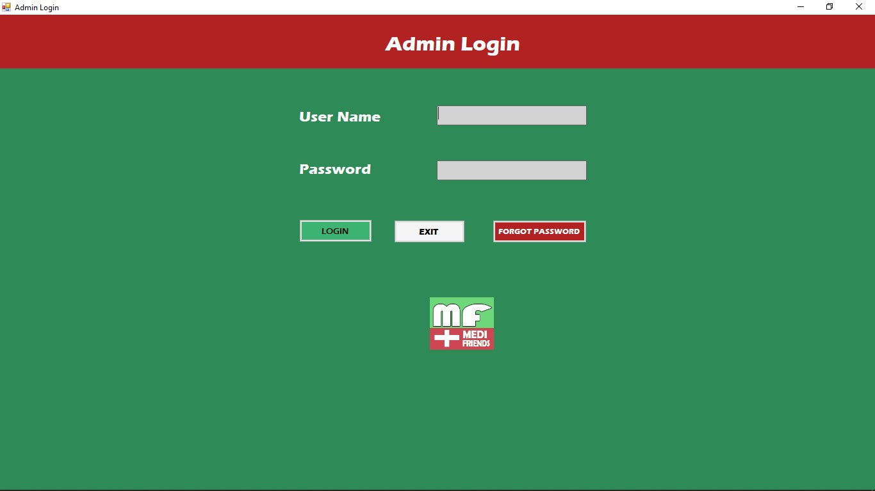
Admin Login

Slide 9
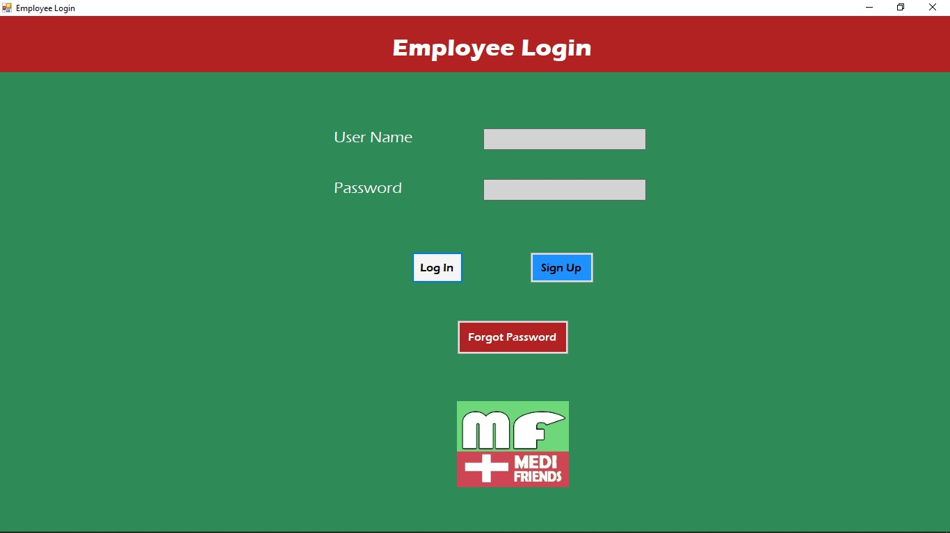
Employee Login

Slide 10
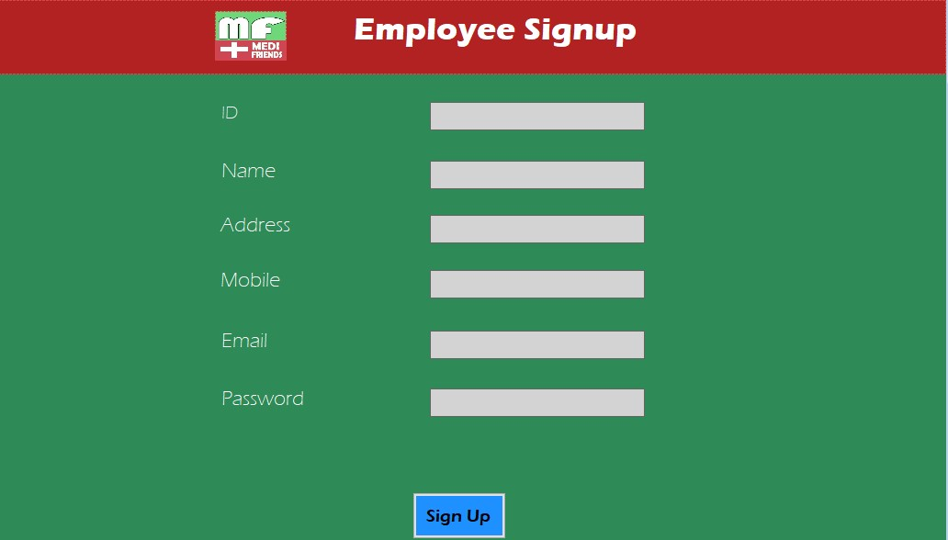
Employee Signup

Slide 11
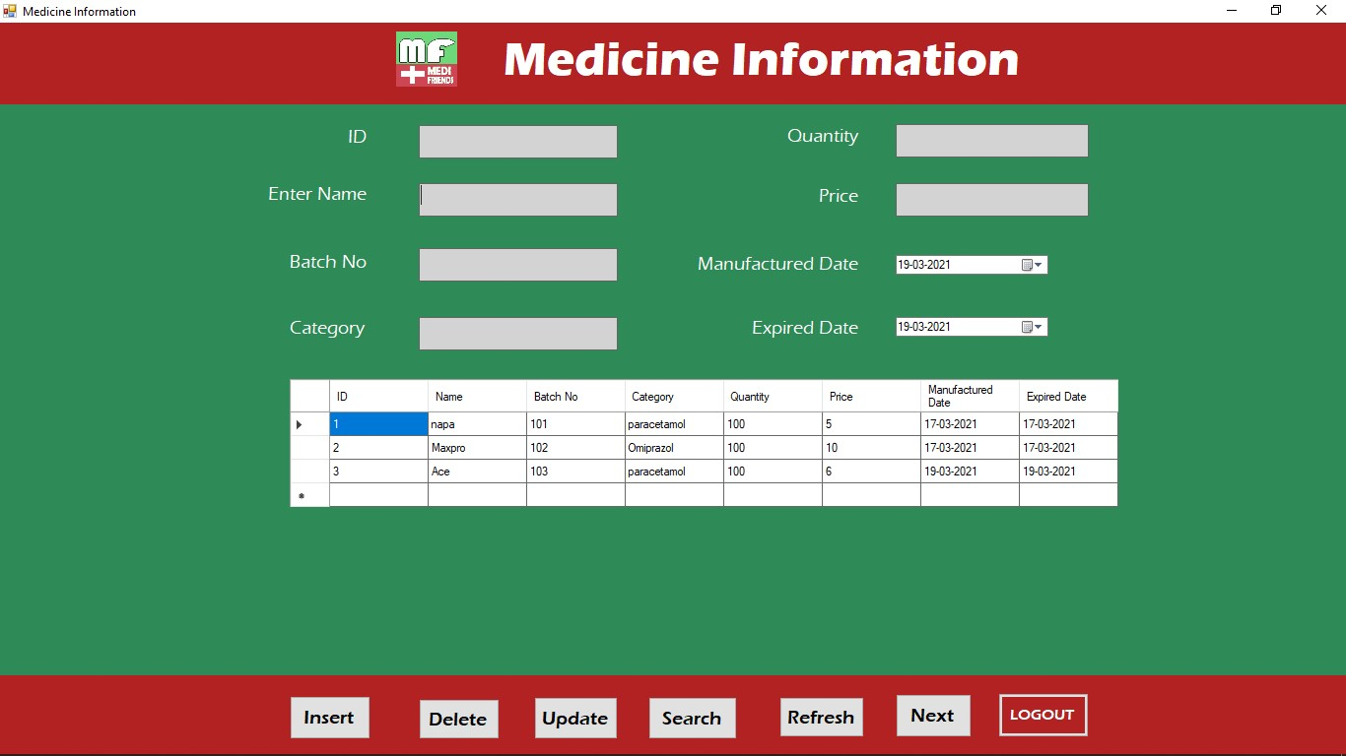
Medicine Information

Slide 12
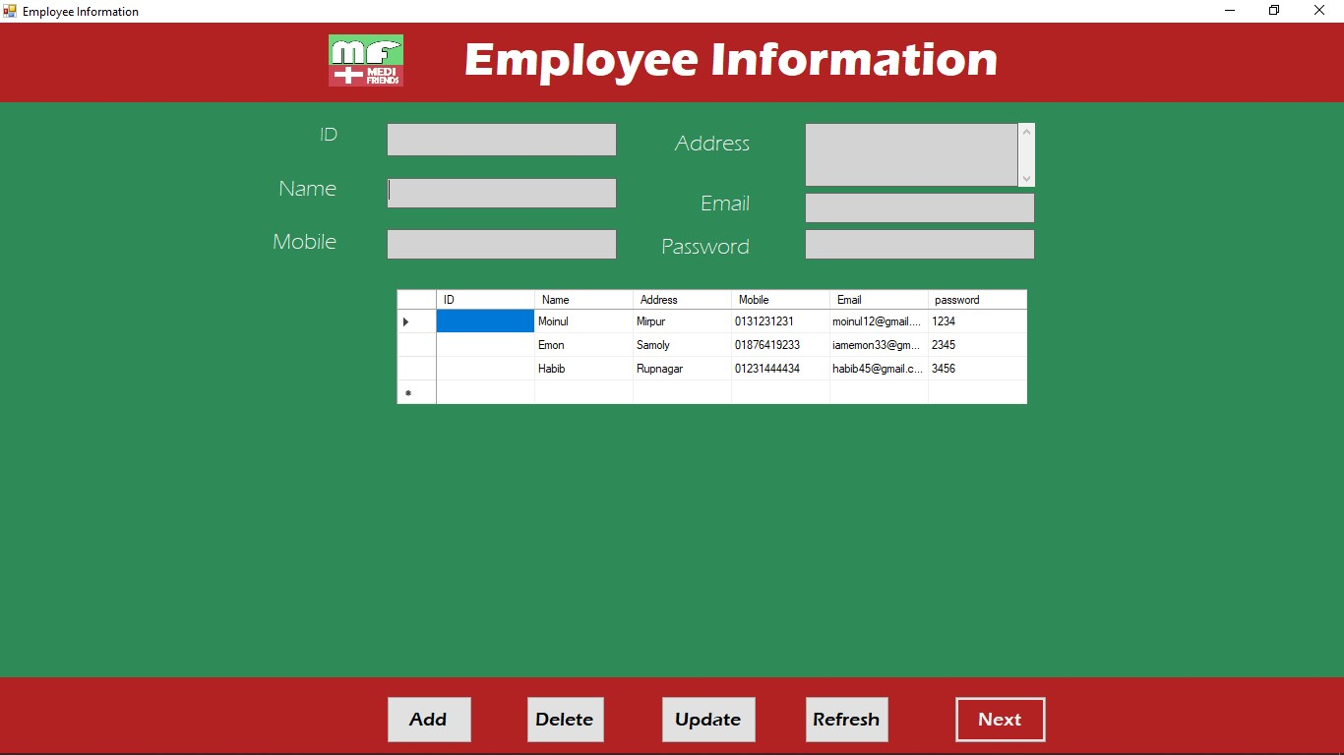
Employee Details

Slide 13
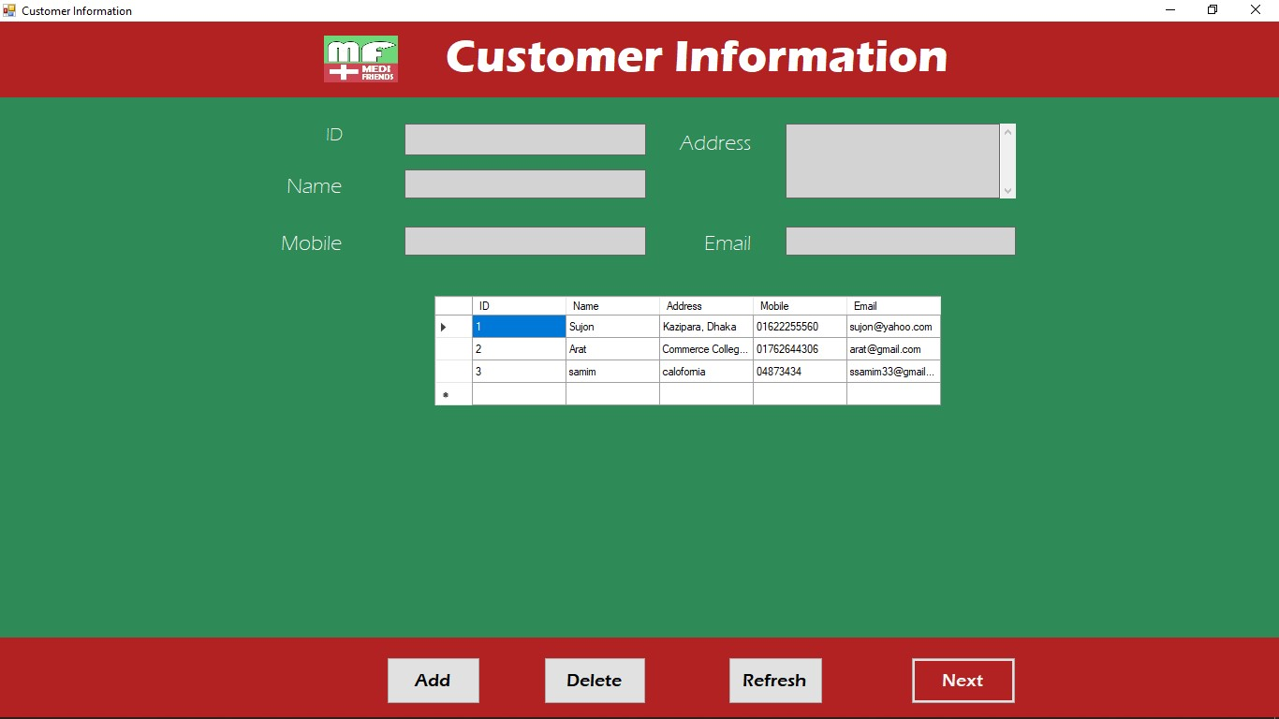
Customer Information

Slide 14
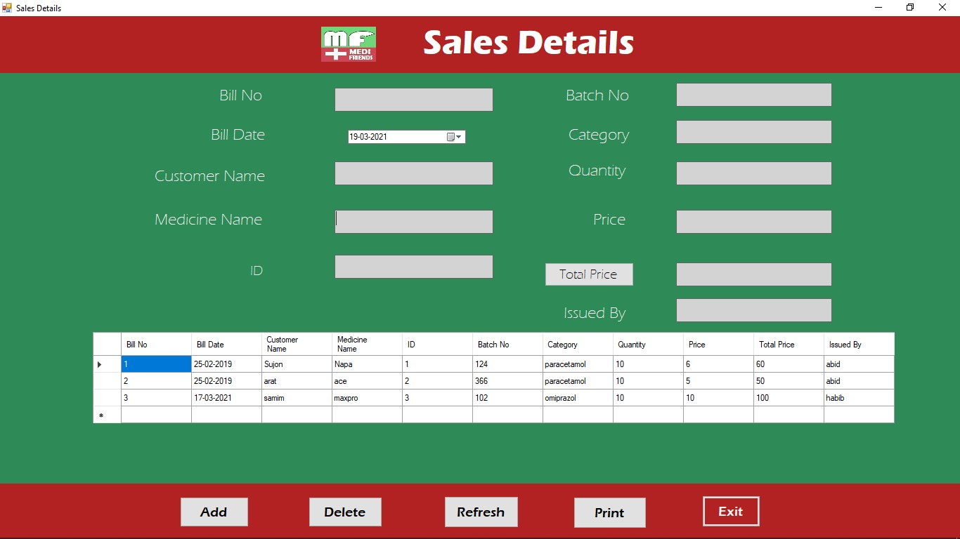
Sales Details

Slide 15
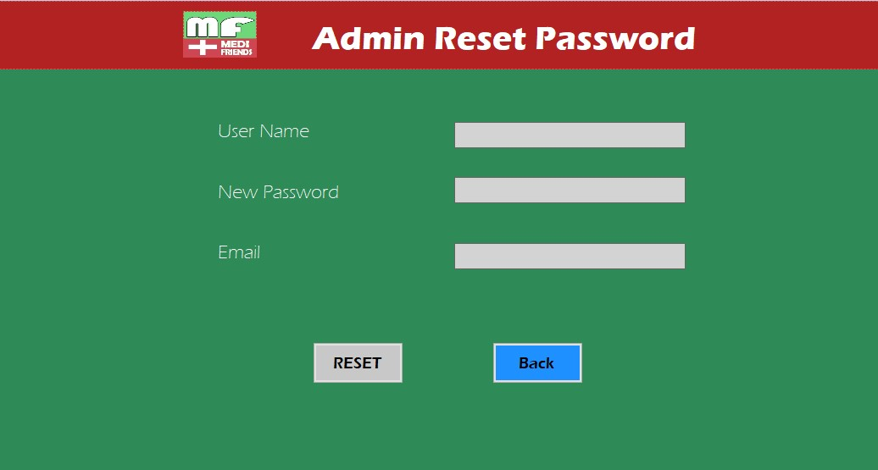
Admin Reset Password

Slide 16
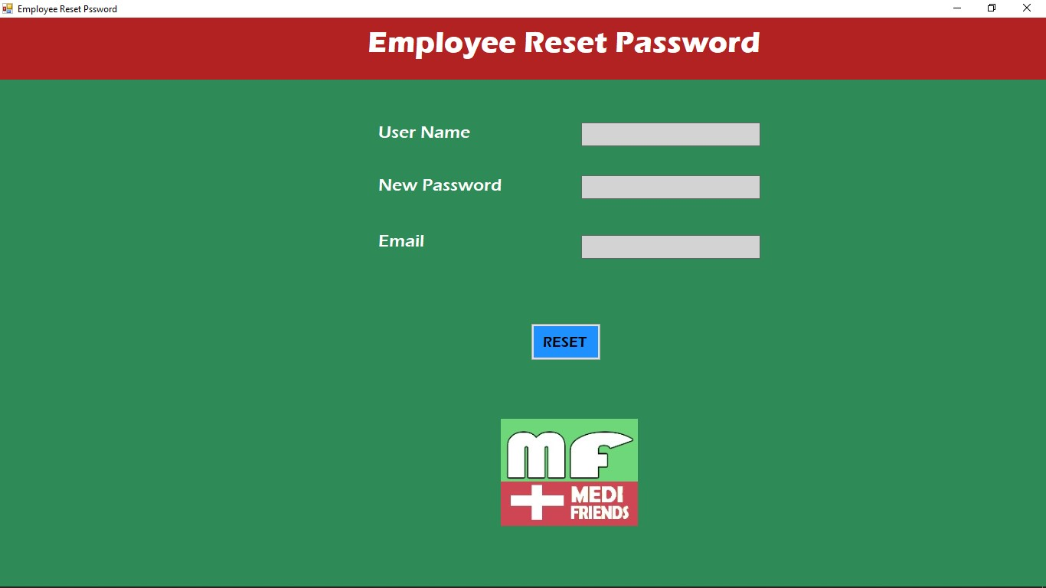
Employee Reset Password

Slide 17
Limitations
Time delay
Redundancy
Accuracy
Information Retrieval
Storage Media

Slide 18
Future Goals
In future add graphics and upgrade this system.
To enable the head and technical supporting group to access the system from anywhere.
To enable the customer buy medicine in online .

Slide 19
Conclusion
It is user-friendly application.
It is easy to use and handle .
It is helps pharmacist to easy to find any medicine price and expire date.

Slide 20

Thank you !

