Slide 1
Lizard Warrior Team
C# 2 Teamwork

Slide 2
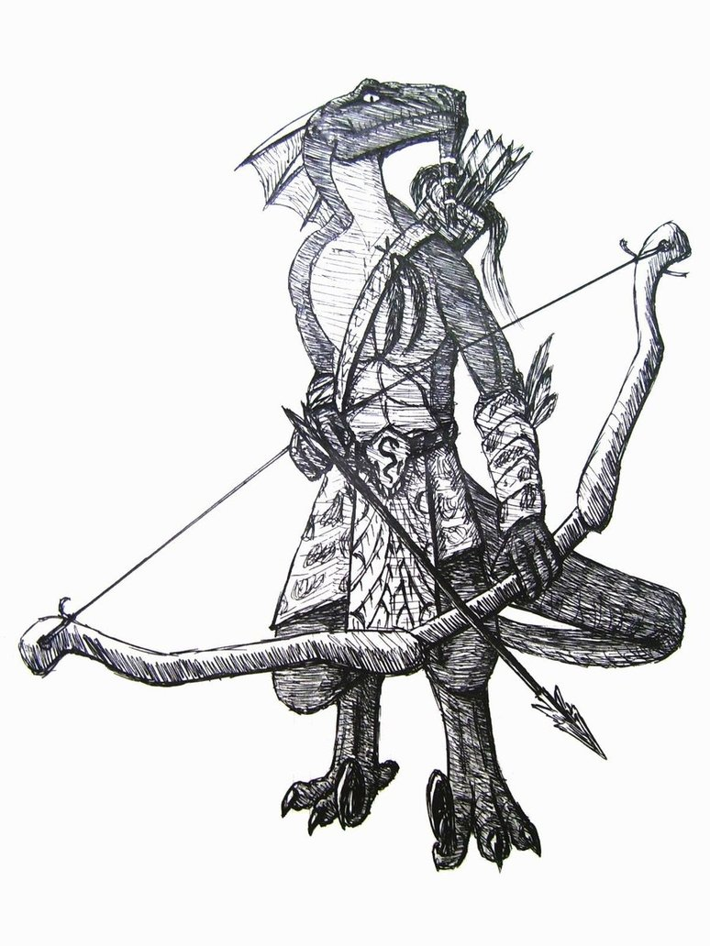

Slide 3
OUR TEAM
Dimitar Gulenov (Димитър Гуленов) – dimitar.gulenov
Ivan Trendafilov (Иван Трендафилов) – Wanker
Lyubomir Yonchev (Любомир Йончев) – Moiraine
Mariya Stoykova (Мария Стойкова) – mariya.stoykova
Martin Tsvetkov (Мартин Цветков) – martyzbg
Petya Kostova (Петя Костова) – pepsi_555
Plamen Bardarov (Пламен Бърдаров) – plomba97
Plamen Dimitrov (Пламен Димитров) – loki88

Slide 4
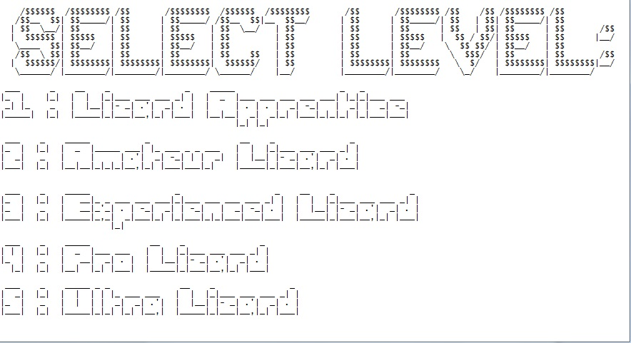
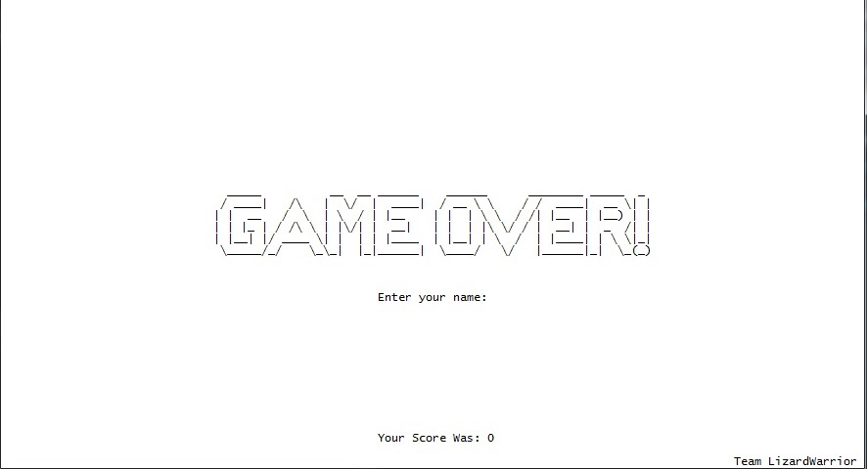
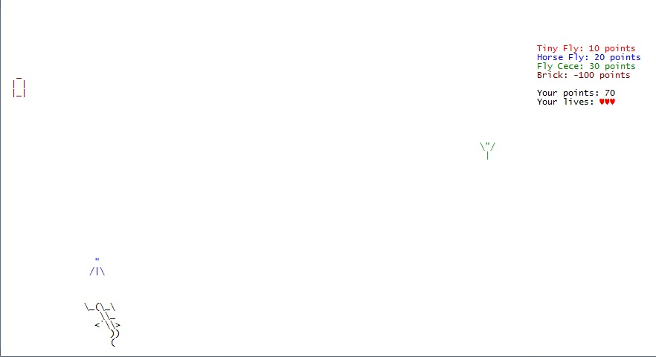
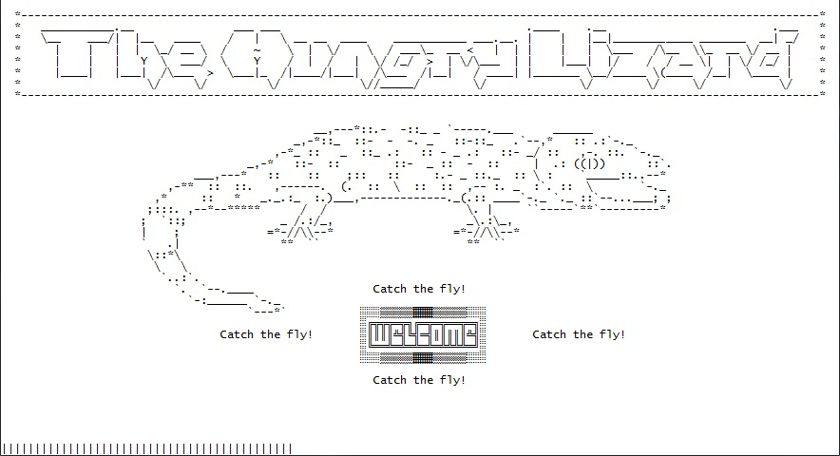
Game description
Hungry Lizard – What is it?
Levels of difficulty
Points system
Bugs/ Features

