Slide 1

NDARUHUTSE MOISE
Monday_28340_Ndaruhutse_Secure user login system_presentation.pptx
Final Exam project PL\SQL

Slide 2
Project Title : Secure user login and activity logging system
Element | Detail
Project Title | Secure User Login and Activity Logging System
Student | Ndaruhutse Moise (ID: 28340)
Course | Database Development with PL/SQL (INSY 8311)
Instructor | Eric Maniraguha
Date | 01/12/2025

Slide 3
Problem Statement & Project Objectives (Phase I)
Problem Definition: Many systems lack robust, auditable mechanisms for user authentication, access control, and activity tracking, leading to security vulnerabilities and compliance risks.
Core Challenge: Prevent unauthorized access and ensure all login attempts are reliably recorded for security auditing.
Project Objectives (S.M.A.R.T.):
  Ensure Role-Based Access Control (User/Admin).
  Implement Secure Authentication using password hashing.
  Automatically lock accounts after a threshold of failed attempts.
  Maintain a comprehensive Activity Log of all login attempts.

Slide 4
Business Process Model (Phase II)
Scope: End-to-end login attempt, credential validation, lockout mechanism, and audit recording.
Key Actors & Components:
User/Admin: Submits credentials and performs administrative functions.
Application: Interfaces between User and Database.
Auth Service (PL/SQL Package): Handles validation, logging, and lockouts.
Process Flow (BPMN Summary):
User enters credentials $\rightarrow$ Auth Package validates $\rightarrow$ SUCCESS (reset fails, log success) OR FAILED (increment fails, check threshold, log failure) OR LOCKED (log failure, deny access).
MIS Relevance: Provides auditable data (login_log, audit_log) essential for compliance and security reporting.

Slide 5
Logical Data Model (ERD) (Phase III)
Focus: Structured data required to support the login, auditing, and lockout processes.
Key Tables & Relationships:
SECURE_USERS: Stores credentials (hashed), roles, lockout status (is_locked, failed_attempts). (Parent Table)
LOGIN_LOG: Records every attempt (success/fail, source IP). (Child of SECURE_USERS)
ACCOUNT_LOCKS: History of every lockout/unlock event. (Child of SECURE_USERS)
AUDIT_LOG: General DML audit trail (e.g., user creation, unlock).
Security Feature: Passwords are never stored in plain text; only a SHA-256 password_hash is stored.
Visual:

Slide 6
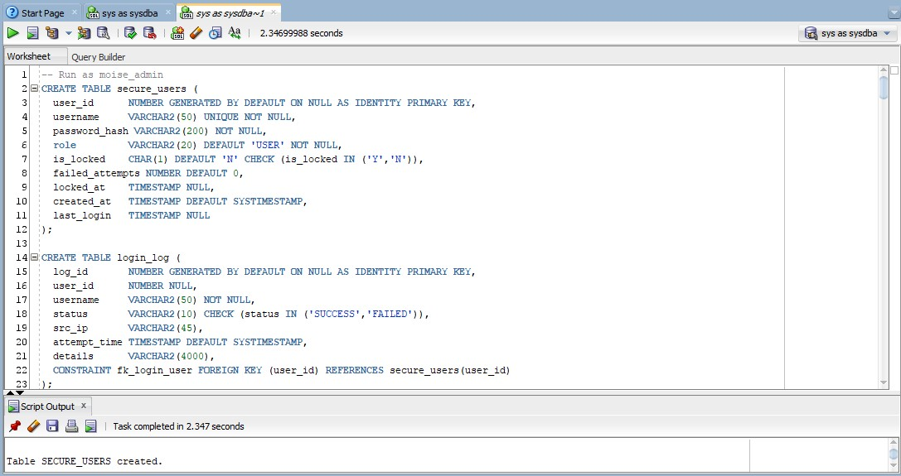
Database & Table Implementation (Phases IV & V)
Database Setup: Oracle Pluggable Database mon_28340_Moise_securesystem_DB.
Key Implementation Details (DML):
SECURE_USERS.user_id: GENERATED BY DEFAULT ON NULL AS IDENTITY (Auto-PK).
Data Security: password_hash is VARCHAR2(200) NOT NULL.
Constraints: is_locked uses CHECK (is_locked IN ('Y','N')).
Foreign Key: LOGIN_LOG references SECURE_USERS (fk_login_user).
Data Population: 200 users and 1000 randomized login attempts were generated using PL/SQL loops to create realistic test data, including failures and lockouts.

Slide 7
PL/SQL Authentication Package (Phase VI)
              Main Component: pkg_auth package to centralize all security logic.
Key Procedures & Functions:
hash_password(p_plain): Encrypts the input password using STANDARD_HASH('SHA256').
authenticate(p_username, p_password, p_src_ip, p_result OUT):
  Checks for lock status first.
  Compares the input hash with the stored hash.
  On success, resets failed_attempts and updates last_login.
  On failure, increments failed_attempts and triggers lockout if $\ge 5$ attempts.
unlock_user(p_username, p_admin): Allows administrators to reset account lock status.
Configuration: c_lock_threshold CONSTANT NUMBER := 5;

Slide 8
Advanced Programming & Auditing (Phase VII)
Automated Auditing (Triggers):
trg_audit_secure_users: An AFTER DML trigger on SECURE_USERS that automatically records all INSERT, UPDATE, or DELETE actions into the AUDIT_LOG table.
Business Rule Enforcement (Triggers):
trg_restrict_user_changes: Implements the course requirement to restrict non-admin DML on SECURE_USERS during weekdays and public holidays. This demonstrates conditional access restriction.
Cursor Example: A cursor (c_suspicious) was developed to efficiently query and report on users with $\ge 3$ failed attempts.

Slide 9
Security Concepts Demonstrated
Data Encryption/Hashing: Used STANDARD_HASH('SHA256') for secure password storage.
Role-Based Access Control (RBAC): Implemented via the role column (USER / ADMIN) and utilized in the DML restriction trigger.
Authentication & Access Restriction: Managed securely via the pkg_auth.authenticate procedure and the account lockout feature.
Activity Auditing: Achieved through the LOGIN_LOG table and the AUDIT_LOG trigger.
Error Handling: Implemented in PL/SQL (e.g., WHEN NO_DATA_FOUND in authenticate) to gracefully handle unknown usernames and log the failed attempt.

Slide 10
Conclusion & Future Enhancements
Conclusion: The project successfully implemented a secure, auditable, and resilient user authentication system using core PL/SQL concepts (packages, procedures, functions, and triggers).
Key Achievement: Demonstrated secure password hashing and an automatic lockout mechanism.
Future Enhancements:
Advanced Lockout: Implement time-based lockouts (e.g., 30 minutes).
Password Policies: Add procedures to enforce password expiration and complexity.
Session Management: Extend the logging to track user activity after successful login across multiple sessions.

