Slide 1

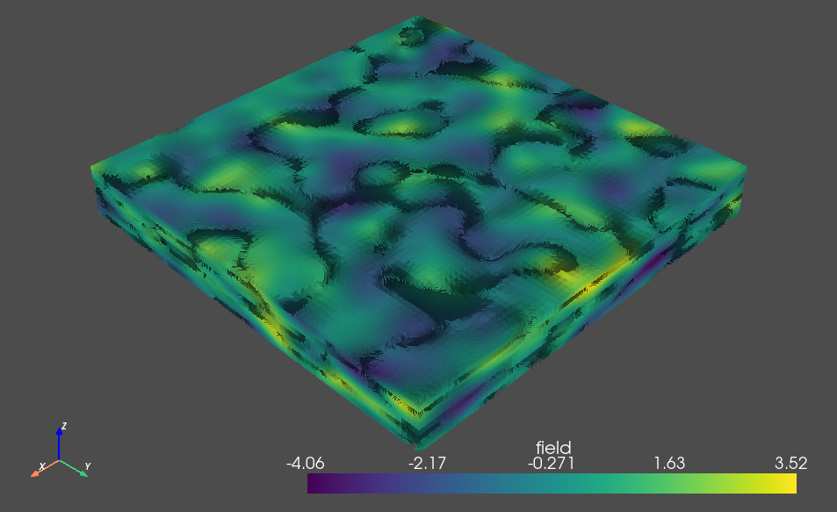
Generation of Petrophysical Data
Developer: Dr. Moises Velasco-Lozano

Slide 2
Workflow in Python
2

Slide 3

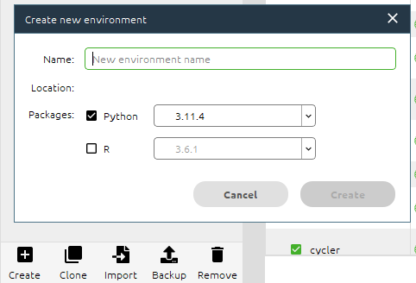
1 – Create a new environment in Python
A
Open Anaconda and click on Environments
B
Go to the bottom and click on Create

Slide 4

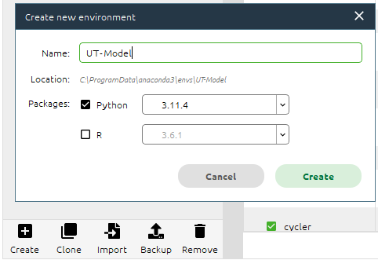
1 – Create a new environment in Python
C
Give a name to this new environment and
click on Create
D
Go back to Environments and click on the new
environment created

Slide 5
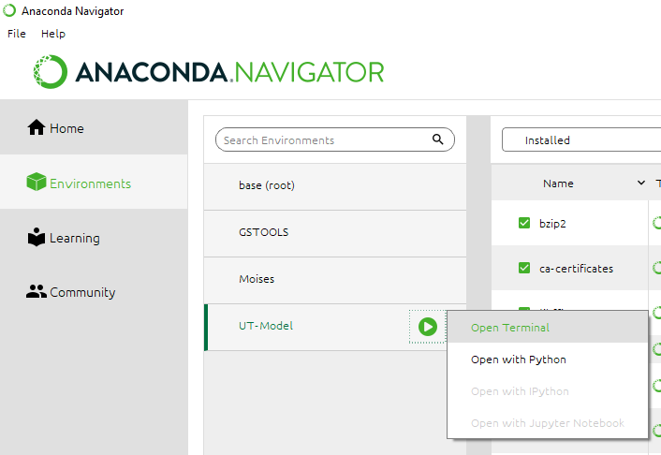
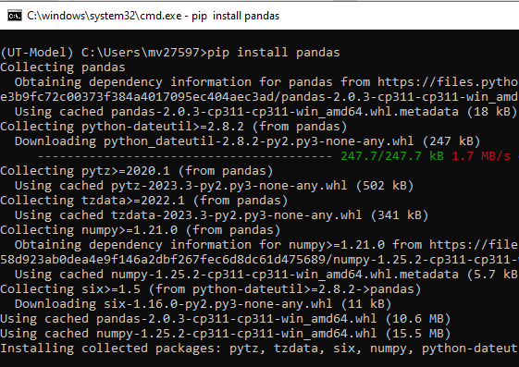
2 – Install libraries
E
Open a terminal to install the required
libraries
F
In this prompt type: pip install pandas
5

Slide 6


2 – Install libraries
G
Similarly, install the following libraries
H
Go back to Anaconda menu and install Jupyter and
launch it!
pip install numpy
pip install gstools
conda install matplotlib
6

Slide 7
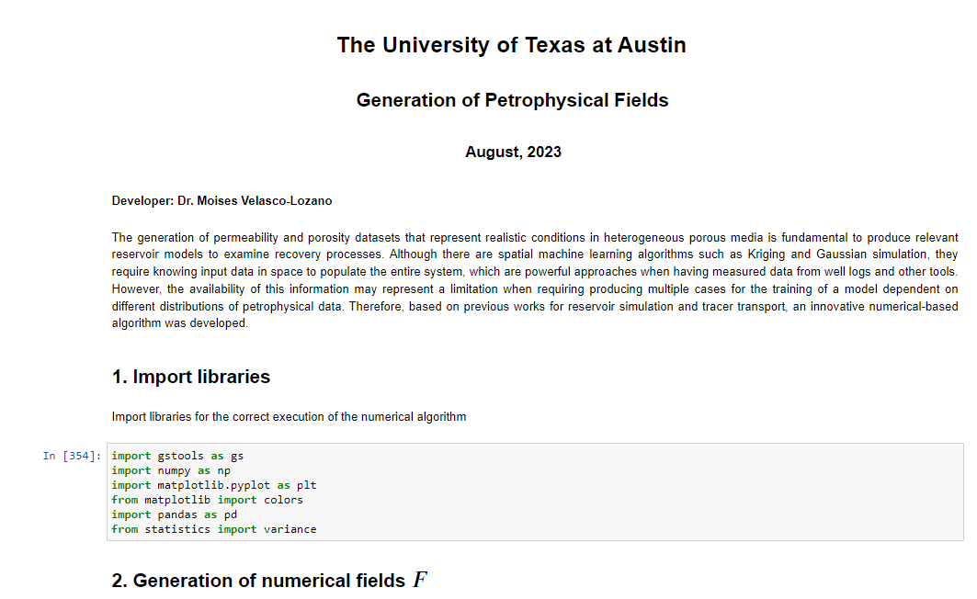
3 – Open .ipynb file
I
open Petrophysical fields.ipynb file
7

Slide 8
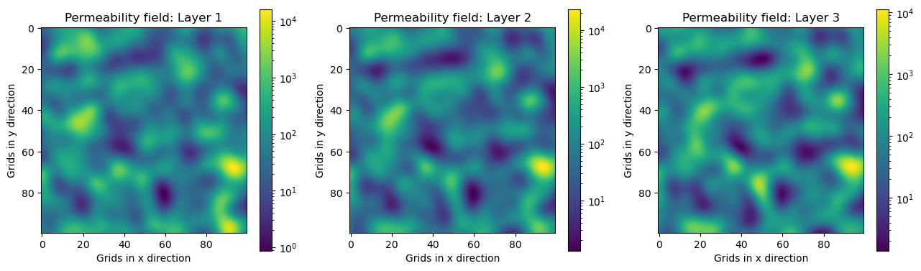
4 – Results
Following the workflow and the steps described in the .ipynb file, multiple heterogeneous permeability and porosity fields can be generated to feed numerical reservoir models
The following are a few datasets obtained:
8

Slide 9
Datasets
9

Slide 10
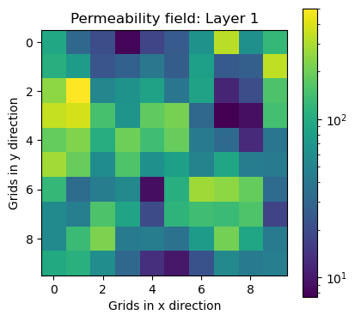
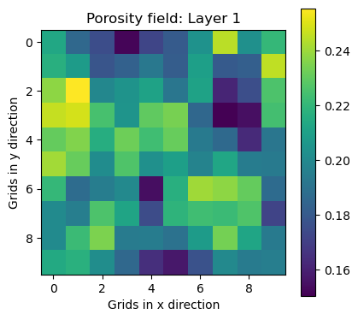







Case 1
$X$= 10, $Y$=10, $Z$=1
Correlation length [1, 1, 1]
$V_{DP}$ = 0.6
$\overline{k}$ = 100 md
$$σ=1$$
Seed = 10
$$θ=0$$
$$n_{1}=4$$
$$n_{2}=40$$
10

Slide 11
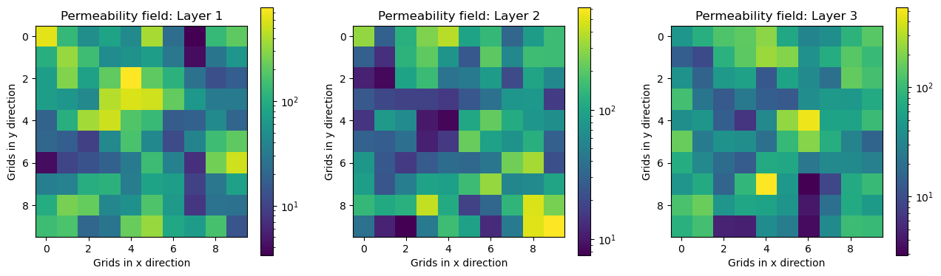
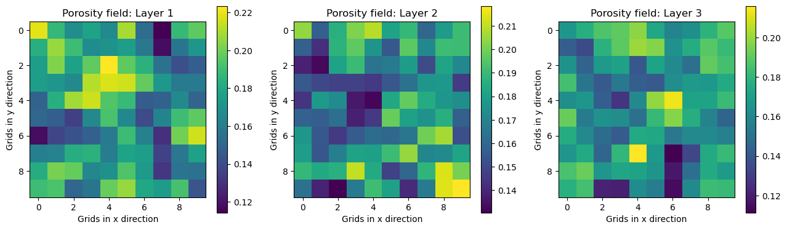




Case 2
$X$= 10, $Y$=10, $Z$=3
Correlation length [1, 1, 0.5]
$V_{DP}$ = 0.7
$\overline{k}$ = 100 md
$$σ=1$$
Seed = 26
$$θ=0$$
$n_{1}=4$.5
$$n_{2}=50$$
11

Slide 12
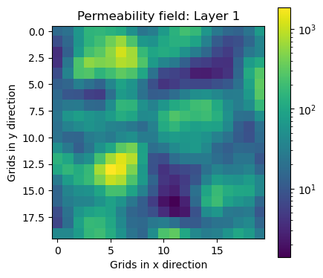
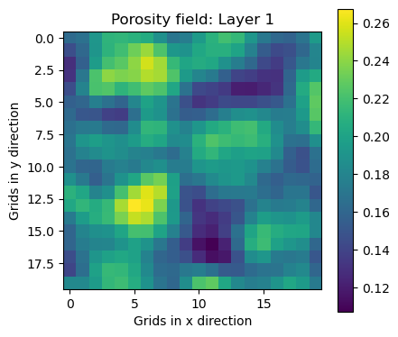



Case 3
$X$= 20, $Y$=20, $Z$=1
Correlation length [2, 2, 1]
$V_{DP}$ = 0.7
$\overline{k}$ = 100 md
$$σ=1$$
Seed = 13
$$θ=0$$
$$n_{1}=4.5$$
$$n_{2}=45$$
12

Slide 13
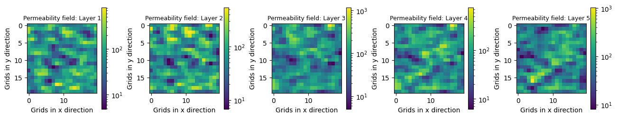
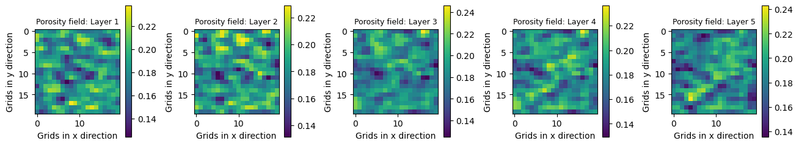

Case 4
$X$= 20, $Y$=20, $Z$=5
Correlation length [1, 1.5, 2]
$V_{DP}$ = 0.6
$\overline{k}$ = 100 md
$$σ=1$$
Seed = 29
$$θ=0$$
$$n_{1}=4$$
$$n_{2}=45$$
13

Slide 14
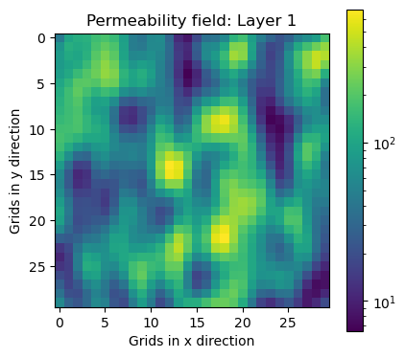
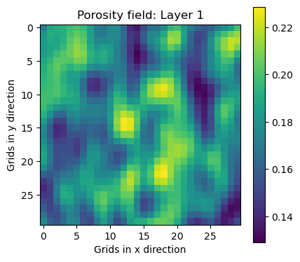




Case 5
$X$= 30, $Y$=30, $Z$=1
Correlation length [3, 2, 1]
$V_{DP}$ = 0.65
$\overline{k}$ = 100 md
$$σ=1$$
Seed = 21
$$θ=0$$
$$n_{1}=4.2$$
$$n_{2}=47$$
14

Slide 15
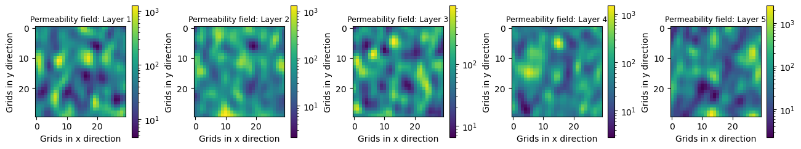
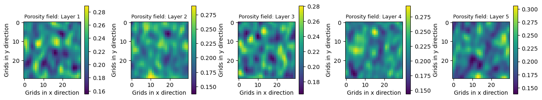



Case 6
$X$= 30, $Y$=30, $Z$=5
Correlation length [3, 2, 1]
$V_{DP}$ = 0.65
$\overline{k}$ = 100 md
$$σ=1$$
Seed = 37
$$θ=0$$
$$n_{1}=5$$
$$n_{2}=42$$
15

Slide 16
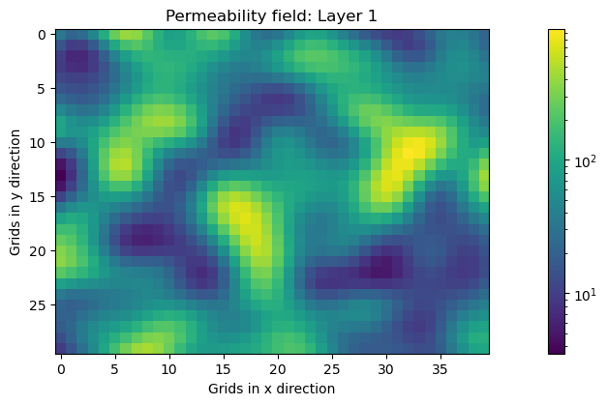


Case 7
$X$= 30, $Y$=40, $Z$=1
Correlation length [3, 4, 1]
$V_{DP}$ = 0.7
$\overline{k}$ = 100 md
$$σ=1$$
Seed = 31
$$θ=0$$
$$n_{1}=4.5$$
$$n_{2}=45$$
16

Slide 17
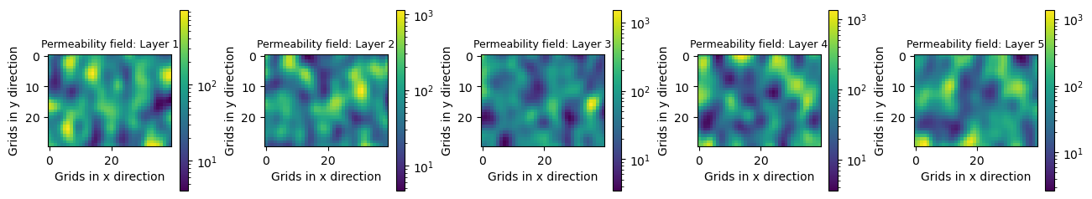
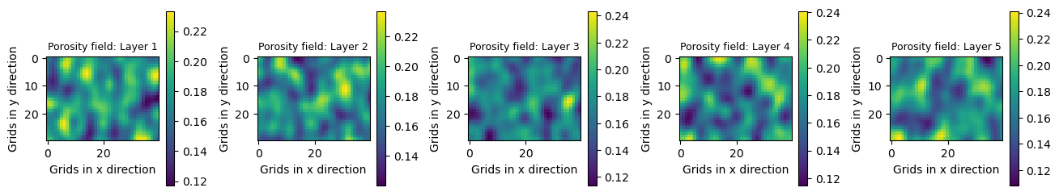



Case 8
$X$= 30, $Y$=40, $Z$=5
Correlation length [4, 3, 1]
$V_{DP}$ = 0.67
$\overline{k}$ = 100 md
$$σ=1$$
Seed = 71
$$θ=0$$
$$n_{1}=4.1$$
$$n_{2}=47$$
17

Slide 18
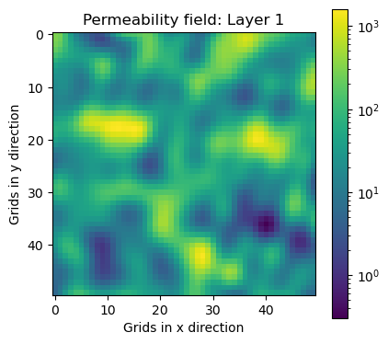
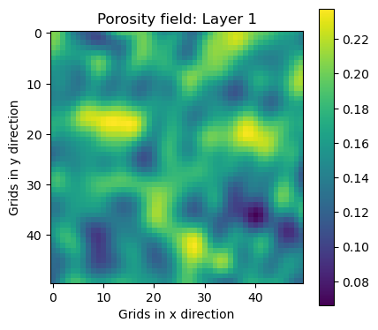
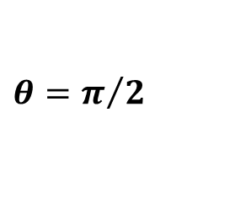


Case 9
$X$= 50, $Y$=50, $Z$=1
Correlation length [4, 4, 1]
$V_{DP}$ = 0.7
$\overline{k}$ = 100 md
$$σ=1$$
Seed = 45
$$θ=π/2$$
$$n_{1}=4.5$$
$$n_{2}=50$$
18

Slide 19
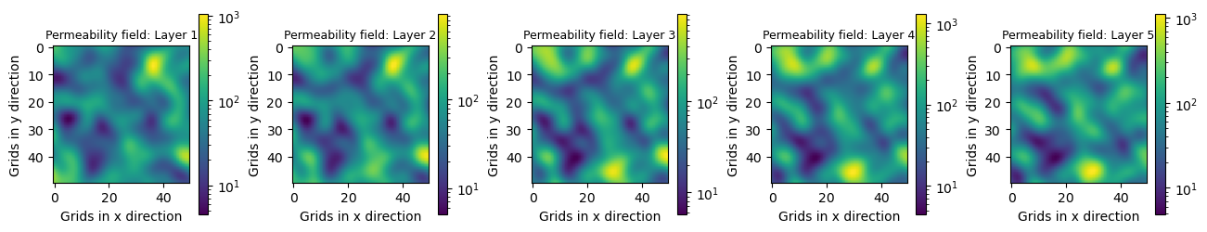
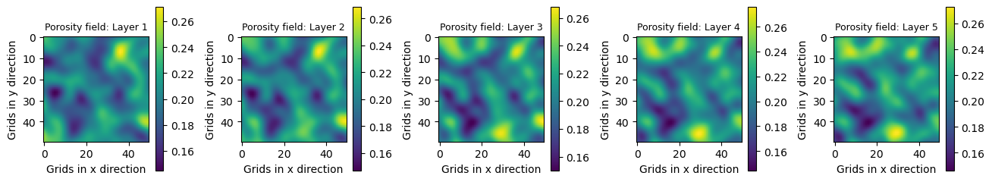




Case 10
$X$= 50, $Y$=50, $Z$=5
Correlation length [5, 5, 3]
$V_{DP}$ = 0.63
$\overline{k}$ = 100 md
$$σ=1$$
Seed = 113
$$θ=0$$
$$n_{1}=4.7$$
$$n_{2}=43$$
19

Slide 20
Generation of Petrophysical Data
Developer: Dr. Moises Velasco-Lozano
Supervisor: Dr. Matt Balhoff
References
Velasco-Lozano, M. (2023). Modeling of Fluid Imbibition and Chemical Tracer Transport in Porous Media for Oil Recovery Applications. PhD Dissertation, The University of Texas at Austin, 2023.
Tham, S. L. (2015). A Simulation Study of Enhanced Oil Recovery Using Carbon Dioxide Foam in Heterogeneous Reservoirs. BS thesis, The Pennsylvania State University, 2015.
Sharma, A., Shook, G. M., and Pope, G. A. (2014). Rapid Analysis of Tracers for Use in EOR Flood Optimization. Presented at the SPE Improved Oil Recovery Symposium, Tulsa, Oklahoma, USA, April 12–16, 2014.
Peters, E. J. (2012). Advanced Petrophysics. Austin, TX: Live Oak Book Company.
Waggoner, J. R., Castillo, J. L., and Lake, L. W. (1992). Simulation of EOR Processes in Stochastically Generated Permeable Media. SPE Form Eval 7 (02): 173-180.
20

