Slide 1
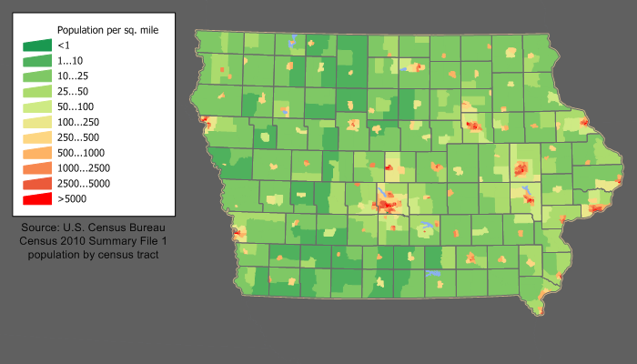
Sales model of Liqueur for Iowa State
Sparsely populate.
The profit margin for spirited beverages is 33.3% across all categories and locations.
Recent demography changes towards a more urban population profile.

Slide 2
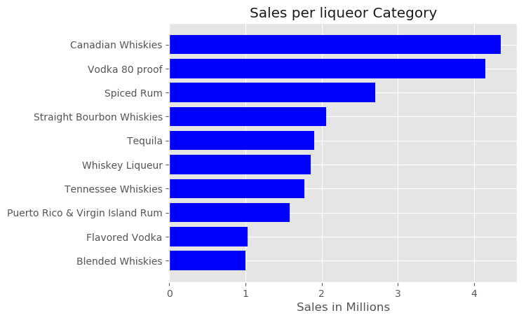
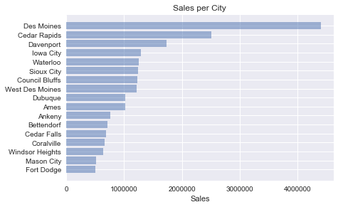
A tale of two variables
What people is drinking
Where they are drinking

Slide 3
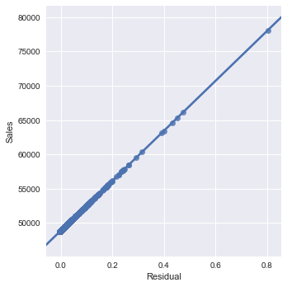
Model Technical Details
Mean absolute error =0.001(with scaled target)
It can predict sales within a error in thousands of dollars range

Slide 4
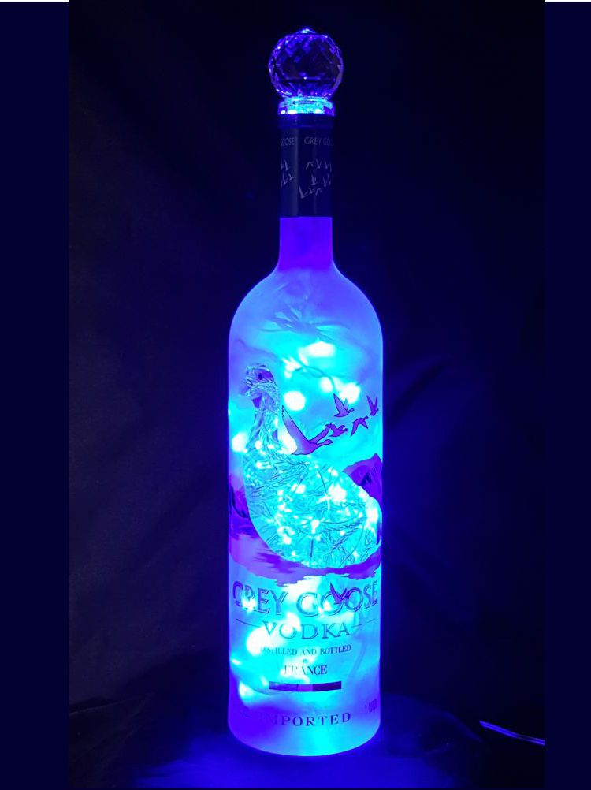
Top seller categories are dominated by Imported liqueurs with the exception Tennessee Whiskies
Emergent Markets should be the target, City like Ankeny increased duplicated its urban population recently

