Slide 1


CARFIX
i220617-i220987-i220903

Slide 2

INTRODUCTON
The problem of: Difficulty in efficiently scheduling and booking car repair services, often relying on phone calls or in-person visits, leading to delays and inconvenience for car owners.
A successful solution would be: A flexible, cost-effective, and user-friendly web-based system (CarFix) that allows car owners to book mechanic services online, view real-time availability, and track repair progress. The system would enable mechanics to manage their schedules, receive bookings, and communicate with customers efficiently. Users would access the system remotely via a web browser, ensuring convenience and reducing the need for physical or phone-based interactions.

Slide 3
FUNCTIONAL REQUIREMENTS
. Mechanic Profile Viewing
FR-010: The system shall display a list of mechanics with basic details (skills, ratings, location) accessible to car owners.
FR-011: The system shall allow users to view detailed mechanic profiles, including experience, certifications, and customer reviews.
FR-012: The system shall display mechanic ratings as a 1–5 star average and update them based on user feedback.
FR-013: The system shall provide navigation to return to the mechanic list from a detailed profile view.

Slide 4
Booking Management
FR-014: The system shall allow users to book a mechanic by selecting a mechanic, date, and time slot from available options.
FR-015: The system shall check mechanic availability and prevent double-booking of time slots.
FR-016: The system shall confirm bookings and display them on the user’s dashboard and mechanic’s schedule.
FR-017: The system shall allow users to select services (e.g., oil change, tire repair, brake repairs) during booking and associate them with the appointment.
FR-018: The system shall allow users to cancel a booking via the dashboard.
FR-019: The system shall notify the mechanic of cancellations and update their availability.
FR-020: The system shall allow users to reschedule an appointment by selecting a new date and time from available slots.
FR-021: The system shall update the booking details and mechanic’s schedule upon rescheduling.

Slide 5
Service Selection
FR-022: The system shall provide a list of basic services (e.g., oil change, tire repair) for users to select during booking.
FR-023: The system shall calculate and display an estimated cost for selected basic services.
FR-024: The system shall provide a list of specialized services (e.g., brake repairs) for users to select during booking.
FR-025: The system shall provide a detailed cost estimate for selected specialized services.

Slide 6
Mechanic Search and Filtering
FR-032: The system shall allow users to search for mechanics by basic service type (e.g., oil change) and display matching mechanics sorted by rating.
FR-033: The system shall allow users to search for mechanics by specialized service type (e.g., brake repairs) and display matching mechanics sorted by proximity or ratings.
FR-034: The system shall allow users to refine search results with filters (e.g., location, availability).
FR-035: The system shall allow users to filter mechanics by availability within a specified time window and update the list in real-time.

Slide 7
Payment Processing
FR-036: The system shall allow users to pay for basic and specialized services online using a payment method (e.g., credit card) after a repair.
FR-037: The system shall process payments and confirm them with a receipt.
FR-038: The system shall store payment history in the user’s dashboard.
FR-039: The system shall generate and deliver digital receipts (via email or dashboard) containing service details, amount, date, and mechanic name.
FR-040: The system shall allow users to download or print receipts

Slide 8
Non-Functional Requirements
Performance
●NFR-001: The system shall load the mechanic list and profiles within 2 seconds under normal conditions.
●NFR-002: The system shall process booking requests and confirmations within 5 seconds.
●NFR-003: The system shall handle at least 1,000 concurrent users without performance degradation.

Slide 9
Security
●NFR-004: The system shall encrypt user passwords and sensitive data (e.g., payment information) during storage and transmission.
●NFR-005: The system shall implement secure authentication to prevent unauthorized access to user and admin accounts.
●NFR-006: The system shall comply with relevant data protection regulations (e.g., GDPR, CCPA) for storing and processing personal information.

Slide 10
Usability
●NFR-007: The system shall provide an intuitive interface, ensuring users can complete registration, booking, and profile updates with no more than 3 clicks from the homepage.
●NFR-008: The system shall be accessible on both desktop and mobile devices with a responsive design.
●NFR-009: The system shall provide clear error messages (e.g., invalid email, incorrect login credentials) to guide users.

Slide 11
Reliability
●NFR-010: The system shall have an uptime of at least 99.9% to ensure availability for booking and payments.
●NFR-011: The system shall prevent data loss during booking cancellations or rescheduling by maintaining consistent updates to schedules.

Slide 12
Maintainability
●NFR-013: The system shall allow updates to service lists (basic and specialized) and cost estimates without requiring downtime.
●NFR-014: The system shall log all admin actions (e.g., mechanic approvals, account removals) for audit purposes.

Slide 13
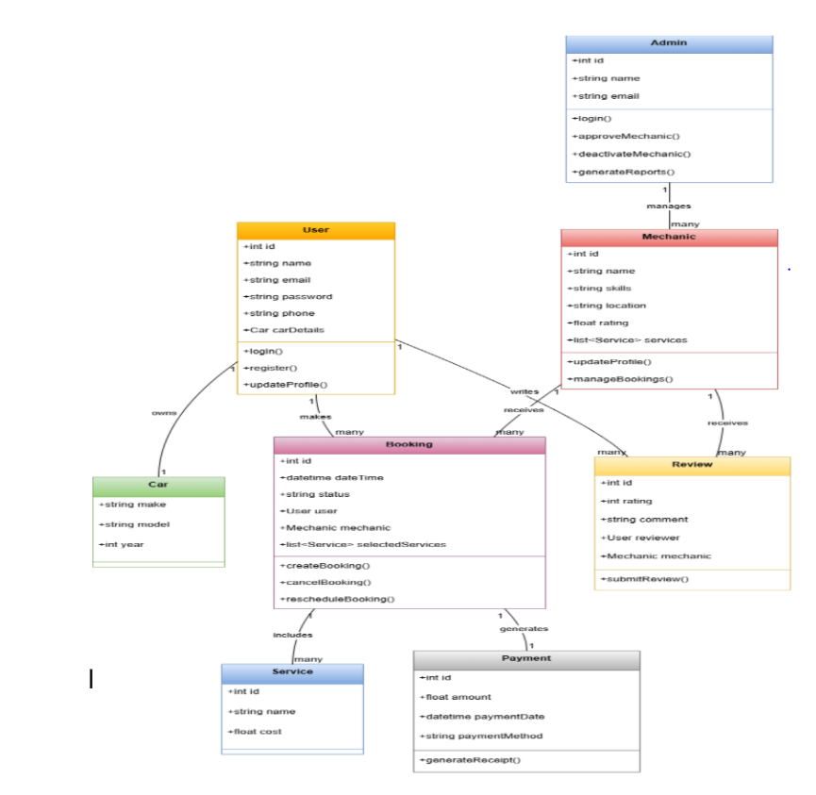
CLASS DIAGRAM

Slide 14
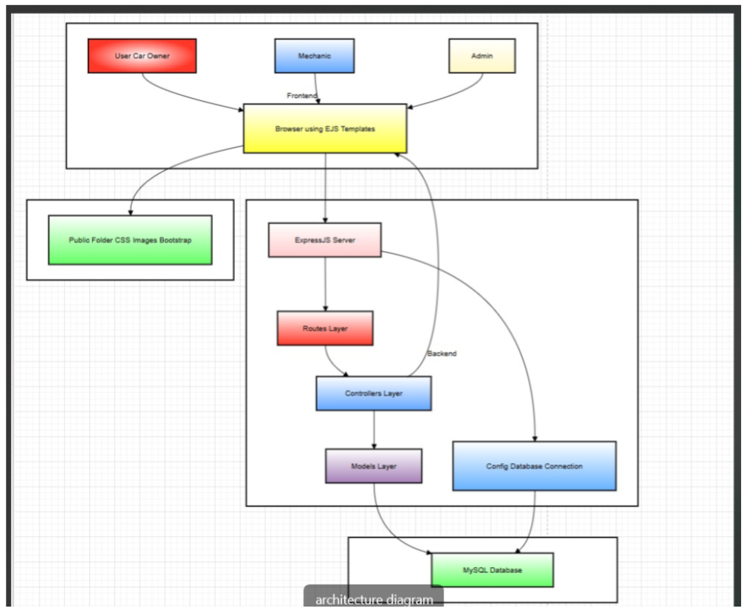
ARCHITECTURE DIAGRAM

Slide 15
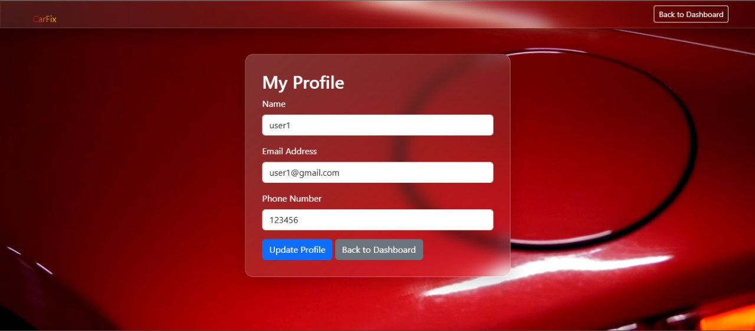
ACTION IMPLEMENTATION

Slide 16
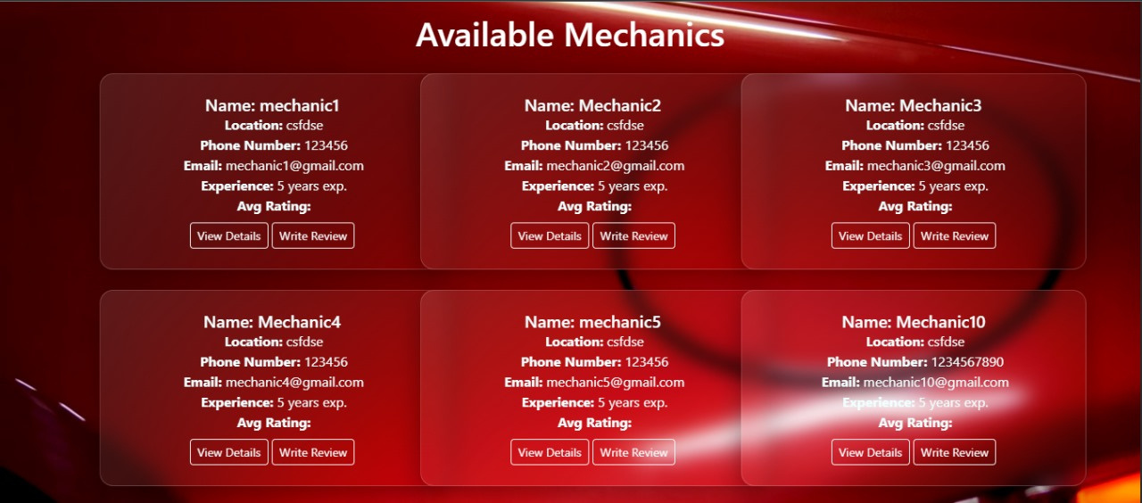

Slide 17
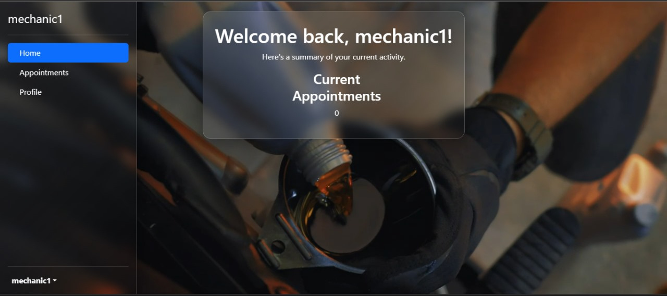

Slide 18
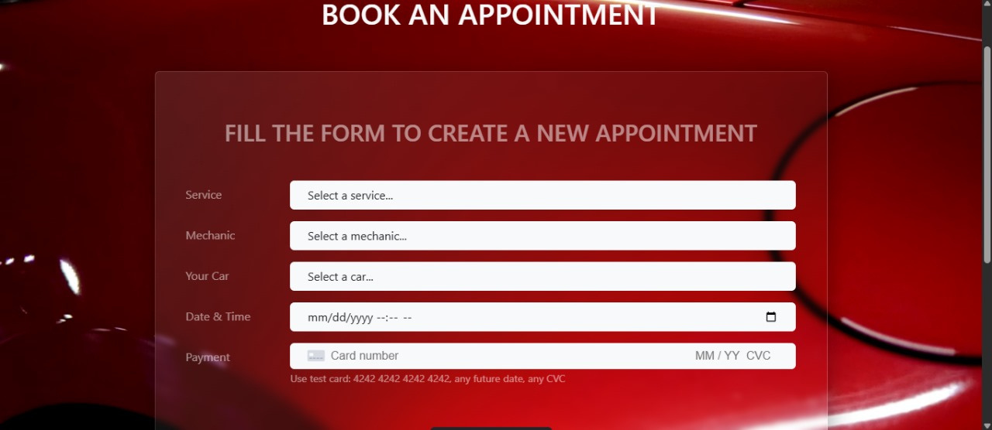

Slide 19
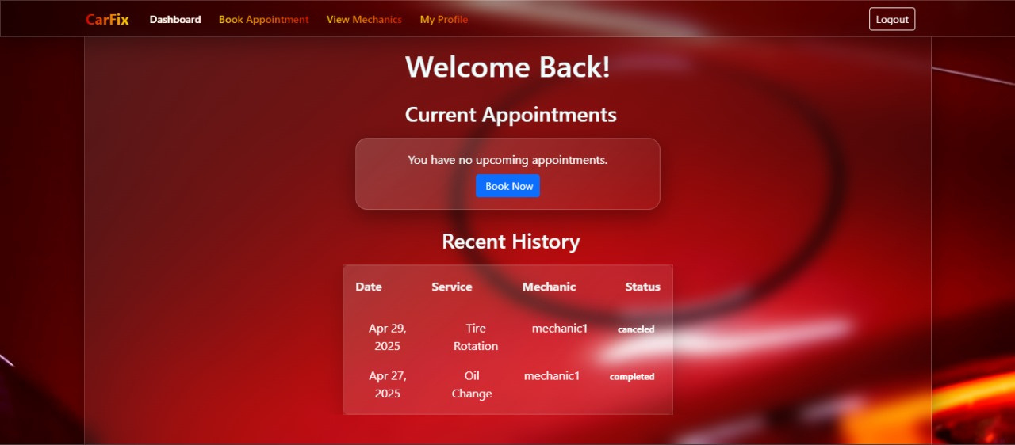

Slide 20
Work Division
Muhammad Moiz:
User implementation+Documentation
Aniq Noor:
Mechanic implementation+Documentaion
Shayan:
Admin implementation+Documentation

Slide 21
Lesson Learnt
Importance of Planning and Design
Modular Code Structure Matters
Team Communication is Key
Version Control is Essential
Database Schema Should Reflect Real-World Use Cases
EJS is Powerful but Requires Discipline
Error Handling and Validation Improve UX
Testing Early Prevents Later Headaches
Documentation is Not Optional
User Feedback is Valuable

Slide 22
Wardiere University
QUESTIONS & ANSWER

Slide 23
Wardiere University
THANK YOU

