Slide 1

NexTec
Home
Service
About Us
Contact
NEXCOMMERCE
MEMBERS:
22i-0617 Muhammad Moiz
22i-0787 Asim Iqbal
22i-0903 Shayan Rauf
22i-0987 Aniq Noor
01

Slide 2

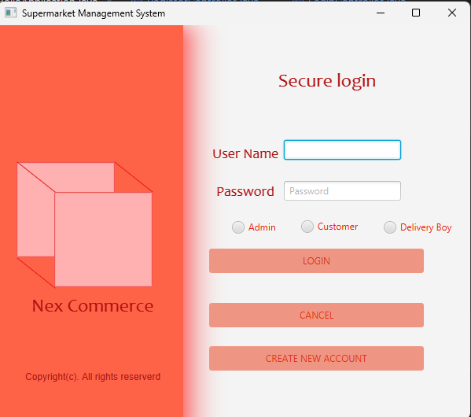
NexTec
Home
Service
About Us
Contact
PURPOSE
The primary objective of this project is to provide a comprehensive, user-friendly platform that facilitates seamless management of supermarket operations. Nex Commerce addresses the needs of both customers and administrators by offering features such as product browsing, cart management, category management, and delivery oversight.
02

Slide 3
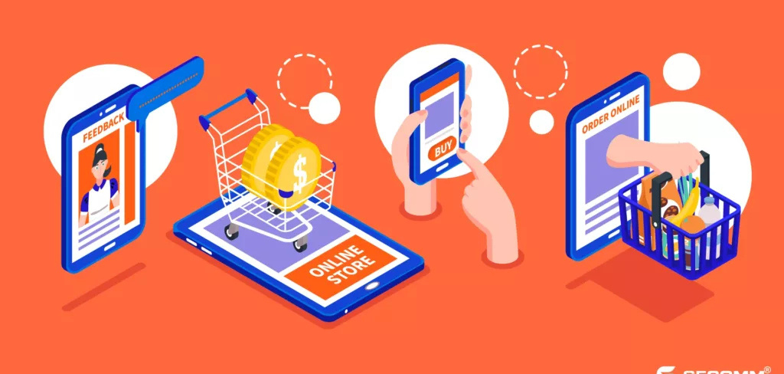
NexTec
Home
Service
About Us
Contact
PROBLEM STATEMENT
Supermarkets often struggle to manage inventory, handle customer orders, and oversee deliveries, especially during peak hours. These challenges can lead to errors, delays, and customer dissatisfaction. Furthermore, the lack of a unified digital platform results in inefficiencies, increasing operational costs and hindering scalability. Nex Commerce addresses these issues by providing a comprehensive solution that integrates all key operations into a single system.
03

Slide 4

NexTec
Home
Service
About Us
Contact
OBJECTIVES
01
02
03
Automate inventory, order, and delivery management processes.
04
Facilitate seamless interaction between customers and supermarket services.
Enhance the user experience through a robust and intuitive JavaFX-based user interface.
Enhance customer engagement by providing seamless features such as product browsing, cart updates, and order tracking.
01
01
01
04

Slide 5
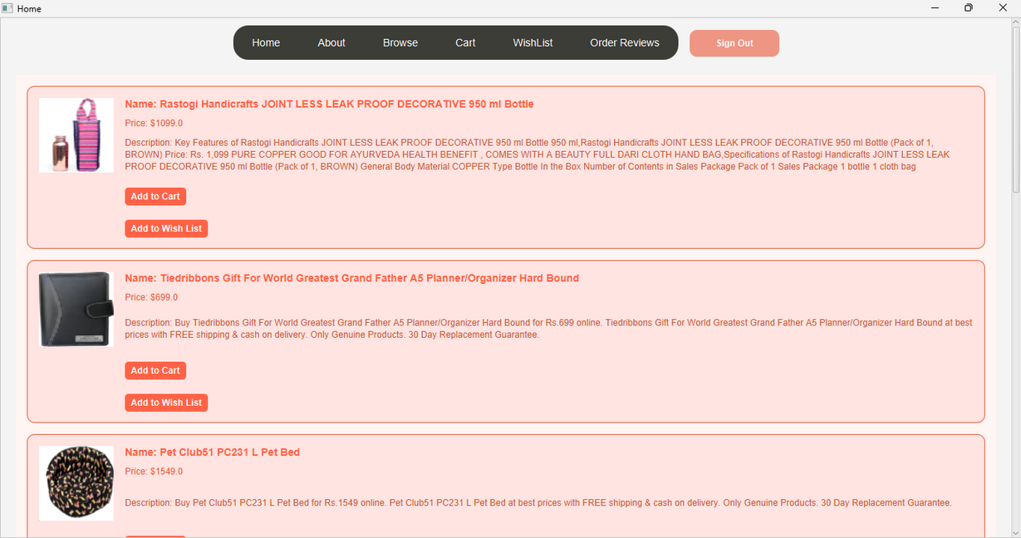
Home
Service
About Us
Contact
INTERFACES
05

Slide 6
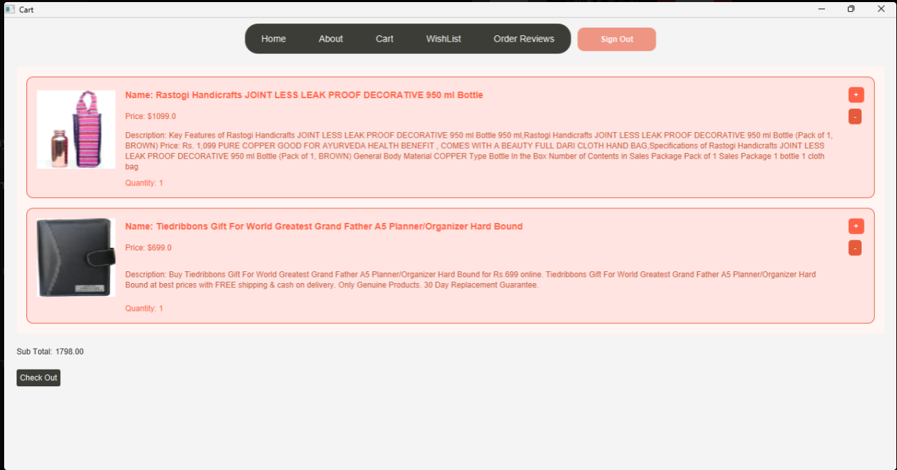
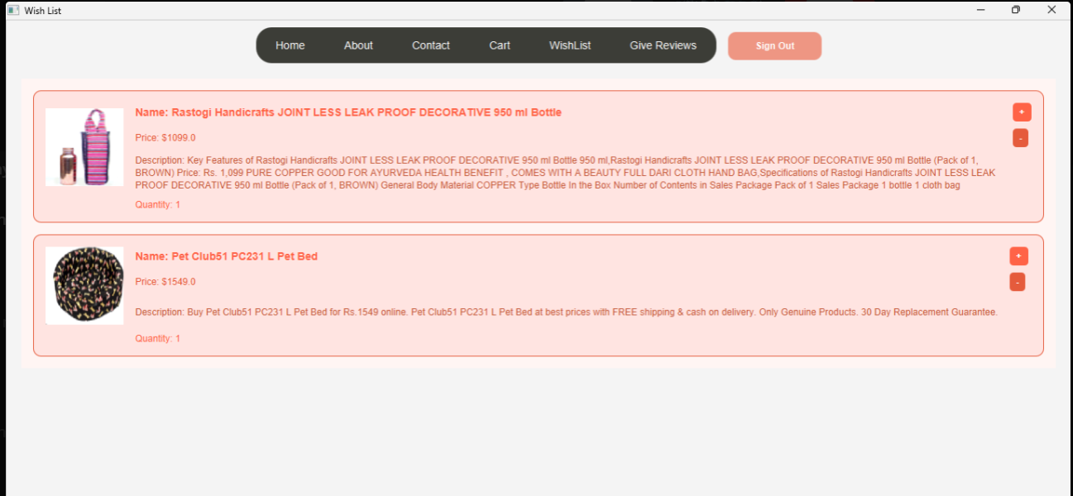
Home
Service
About Us
Contact
06

Slide 7
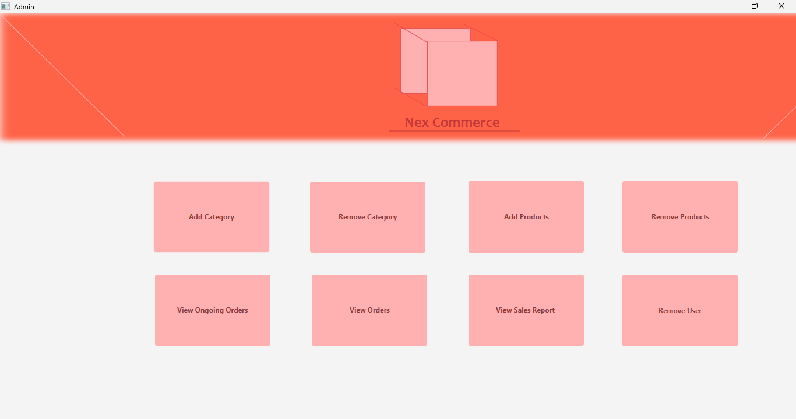
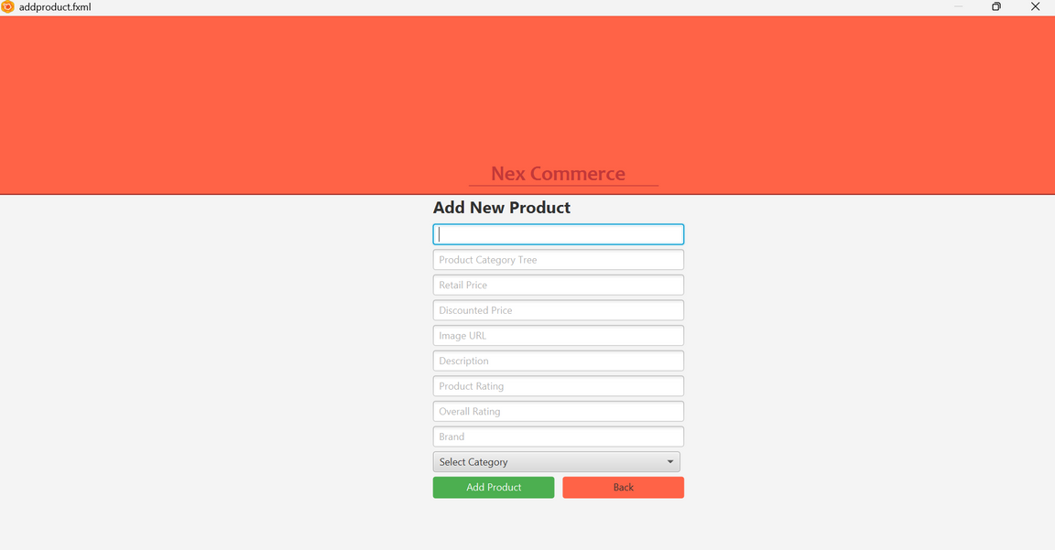
Home
Service
About Us
Contact
06

Slide 8
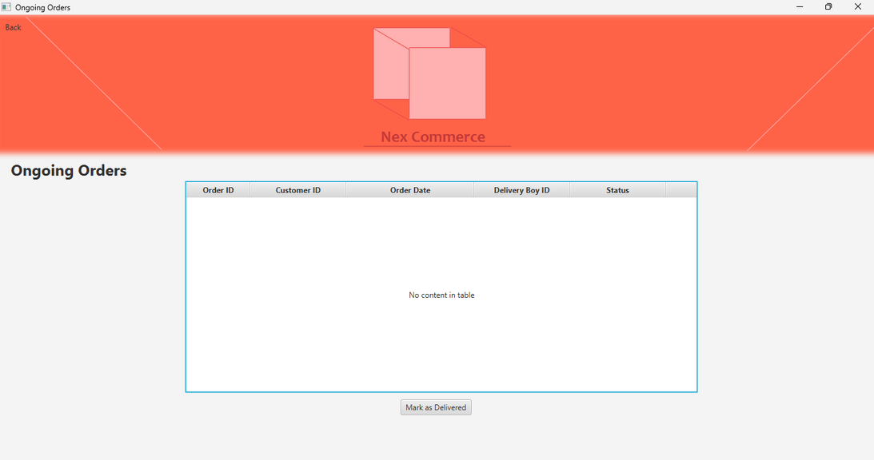
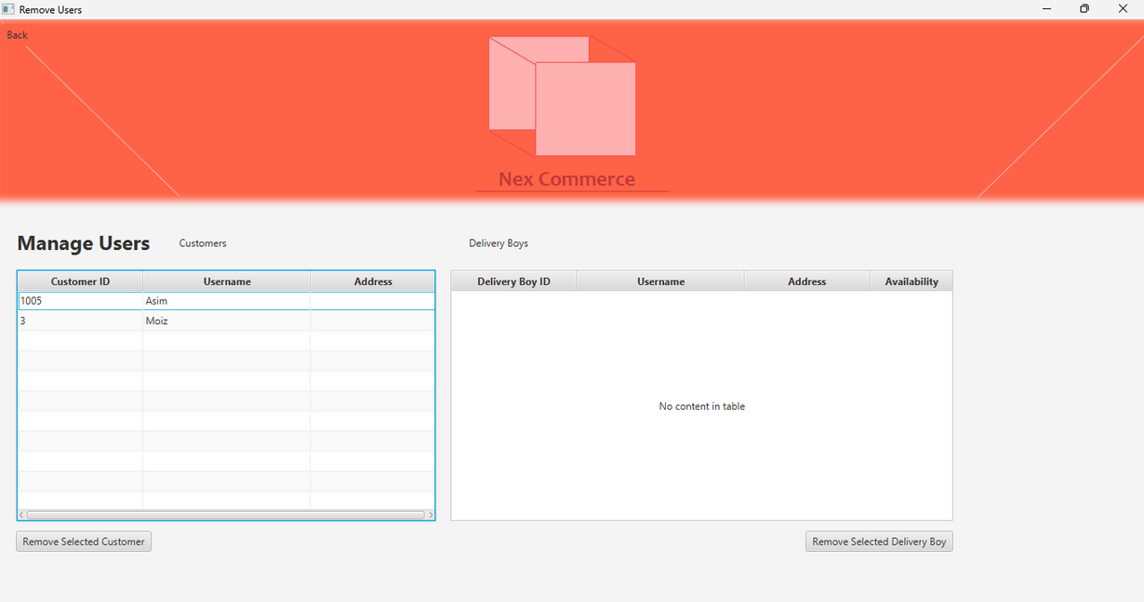
Home
Service
About Us
Contact
06

Slide 9
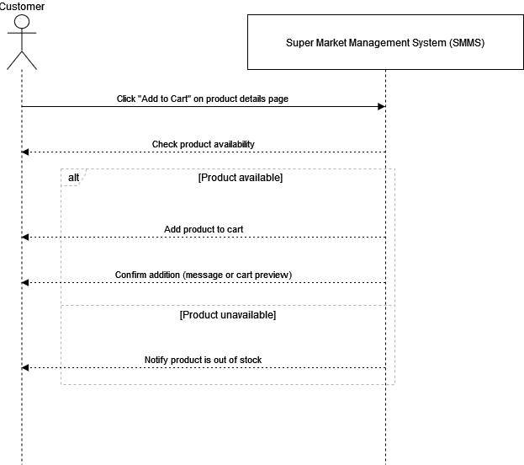
NexTec
Main UseCase
Home
Service
1. Use case name:
Add to Cart
2. Scope:
Super Market Management System (SMMS)
3. Level:
User goal
4. Primary actor:
Customer
5. Stakeholders and interests:
- Customer: Wants to select products for purchase and store them temporarily before checkout.
- Super Market Management: Wants a seamless and error-free cart experience to encourage purchases.
6. Preconditions:
- Customer is browsing or viewing product details.
- Product is available in stock.
7. Success guarantee (postcondition):
Product is successfully added to the customer’s cart.
8. Main success scenario:
User Actions
1. Customer clicks “Add to Cart” from the product details page.
System Responses
1. System checks product availability and if available adds the product to the customer’s cart.
2. System confirms addition with a message or cart preview.
07

Slide 10
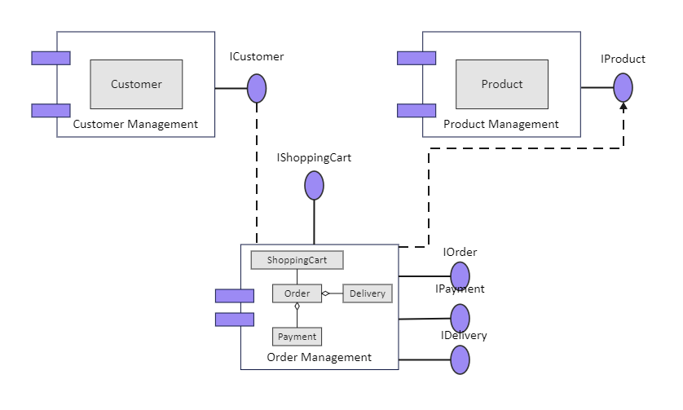
NexTec
Home
Service
About Us
Contact
COMPONENT DIAGRAM
08

Slide 11
NexTec
Home
Service
About Us
Contact
The Factory Pattern defines an interface or abstract class for creating objects, but it lets subclasses or derived classes decide which class to instantiate. This pattern allows the creation process to be decoupled from the main logic of the program.
FACTORY
The Singleton Pattern restricts the instantiation of a class to one "single" instance. It ensures that there is a single, shared instance that can be accessed globally throughout the application.
SINGLETON
09

Slide 12
NexTec
Home
Service
About Us
Contact
THANK YOU
10

