Slide 1
Scheduling Algorithms
by Miffy Chen & James Yu

Slide 2
Job Scheduling
A CPU can only execute the instructions of process or thread at a time
Choosing which program will execute and for how long is a primary OS function.
The scheduler is called upon when a process terminates or is waiting for another process to finish
Systems may allow a new job to be selected under other circumstances (Preemption, idle, interrupts)
Notes:
Cpu can only handle one job or process at a time
Choosing which job executes is a critical function of an OS because it determines how responsive the machine is to the user
Scheduler is minimally called upon whenever a job terminates
It can be called upon more frequently for if preemption or other features are implemented in the OS

Slide 3
Our Project
The choice of algorithm has significant impact on performance and the user experience
Our project was to create a simulated CPU and set of jobs in java
We created several different schedulers and compared them
First Come First Serve
Shortest Job First
Round Robin
Notes:
For our project we simulated a CPU and implemented several scheduling algorithms to compare them
We tried several common algorithms

Slide 4
Metrics
Completion Time: Time at which process completes its execution.
Turn Around Time: Difference between completion and arrival time.
Waiting Time (W.T): The sum of all time spent waiting . The CPU-scheduling algorithm is only directly responsible for the time a process waits in the ready queue.

Slide 5
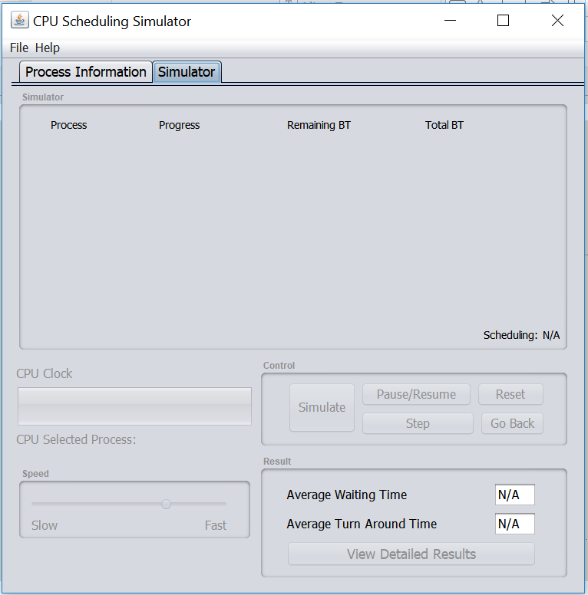
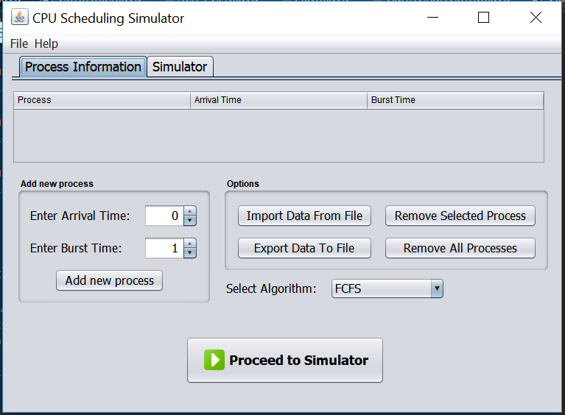
Simulation
Notes:
Process.java
Processes take info such as arrival time and burst time from user or input file.
Have values such as boolean isFinished, and because we made Gantt Charts, color for displaying on the GanttChart, generated from a random generator.
Later, it also stores values calculated from during simulation runs, such as remainingBT, average wait time, average turnaround time, and keeps a copy of the CPU clock data.
Sch_FCFS/SJF/RR.java
Select the Algorithm: FCFS, SJF, RR.
Extend the Algo.java abstract class which contains a clock() to be implemented by each Sch.
In clock(), processes will be executed according to each algorithm in accordance to the CPU clock, until their remainingBT is over.
When all processes are set, click run simulation (next photo)
The processes will be listed here, if RR, will ask for Quantum split time.
Can choose from: simulate, pause during a simulation, adjust the speed, go in steps, reset data, etc.
(Next slide)

Slide 6
Details of Simulation
Process.java
Sch_FCFS.java / Sch_SJF.java / Sch_RR.java extends Abstract Algo.java
Controller.java
GanttChartComp.java
Main.java
ViewResults.java
Notes:
Just went over first two points.
Controller.java
LinkedList of GanttChart to be added according to the algorithm implemented in the Sch_X files
GanttChartComp.java
GC Component contains a Process, ints startingPoint and endingPoint numerical value.
Because we wanted to have a graphical component to better demonstrate how the processes are run,
Main.java & ViewResults.java
Main very long, 1200 lines of code, contains both the ProcessInfo tab and RunSimulation tab.
ViewResults = display results such as the Avg Wait Time, Avg Turnaround Time & GanttChart

Slide 7
FCFS
The simplest algorithm that allocates the CPU to processes in the order they requested CPU time.
Easily implemented with a FIFO queue. A process is entered into the ready queue by being appended to the tail of the queue.
When CPU is free the head of the queue is given CPU time.
Downside: average waiting time can be excessively long due to the convoy effect as all processes must wait for one big process finish. This effect results in lower CPU and device utilization than might be possible if the shorter processes were allowed to go first.
Let’s look at an example
Notes:
FCFS is…
It is implemented with…
Downside is convoy effect

Slide 8
Job Set
Job 1: 200 cycles. Arrives at time 0
Job 2: 1000 cycles. Arrives at time 1
Job 3: 200 cycles. Arrives at time 2
Job 4: 150 cycles. Arrives at time 3
Job 5: 200 cycles. Arrives at time 4

Slide 9
FCFS
Completion Time: Time at which process completes its execution.
Process 1: 200
Process 2: 1200
Process 3: 1400
Process 4: 1550
Process 5: 1700
Average: 1210
Turn Around Time:
Process 1: 200 – 0 = 200
Process 2: 1200 – 1 = 1999
Process 3: 1400 – 2 = 1398
Process 4: 1550 – 3 = 1447
Process 5: 1700 – 4 = 1696
Average: 1348
Waiting Time (W.T):
Process 1: 200 – 200 = 0
Process 2: 1999 – 1000 = 999
Process 3: 1398 – 200 = 1198
Process 4: 1447 – 150 = 1297
Process 5: 1694 – 200 = 1494
Average: 997.6

Slide 10
SJF
The job with shortest CPU burst is given the CPU whenever the scheduler is called upon
The SJF scheduling algorithm is optimal because it minimizes average waiting time.

Slide 11
SJF
Waiting Time (W.T):
Process 1: 200 – 200 = 0
Process 2: 1699 – 1000 = 699
Process 3: 698 – 200 = 498
Process 4: 347 – 150 = 197
Process 5: 496 – 200 = 296
Average: 338
Turn Around Time:
Process 1: 200 – 0 = 200
Process 2: 1700 – 1 = 1699
Process 3: 700 – 2 = 698
Process 4: 350 – 3 = 347
Process 5: 500 – 4 = 496
Average: 688
Completion Time:
Process 1: 200
Process 2: 1700
Process 3: 700
Process 4: 350
Process 5: 500
Average: 690

Slide 12
Round Robin
In the RR scheduling algorithm processes are given turns of a fixed quantum. If a process’s CPU burst exceeds 1 time quantum it is preempted and returned to the queue.
The size of the time quantum is critical. If too large it becomes FCFS since all processes will run to completion on their first turn. If too small there will be excessive context switches.
We want the time quantum to be large with respect to the context- switch time.
A rule of thumb is that 80 percent of the CPU bursts should be shorter than the time quantum.
Notes:
What is RR
Importance of quantum size

Slide 13
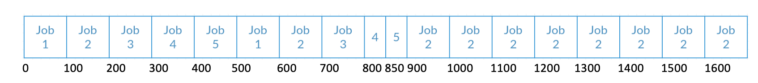
Round Robin
Waiting Time (W.T):
Process 1: 600 – 200 = 400
Process 2: 1699 – 1000 = 699
Process 3: 798 – 200 = 598
Process 4: 847 – 150 = 697
Process 5: 896 – 200 = 696
Average: 618
Turn Around Time:
Process 1: 600 – 0 = 600
Process 2: 1700 – 1 = 1699
Process 3: 800 – 2 = 798
Process 4: 850 – 3 = 847
Process 5: 900 – 4 = 896
Average: 888
Completion Time:
Process 1: 600
Process 2: 1700
Process 3: 800
Process 4: 850
Process 5: 900
Average: 970

Slide 14
Comparison
 | Completion Time | Turn Around Time | Waiting Time
FCFS | 1210 | 1348 | 997.6
SJF | 690 | 688 | 338
RR | 970 | 888 | 618
Highlights of the comparisons
FCFS has very poor performance
SJF has best performance
Round Robin is intermediate but in practice easier to implement than SJF
However it is impossible to actually know the length of the next CPU request in short term
scheduling.
The next CPU burst is most often predicted as an exponential average of the measured lengths
of previous CPU bursts.

Slide 15
Priority
Scheduling Algorithms can handle tasks efficiently. But only prioritizing average values may not reflect users’ preferences (i.e. user won’t notice if saving a file to memory is delayed but will notice if opening a web browser is). Assigning each task priority can address this. It can also be used to prevent starvation by increasing the priority of tasks the longer they wait.
A multilevel queue divides waiting processes into multiple queues. The processes are assigned based on some criteria, such as memory size or type.

Slide 16
SJF Example
Job Set
Job 1: 500 cycles. Arrives at time 0. Priority 1
Job 2: 300 cycles. Arrives at time 150. Priority 1
Job 3: 400 cycles. Arrives at time 300. Priority 3
Job 4: 200 cycles. Arrives at time 400. Priority 2
Job 5: 200 cycles. Arrives at time 600. Priority 5

Slide 17
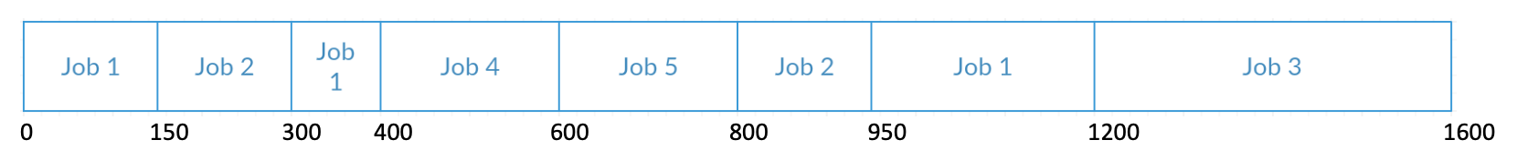
SJF without Priority
Without Priority we see:
Scheduling minimizes wait times, but de prioritizes important tasks.
Turn Around Time:
Job 1: 1200
Job 2: 800
Job 3: 1200
Job 4: 200
Job 5: 200
Average: 720
Waiting Time:
Job 1: 700
Job 2: 500
Job 3: 900
Job 4: 0
Job 5: 0
Average: 420
780

Slide 18
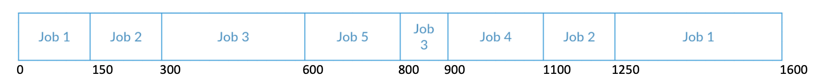
SJF with Priority (SJRF)
Efficiency declines slightly but the highest priority tasks have much shorter times.
Turn Around Time:
Job 1: 1600
Job 2: 1100
Job 3: 600
Job 4: 700
Job 5: 200
Average: 840
Waiting Time:
Job 1: 1100
Job 2: 800
Job 3: 0
Job 4: 500
Job 5: 0
Average: 480
Weighted Wait Time:
SJRF:
580
SJF:
780

Slide 19
Advanced Topics
Mixing in I/O bursts
True SJF
Race conditions
multilevel feedback queue
Thread scheduling
Multi processor systems
Processor affinity
Notes:
multilevel feedback queue:
scheduling algorithm, in contrast, allows a process to move between queues. The idea is to separate processes according to the characteristics of their CPU bursts. If a process uses too much CPU time, it will be moved to a lower-priority queue. This scheme leaves I/O-bound and interactive processes in the higher-priority queues. In addition, a process that waits too long in a lower-priority queue may be moved to a higher-priority queue. This form of aging prevents starvation

