Slide 1
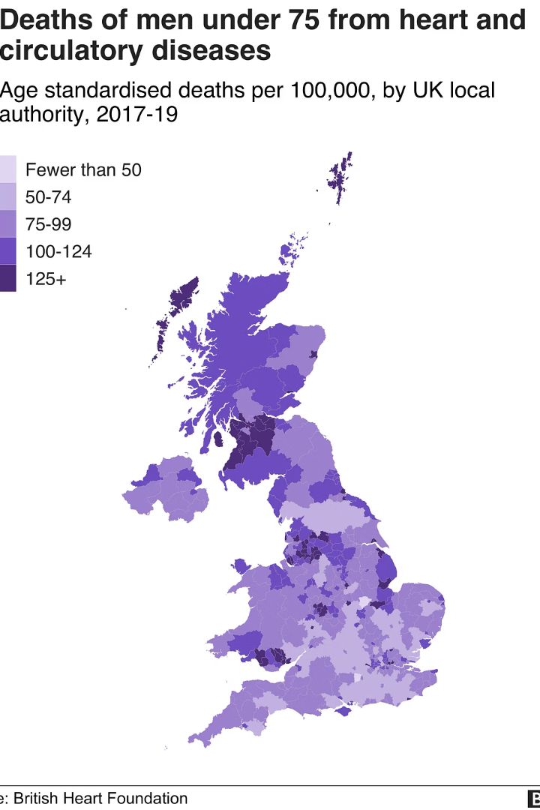
Towards Explainable AI in Cardiovascular Risk Prediction: A Machine Learning Framework Using Patient Data
By Moses John, Dr. AD Verma
Lovely Professional University
CVD leading cause of death worldwide as per WHO
Approximately 17.9 million deaths yearly (2021 estimate) and 941,652 in 2022
Early detection and prediction are vital to reduce impact
Paper ID 284

Slide 2
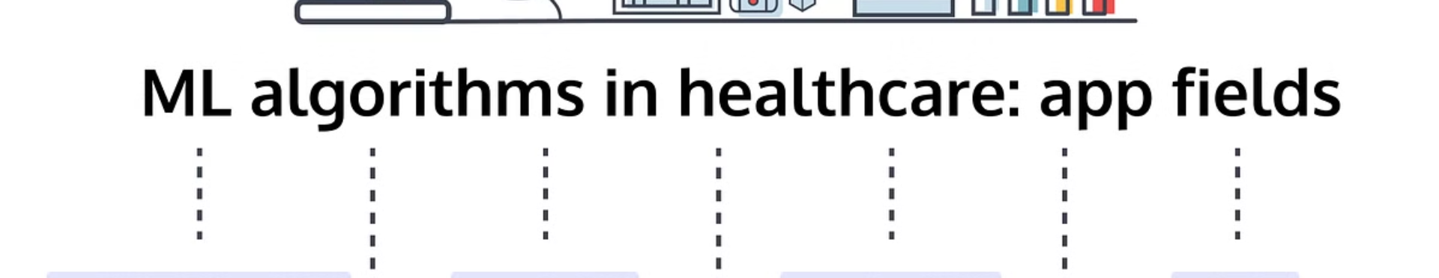
The Promise of Machine Learning
Early & Accurate Detection
Data-Driven Modeling
Improved Patient Outcomes
ML enables prompt diagnosis of cardiovascular disease
Uses clinical data for precise prediction
Supports clinical decisions for better care

Slide 3
Data Sources: Public Clinical Datasets (Kaggle)
Available Datasets
Key Clinical Features
Large, well-annotated clinical collections
Age
Patient demographics
Cholesterol levels
Health indicators like blood pressure
Blood pressure readings
Feature accuracy ensures reliable models

Slide 4

Methodology: Machine Learning Algorithms
Explored Models
Selection Criteria
Logistic Regression, SVM, Random Forest
Accuracy, precision, recall, F1-score metrics
Clinical Interpretability
Models understandable for healthcare providers

Slide 5




Feature Engineering and Selection
Identify Significant Predictors
Apply PCA & Ranking
Improve Model Performance
Effective features boost prediction accuracy and reduce noise

Slide 6

Model Training and Validation
1
Data Split
2
Cross-Validation
Training, validation, and test sets
Robust evaluation to avoid overfitting
3
Class Imbalance Handling
Techniques like SMOTE to balance data

Slide 7
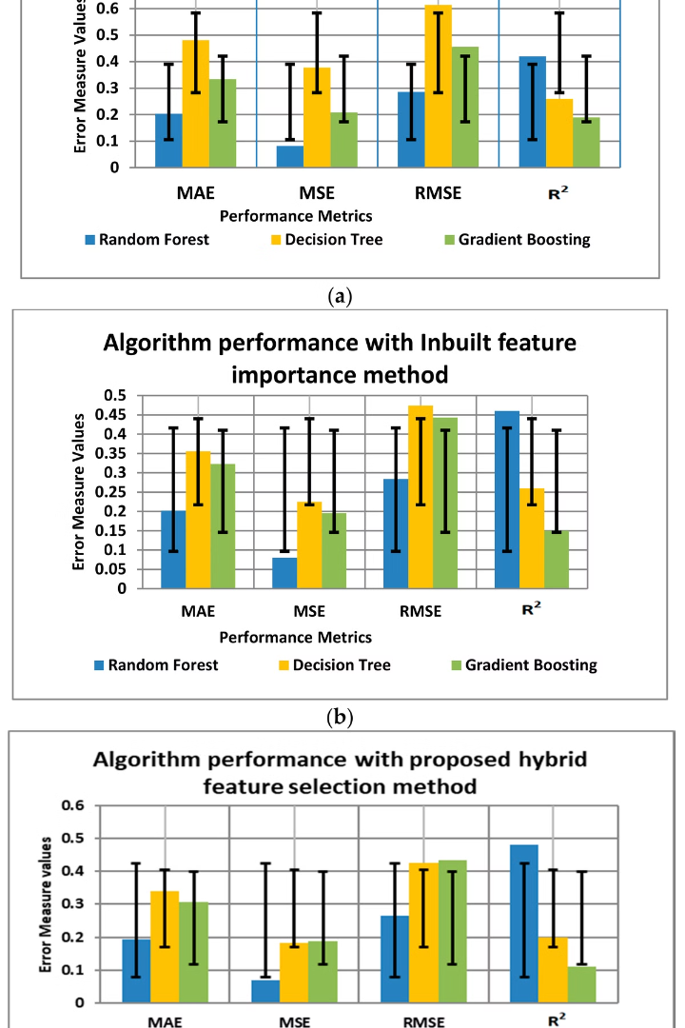
Results: Performance Metrics
73%
Fair
Accuracy
Precision
Test datasets show >90% accuracy
Reliable identification of positive CVD cases
Normal
Recall
Effective detection of true positives

Slide 8
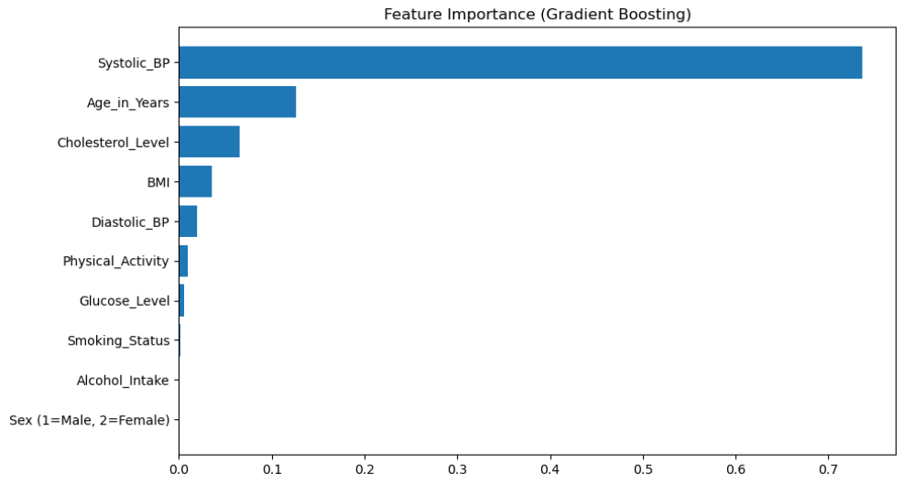

Slide 9
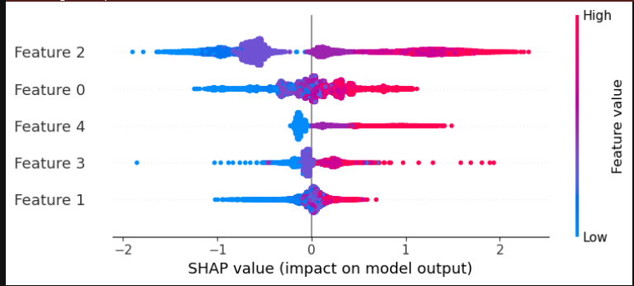
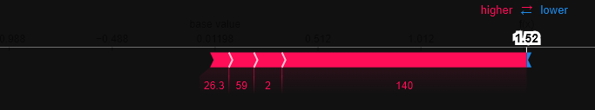
Results for Explainability
For Complete Dataset
For the First Patient Data
Total features in the dataset had 11 features but the program identified only the ones that had most affect in Cardiac Disease.
The Following features made it out of the filter: Age_in_Years, BMI, Systolic_BP, Diastolic_BP, Cholesterol_Level

Slide 10



Clinical Significance and Early Detection
Identify High-Risk
Enables targeted preventive interventions
Clinician Aid
Personalized Medicine
Supports doctors in making timely diagnoses
Tailors treatment based on individual risk
2
1
3

Slide 11
Challenges and Future Directions
Dataset Limitations
Expanded Data Inputs
AI’s Future Role
Need for more diverse, comprehensive data
Lifestyle and genetic factors inclusion
Integrating AI deeper into cardiovascular care

Slide 12
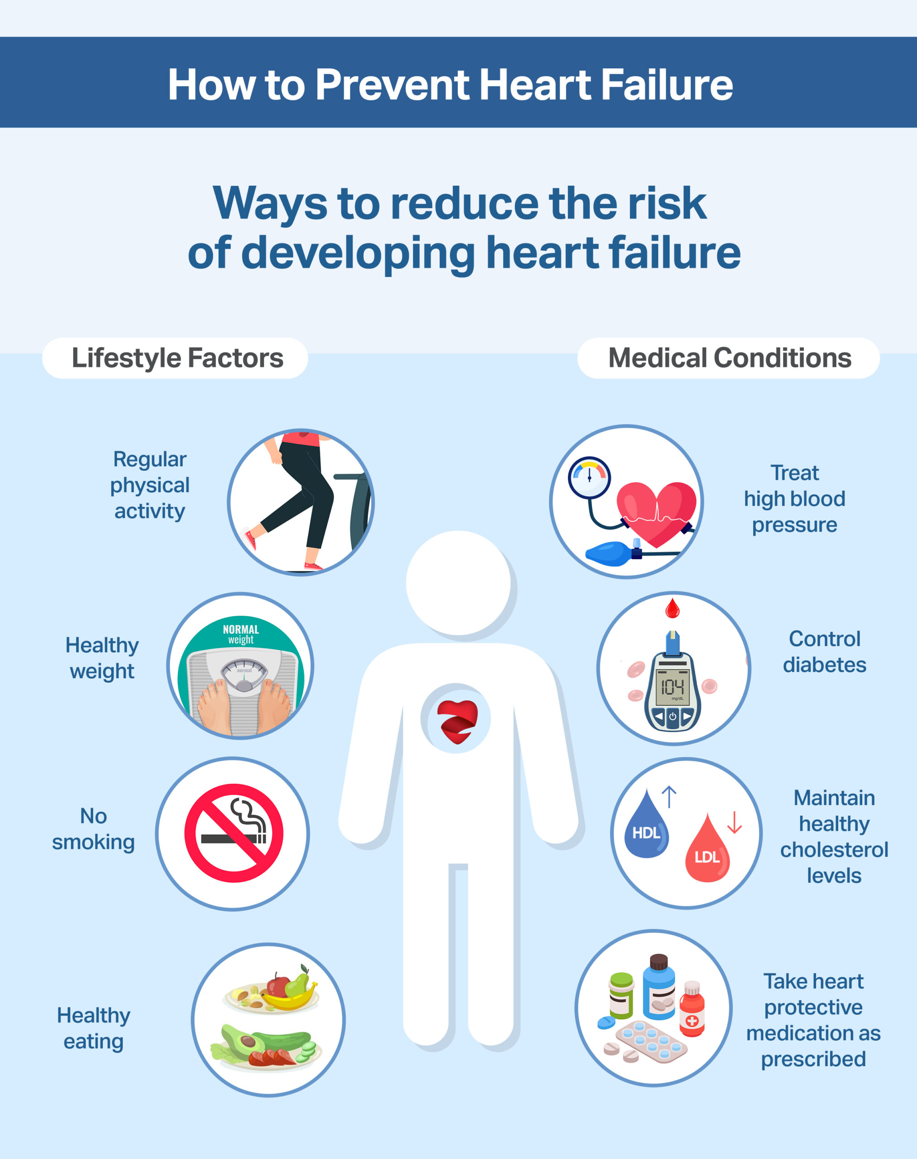
Conclusion: A Data-Driven Path to Reducing CVD Mortality
Powerful Tool
Reduced Morbidity & Mortality
ML enables early detection and intervention
Potential to save millions of lives
Call to Action
Promote further research and clinical use

Slide 13
REFERENCES
Roth GA, Mensah GA, Johnson CO, et al. Global Burden of Cardiovascular Diseases and Risk Factors, 1990–2019: Update From the GBD 2019 Study. J Am Coll Cardiol. 2020;76(25):2982–3021.
Krittanawong C, Johnson KW, Rosenson RS, et al. A review of risk prediction models in cardiovascular disease: conventional approach vs. artificial intelligent approach. BMC Med Inform Decis Mak. 2021;21(1):1–9.
Shameer K, Johnson KW, Glicksberg BS, et al. Artificial Intelligence and Machine Learning in Cardiovascular Health Care. J Am Coll Cardiol. 2018;71(23):2668–2679.
Holzinger A, Langs G, Denk H, et al. A review of evaluation approaches for explainable AI with applications in cardiology. Artif Intell Med. 2024;139:102456.
Ali MM, Paul BK, Ahmed K, Bui FM, Quinn JMW, Moni MA. Heart disease prediction using supervised machine learning algorithms: Performance analysis and comparison. Comput Biol Med. 2021 Sep;136:104672. doi: 10.1016/j.compbiomed.2021.104672. Epub 2021 Jul 21. PMID: 34315030.
Bouqentar MA, Terrada O, Hamida S, Saleh S, Lamrani D, Cherradi B, Raihani A. Early heart disease prediction using feature engineering and machine learning algorithms. Heliyon. 2024 Oct 1;10(19):e38731. doi: 10.1016/j.heliyon.2024.e38731. PMID: 39397946; PMCID: PMC11471268.
Ejiyi CJ, Qin Z, Nneji GU, Monday HN, Agbesi VK, Ejiyi MB, Ejiyi TU, Bamisile OO. Enhanced Cardiovascular Disease Prediction Modelling using Machine Learning Techniques: A Focus on CardioVitalnet. Network. 2024 Apr 16:1-33. doi: 10.1080/0954898X.2024.2343341. Epub ahead of print. PMID: 38626055.

Slide 14
Thankyou
In the name of SCIENCE!!

