Slide 1
Mohammad Rasool MOJALLIZADEH
Poste : Enseignant-chercheur
Profile : Instrumentation, Automatique, Contrôle-Commande
Laboratoire : LAMPA
Campus : Angers
12 juillet 2024
Notes:
1

Slide 2
2 / 12
Personal details
First name: | Mohammad Rasool
Last name: | MOJALLIZADEH
Birth: | June 1988 (Esfahan, Iran)
Notes:
2

Slide 3
3 / 12
Overview
Total presentation time: 20 minutes
Introducing the profile and academic contributions (10 minutes)
Representative works (10 minutes)
Notes:
3

Slide 4
4 / 12
Education and academic career
Academic career
Teacher-Researcher | 2024-now | Arts et Métiers d'Angers, LAMPA, Angers
Research Engineer | 2022-2024 | École Centrale de Nantes, LS2N
Researcher | 2020-2022 | INRIA, TRIPOP, Grenoble, France
Postdoc | 2019-2020 | INRIA, TRIPOP, Grenoble, France
Postdoc | 2018-2019 | University of Tabriz, Department of Electrical Engineering, Iran
Education
PhD | 2013-2017 | Tabriz, Tabriz, Iran | Automatic Control
Master | 2011-2013 | Isfahan, Isfahan, Iran | Automatic Control
Bachelor | 2007-2011 | Isfahan, Isfahan, Iran | Electrical Engineering
Notes:
4

Slide 5
5 / 12
Research activities
Research contributions
Topic | Details
Automatic control | Design and analysis of controllers, observer, and parameter estimators
Signal processing and instrumentation | Noise filtration, online differentiation, and sensor fusion
Mathematical modeling | Euler-Lagrange and port-controlled Hamiltonian modeling for multi-physic systems
Application | Electrical and mechanical systems such as electrical motors, electro-pneumatic systems, and cranes
Discretization | Digital implementation of controllers, observers, and filters
Notes:
5

Slide 6
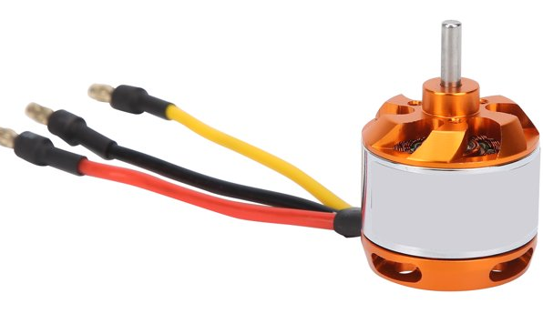
6 / 12
A typical control system
Disturbance
Control signal
Output
Desired output
Controller
Actuator
+
Plant
Noise
Observer
and filter
Sensor
+
Control objective: Output tracks the desired output
Example of actuator: electric, hydraulic, pneumatic actuators
DC motor
Control output: Speed
Control signal (PWM)
Notes:
6

Slide 7
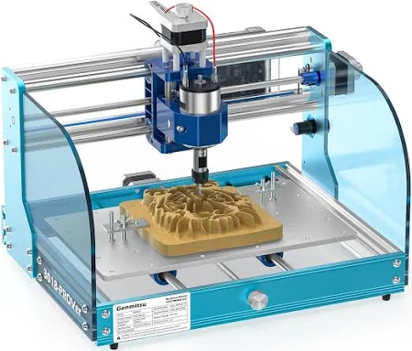
7 / 12
A typical control system
Disturbance
Control signal
Output
Desired output
Controller
Actuator
+
Plant
Noise
Observer
and filter
Sensor
+
Control objective: Output tracks the desired output
Example of plants: CNC machines
A CNC machines
Notes:
7

Slide 8
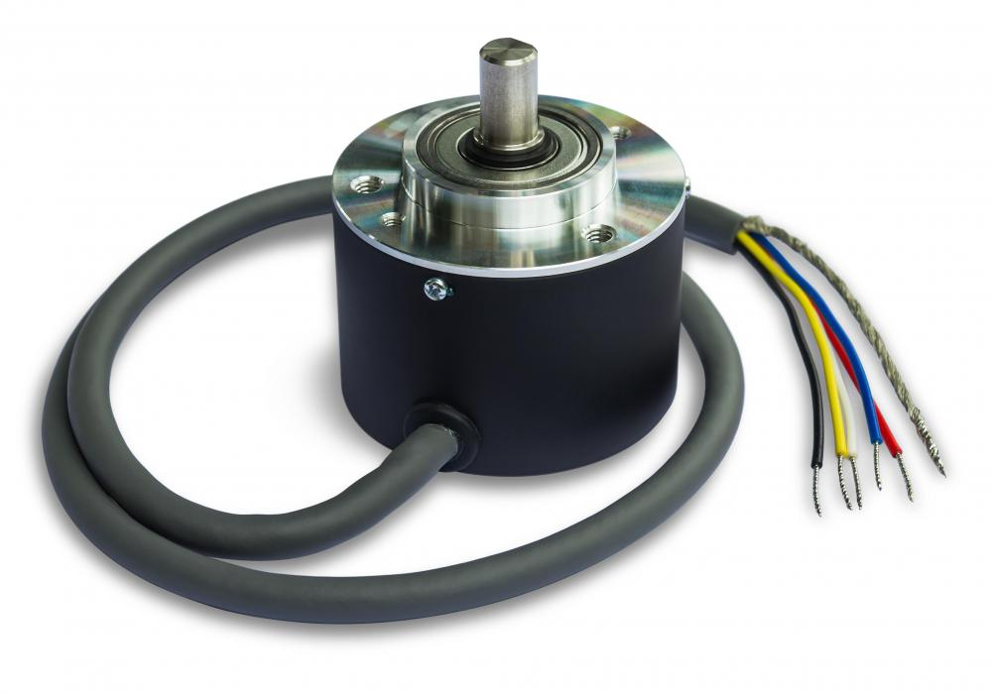
8 / 12
A typical control system
Disturbance
Control signal
Output
Desired output
Controller
Actuator
+
Plant
Noise
Observer
and filter
Sensor
+
Control objective: Output tracks the desired output
Necessity of filter and observer: to filter out the noise and estimate the physical quantities that cannot be directly measured by the sensor.
Shaft encoder
Observer
and filter
Noise-free velocity estimation
Noisy position measurement using shaft encoder
Notes:
8

Slide 9
9 / 12
A typical control system
Disturbance
Control signal
Output
Desired output
Controller
Actuator
+
Plant
Noise
Observer
and filter
Sensor
+
Control objective: Output tracks the desired output
Necessity of controller: to ensure achieving the control objectives such as the stability, tracking performance, robustness to noise and disturbances, etc.
Notes:
9

Slide 10
10 / 12
Some roles of a control engineer/scientist
Choosing different elements such as the actuator and the sensor to achieve an specific control objective
Design of the controller
Design of the observer and filter
Time-discretization
Disturbance
Control signal
Output
Desired output
Controller
Actuator
+
Plant
Noise
Observer
and filter
Sensor
+
Notes:
10

Slide 11
11 / 12
Why the control design is important?
The conventional PID controller may not provide a satisfactory result because:
The plant may not be linear.
The perturbation (disturbance or noise) may affect the performance.
The plant’s model maynot be available or maybe uncertain.
The PID controller cannot be used on several classes of systems.
Disturbance
Control signal
Output
Desired output
Controller
Actuator
+
Plant
Noise
Observer
and filter
Sensor
+
Notes:
11

Slide 12
12 / 12
Why time-discretization is important?
The algorithms (controllers, observers and filters) are mostly designed in the continuous-time domain.
Two parameters
The PD control signal designed in the continuous-time domain: $u\left(t\right)=k_{p}e\left(t\right)+k_{d}\dot{e}\left(t\right)$
Control signal
error = output - desired output
The Euler forward (explicit) discretization is usually used for the implementations:
$$u\left(k\right)=k_{p}e\left(k\right)+k_{d}\frac{e\left(k\right)−e\left(k−1\right)}{h}$$
Sampling time
However, such an discrete-time implemented control law may lead to a different response or even instability.
Result: The time-discretization must be made carefully to keep the continuous-time counterpart properties.
Notes:
12

Slide 13
A1
Research program at a glance
Communication and team working
Identifying existing laboratory setups:
Robotics, mechanical and electromechanical systems such as different machines, autonomous systems, and drones.
Developing new setups:
PV systems, hydrodynamic turbine
Control design:
Position control
Velocity control
Force control
Filter design:
Noise filtering
Estimation
Adding “pilotage automatique” to current machines:
Fatigue analysis
Notes:
13

Slide 14
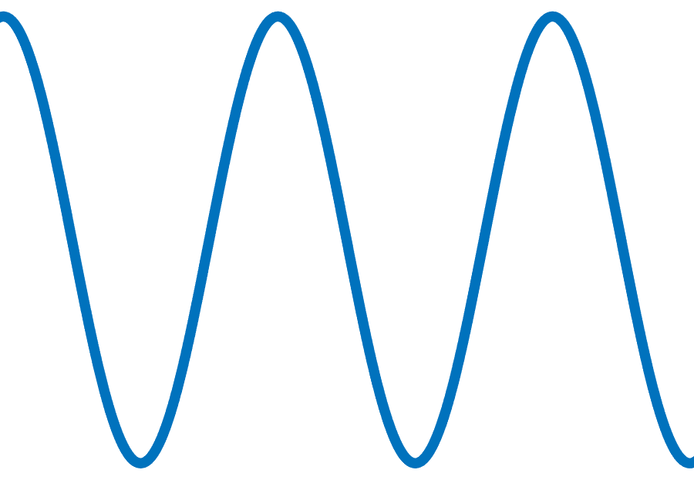
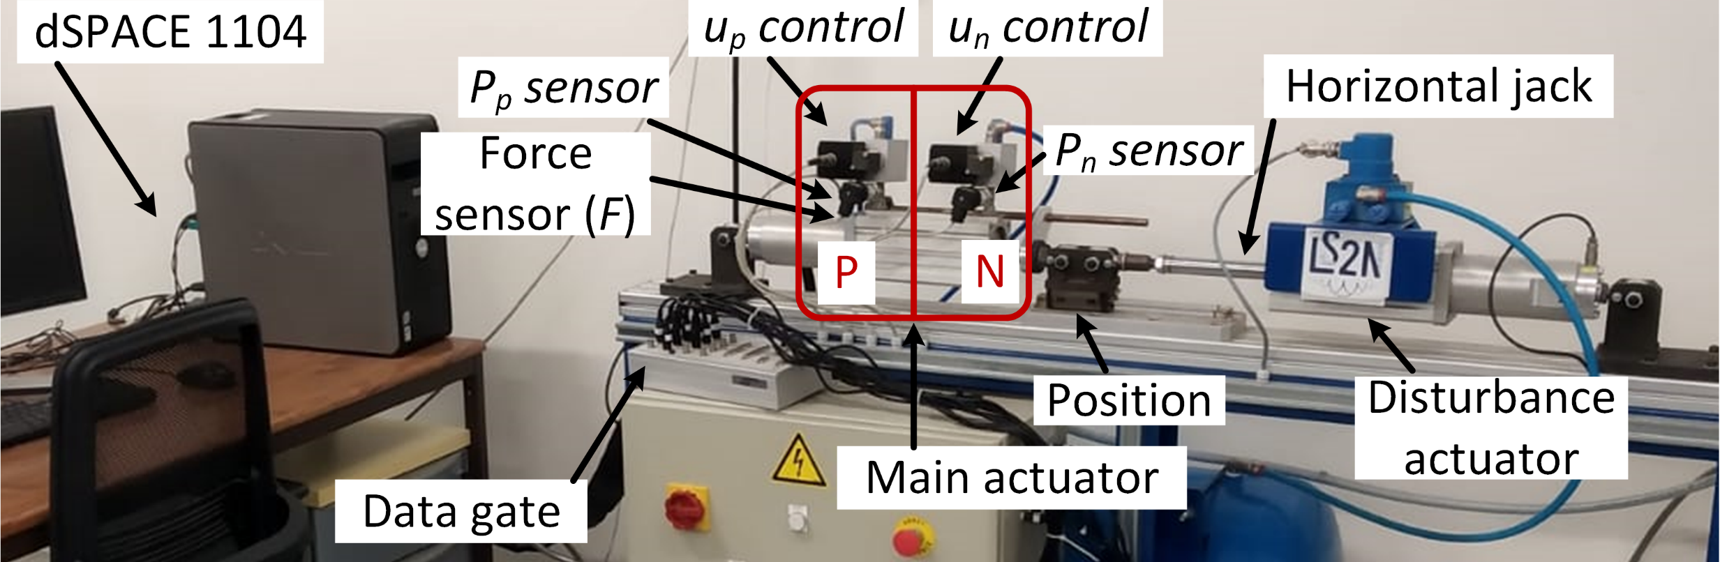
A2
An example: control of machines used for fatigue analysis
Disturbance
Noise
-
Filter
+
Differentiator
Reference
Velocity
Velocity
Error
Controller
Control
Actuator
Force
Plant
Sensor
Position Measure
Output
Velocity
Objectives: designing the controller, filters and differentiator
Application: velocity tracking for fatigue analysis
Notes:
14

