Slide 1


Heart Disease(CHD) Classification
Name : Mojammel Hossain
ID : 1631011043

Slide 2
Dataset
We used Framingham Heart Study data set.
The data set contain 4,240 instances where 3658 have full data.
The data set is a combination of continuous and categorical values.
Attributes provide in data set include gender, education, age, blood pressure medication(BPmeds), systolic and diastolic blood pressure(sysBP,diaBP), total cholesterol, glucose level, body mass index(BMI),diabetes, prevalent stroke, hypertensive(prevalentHyp), smoke habit, heart rate and number of cigs per day.

Slide 3
Preprocessing
Remove Missing Value and Duplicate Data.
Feature Selection.
Resampling.
Under Sampling
Over Sampling

Slide 4
Project Mid
K-Nearest Neighbors Classifier.
Logistic Regression Classifier(LR).
Support Vector Machine Classifier(svm).
Naïve Bayes Classifier

Slide 5
Decision Tree Classifier(DTC)
Voting Classifier
Neural Network

Slide 6
Voting Classifier
Svm
LR
DTC
Neural Network
Hidden Layers (7, 8)
Activation function (relu)
Learning rate (adaptive)

Slide 7
Model Name | Accuracy
Logistic Regression | 0.67
K-Nearest Neighbor K=1 | 0.72
K-Nearest Neighbor K=5 | 0.66
K-Nearest Neighbor K=10 | 0.69
Naïve Bayes | 0.79
Decision Tree | 0.67
Support Vector Machine | 0.65
Voting Classifier | 0.68
Neural Network | 0.67

Slide 8
Model Evaluation
Confusion Matrix.
Cost matrix.
Precision.
Recall.
F-measure.
Area Under Receiver Operating Characteristic(ROC) Curve.

Slide 9
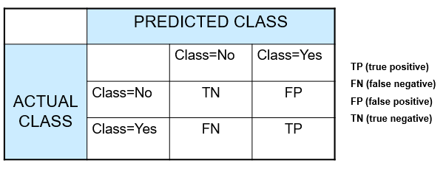
Confusion Matrix.

Slide 10
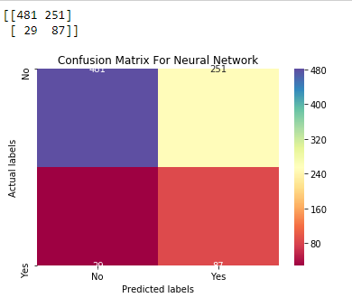
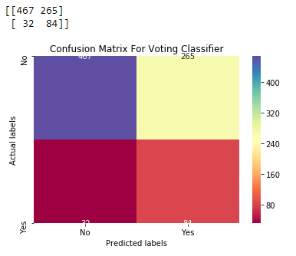
Unbiased model

Slide 11

Cost Matrix

Slide 12
Model Name | Cost
Logistic Regression | 3565
K-Nearest Neighbor K=1 | 7922
K-Nearest Neighbor K=5 | 6068
K-Nearest Neighbor K=10 | 6052
Naïve Bayes | 7666
Decision Tree | 4080
Support Vector Machine | 3487
Voting Classifier | 3380
Neural Network | 3151

Slide 13
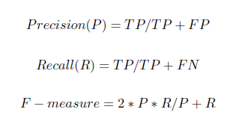
Precision, Recall and F-measure

Slide 14
Model Name | Precision | Recall | F-measure
Logistic Regression | 0.25 | 0.71 | 0.37
K-Nearest Neighbor K=1 | 0.19 | 0.33 | 0.24
K-Nearest Neighbor K=5 | 0.20 | 0.49 | 0.29
K-Nearest Neighbor K=10 | 0.22 | 0.49 | 0.30
Naïve Bayes | 0.27 | 0.34 | 0.31
Decision Tree | 0.23 | 0.66 | 0.34
Support Vector Machine | 0.24 | 0.72 | 0.35
Voting Classifier | 0.24 | 0.73 | 0.36
Neural Network | 0.26 | 0.75 | 0.38

Slide 15
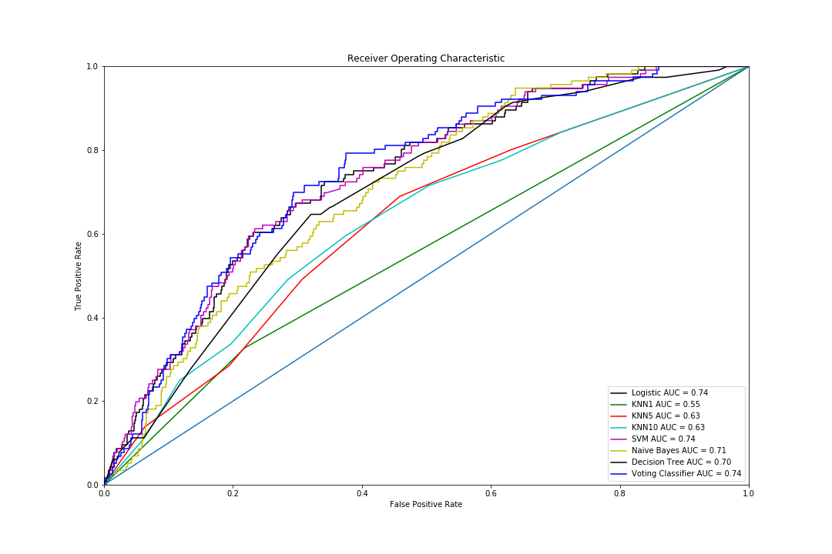
Area Under Receiver Operating Characteristic(ROC) Curve

Slide 16
