Slide 1
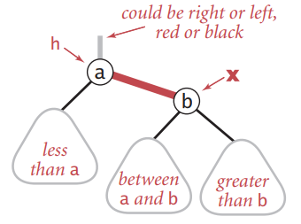
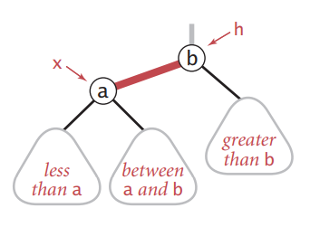
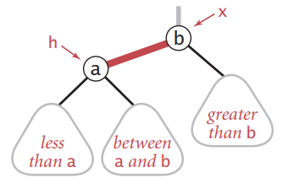
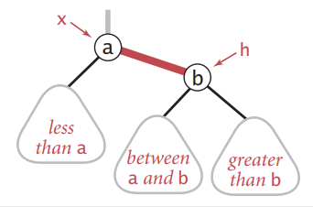
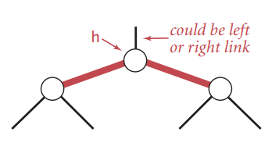
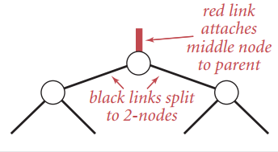
Left Rotate
Node RotateLeft(Node h)
{
x = h.right;
h.right = x.left;
x.left = h;
x.color = h.color;
h.color = RED;
return x;
}
Node RotateRight(Node h)
{
x = h.left;
h.left = x.right;
x.right = h;
x.color = h.color;
h.color = RED;
return x
}
Right Rotate
void FlipColors(Node h)
{
h.color = !h.color;
h.left.color = !h.left.color;
h.right.color
= !h.right.color;
}

Slide 2
1
2
PP
PP
P
P
N
N
3
PP
PP
4
P
P
N
N

Slide 3
PP
PP
P
RotateLeft(P)
N
N
P
PP
PP
P
RotateRight(P)
N
N
P

Slide 4
PP
PP
PP
FlipColor(PP)
P
P
U
P
U
N
N
N
N
N
RotateLeft(P)
PP
P
PP
RotateRight(PP)
P
U
N
PP
P
N
U
N

Slide 5
PP
PP
PP
FlipColor(PP)
P
U
P
U
P
N
N
N
N
N
RotateRight(P)
PP
P
PP
RotateLeft(PP)
U
P
PP
N
N
N
U
P

Slide 6
B
__z
C
__z
C
__z
A
K
A
K
A
K
C
__y
B
B
G
__x
Q
__w
__y
__y
G
__x
G
__x
L
T

Slide 7
K
K
K
__y
B
__y
B
__y
B
__x
G
__x
G
__x
G
F
H
F
H
F
H
__y
B
__y
B
K
__y
B
K
K
__x
G
__x
G
G
__x
F
H
F
H
F
H

Slide 8
1
__z
2
__z
C
C
A
K
A
K
__y
B
G
__x
Q
__w
B
G
__x
__w
__y
Q
L
T
L
T
3
__z
4,5
__z
C
C
A
K
A
K
G
__x
__w
__x
__w
__y
B
Q
__y
B
G
Q
L
T
L
T

Slide 9
C
__z
C
__z
A
K
A
Q'
__y
B
G
__x
Q
__w
B
__y
K'
T'
L
T
G
__x
L'
__w

Slide 10
C
__z
C
__z
A
K
A
Q'
__y
B
G
__x
Q
__w
B
__y
K'
T'
L
T
G
__x
L'
__w
C
__z
C
__z
A
K
A
Q'
__y
B
G
__x
Q
__w
B
__y
K'
T'
L
T
G
__x
L'
__w

Slide 11
C
__z
C
__z
A
K
A
Q'
__y
B
G
__x
Q
__w
B
__y
K'
T'
L
T
G
__x
L'
__w

Slide 12
case1
C
__z
C
__z
C
__z
A
K
A
Q
A
Q
__y
B
G
__x
Q
__w
B
K
__y
B
K
T
__y
T
L
T
G
__x
L
__w
G
__x
L
__w

Slide 13
case2
C
__z
C
__z
A
K
A
__w
K
__x
__y
B
G
__x
Q
__w
B
G
Q
L
T
L
T

Slide 14
case3
C
__z
C
__z
C
__z
A
K
A
K
A
K
__y
B
G
__x
Q
__w
__y
B
G
__x
L
__w
__y
B
G
__x
L
__w
L
T
Q
Q
T
T

Slide 15
case4
C
__z
C
__z
C
__z
A
K
A
Q
A
Q
__y
B
G
__x
Q
__w
B
__y
B
K
__y
K
T
T
__x = root
L
T
G
__x
L
__w
G
L

