Slide 1
User Registration Results
LaBraM · EEG window sizes 1s, 2s, 4s · registering_users_results

Slide 2
User registration overview
Goal: enroll new EEG users and recognize their probes; reject unregistered strangers.
Data source: registering_users_results/pipeline_{1s,2s,4s}_active_passive/.
LaBraM + ArcFace embeddings; prototypes built from enrollment segments.
5-fold cross-validation; values are mean ± std.
Window sizes 1s, 2s, 4s — active and passive tasks reported separately.

Slide 3
How registration metrics are calculated
1. Evaluate only held-out unknown participants.
2. Enroll 50% of unknown users; 50% act as unregistered strangers.
3. Per enrolled user: 70% of segments → prototype (mean L2-normalized embedding).
4. Probes: nearest prototype; reject as UNKNOWN if match score 1/(1+d) < τ.
5. Threshold τ tuned via grid search (weighted_recall_balance).
6. Open-world accuracy = correct enrolled-user match + correct UNKNOWN on strangers.

Slide 4
Registration methodology
User registration tests whether new EEG users can be enrolled from their segments and later recognized, while strangers are rejected. Only held-out unknown participants are used. Per fold: 50% of unknown users are enrolled; 50% remain unregistered strangers. For each enrolled user, 70% of segments build an L2-normalized prototype (mean ArcFace embedding from the LaBraM model). Each probe is matched to the nearest prototype; segments with match score 1/(1 + d) below threshold τ are labeled UNKNOWN. Threshold τ is swept (501 points) to maximize weighted_recall_balance on registered probes plus all stranger segments. Open-world accuracy is the fraction of correct decisions (correct enrolled user or UNKNOWN). Values are 5-fold mean ± std from registering_users_results.

Slide 5
Registration results — accuracy (1s, 2s, 4s)
Window | Task | Open-world acc. | Balanced acc. | Unknown recall
1s | active | 81.2% ± 2.7% | 79.1% ± 2.7% | 82.7% ± 2.9%
1s | passive | 76.0% ± 1.7% | 67.8% ± 3.6% | 78.9% ± 1.4%
2s | active | 82.3% ± 1.7% | 80.6% ± 2.8% | 83.5% ± 1.8%
2s | passive | 77.8% ± 0.9% | 73.0% ± 0.8% | 79.7% ± 1.3%
4s | active | 83.5% ± 1.8% | 82.5% ± 1.6% | 84.6% ± 1.8%
4s | passive | 78.3% ± 1.1% | 72.4% ± 1.1% | 80.6% ± 1.2%
Source: registering_users_results/pipeline_{1s,2s,4s}_active_passive/registration_pipeline_manifest.json

Slide 6
Registration results — per-user recall (1s, 2s, 4s)
Window | Task | Registered recall | Registered probe acc.
1s | active | 79.1% ± 2.7% | 87.6% ± 2.3%
1s | passive | 67.7% ± 3.7% | 79.8% ± 3.6%
2s | active | 80.6% ± 2.8% | 88.6% ± 2.4%
2s | passive | 73.0% ± 0.8% | 83.9% ± 0.2%
4s | active | 82.5% ± 1.6% | 90.3% ± 1.5%
4s | passive | 72.4% ± 1.1% | 83.5% ± 1.0%

Slide 7
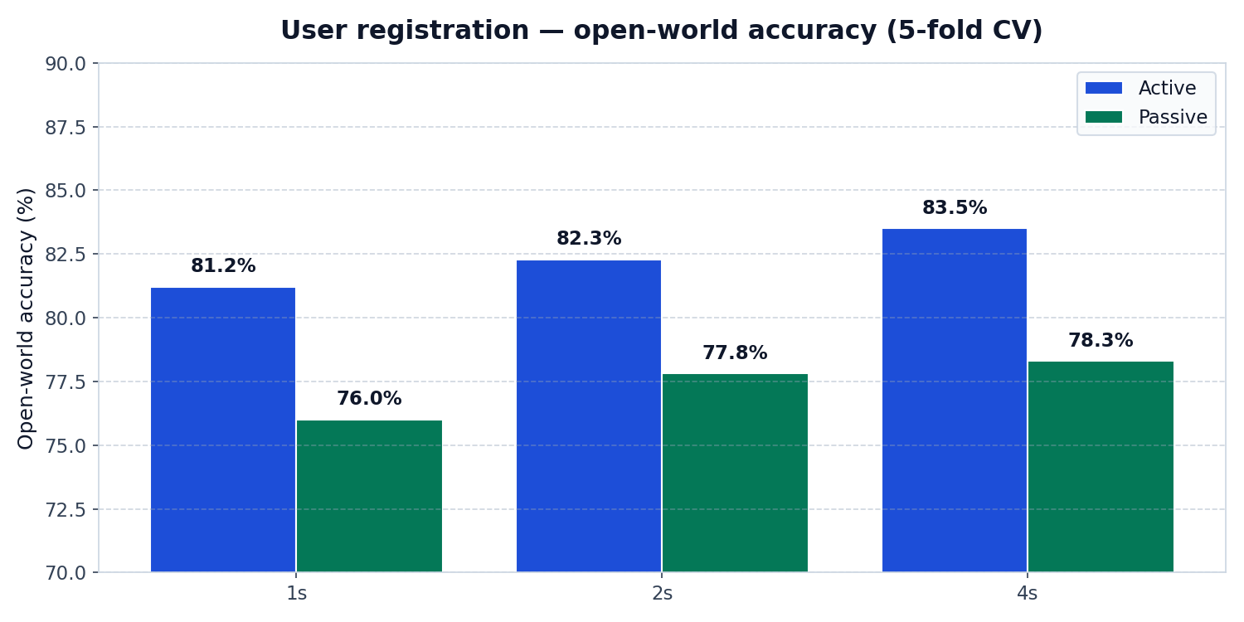
Registration open-world accuracy — 1s, 2s, 4s

Slide 8
Summary
Best open-world: 4s active — 83.5% ± 1.8% (unknown recall 84.6% ± 1.8%).
4s active: highest open-world (~83.5%); passive is ~5 points lower at each window.
1s active ~81%; 2s active ~82%; registration is strong at all segment lengths.
Active EEG outperforms passive for registration (1s, 2s, 4s).
All metrics from registering_users_results (registration pipeline, 5-fold CV).

