Slide 1
Capstone Project
Car Accident severity study
Matt Pirecki

Slide 2
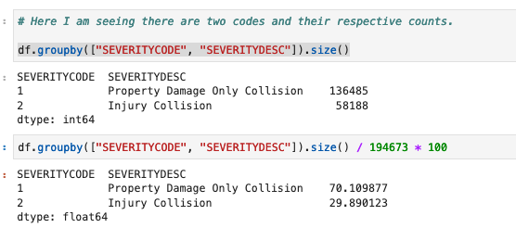
Finding the conditions which cause the most impactful accidents
Using Seattle DOT data sample

Slide 3
Initial hypothesis of the study
The data set provided for this study contains over 194,000 traffic accidents and labeled fields that will be key to helping predict weather conditions are ideal for driving or if avoidance of an area/specific conditions should be alerted on. These fields contain, lighting, weather, road conditions, as well as, severity of the accident, what type of object was hit or description of impact. The data also contains lat-long coordinates (columns “X”,”Y” respectively) which could be used to create a mapping of the accidents, which in an advanced program could be used to program into your vehicle’s GPS to recommend said locations during met conditional periods of high risk.

Slide 4
Exploring the data I’m looking into the severity of the traffic accidents. Based on these results 70% of all accidents in this study result in property damage and only ~30% of them have an injury result.

Slide 5
77% of the accidents are..
Rear ended and angle turn collisions.
Conditions factor into this type of impact study and below are some of the key fields:
"COLLISIONTYPE","INATTENTIONIND", "UNDERINFL","WEATHER","ROADCOND","LIGHTCOND","SPEEDING"

Slide 6
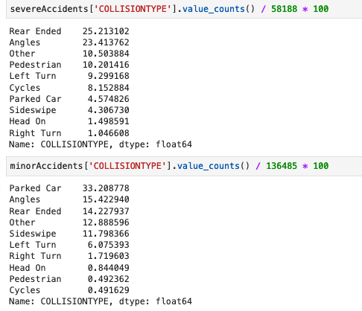

Slide 7
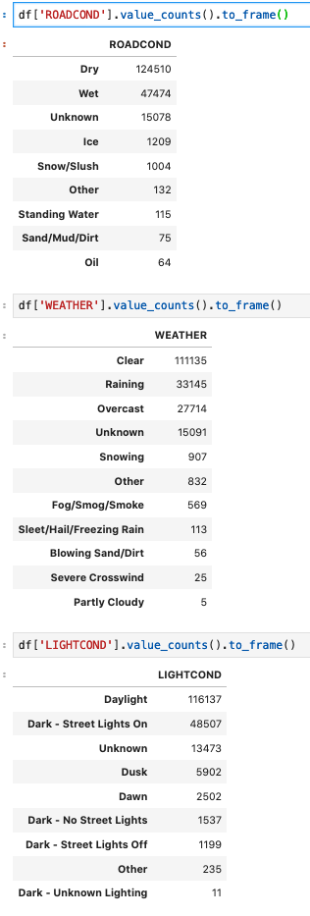
Weather conditions initially thought to be a factor do show some upticks in wet road conditions, however, it was found that the most frequent of all issues on the road are Dry, Clear and Daylight hours.

Slide 8
Conclusion
Weather conditions can attribute to some of the severe accidents but the majority of all Seattle based DOT collisions occurred during the higher commuter times of the day. Generally, it was a surprise to my research to find that dry and light conditions had the highest amount of issues. Attributing to this factor is likely the assumption that sheer volume of persons driving during those times attribute to the accident volumes.

