Slide 1
Walk-in Clinics Application
Group #22
By: Ahmad El Mokahal, Ara Kirijian, Aldo Mendoza, James Gilhespy, and Utibe Biobasholuwa

Slide 2
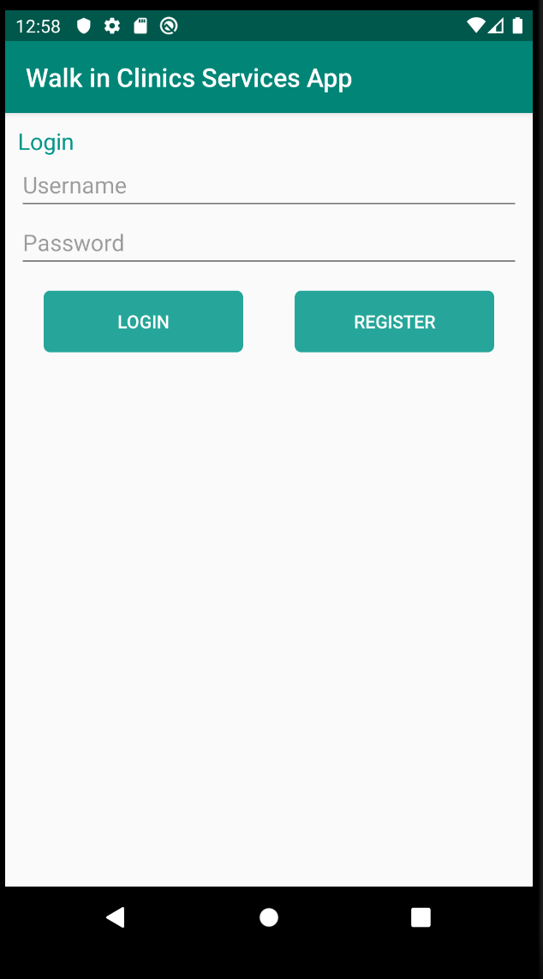
Application’s Main Screen
The first screen that a user will see
User can either login with an existing account or register a new account.

Slide 3
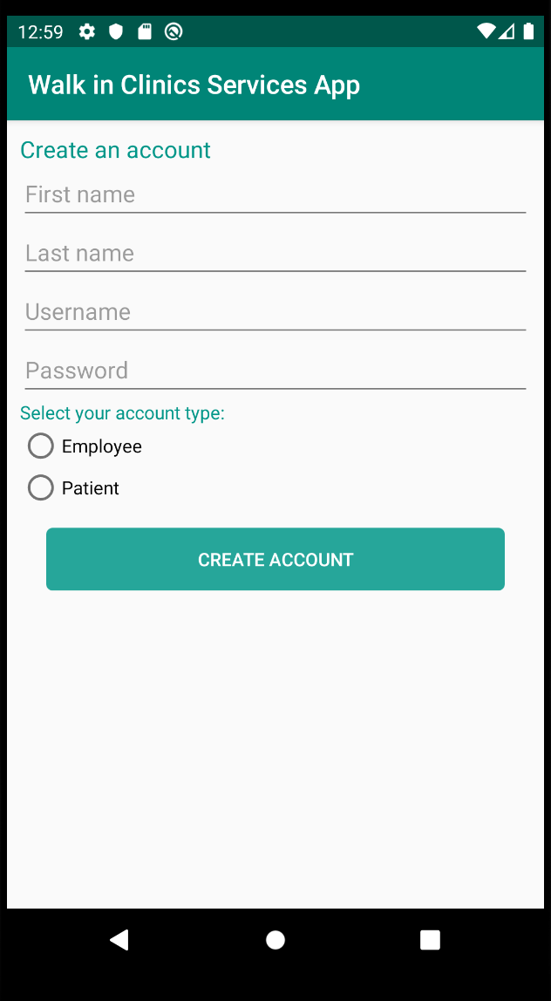
User Registration Activity
3 User Account types:
Admin (Hard-coded)
Employee
Patient
User passwords are hashed for added security.

Slide 4
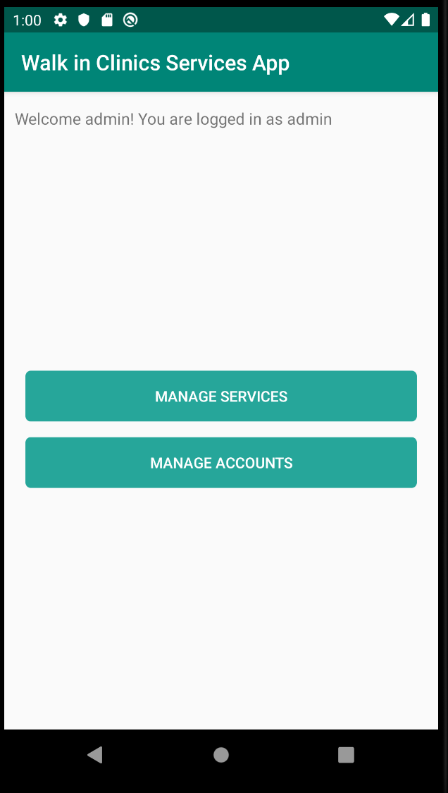
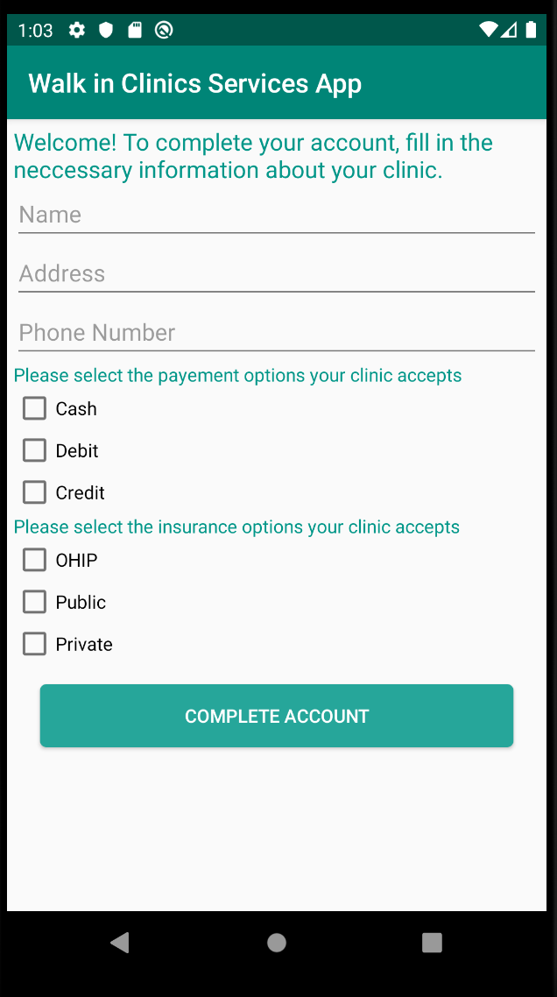
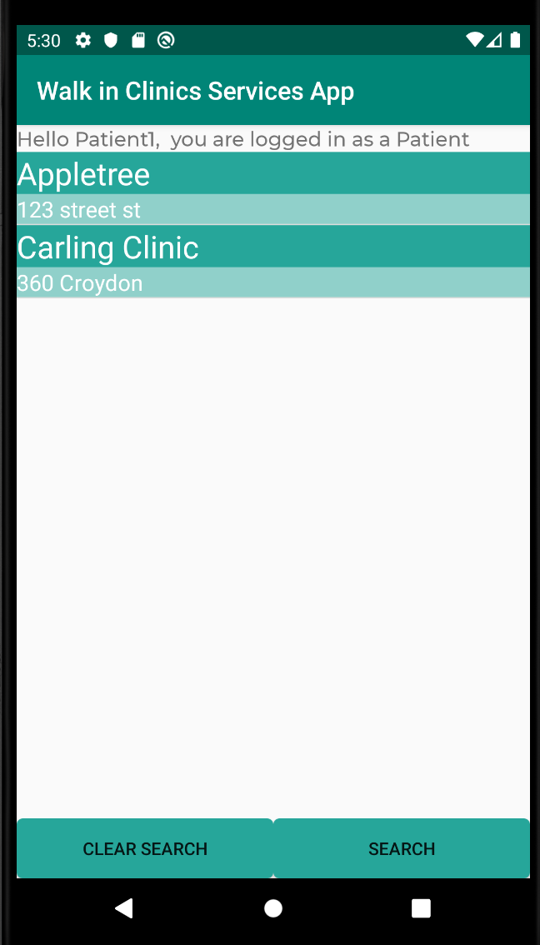
Main User Activities
Admin
Employee
Patient

Slide 5
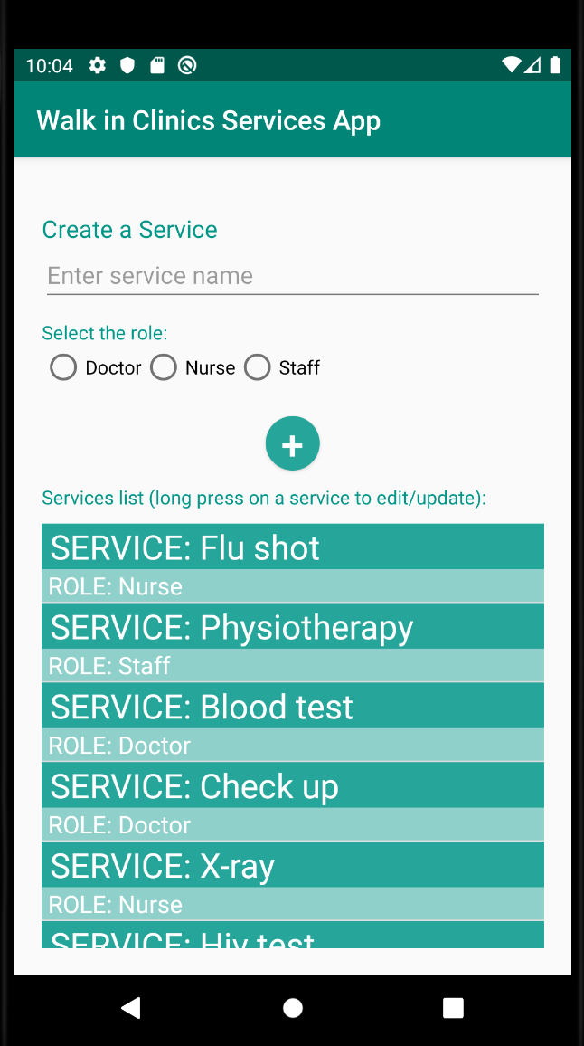
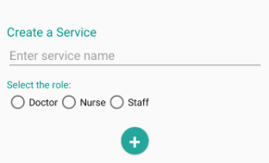
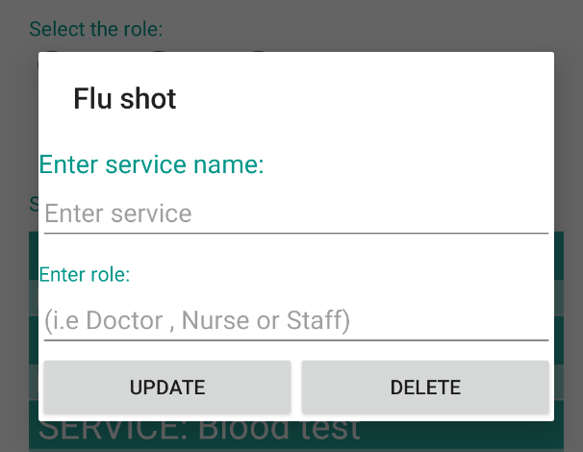
Admin User’s Functionality
Manage Services
To Add a Service:
Clicking “MANAGE SERVICES” from the Admin Main User Activity will lead you to an Activity where you can either create a service or edit/delete already existing services displayed as a list.
Fill in the editText field with the name of the service.
Choose a role (doctor, nurse, staff)
Click-on the add button.
To Edit/ Delete a Service:
Long press the service
Pop-up dialog
Fill in the fields and click confirm.
Click delete.

Slide 6
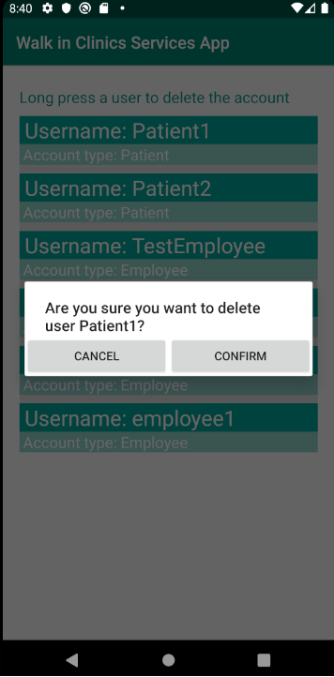
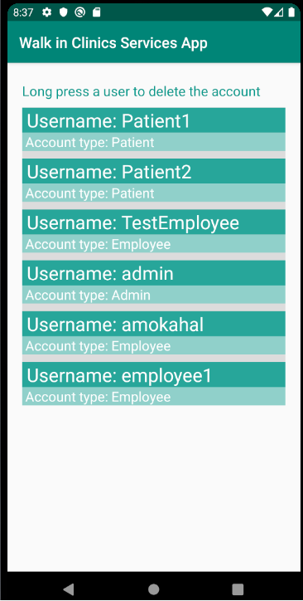
Admin User’s Functionality
Manage Accounts
To delete any account, the user will simply press and hold down on any of the accounts in the list. A pop-up dialog will appear prompting the user to either cancel or confirm. If confirm is selected, the account is deleted from the database.
Clicking “MANAGE ACCOUNTS” from the Admin Main User Activity will lead you to a list of all accounts within the database, listing each account, account type, and username.

Slide 7
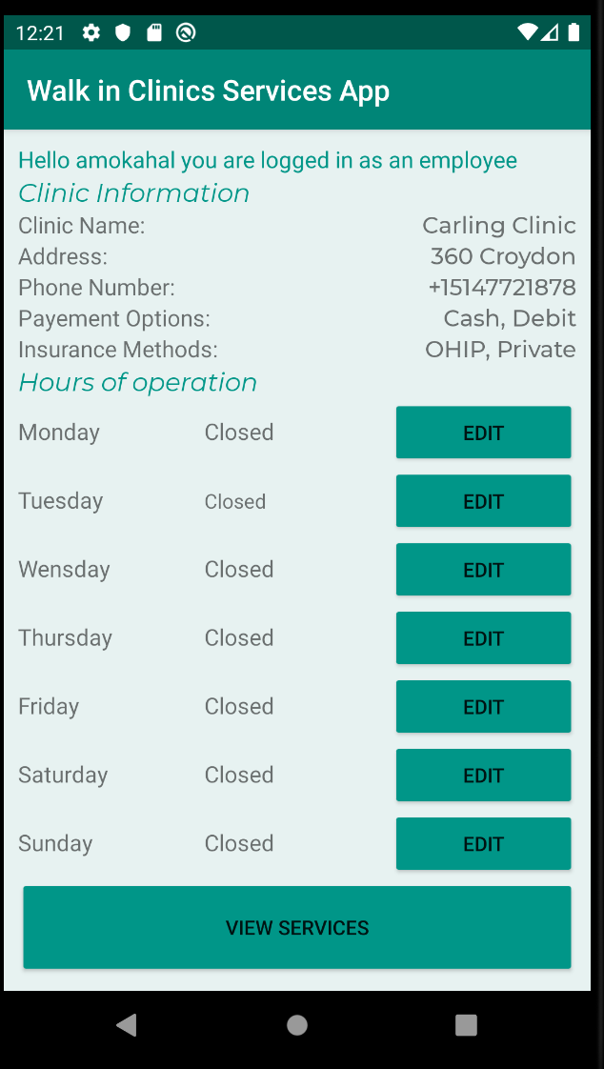
Employee User’s Functionality
Employee Initialization
First log-in
After initialized
MainActivity
EmployeeCompleteAccActivity
EmployeeMainActivity

Slide 8
Employee User’s Functionality
Employee Initialization
User will fill in the required fields on the clinic’s information:
Name
Address
Phone number
Accepted payment methods:
Cash
Debit
Credit
Accepted insurance:
OHIP
Public
Private
Click on “Complete Account” to initialize the clinic’s account.

Slide 9
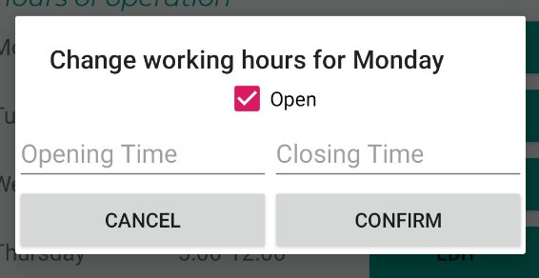
Employee User’s Functionality
Working Hours
Clinic’s information is displayed on top of the screen.
Clinic’s hours are by default ‘closed’ and displayed in a day-to-day basis.
Edit Hours
After clicking the “Edit” button.
Pop-up dialog
Fill in opening and closing times
Click confirm button

Slide 10
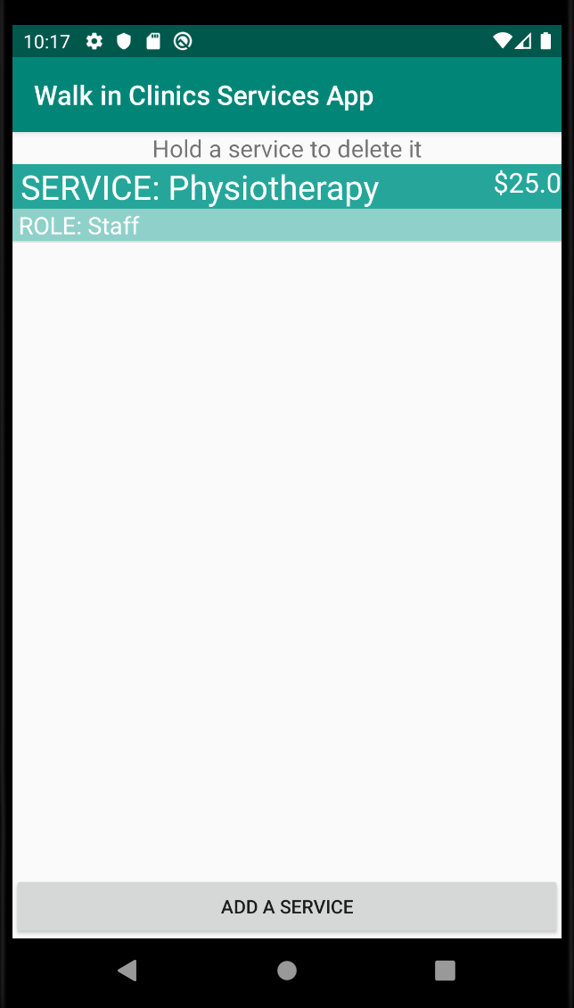
Employee User’s Functionality
Services & rates
Added services are displayed as a list.
Each item on the list shows:
Service name
Role
Rate
To delete long-press the item and press confirm on the dialog pop-up.
To add service click on “Add a service” button.
VIEW SERVICES

Slide 11
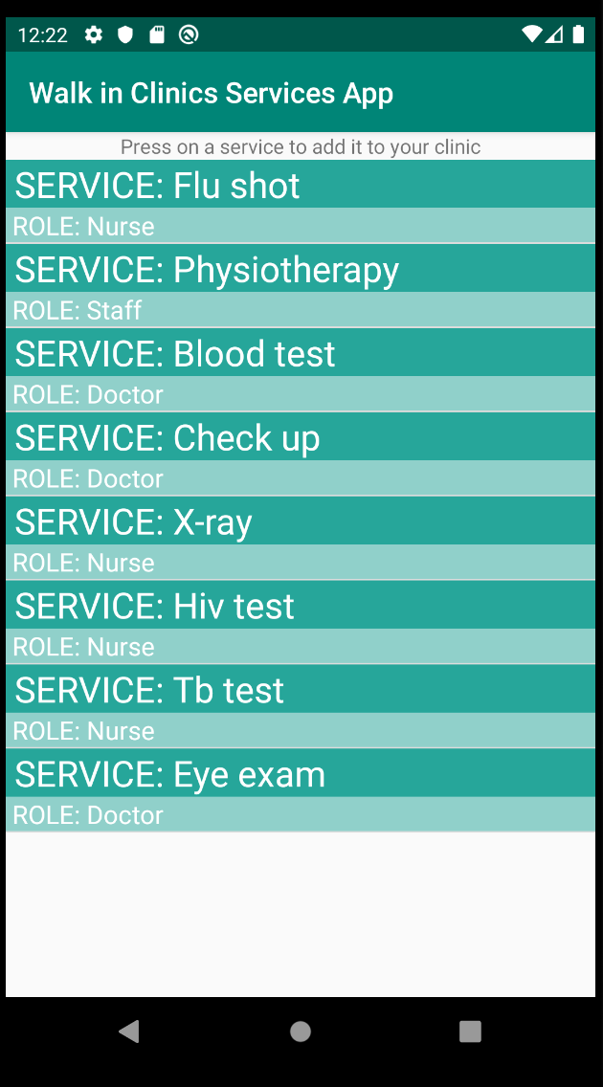
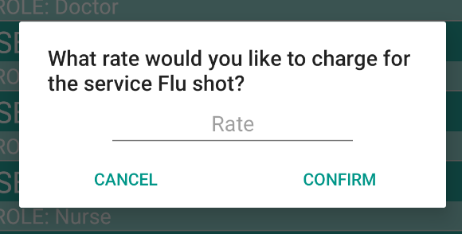
Employee User’s Functionality
Services & rates
Services added by the admin are displayed on this activity so the clinic can add them to it’s list.
To add a service, click on the desired service and a dialog will pop-up.
Dialog will ask the user to add a rate to the service.
Press ‘confirm’ to add the selected service with the given rate.

Slide 12
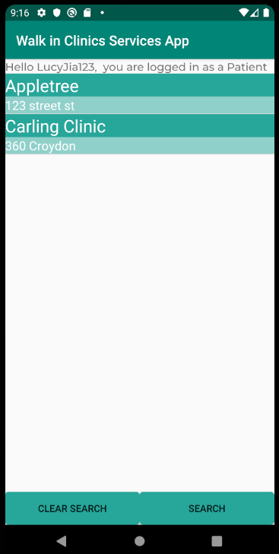
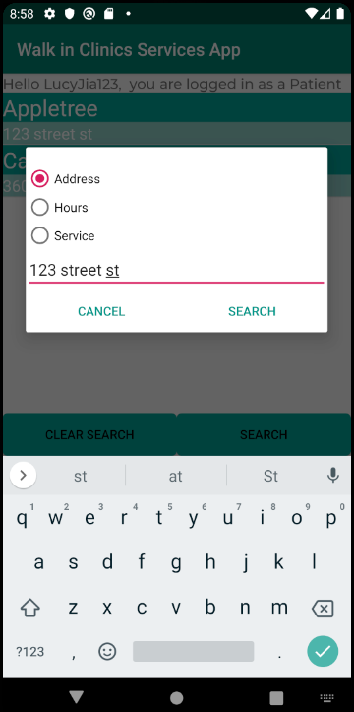
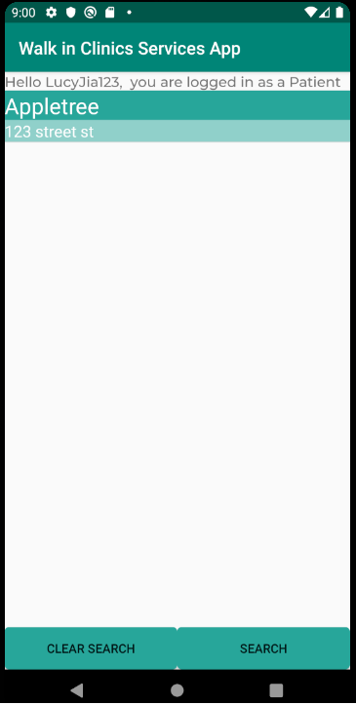
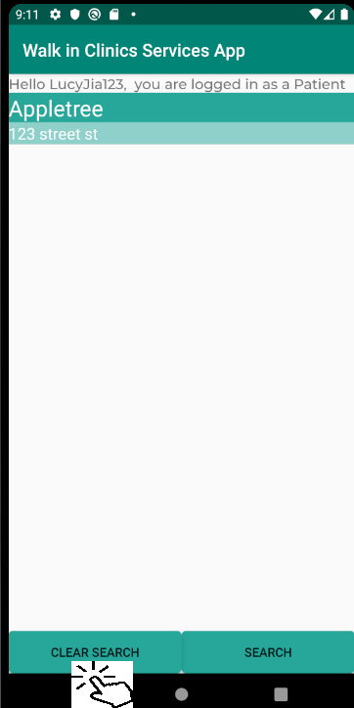
Patient User Functionality
Search for Clinic
As soon as you are logged in as a patient you will be able to search for any clinic based on 3 metrics; Address, Clinic hours, and services offered.
After the user is done with their search, they can click “CLEAR SEARCH” to return to the complete list of clinics.
(An example of searching via Address, resulting in a list matching the inputted value.)

Slide 13
Demo and Questions

