Slide 1

Top 50 Beer Profile
Beer Dataset with Tasting Profiles and Consumer Ratings

Slide 2

Data Source : Kaggle.com
https://www.kaggle.com/datasets/stephenpolozoff/top-beer-information
A dataset of up to 50 top-rated beers across 112 styles, 5558 beers in total.
The first ten columns are information on the beer provided by the source, along with contributed information like a unique key for each beer and style. The last eleven columns represent the tasting profile features of the beer, and are defined by word counts found in up to 25 reviews of each beer.
Data Collection | BeerAdvocate.com
Collection Methodology | Scraped information on rated beers and their reviews. Word counts from reviews were used to define a beer's features (Astringency, Body, Alcohol, Bitter, Sweet, Sour Salty, Fruity, Hoppy, Spicy, Malty).

Slide 3
My Role
A beer sommelier, also known as a cicerone in the United States, is a trained professional, working in the hospitality and alcoholic beverage industry, who specializes in the service and knowledge of beer.
Use data analysis skill to find out :
Top 5 Beer & it’ Brewery
Determine the most popular beer style
Analyzing the properties that make a highly-rated beer
Suggest Beer Style, Mouthfeel, Taste, Flavor & Aroma for upcoming Oktober Fest!

Slide 4
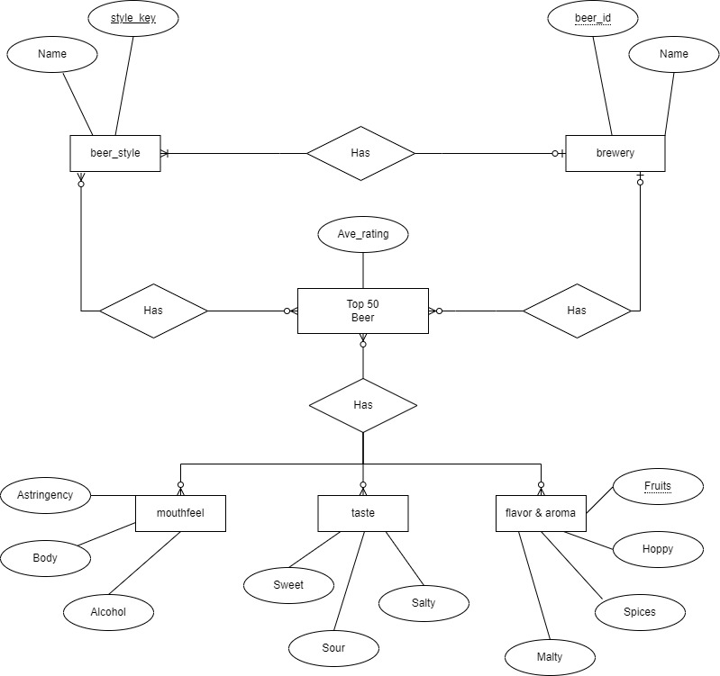
ER Diagram

Slide 5
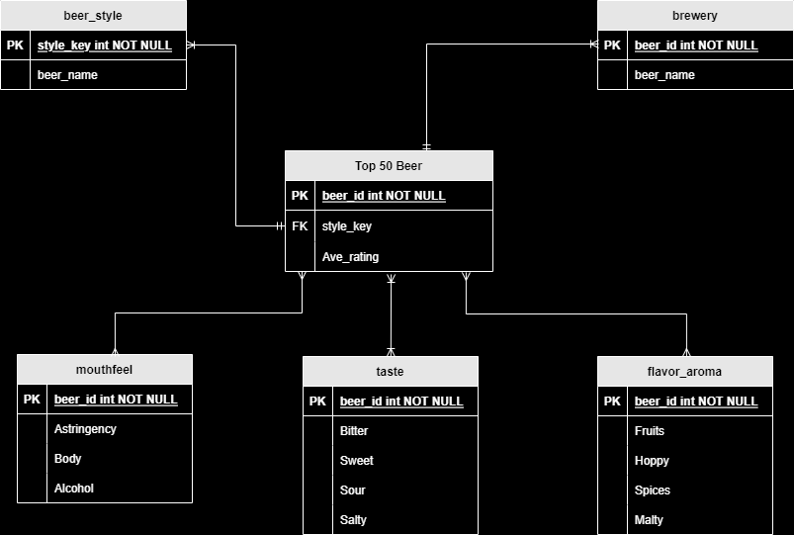
Schema Diagram

Slide 6
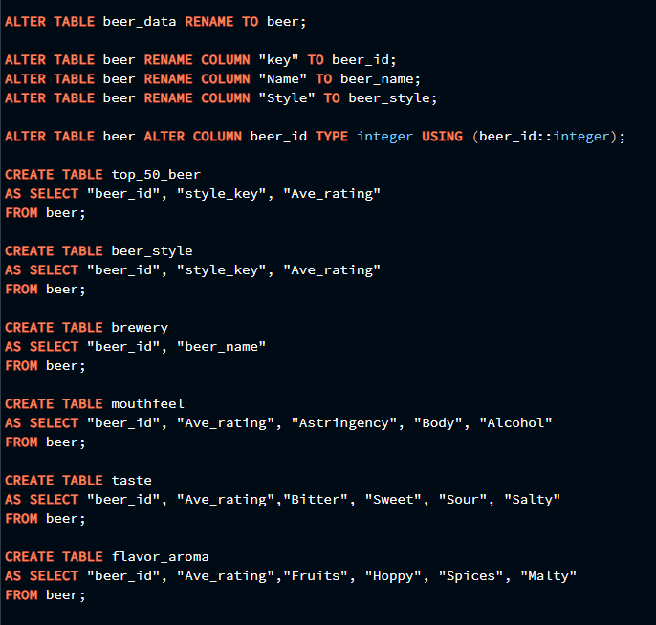
Raw csv/ Data Cleaning
Beer-data
Name TEXT
Key TEXT
Style TEXT
Style Key TEXT
Brewery TEXT
Description TEXT
ABV (alcohol by volume) TEXT
Ave Rating TEXT
Min IBU TEXT
Max IBU TEXT
Astringency TEXT
Body TEXT
Alcohol TEXT
Bitter TEXT
Sweet TEXT
Sour TEXT
Salty TEXT
Fruity TEXT
Hoppy TEXT
Spices TEXT
Malty TEXT
Change to beer_id (5558)
Remove
Not using this IBU
As Mouthfeel
As Taste
As Flavor & Aroma
Notes:
Instead of drop table, I create table to prevent

Slide 7
Challenges
Unable to define the number of word counts for each review whether the review is positive or negative review.
Therefore, base on assumption, the word counts is taken in such that the reviews are positive reviews.
Notes:
Instead of drop table, I create table to prevent

Slide 8
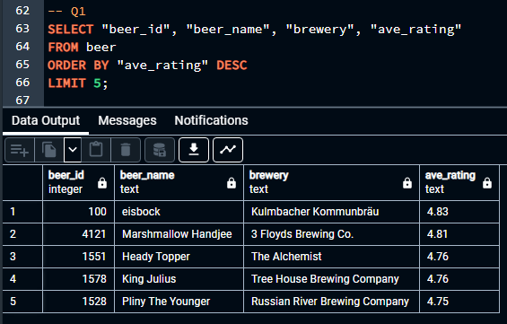
Top 5 Beer & it’ Brewery
Notes:
Instead of drop table, I create table to prevent

Slide 9
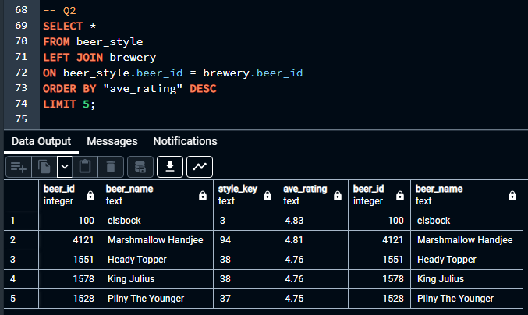
Determine the most popular beer style
Notes:
Instead of drop table, I create table to prevent

Slide 10
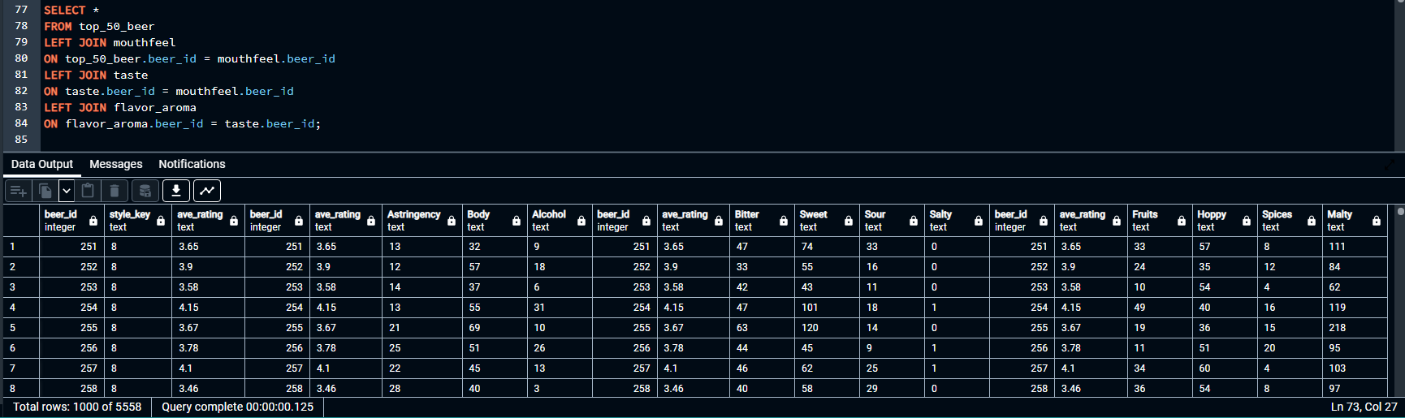
Properties that make a highly-rated beer
Notes:
Instead of drop table, I create table to prevent

Slide 11
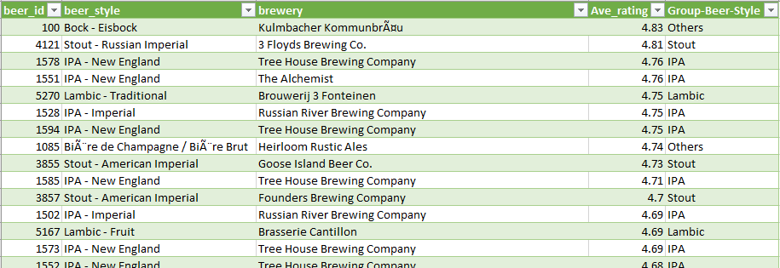
Excel
Notes:
Instead of drop table, I create table to prevent

Slide 12
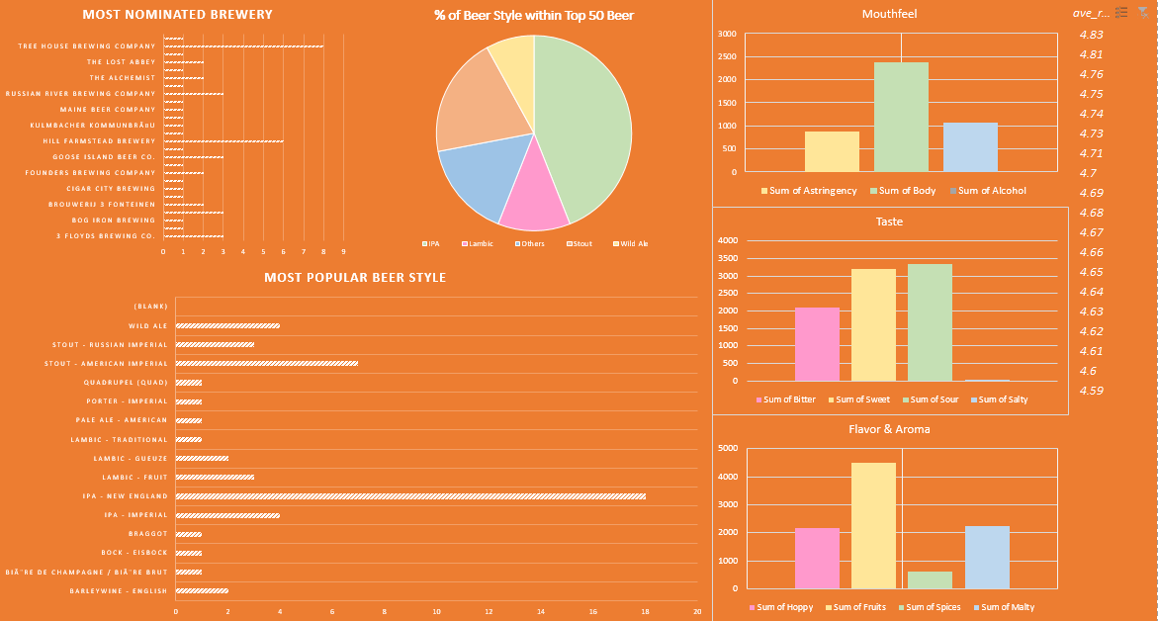
Dashboard
Notes:
Instead of drop table, I create table to prevent

Slide 13
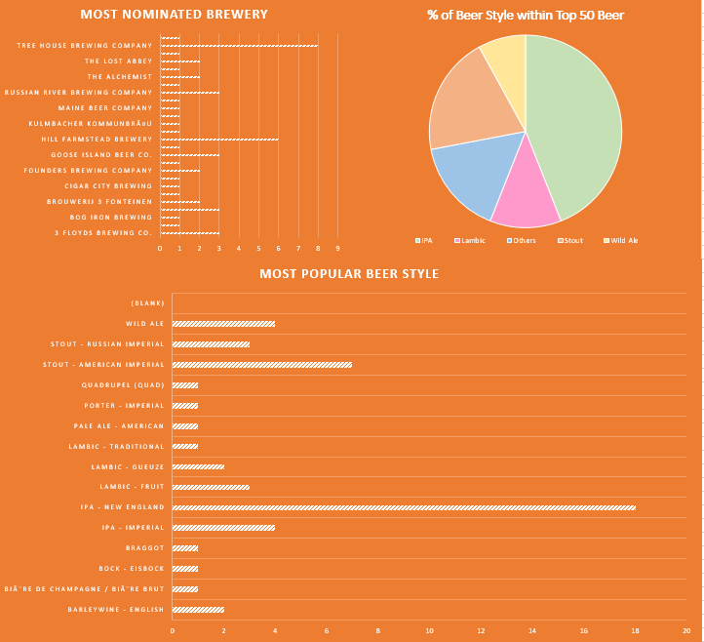
Dashboard
Notes:
Instead of drop table, I create table to prevent

Slide 14
Dashboard
Notes:
Instead of drop table, I create table to prevent

Slide 15
Dashboard
Notes:
Instead of drop table, I create table to prevent

