Slide 1
Exploring Computer Science Concepts
Via ACSL Competitions

Slide 2
Number Systems
Decimal
base 10
Binary
base 2
Octal
base 8
HexaDecimal
base 16

Slide 3
Digits per base
Decimal
Ten digits
0 1 2 3 4 5 6 7 8 9
Binary
Two Digits
0 1
Octal
8 digits
0 1 2 3 4 5 6 7
Hexadecimal
16 digits
0 1 2 3 4 5 6 7 8 9 A B C D E F

Slide 4
Counting in Decimal
Increment the lowest place value ( right most digit)
When last digit is reached
Set the current column to 0
Increment the column on the left by 1
Lets count with decimal
0 to 10
95 to105
How frequently do we add a new digit ?
Decimal | Decimal
0 | 95
1 | 96
2 | 97
3 | 98
4 | 99
5 | 100
6 | 101
7 | 102
8 | 103
9 | 104
10 | 105

Slide 5
Counting in other bases
Counting in binary
We add a new digit frequently
At 2 , 4, 8, 16 … decimal values
Counting in Octal
We add a new digit at every
At 8, 64,128 …
Counting in HexaDecimal
We add a new digit at every
At 16, 256 … values
Decimal | Binary | Octal | HexaDecimal
0 | 0 | 0 | 1
1 | 1 | 1 | 1
2 | 10 | 2 | 2
3 | 11 | 3 | 3
4 | 100 | 4 | 4
5 | 101 | 5 | 5
6 | 110 | 6 | 6
7 | 111 | 7 | 7
8 | 1000 | 10 | 8
9 | 1001 | 11 | 9
10 | 1010 | 12 | A
11 | 1011 | 13 | B
12 | 1100 | 14 | C
13 | 1101 | 15 | D
14 | 1110 | 16 | E
15 | 1111 | 17 | F
16 | 10000 | 20 | 10

Slide 6
Place Values
Decimal
We deal in power of 10s
2452 = 2 * 1000 + 4 * 100 + 5 * 10 + 2 * 1
101 = 1 * 100 + 0 * 10 + 1 * 1
Binary
We deal in power of 2s
111 = 1 * 4 + 1 * 2 + 1 * 1
1010 = 1 * 8 + 0 * 4 + 1 * 2 + 0 * 1

Slide 7
Place values Converting binary →decimal
Decimal | Binary
2452 ➔ 2 x 10^3 = 2000 4 x 10^2 = 400 5 x 10^1 = 50 2 x 10^0 = 2 = 2452 | 111 ➔ 1 x 2^2 = 1 x 4 = 4 1 x 2^1 = 1 x 2 = 2 1 x 2^0 = 1 x 1 = 1 = 7
101 ➔ 1 x 10^2 = 100 0 x 10^1 = 0 1 x 10^0 = 1 = 101 | 1010 ➔ 1 x 2^ 3 = 1 x 8 = 8 0 x 2^ 2 = 0 x 4 = 0 1 x 2^ 1 = 0 x 2 = 2 0 x 2^ 0 = 0 x 1 = 0 = 10
756 ➔ | 1000 ➔

Slide 8
Converting Binary to Decimal
128 64 32 16 8 4 2 1
1 0 0 1 0 0 1 = 64 + 16 + 1 = 81
1 0 0 0 0 1 1 1 = 128 + 4 + 2 + 1 = 135
1 1 1 0 0 0 0 0 = ?

Slide 9
Converting Decimal to Binary
128 64 32 16 8 4 2 1
= 22
= 33
= 130

Slide 10
Exercises
Convert following Decimal numbers to binary
127₁₀
128₁₀
129₁₀
255₁₀
256₁₀
Convert following Binary numbers to Decimal
101101₂
1110₂
1111₂
0110₂

Slide 11
Challenge
How does binary addition and subtraction work ?

Slide 12
Place values Converting octal,hexadecimal→decimal
Octal → Decimal | HexaDecimal → Decimal
777 ➔ 7 x 8^2 = 7 x 64 = 448 7 x 8^1 = 7 x 8 = 56 7 x 8^0 = 7 x 1 = 7 = 511 | 2AB ➔ 2 x 16^2 = 2 x 256 = 512 A x 16^1 = 10 x 16 = 160 B x 16^0 = 11 x 1 = 11 = 683
137 ➔ 1 x 8^2 = 1 x 64 = 64 3 x 8^1 = 3 x 8 = 24 7 x 8^0 = 7 x 1 = 7 = 95 | 101 ➔ 1 x 16^2 = 1 x 256 = 256 0 x 16^1 = 0 x 16 = 0 1 x 16^0 = 1 x 1 = 1 = 257
756 ➔ | 4A3 ➔

Slide 13
Converting Decimal to Octal
(312)₁₀ → (?)₈
312 / 8 → quotient : 39 , Remainder 0
39 / 8 → quotient : 4 , Remainder 7
4 / 8 → quotient : 0 , Remainder 4
(470)₈
(112)₁₀ →(?)₈
112 / 8 → quotient : 14 , Remainder 0
14 / 8 → quotient : 1 , Remainder 6
1 / 8 → quotient : 0 , Remainder 1
(160)₈

Slide 14
Exercises
Convert following Decimal numbers to Octal
111₁₀
88₁₀
511₁₀
512₁₀
513₁₀
Convert following Octal numbers to Decimal
45₈
77₈
100₈
101₈

Slide 15
Converting Decimal to Hexadecimal
(312)₁₀ → (?)₈
312 / 16 → quotient : 19 , Remainder 8
19 / 16 → quotient : 1 , Remainder 3
1 / 16 → quotient : 0 , Remainder 1
(138)₁₆
(112)₁₀ →(?)₈
112 / 16 → quotient : 7 , Remainder 0
7 / 16 → quotient : 0 , Remainder 7
(70)₁₆

Slide 16
Hexadecimal → Octal
(AC)₁₆→ (1010)₂ x 16 + (1100)₂ x 1 //Replace hexa with binary
→ (1010 1100)₂ // Convert to binary → (010 101 100)₂ // group by 3s , added extra 0s in the front
→ ( 254)₈// Replace each group by octal value
(1EF)₁₆→ (0001)₂ x 256 + (1110)₂ x 16 + (1111) x 1
→ (0001 1110 1111)₂ // Convert to binary → (000 111 101 111)₂ // group by 3 , removed 0s in the front
→ ( 757)₈// Replace each group by octal value

Slide 17
Octal → Hexadecimal
( 757)₈ → (?)₁₆
( 254)₈ → (?)₁₆

Slide 18
Exercises
Convert following Decimal numbers to HexaDecimal/Octal
255₁₀
256₁₀
257₁₀
Convert following HexaDecimal numbers to Decimal, Octal
99₁₆
100₁₆
101₁₆

Slide 19
Recursion : programming
Create factorial
5! = 5 x 4 x 3 x 2 x 1 = 120
2! = 2
Provide sum of Fibonacci numbers using recursion
fibonacci(13)
0 + 1 + 1 + 2 + 3 + 5 + 8 + 13 = 33
fibonacci(3)
0 + 1 + 1 + 2 + 3 = 7

Slide 20
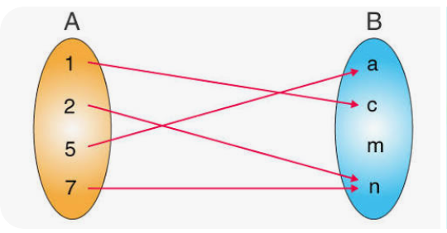
Relations
A relation : connection/mapping between elements of two or more sets, Some characteristics …
It is a mapping as shown in figure
Can be written as Ordered pairs
{(1,c), (2,n),(5,a),(7,n)}
Not always unique
E.g. y² = 4 has multiple solutions (how many?)
Examples
Numerical relationship : 4+3 = 7
Equation : y = 2x+3
Geometry : two congruent triangles
Set theory : A is a subset of B

Slide 21
Functions , mathematical kind
A relation that gives exactly one unique output for each input
x → → y :this is a function as you always get one answer
x → :Not a function as you get multiple answers
Representation
f(x) = 2x+1 : this is a function
g(x) = ± 3x : this is not a function , why?
Follow up reading (optional): pg 11-13 : functions
Rule
a
b
c
Rule

Slide 22
Evaluating functions
Solving
Substitute variables with numerals
Evaluate
Follow PEMDAS/BODMAS
Solve for x = 0,1,2,3
f(x) = 3x + 1
g(x) = 2x² + 3
h(x) = x² + 2x +1

Slide 23
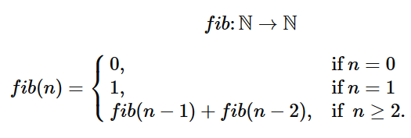
Recursive Functions
Functions calling themselves
Evaluate for ‘n’ = 2 , 4, 5, 6
Follow up reading (optional): nested functions visualized
Fibonacci numbers
Factorial | fact(n) = n * fact(n-1) {given, fact(1) = fact(0) =1}
Lucas numbers (same rule as Fibonacci but with different starting values) | l (n) = l(n-1) + l(n-2) {given , l(0) = 2, l(1) = 1}

Slide 24
Programming, , Test #1
Need to know
Data types
Conditionals : If/else
Loops : for
Arrays : 2 dimensional
Practice
Arrays- DS (Hackerrank)
Do the 4 problems marked “easy”
Optional :“hard”, “medium” one are for extra challenge

Slide 25
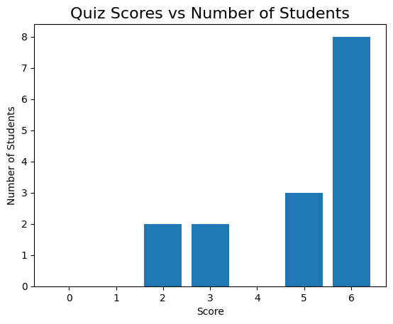
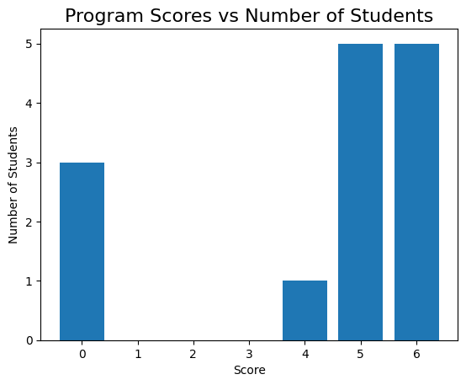
Test 1, observations
Great participation, nearly everyone attempted!
Overall students did better in quiz
8x full marks in quiz vs 5x full marks in programming
4 students got a zero in programming ( with 1 not attempted)

Slide 26
Test 2 , analysis
The quizzes
seem to be easier for students to master
Success cause everyone attempted, next we figure out how to raise scores there
Suggestions ?
Programming
It was amazing attempt
The codes generally worked
But 4/15 students had zeroes.
Suggestions ?
Goal :We need raise scores for everyone and move some in attempted stage
Note
Compete with yourself , Do better than your last attempt
Ask for help
on what you don’t know, to learn it.
And even on what you know , i.e. to master it

Slide 27
Topics for Test 2
Mathematical expressions
Representations ( infix, prefix, postfix)
Evaluation or expression
Discrete Mathematics
Logical Operators (AND , OR , NOT, SHIFT,…)
Boolean logic
Programming
char, string ,arrays
Loops
Conditionals
If/else
switch/case

Slide 28
Infix expressions
Encounter them in grade maths. e.g.
(11+14)/(9 - 3) + 2
3+7 / (4 * 5 - 6)
- 2 + 8 / 2
Can also be written using variables
(a + b) / (c – d ) + e
x + y / (g * h – k)
Evaluated using
PEMDAS / BODMAS

Slide 29
Expression : anatomy
Expression is made of
Operators ( + , - , * , /)
Operands (numbers, variables)
Unary operators : - a
<operator> <operand>
Binary operators (infix) : a + b
< operand> <operator> <operand>

Slide 30
Prefix/Postfix expressions
Benefits
Remove ambiguity( i.e. can forget PEMDAS, BODMAS)
Computer friendly
Works with both unary/binary
Faster evaluation
Expression styles
Infix : operator in middle of operands
(5+6)*3
< operand> <operator> <operand>
Prefix : operator before operands
* + 5 6 3
<operator> <operand> < operand>
Postfix : operator after operands
5 6 + 3 *
<operand> < operand> <operator>

Slide 31
Evaluating expression, but first Stacks and Queues
What is a Stack ?
This is a sequential structure of items
That are pushed at one end
Pulled via the same end
LIFO : Last in First Out
Examples
Stack of plates
Your turned in paper assignments
What is a Queue?
Another sequential structure of items
that are pushed at one end
Pulled via the opposite end
FIFO : First In First Out
Examples
Queue for buying tickets
Traffic in one way single lane

Slide 32
Evaluating prefix expression
Infix : (5+6)*3
* + 5 6 3
- + 2 * 3 4 / 16 ^ 2 3
Algorithm (harder way)
Scan from right to left
Anytime you find an operator
Evaluate the operation using the previous 2 operands
Replace the <operator> <operand> < operand> with result in the expression
Repeat the steps till only 1 operand is left

Slide 33
Evaluating postfix expression
Evaluate
2 3 1 * + 9 –
5 3 + 6 2 / * 3 5 * +
Algorithm to evaluate (use stack)
Push the operands in a stack
When you encounter a operator
Pop 2 operands
Perform the operation on operands
Push the result in stack
Repeat from 1 until expression is parsed
The last item in stack is the answer
There would be only 1 item left when done correctly
* prefix expr can also be evaluated in this way ( just in reverse)

Slide 34
Evaluate
Prefix
- * 5 + - 4 2 2 / 6 3
- * + 3 5 7 + / 4 2 1
- + 10 * 2 3 + 4 / 5 5
Postfix
1 2 + 3 4 + * 5 6 - / 7 +
8 2 / 3 4 + * 5 1 + 2 / -
9 8 4 2 1 ^ * / - 3 +

Slide 35
Answers
Prefix
- * 5 + - 4 2 2 / 6 3
Ans : 18
- * + 3 5 7 + / 4 2 1
Ans : 53
- + 10 * 2 3 + 4 / 5 5
Ans : 11
Postfix
1 2 + 3 4 + * 5 6 - / 7 +
Ans : -14
8 2 / 3 4 + * 5 1 + 2 / -
Ans : 25
9 8 4 2 1 ^ * / - 3 +
Ans : 11

Slide 36
Practice: Programming
Write a function that takes a string and checks if it is a palindrome
Returns true if palindrome is found else false
Hints: string indexing, loops, if , comparing characters
Count the number of vowels, consonants in a sentence.
Vowels : a,e,i,o,u
Consonant : everything else other than vowels
Ignore : spaces (‘ ’,) comma(,) dash(-),semicolon(;),colon( : )
Find the most frequent word in a sentence
If more than 1 word has same frequency return the lexicographically smaller one.

Slide 37
Review Evaluating Prefix/Postfix
From last week
Operator
Operand
Stack
Queue
Evaluating Prefix/Postfix
<3 questions each>

Slide 38
Precedence and associativity
Precedence ( highest priority first)
()
^
/ *
- +
Associativity
Right to left : ^
Left to right : + , - , * , /
Notes
() not categorized as associative, they represent grouping mechanism

Slide 39
Precedence and associativity
Example
10 + 20 / 2 * 3 – 5
➔ 10 +((20 / 2) * 3)-5 // added parenthesis for denoting precedence
➔ 10 + (10 * 3 ) -5 // interior most precedence first
➔10 + 30 - 5
➔ 35

Slide 40
Precedence and associativity (lets evaluate)
2 + 3 * 4 ^2
2 ^ 3 ^ 2
100 / 2 * 5 ^ 2 ^ 1

Slide 41
Precedence and associativity (answers)
2 + 3 * 4 ^2
➔ 2 + 3 * 16
➔ 2 + 48
➔ 50
2 ^ 3 ^ 2
➔ 2 ^ 9 // ^ is evaluated from right to left , so 3 ^ 2 goes first
➔ 512
Not 64
100 / 2 * 5 ^ 2 ^ 1
➔ 100 / 2 * 25 // Again 2 ^ 1 goes first
➔ 50 x 25
➔1250

Slide 42
Convert to Prefix/Postfix (examples)
B * C
Prefix : * B C
Postfix : B C *
A + B * C
Prefix : +A*BC
Postfix : ABC*+
(5 + 6) * 3
Prefix : * + 5 6 3
Postfix : 5 6 + 3 *

Slide 43
Convert to Postfix
How to convert!
Convert the highest precedence/priority first
( do paranthesize for mental ease)
(a + b) / (c – d ) + e
x + y / (g * h – k)

Slide 44
Convert to Postfix
How to convert!
Convert the highest priority first
( and paranthesize for mental ease)
(a + b) / (c – d ) + e
Prefix : + / + a b – c d e
Postfix : a b + c d - / e +
x + y / (g * h – k)
Prefix : + x / y - * g h k
Postfix : x y g h * k - / +

Slide 45
Convert to Prefix and Postfix
a + b - c * d + e ^ f
(a + b) * c - (d - e) * (f + g)
((a + b) * (c + d) / (e - f)) + g
a * (b + c) / (d - e)
a - b / (c * d ^ e)
(a + b) * (c + d) - e

Slide 46
Convert to Prefix and Postfix (answers)
Infix | Prefix | Postfix
a + b - c * d + e ^ f | + - + a b * c d ^ e f | a b + c d * - e f ^ +
(a + b) * c - (d - e) * (f + g) | - * + a b c * - d e + f g | a b + c * d e - f g + * -
((a + b) * (c + d) / (e - f)) + g | + / * + a b + c d - e f g | a b + c d + * e f - / g +
a * (b + c) / (d - e) | / * a + b c - d e | a b c + * d e - /
a - b / (c * d ^ e) | - a / b * c ^ d e | a b c d e ^ * / -
(a + b) * (c + d) - e | - * + a b + c d e | a b + c d + * e -

Slide 47
Logical operators (for bits/bytes)
Bitwise
NOT, AND, XOR , OR
Shift
Linear : LSHIFT, RSHIFT,
Circular : RCIRC, LCIRC
Precedence
NOT,
SHIFT, CIRC,
AND ,
XOR,
OR

Slide 48
Truth Tables
X | NOT X
0 | 1
1 | 0
X | Y | X AND Y | X OR Y | X XOR Y
0 | 0 | 0 | 0 | 0
0 | 1 | 0 | 1 | 1
1 | 0 | 0 | 1 | 1
1 | 1 | 1 | 1 | 0

Slide 49
Truth Tables
Linear shift , add 0s as padding ( either left or right)
Shifting by word size (or more) would result in all 0s
Circular shift just rolls over the bits ( as per direction)
Shifting by the number of word size , same bit sequence would be produced
X | (LSHIFT-2 X) | (RSHIFT-3 X) | (LCIRC-3 X) | (RCIRC-1 X)
01101 | 10100 | 00001 | 01011 | 10110
10 | 00 | 00 | 01 | 01
1110 | 1000 | 0001 | 0111 | 0111
1011011 | 1101100 | 0001011 | 1011101 | 1101101

Slide 50
Operations (evaluate)
0110 AND 1011
1100 OR 0101
1010 XOR 1111
1010 AND 1100 OR 0001
0011 OR 1010 AND 0110
(1100 XOR 1010) AND 0110

Slide 51
Operations (evaluate)
0110 AND 1011
1100 OR 0101
1010 XOR 1111
1010 AND 1100 OR 0001
0011 OR 1010 AND 0110
(1100 XOR 1010) AND 0110

Slide 52
Operations : Shift (evaluate)
(LSHIFT-1 10101) AND (RSHIFT-2 11010)
(RCIRC-2 01111) OR (LSHIFT-3 10010)
(RSHIFT-1 11100) XOR (LCIRC-2 01011)
(LSHIFT-2 00110) OR (RCIRC-1 10101) AND (RSHIFT-3 11101)
(LCIRC-3 11001) AND (RSHIFT-2 10110)
(RCIRC-4 10011) OR (LSHIFT-1 01101)
(RSHIFT-3 11110) AND (LCIRC-1 00111) OR (LSHIFT-2 01010)
(LSHIFT-2 01101) OR (RCIRC-3 10110) AND (RSHIFT-1 11011)

Slide 53
Answsers 1..3
(LSHIFT-1 10101) AND (RSHIFT-2 11010)
→ 01010 AND 00110
→ 00010
(RCIRC-2 01111) OR (LSHIFT-3 10010)
→ 11011 OR 10000
→ 11011
(RSHIFT-1 11100) XOR (LCIRC-2 01011)
→ 01110 XOR 01101
→ 00011

Slide 54
Answers 4..6
(LSHIFT-2 00110) OR (RCIRC-1 10101) AND (RSHIFT-3 11101)
11000 OR 11010 AND 00011 //parenthesis evaluated first
11000 OR 00010 // And has higher precedence so evaluated first
11010
(LCIRC-3 11001) AND (RSHIFT-2 10110)
01110 AND (RSHIFT-2 10110)
01110 AND 00101
00100
(RCIRC-4 10011) OR (LSHIFT-1 01101)
00111 OR 11010
11111

Slide 55
Answers 7..8
(RSHIFT-3 11110) AND (LCIRC-1 00111) OR (LSHIFT-2 01010)
00011 AND 01110 OR (01000)
00010 OR 01000
01010
(LSHIFT-2 01101) OR (RCIRC-3 10110) AND (RSHIFT-1 11011)
11010 OR 11010 AND 01101
11010 OR 01000
11010

Slide 56
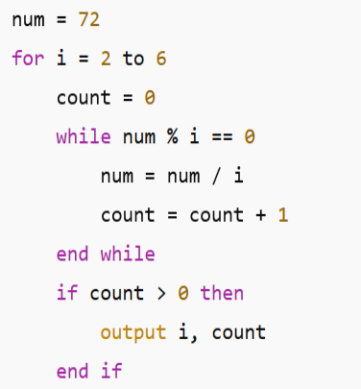
What does this Program do ? Q1.
Notes:
2, 3 have outputs 4,5,6 don’t

Slide 57
What does this Program do ? A1.
i = 2
num = 72
72 % 2 == 0 → yes
num = 36, count = 1
36 % 2 == 0 → yes
num = 18, count = 2
18 % 2 == 0 → yes
num = 9, count = 3
9 % 2 != 0 → stop
output → 2 3
I =3
output → 3 2
I = 4 ,5, 6
num = 1 ( not divisible by any)
no output

Slide 58
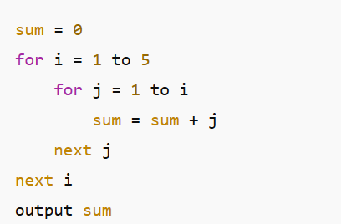
What does this Program do ? Q2.

Slide 59
What does this Program do ? A2.
Nested loop sum : 35
i | j | Added | sum
1 | 1 | 1 | 1
2 | 1+2 | 3 | 4
3 | 1+2+3 | 6 | 10
4 | 1+2+3+4 | 10 | 20
5 | 1+2+3+4+5 | 15 | 35

Slide 60
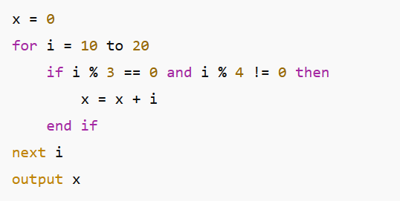
What does this Program do ? Q3

Slide 61
What does this Program do ? A3
We want
Divisible by 3
NOT divisible by 4
15 + 18 = 33
i | %3 | %4 | Include?
12 | Y | Y | No
15 | Y | N | Yes
18 | Y | N | Yes

Slide 62
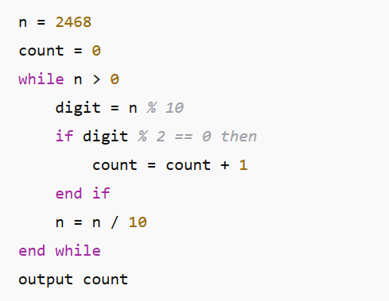
What does this Program do ? Q4

Slide 63
What does this Program do ? A4
Output 4
Step digit even? count
8 yes 1 1
6 yes 2 2
4 yes 3 3
2 yes 4 4

Slide 64
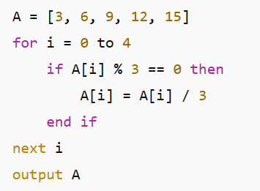
What does this Program do ? Q5

Slide 65
What does this Program do ? A5
Divide every element by 3
Output 1,2,3,4,5
Index Original New
0 3 1
1 6 2
2 9 3
3 12 4
4 15 5

Slide 66
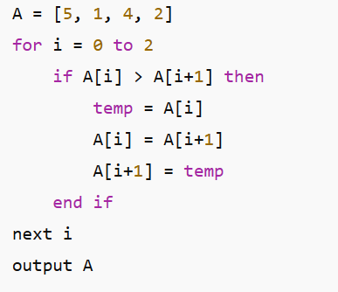
What does this Program do ? Q6

Slide 67
What does this Program do ? A6
Single pass swap
Output : 1,4,2,5
Note : not sorted
i =0
5 > 1 → swap → [1, 5, 4, 2]
i =1
5 > 4 → swap → [1, 4, 5, 2]
i = 2
5 > 2 → swap → [1, 4, 2, 5]

Slide 68
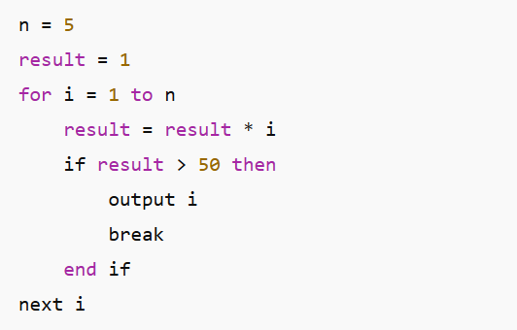
What does this Program do ? Q7

Slide 69
What does this Program do ? A7
Output 5
Step i result action
1 1 1 result < 50 continue
2 2 2 result < 50 continue
3 3 6 result < 50 continue
4 4 24 result < 50 continue
5 5 120 result > 50 break

Slide 70

Boolean Logic/Algebra
The inputs are : 0,1 {only}
The outputs are : 0,1 {only}
Operators
()
NOT → $\overline{A}$
AND→ $A .B$
XOR →$A⊕B$
XNOR → $\overline{A⊕B}$
OR →$A+B$

Slide 71
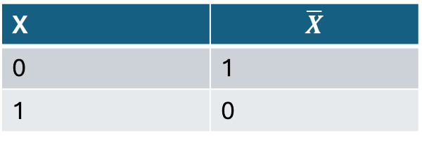
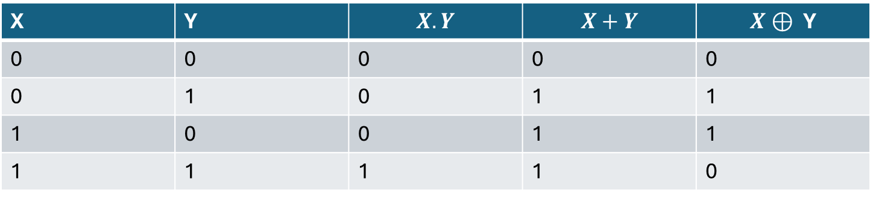
Truth Tables ( same as bitwise operations → easy)
X | $$\overline{X}$$
0 | 1
1 | 0
X | Y | $$X.Y$$ | $$X+Y$$ | $$X⊕ \text{Y}$$
0 | 0 | 0 | 0 | 0
0 | 1 | 0 | 1 | 1
1 | 0 | 0 | 1 | 1
1 | 1 | 1 | 1 | 0

Slide 72

Some expressions
Evaluate for A = 1 , B = 0 , C =0
$A.\left(B+C\right)$
$\overline{A}.\left(B+C\right)$
$A.\left(\overline{B}+C\right)$
$\left(A+B\right)\left(A+C\right)$
$A+\overline{A}$.B
$A+AB$

Slide 73

Rules/Discovery
Identity
A + 0 = A
A . 1 = A
A + 1 = 1
A . 0 = 0
Idempotent
$A+A$ = A
$A . A$ = A
Complement
$A+\overline{A}$ = 1
$A . \overline{ A}\text{ = }\text{0}$

Slide 74

Some more rules
Double Negation
$\overset{̿}{A}=A$
Absorption law
$A+A.B=A$
$A.\left(A+B\right)=A$
Distribution law (symmetrical to both . and +)
$A.\left(B+C\right)=(A.B)+(A.C)$
$A+\left(B.C\right)=\left(A+B\right).(A+C)$

Slide 75

Do it yourself
Hint : These may be actual theorems
$\overline{A.B}=?$
$\overline{A+B}=?$
$\left(A+B\right).\left(\overline{A}+C\right)= ?$
$A\left(\overline{A}+B \right)= ?$
$A+\overline{A}B= ?$
Notes:
$$\left(A+B\right).\left(\overline{A}+C\right)=AC+\overline{A}B \\ A\left(\overline{A}+B \right)=A.B$$
$$A+\overline{A}B=A+B$$

Slide 76
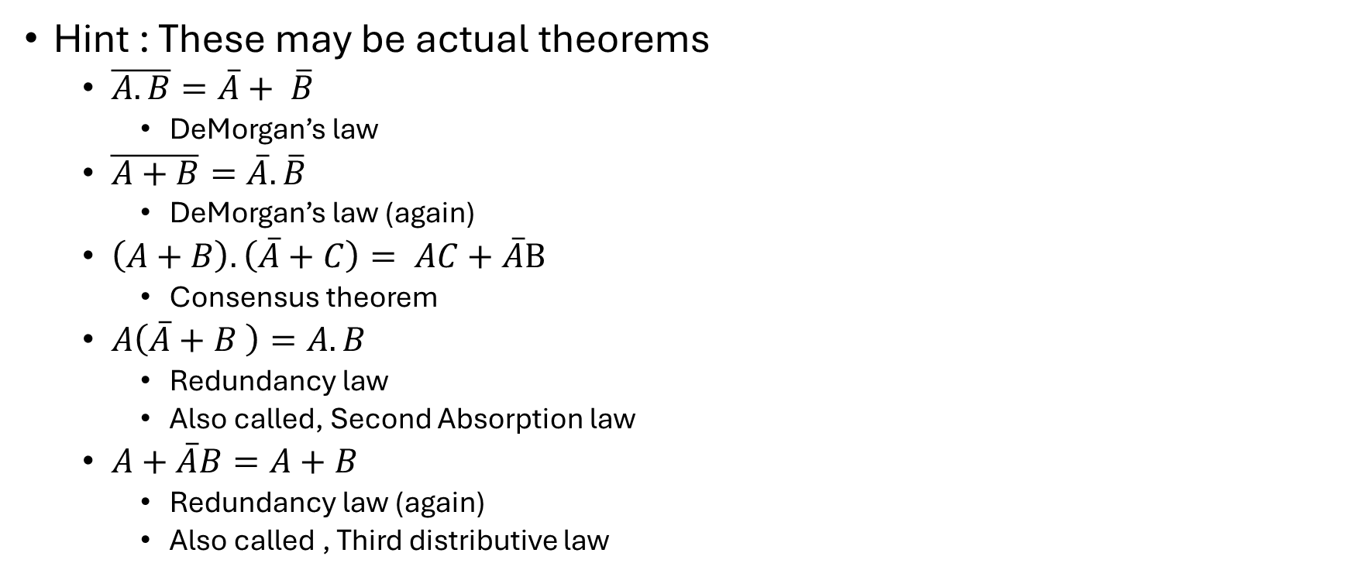
Solved (and named)
Hint : These may be actual theorems
$\overline{A.B}=\overline{A}+ \overline{B}$
DeMorgan’s law
$\overline{A+B}=\overline{A}. \overline{B}$
DeMorgan’s law (again)
$\left(A+B\right).\left(\overline{A}+C\right)= AC+\overline{A}B$
Consensus theorem
$A\left(\overline{A}+B \right)=A.B$
Redundancy law
Also called, Second Absorption law
$A+\overline{A}B=A+B$
Redundancy law (again)
Also called , Third distributive law
Notes:
$$\left(A+B\right).\left(\overline{A}+C\right)=AC+\overline{A}B \\ A\left(\overline{A}+B \right)=A.B$$
$$A+\overline{A}B=A+B$$

Slide 77

Lets Simplify 1..4
$A.\left(A+B\right)$
$A+\left(A.B\right)$
$\overline{A}+\left(A.B\right)$
($A+B).(A+\overline{B})$

Slide 78

Lets Simplify 1..4 : answers
$A.\left(A+B\right)$
By Absorption law = A, OR
A.A + A.B
A + AB //(A.A = A), Idempotent Law
A (1+ B) // factor A out
A // By null law 1+B = 1 and A.1 = A
$A+\left(A.B\right)$
A
$\overline{A}+\left(A.B\right)$
$\left(\overline{A}+A\right).(\overline{A}+$ B) //Distribution law
1. $(\overline{A}+$ B) // By Complement law $\left(\overline{A}+A\right)=1$
$\overline{A}+$ B
($A+B).\left(A+\overline{B}\right)$
($A.A)+(B.\overline{B})$ //Distribution law
A$+0$ //Idempotent law + Complement law
A

Slide 79

Lets Simplify 5..11
$\left(A.B\right)+\left(A.\overline{B}\right)+\left(\overline{A}.C\right)$
$A+C$
$\left(A+B\right).\left(A+\overline{B}\right).\left(\overline{A}+B\right)$
$A.B$
$\overline{A+B}+A. \overline{B}$
$\overline{B}$
$\left(A+B+C\right).\left(\overline{A}+B\right).(A+\overline{C}$)
$B.(A+\overline{C}$)
$\left(A.\overline{B}+B.C\right).\left(\overline{A}+\overline{C}\right)$
$A.\overline{BC}+ \overline{A}.B.C$
$\overline{(A.B)}$.$\left(\overline{A}+C\right)+(A.\overline{C}$)
$\overline{A}$ + $\overline{B}+\overline{C}$

Slide 80

Lets Simplify 5..11 : answers
These are hard , think of them as puzzles,
$\left(A.B\right)+\left(A.\overline{B}\right)+\left(\overline{A}.C\right)$
$\left(A+B\right).\left(A+\overline{B}\right).\left(\overline{A}+B\right)$
$\overline{A+B}+A. \overline{B}$
$\left(A+B+C\right).\left(\overline{A}+B\right).(A+\overline{C}$)
$\left(A.\overline{B}+B.C\right).\left(\overline{A}+\overline{C}\right)$
$\overline{(A.B)}$.$\left(\overline{A}+C\right)+(A.\overline{C}$)

Slide 81
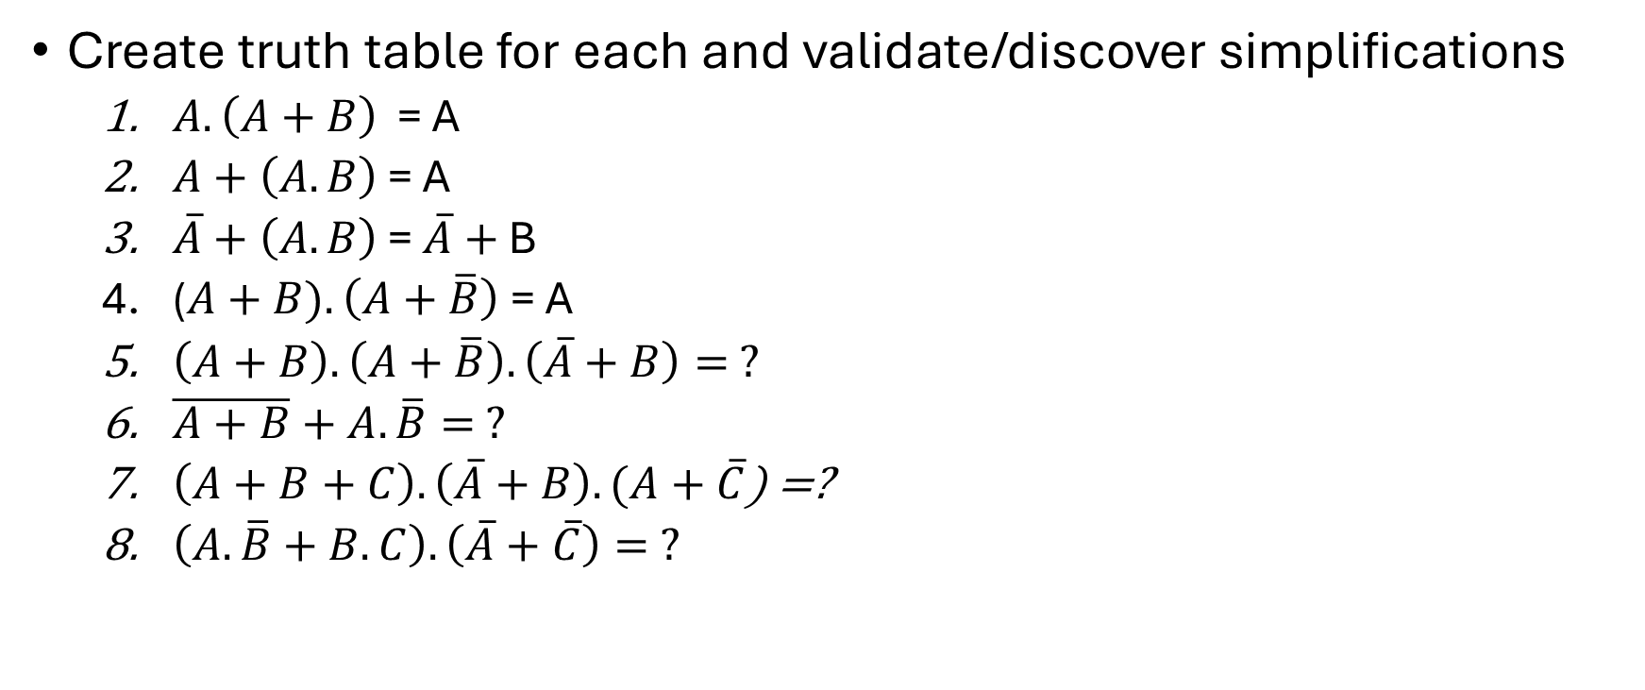
Truth Tables/Expressions
Create truth table for each and validate/discover simplifications
$A.\left(A+B\right)$ = A
$A+\left(A.B\right)$ = A
$\overline{A}+\left(A.B\right)$ = $\overline{A}+$ B
($A+B).\left(A+\overline{B}\right)$ = A
$\left(A+B\right).\left(A+\overline{B}\right).\left(\overline{A}+B\right)= ?$
$\overline{A+B}+A. \overline{B}= ?$
$\left(A+B+C\right).\left(\overline{A}+B\right).(A+\overline{C}$) =?
$\left(A.\overline{B}+B.C\right).\left(\overline{A}+\overline{C}\right)= ?$

Slide 82
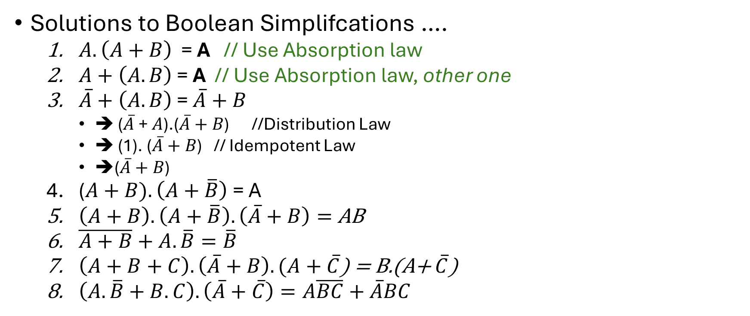
Expressions: Soln
Solutions to Boolean Simplifcations ….
$A.\left(A+B\right)$ = A // Use Absorption law
$A+\left(A.B\right)$ = A // Use Absorption law, other one
$\overline{A}+\left(A.B\right)$ = $\overline{A}+B$
➔ ($\overline{A}$ + $A$).($\overline{A}+B$) //Distribution Law
➔ (1). ($\overline{A}+B$) // Idempotent Law
➔($\overline{A}+B$)
($A+B).\left(A+\overline{B}\right)$ = A
$\left(A+B\right).\left(A+\overline{B}\right).\left(\overline{A}+B\right)=$AB
$\overline{A+B}+A. \overline{B}=\overline{B}$
$\left(A+B+C\right).\left(\overline{A}+B\right).(A+\overline{C}$) = B.(A+ $\overline{C}$)
$\left(A.\overline{B}+B.C\right).\left(\overline{A}+\overline{C}\right)=A\overline{BC}+\overline{A}BC$

Slide 83
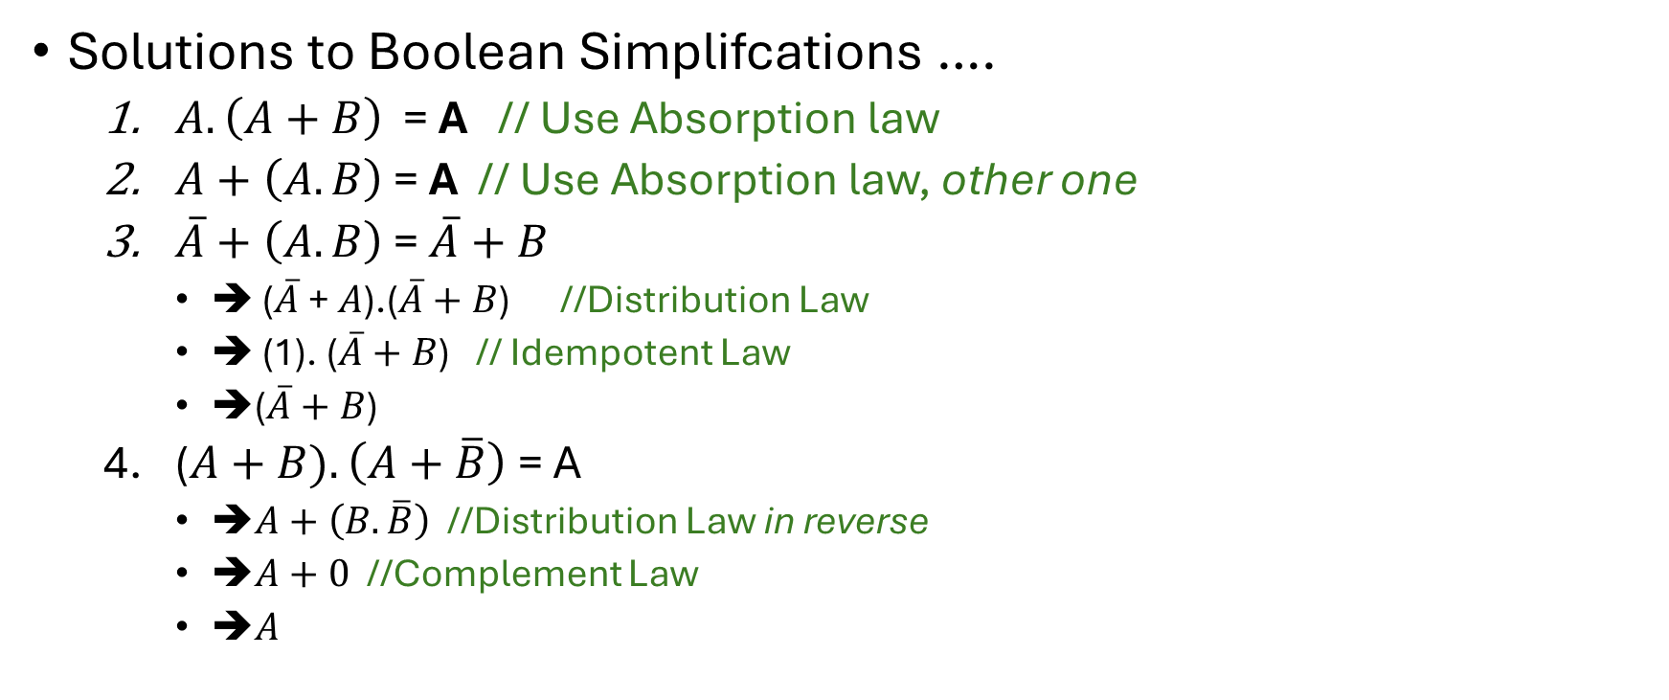
Expressions: Soln 1..4
Solutions to Boolean Simplifcations ….
$A.\left(A+B\right)$ = A // Use Absorption law
$A+\left(A.B\right)$ = A // Use Absorption law, other one
$\overline{A}+\left(A.B\right)$ = $\overline{A}+B$
➔ ($\overline{A}$ + $A$).($\overline{A}+B$) //Distribution Law
➔ (1). ($\overline{A}+B$) // Idempotent Law
➔($\overline{A}+B$)
($A+B).\left(A+\overline{B}\right)$ = A
➔$A+\left(B.\overline{B}\right)$ //Distribution Law in reverse
➔$A+0$ //Complement Law
➔$A$

Slide 84
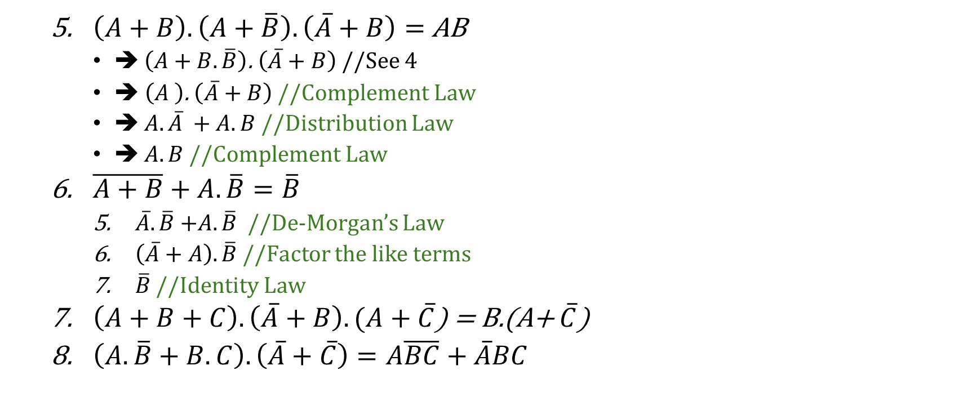
Expressions: Soln 5,6
$\left(A+B\right).\left(A+\overline{B}\right).\left(\overline{A}+B\right)=$AB
➔ $\left(A+B.\overline{B}\right)$. $\left(\overline{A}+B\right)$//See 4
➔ $\left(A \right)$. $\left(\overline{A}+B\right)$ //Complement Law
➔ $A.\overline{A} +A.B$ //Distribution Law
➔ $A.B$ //Complement Law
$\overline{A+B}+A. \overline{B}=\overline{B}$
$\overline{A}.\overline{B}$ $+A. \overline{B}$ //De-Morgan’s Law
$\left(\overline{A}+A\right).\overline{B}$ //Factor the like terms
$\overline{B}$ //Identity Law
$\left(A+B+C\right).\left(\overline{A}+B\right).(A+\overline{C}$) = B.(A+ $\overline{C}$)
$\left(A.\overline{B}+B.C\right).\left(\overline{A}+\overline{C}\right)=A\overline{BC}+\overline{A}BC$

Slide 85
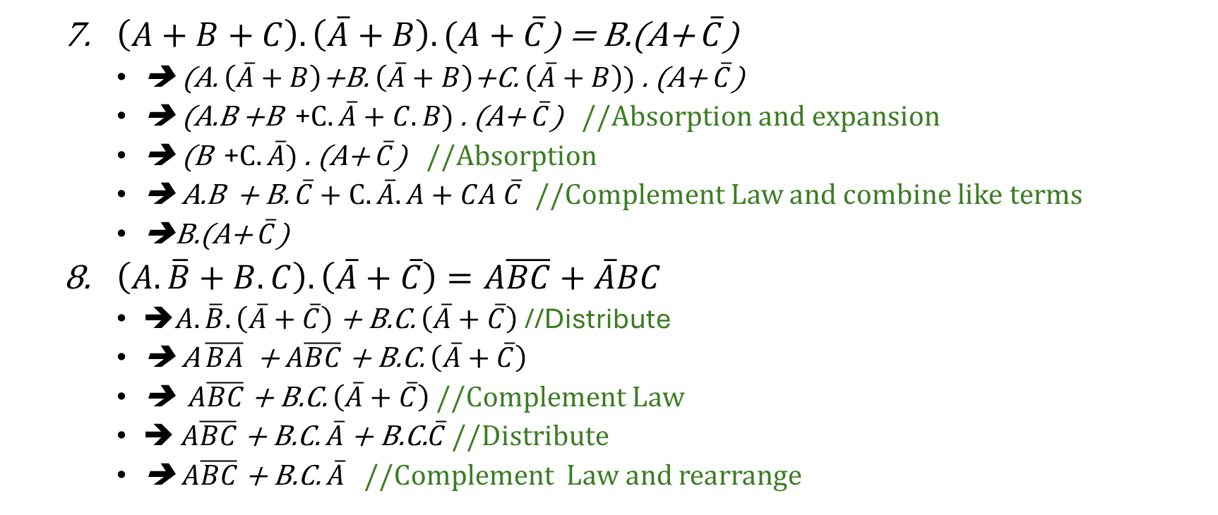
Expressions: Soln 5,6
$\left(A+B+C\right).\left(\overline{A}+B\right).(A+\overline{C}$) = B.(A+ $\overline{C}$)
➔ (A. $\left(\overline{A}+B\right)$+B. $\left(\overline{A}+B\right)$+C. $\left(\overline{A}+B\right))$ . (A+ $\overline{C}$)
➔ (A.B +B +$C.\overline{A}+C.B)$ . (A+ $\overline{C}$) //Absorption and expansion
➔ (B +$C.\overline{A})$ . (A+ $\overline{C}$) //Absorption
➔ A.B + B. $\overline{C}+C.\overline{A}.A+CA$ $\overline{C}$ //Complement Law and combine like terms
➔B.(A+ $\overline{C}$)
$\left(A.\overline{B}+B.C\right).\left(\overline{A}+\overline{C}\right)=A\overline{BC}+\overline{A}BC$
➔$A.\overline{B}.\left(\overline{A}+\overline{C}\right)$ + B.C. $\left(\overline{A}+\overline{C}\right)$ //Distribute
➔ A $\overline{BA}$ + $A\overline{BC}$ + B.C. $\left(\overline{A}+\overline{C}\right)$
➔ $A\overline{BC}$ + B.C. $\left(\overline{A}+\overline{C}\right)$ //Complement Law
➔ $A\overline{BC}$+ B.C. $\overline{A}$ + B.C.$\overline{C}$ //Distribute
➔ $A\overline{BC}$+ B.C. $\overline{A}$ //Complement Law and rearrange

Slide 86
Programming Practice
Specific to Test2 ,(skip if you are already done with test 2)
https://www.hackerrank.com/acsltest2practise
Specific to Test 3
https://www.hackerrank.com/acsltest3practise
Knowledge needed
New: Stacks and Queues
Existing: if else, loops, arrays, functions, …

Slide 87
Data Structures : Queue
FIFO : First In First Out
Push
Action: Push an item into queue
Can also be called (enqueue , push_back, …)
Pop
Action :Remove the first item in queue
Can also be called (dequeue , pop_front,…)
Top
Action : Peek (do not remove) the first item in queue
Can also be called ( front, …)
Simulation
ems_winter_2025_acsl101\source\queue_stack

Slide 88
Data Structures : Stack
LIFO : Last In First Out
Push
Action: Push an item into stack
Can also be called (insert,push_back, …)
Pop
Action :Remove the first item in queue
Can also be called ( pop_front,…)
Top
Action : Peek (do not remove) the first item in queue
Can also be called (back, …)
Simulation
ems_winter_2025_acsl101\source\queue_stack

Slide 89
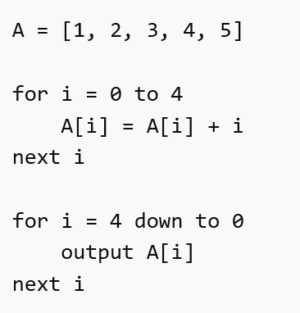
What does this program do ? Q1

Slide 90
What does this program do ? A1
9 7 5 3 1
i | A[i] : Before | A[i] : After
0 | 1 | 1
1 | 2 | 3
2 | 3 | 5
3 | 4 | 7
4 | 5 | 9

Slide 91
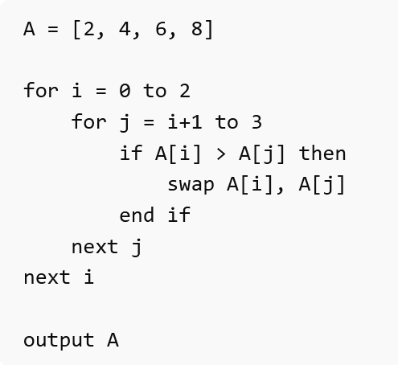
What does this program do ? Q2

Slide 92
What does this program do ? A2
2 4 6 8
This program tried to sort
Already sorted →Nothing happens

Slide 93
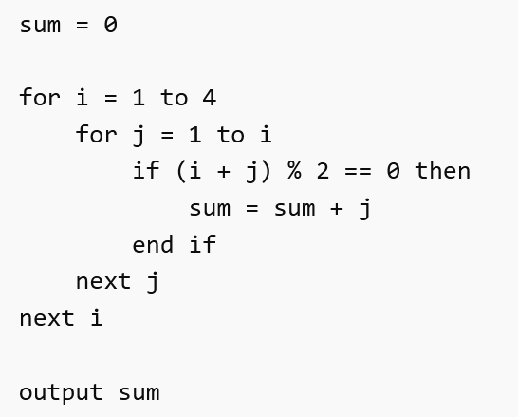
What does this program do ? Q3

Slide 94
What does this program do ? A3
13
Add j only when (i+j) is even
i =1
j=1 → 2 (even) → +1 → sum=1
i=2
j=1 → 3
j=2 → 4(even) → +2 → sum=3
i=3
j=1 → 4 (even) → +1 → sum=4
j=2 → 5 (odd)
j=3 → 6 (even) → +3 → sum=7
i=4
j=1 → 5 (odd)
j=2 → 6 (even) → +2 → sum=9
j=3 → 7 (odd)
j=4 → 8 (even) → +4 → sum=13

Slide 95
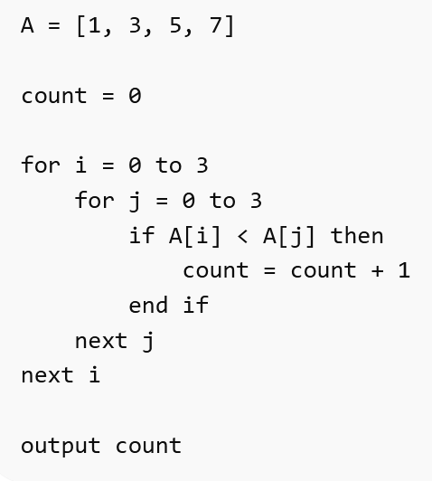
What does this program do ? Q4

Slide 96
What does this program do ? A4
6
Count how many times A[i] < A[j]
1 < 3,5,7 → 3
3 < 5,7 → 2
5 < 7 → 1
7 < none → 0
Total = 3 + 2 + 1 = 6

Slide 97
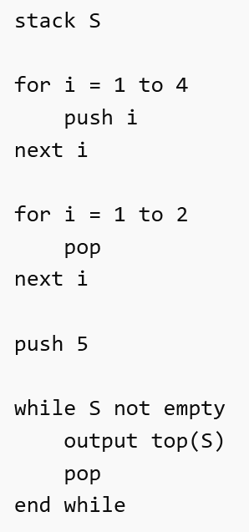
What does this program do ? Q5

Slide 98
What does this program do ? Q5
5 2 1
Push 1,2,3,4
Pop twice
4 → 1,2,3
3 → 1,2
Push 5
1,2,5
Pop all
5,2,1

Slide 99
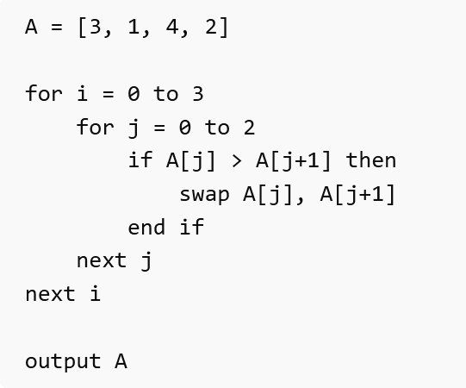
What does this program do ? Q6

Slide 100
What does this program do ? A6
1 2 3 4
Bubble sort
Pass 1 → 1,3,2,4
Pass 2 → 1,2,3,4
Pass 3 → (No Change)
Pass 4 → (No Change)

Slide 101
Data structure : Trees
Not the green/woody kind
But they actually look like upside down trees
Trees are data structures that represents data in parent/child relationships
Start with a root node
(May) point to other nodes
This is parent pointing to child ( generally) or vice versa
The nodes with no children are leaf nodes

Slide 102
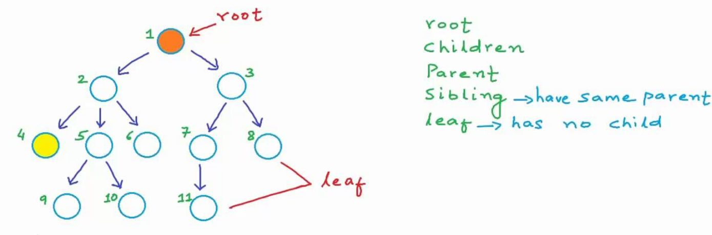
Tree: Visuals

Slide 103
Trees : types
Based on child count
Binary trees (most popular)
Each node max 2 children (i.e 0,1 or 2 )
Ternary trees
Max 3 children
N-ary
Max N children

Slide 104
Trees: Types
Based on data organization
Binary Tree
No organization requirement
Binary Search trees ,
Left child is smaller ( or equal to) the root
Right child is bigger than the root
AVL tree (Adelson-Velsky and Landis)
Binary search tree with limits on height
No one leaf can be more than a 1 distance logner than any other leaf node
Red black tree
A representation of AVL tree that color codes the nodes ( red/black) to organize info.
…

Slide 105
Binary Tree : Key terms
Root : there is only 1 root( 0 for empty tree)
Parent
All other nodes have one parent (except the root node)
Children
In Binary Tree : there can be at most 2 children
The 2 children are also referred as siblings
Leaf nodes : nodes with no children are leaf nodes
Height : the distance from the root to furthest leaf node is height of the tree

Slide 106
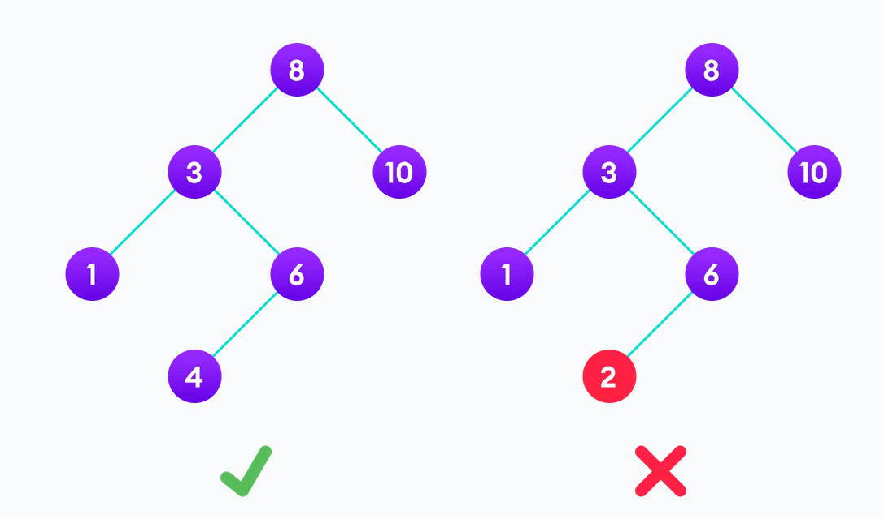
Binary Search tree : Examples
Left child must be smaller than or equal to the parent
Right child must be larger than the parent

Slide 107
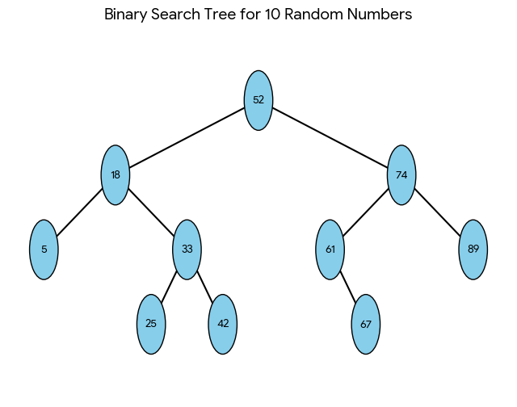
Creation of a BST
52, 18, 74, 5, 33, 61, 89, 25, 42, 67

Slide 108
Binary Search Tree : exercise
Create a tree for
S U P E R N A T U R A L
16 93 81 37 98 84
0 9 2 6 2 3 5 1 4 2 9 7 6 8 9 2 7
C O N I O S I S
A L P H A B E T I C A L
M A T H E M A T I C S

Slide 109
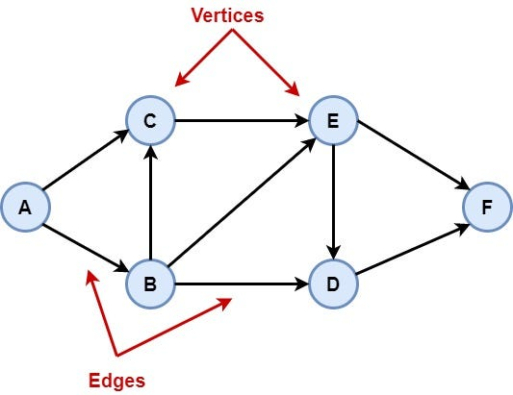
Data Structure : Graphs
Graphs are data structure that can represent complex relationships between items. They are made of
Vertices( also called nodes)
Edges

Slide 110
Graphs : uses
Major part of day to day life
Maps
Shortest/fastest routes
Internet/Computer networks
Communication over internet
Commerce
Stocks
goods
Social Networks
Friends
Ads
Circuits
Computer
Schedules
dependency

Slide 111
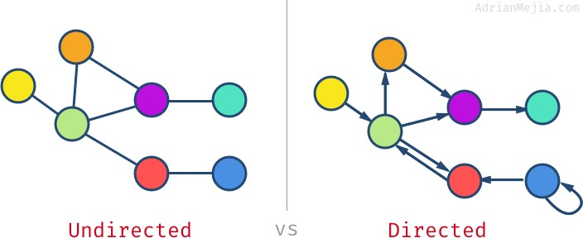
Graphs : by Edge types
Directed : think one way
The edges have a source where they begin from
And a destination where they end.
Think of this as one way connection
Undirected

Slide 112
Graphs : by Edge types
Directed
Undirected
The edges do not have direction
The edge connects vertices in both direction
Think of this as two way connection

Slide 113
Graph representation(s)
Assuming graph with ‘V’ vertices and ‘E’ edges
Adjacency matrix (double dimension array)
VxV array, entry in row ‘i’ column ‘j’ denotes connectivity between node i : j
Very useful and efficient representation
array of edges
Array of size ‘E’ containing source and destination of edges
Simple but slower representation
Array of adjacency lists
Vertex indexed array of edges.
Flexible and quite efficient (the goat)
…(and there are more representations)

Slide 114
In class exercises
…

Slide 115
Logic gates
The Cictuits in electronics ( Pcs, gaming consoles, phones) are made of basic logic units, called logic gates
Basic : AND, OR, NOT , XOR
Negated : NAND, NOR , XNOR
Similar to AND , OR, XOR respectively but with extra NOT at the end
There are more custom gates but these are basic ones
These are visual representation of the Boolean algebra
All the complex calculations you can think of are fundamentally run by these gates

Slide 116
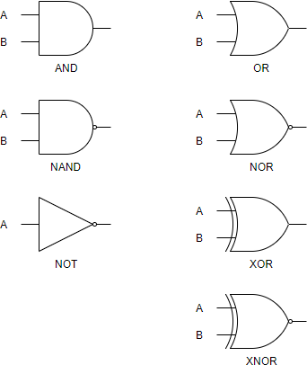







Logic gates
$$A .B$$
$$A+B$$
$$\overline{A.B}$$
$$\overline{A+B}$$
$$\overline{A}$$
$$A⊕B$$
$$\overline{A⊕B}$$

Slide 117

Create a logic diagram …
$\left(A.B\right)+\left(A.\overline{B}\right)+\left(\overline{A}.C\right)$
$\left(A+B\right).\left(A+\overline{B}\right).\left(\overline{A}+B\right)$
$\overline{A+B}+A. \overline{B}$

Slide 118
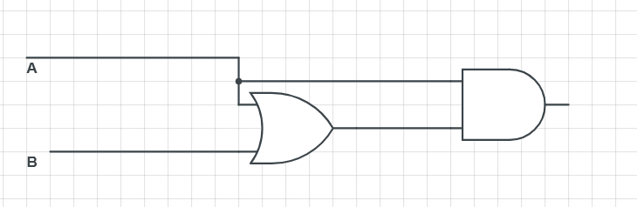
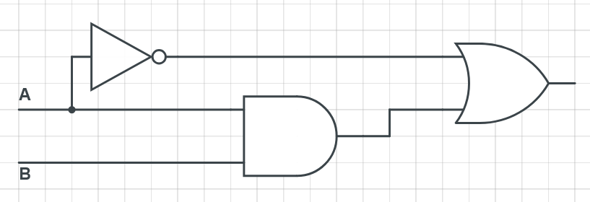
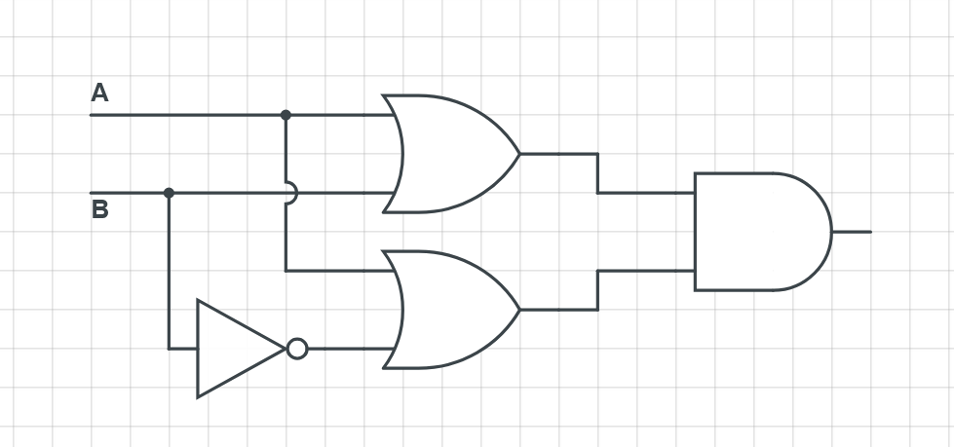
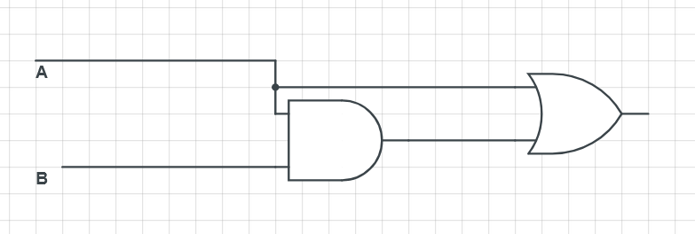
Create a Boolean Expression and Simplify

Slide 119
Answers
$A.\left(A+B\right)$
By Absorption law = A, OR
A.A + A.B
A + AB //(A.A = A), Idempotent Law
A (1+ B) // factor A out
A // By null law 1+B = 1 and A.1 = A
$A+\left(A.B\right)$
A
$\overline{A}+\left(A.B\right)$
$\left(\overline{A}+A\right).(\overline{A}+$ B) //Distribution law
1. $(\overline{A}+$ B) // By Complement law $\left(\overline{A}+A\right)=1$
$\overline{A}+$ B
($A+B).\left(A+\overline{B}\right)$
($A.A)+(B.\overline{B})$ //Distribution law
A$+0$ //Idempotent law + Complement law
A

Slide 120
Graphs
Identify number of cycles in this graph
Represented as adjacency matrix
Hint : Convert to a graph first (one that you can see)
 | 1 | 2 | 3 | 4 | 5 | 6 | 7
1 | 0 | 1 | 0 | 0 | 0 | 0 | 0
2 | 1 | 0 | 1 | 0 | 1 | 0 | 0
3 | 0 | 1 | 0 | 1 | 0 | 0 | 0
4 | 0 | 0 | 1 | 0 | 1 | 0 | 0
5 | 0 | 1 | 0 | 1 | 0 | 1 | 1
6 | 0 | 0 | 0 | 0 | 1 | 0 | 1
7 | 0 | 0 | 0 | 0 | 1 | 1 | 0

Slide 121
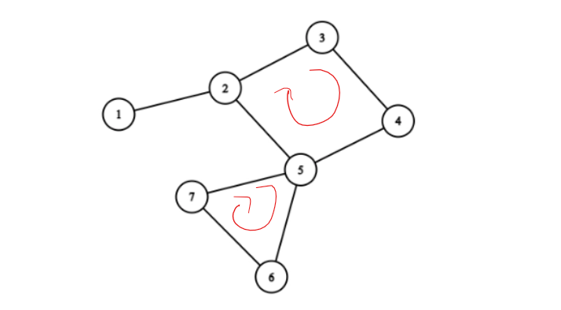
Graphs
There are 2 cycles in this graph
 | 1 | 2 | 3 | 4 | 5 | 6 | 7
1 | 0 | 1 | 0 | 0 | 0 | 0 | 0
2 | 1 | 0 | 1 | 0 | 1 | 0 | 0
3 | 0 | 1 | 0 | 1 | 0 | 0 | 0
4 | 0 | 0 | 1 | 0 | 1 | 0 | 0
5 | 0 | 1 | 0 | 1 | 0 | 1 | 1
6 | 0 | 0 | 0 | 0 | 1 | 0 | 1
7 | 0 | 0 | 0 | 0 | 1 | 1 | 0

Slide 122
Programs (matrix practice)
Create a 2d array(matrix) and fill it with values
Input N ( size of the matrix would be N x N)
Fill 4 different ways (these are 4 different problems)
1 | 2 | 3 | 4
5 | 6 | 7 | 8
9 | 10 | 11 | 12
13 | 14 | 15 | 16
1 | 5 | 9 | 13
2 | 6 | 10 | 14
3 | 7 | 11 | 15
4 | 8 | 12 | 16
1 | 2 | 3 | 4
8 | 7 | 6 | 5
9 | 10 | 11 | 12
16 | 15 | 15 | 13
1 | 2 | 3 | 4
12 | 13 | 14 | 5
11 | 16 | 15 | 6
10 | 9 | 8 | 7

Slide 123
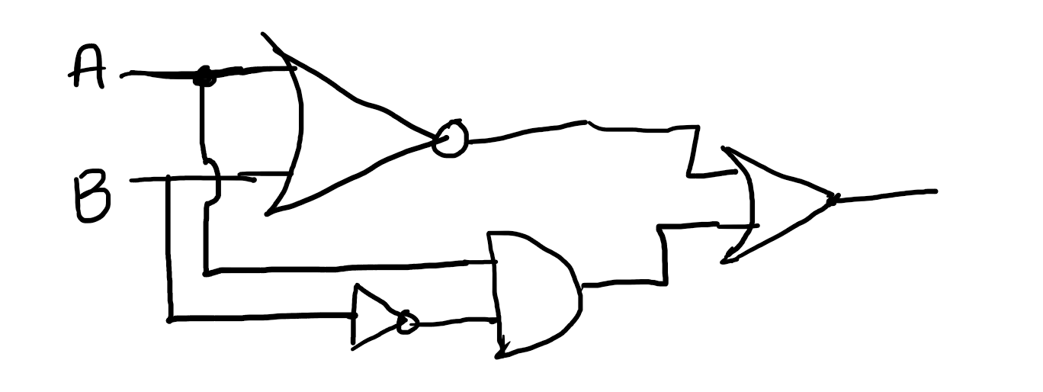
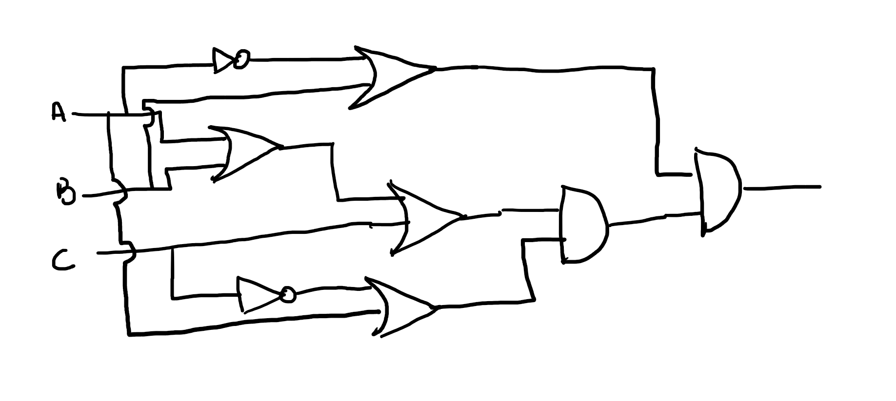
Gates -> Boolean | truth Table
Create a Boolean expression and simplify the expression
Create a truth table for original and simplified expressions.

Slide 124

Gates -> Boolean | truth Table
Create a Boolean expression and simplify the expression
Create a truth table for original and simplified expressions.
$\overline{A+B}+A. \overline{B}$ $= \overline{B}$
$\left(A+B+C\right).\left(\overline{A}+B\right).(A+\overline{C}$) $= B.(A+\overline{C}$)

Slide 125


Graphs
Create adjacency matrix for each
Count paths of size 1, 2, 3, 4, 5
Count number of cycles

Slide 126
Programs | strings
Write a program to take a string(char array) and convert it into number
“256” → 256
Modify the program to sum each number individually and print
2+5+6 → 13
Modify the program to add the summed number to original, convert to string and print
“256” → 256
2+5+6 → 13
256+ 13 →269
269 → “269”

